Slide 1
Vibration
2020.04.06
Waltor Huang

Slide 2
Hertz
The hertz (symbol: Hz) is the derived unit of frequency in the International System of Units (SI) and is defined as one cycle per second.

Slide 3
Fast Fourier Transform(FFT)
A Fourier transform converts a signal from a space or time domain into the frequency domain. In the frequency domain the signal is represented by a weighted sum of sine and cosine waves. A discrete digital signal with N samples can be represented exactly by a sum of N waves.

Slide 4
FFT Reference
https://blog.xuite.net/lapuda.chen/PaulBlog/221866406-%E5%A6%82%E6%9E%9C%E7%9C%8B%E4%BA%86%E6%AD%A4%E6%96%87%E4%BD%A0%E9%82%84%E4%B8%8D%E6%87%82%E5%82%85%E9%87%8C%E8%91%89%E8%AE%8A%E6%8F%9B%28Fourier+Transform%29%EF%BC%8C%E9%82%A3%E5%B0%B1%E9%81%8E%E4%BE%86%E6%8E%90%E6%AD%BB%E6%88%91%E5%90%A7%21
https://www.youtube.com/watch?v=5foHK_K151w
https://www.itread01.com/content/1550471233.html

Slide 5
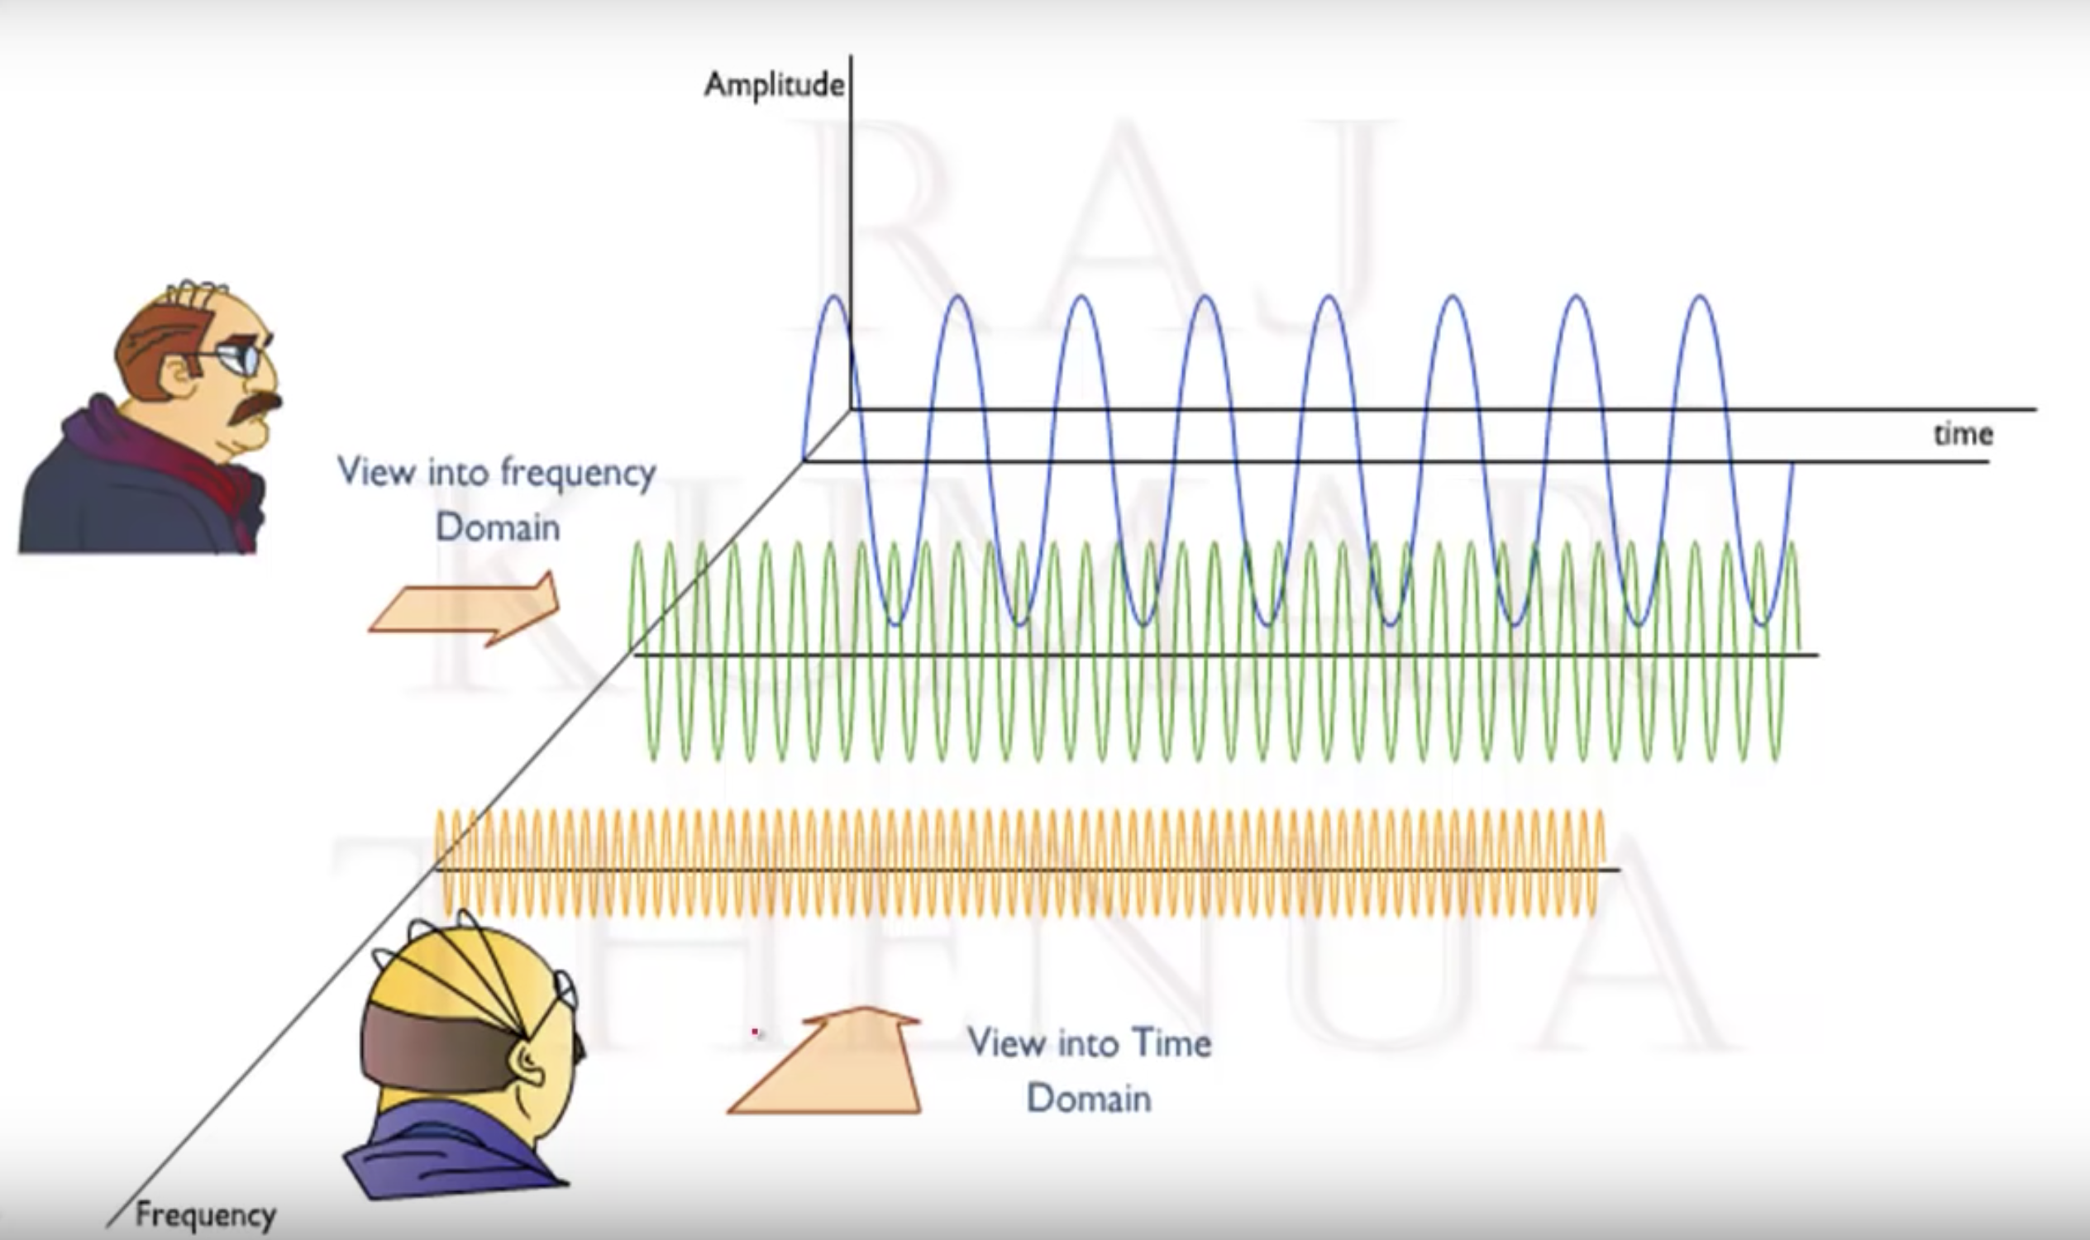
Time-domain waveform vs Frequency-domain spectrum

Slide 6
Single Generator

