Slide 1
Pix2Pix
Image to Image Translation with Conditional Adversarial Networks
CS624 Project 2019

Slide 2
CS624 Project 2019
Students:
Osama Ahmed Aref osamaahmed694@gmail.com Hossam Abdel Nasser Ibrahim hossamabdelnasser9@gmail.com Sameh Ramadan Ahmed Sameh.bilal@outlook.com
Supervisor: Prof. Aly Fahmy

Slide 3
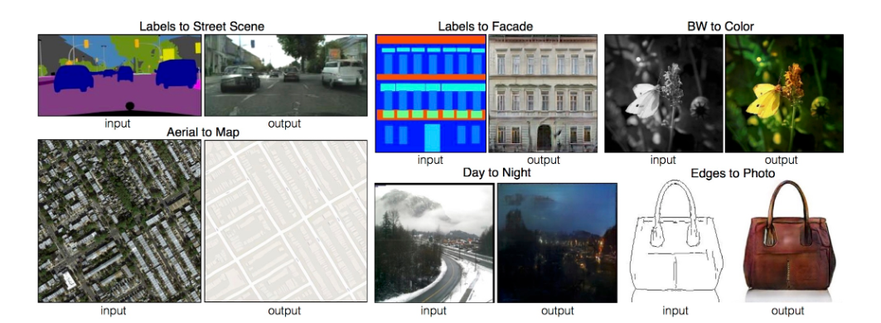
Introduction

Slide 4
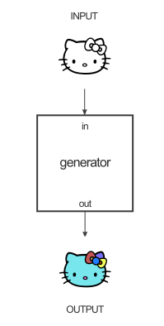
How pix2pix works

Slide 5
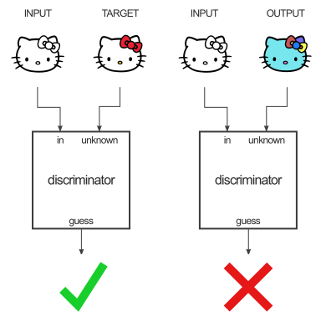
How pix2pix works

Slide 6
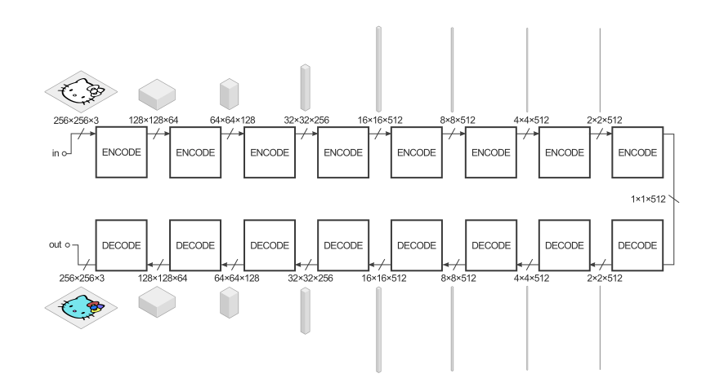
Generator Architecture

Slide 7
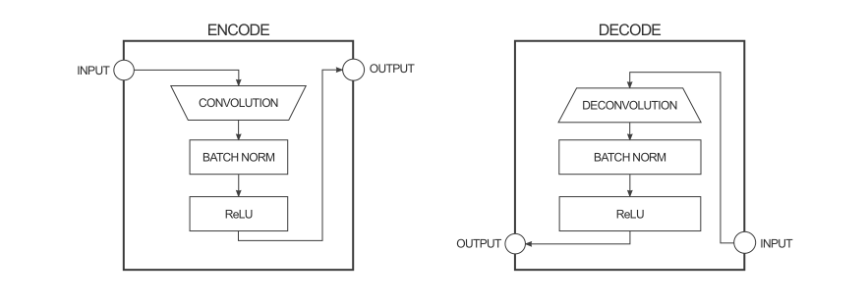
Generator Architecture

Slide 8
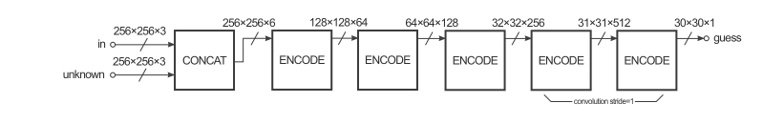
Discriminator Architecture

Slide 9
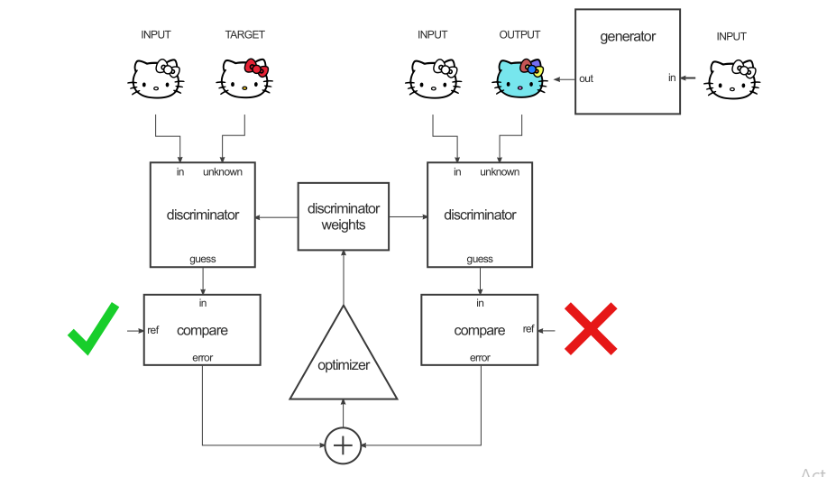
Discriminator Training

Slide 10
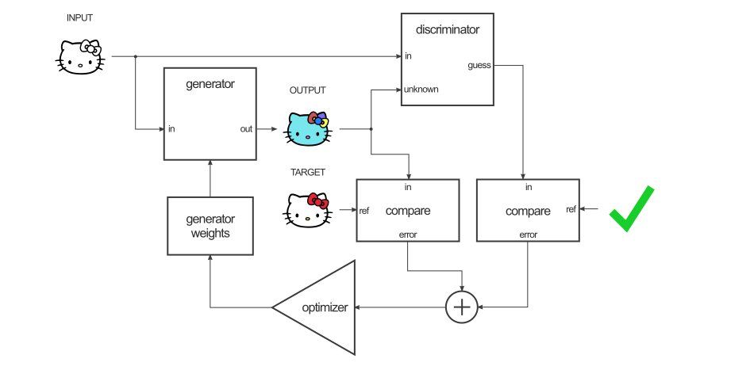
Generator Training

Slide 11
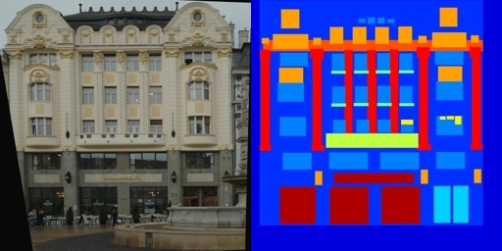
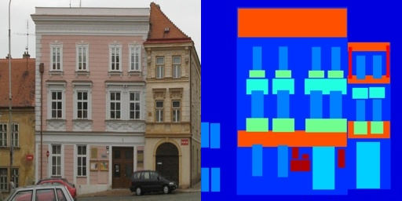
Labels to Facade

Slide 12
CMP (Center for Machine Perception) Facade Dataset
Training set : 400 images (Each image contains the real image and its corresponding labeled one)
Validation set : 100 images
Test set : 106 images

Slide 13
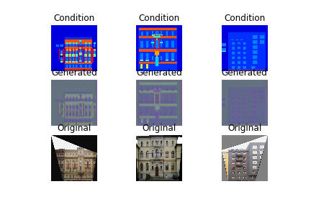
Generated samples during Training
At the Beginning of the training

Slide 14
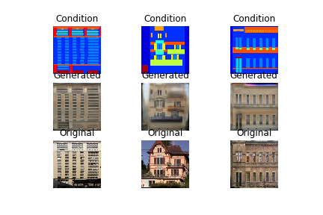
Generated sample at epoch 100

Slide 15
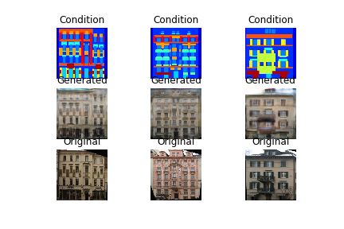
Generated sample at epoch 200

Slide 16
Training Details
Epochs No : 200
We Used Adam optimizer.
We Used MSE and MAE as loss functions.

Slide 17
Implementation and Results
Google Colab Link
Containes the implementation of pix2pix trained on facades dataset
Google Drive Link
Exported trained models
Generator
Discriminator
Combined
Facades Dataset (train – validation - test)
Images folder (Contains generated samples on testing data during the training)

Slide 18
References
https://affinelayer.com/pix2pix/
https://github.com/eriklindernoren/Keras-GAN/tree/master/pix2pix
https://affinelayer.com/pixsrv/
https://neurohive.io/en/popular-networks/pix2pix-image-to-image-translation/

