Slide 1
RESEARCH PRESENTATION | 25 MIN
Finding ambiguity
before publication
Leakage-controlled, model-assisted prioritization of
IETF Internet-Draft clauses
Mostafa Elofy · Mohamed Ghanem · Mohamed Abdelkhalek · Osama Elkhuribi
School of Computing, Queen's University
Research-stage evidence — not a validated production detector
01 | 20

Slide 2
MOTIVATION
One sentence can lead to different implementations
Normative keywords are precise; the surrounding prose can still leave room for interpretation.
“A receiver SHOULD retry when appropriate.”
Implementation A
Implementation B
Implementation C
Retry immediately;
stop after one failure.
Retry with backoff;
continue until a limit.
Retry only for selected
error classes.
The goal is not to declare a clause defective. It is to help a human reviewer decide where to look first.
Illustrative example; not a quoted clause from the corpus.
02 | 20

Slide 3
RESEARCH QUESTION
The research question is about prioritization—not verdicts
Can we rank draft clauses likely to be operationally ambiguous using only information available at that draft stage?
Input
Output
Boundary
A clause as it appeared in an Internet-Draft
A ranked queue for human review
No automatic judgment of correctness
Success means useful review allocation under a defensible evaluation—not “AI understands standards.”
Project framing: paper/main.tex, Introduction and Conclusion.
03 | 20

Slide 4
PROBLEM FRAMING
Three traps can make an ambiguity detector look better than it is
1 Future-information leakage
2 Repeated language
3 Rare, uncertain positives
Later revisions, final RFCs, and errata can explain what became problematic—but they were not available at draft time.
Related clauses recur across a document's revision lineage. Random clause splits can place near-duplicates in train and test.
The latest DeBERTa cohort is 6.4% positive. Operational labels are AI-assisted and not expert-adjudicated gold.
So the central engineering problem is as much about information boundaries and evaluation design as model choice.
Source: paper/main.tex, Introduction; latest DeBERTa cohort.
04 | 20

Slide 5
DATA
The project connects a corpus to several distinct studies
253
12
31
Internet-Draft revisions
RFCs
verified technical errata
CLASSICAL ML
2,425 clauses · 11 families
160 positives · prevalence 6.60%
QWEN / HYBRID
2,142 clauses · 9 families
126 positives · prevalence 5.88%
LATEST DEBERTA
2,143 clauses · 9 families
138 positives · prevalence 6.44%
Different label snapshots and protocols: scores across these rows are not a common leaderboard.
Source: paper/main.tex; study-specific cohorts and label snapshots.
05 | 20

Slide 6
METHOD
The pipeline makes the information boundary explicit
1
2
3
4
5
6
7
Public sources
Parse
Track change
Label
Model
Evaluate
Prioritize
›
›
›
›
›
›
Drafts · RFCs
errata
Documents →
clauses
Revision alignment
& lineage
AI-assisted
operational reference
Rules · ML ·
LLM · transformer
Family-grouped
out-of-fold
Ranked human
review queue
Prediction-time boundary: no later draft, final RFC, erratum, label, vote, rationale, or split metadata as model input.
The latest all-family classical rerun includes TCP and DNS, so the proposal's project-level holdouts are no longer untouched.
Source: paper/figures/project_pipeline.png and paper/main.tex.
06 | 20

Slide 7
MEASUREMENT
The label is an operational reference—not a definition of truth
95.6%
20 / 455
0.017-0.113
of positive labels were 2-to-1 votes
positive labels were unanimous
pairwise Cohen's kappa
What the labels support
What they do not establish
A repeatable, provenance-recorded operational reference for development experiments.
Independent expert truth, human reliability, or population-level ambiguity accuracy.
Scores measure agreement with a noisy, model-dependent reference; they do not identify which annotator is correct.
Source: paper/main.tex, Annotation Disagreement Audit and Construct Validity.
07 | 20

Slide 8
MODELS
The project tests multiple model families—not one magic model
Transparent rules
Classical ML
Hand-set lexical and structural cues; an interpretable low-cost baseline.
Logistic regression / SVM; engineered clause features + TF–IDF.
Transformers
Local LLM & hybrid
DeBERTa-v3-base; target-only fine-tuning and rank-based combinations.
Qwen prompting plus lexical / MiniLM semantic signals in separate studies.
Revision-only signals and frozen embeddings were also examined; the tested versions were not consistently stronger.
Source: paper/main.tex; results/final_summary/conclusions.md.
08 | 20

Slide 9
EVALUATION
Evaluation is grouped to test transfer across protocol families
WHAT THE DESIGN PROTECTS
Keep related clauses from the same family together
Latest DeBERTa study
Fit preprocessing and feature selection inside training folds
5-fold
3-fold
transformer family OOF
classical family OOF
Use average precision (AP) under class imbalance
Report fixed review-budget retrieval
Protocols differ; the newest transformer also uses one seed.
No single score answers whether the system transfers to a new protocol family.
Source: paper/main.tex, Evaluation Design and Results.
09 | 20

Slide 10
RESULTS · CLASSICAL ML
Classical text features give the strongest result in their own cohort
2,425 clauses · 160 positives · 11 families
base 0.066
Linear SVM: engineered + TF–IDF
0.3584
Key signal
Random forest: engineered + TF–IDF
0.3363
Lexical plus engineered features lead this matched cohort; thresholds trade precision for recall.
Logistic: engineered + TF–IDF
0.3265
Fixed engineered heuristic
0.0873
Positive prevalence
0.0660
Logistic recall is 0.706 at precision 0.190; SVM recall is 0.313 at precision 0.455. TCP and DNS are included, so this is not untouched holdout evidence.
Source: paper/main.tex, Table classical; matched 3-fold family-grouped OOF.
10 | 20

Slide 11
RESULTS · TRANSFORMER
Latest DeBERTa comparison: promising ranking, wide uncertainty
2,143 clauses · 138 positives · 9 families · 5-fold family-isolated OOF
base 0.064
Equal-weight ECDF ensemble
0.6736
46 / 50
Focal loss
0.5823
operational positives among the top 50 ranked clauses
Partial fine-tuning
0.5761
Ensemble AP family interval: 0.592–0.764
Prevalence baseline
0.0644
The ECDF ensemble is a ranking score, not a calibrated probability. Intervals overlap across nine families; the 100 labels were error-selected, and this repair reuses parent predictions—not an independent test.
Source: updated reviewed-label DeBERTa outputs; paper/main.tex. OOF development results.
11 | 20

Slide 12
RESULTS · REVISION ABLATION
Revision history did not improve ranking AP in the matched rerun
Same 2,425 rows, grouped folds, engineered features, TF–IDF, and classifier settings; only 12 past-only revision features change
base 0.066
Logistic baseline
0.3265
AP deltas
Logistic + revision
0.3185
Logistic -0.0081
SVM -0.0012
Forest -0.0015
SVM baseline
0.3584
SVM + revision
0.3572
Random forest baseline
0.3363
F2: unchanged for logistic; small gains for SVM and forest.
Random forest + revision
0.3348
RQ2 is only partly answered: cross-reference features were not isolated and no calibration metrics were recorded.
Source: paper/main.tex, Revision-Feature Implementation and Feature Comparisons.
12 | 20

Slide 13
RESULTS · LLM
LLM experiment: V4 ranks best on the development cohort
2,142 clauses · 126 positives · 9 families · five family-held-out folds
base 0.059
V1 best raw
0.1960
V4 at raw 0.5
V2 best raw
0.1035
AP 0.3252
Recall 0.524
F2 0.421
V3 nested hybrid
0.2554
V4 semantic ensemble
0.3252
Positive prevalence
0.0588
5.5× prevalence AP
V4 combines the V3 signal with frozen target and context MiniLM signals. Adaptive development comparison—not a sealed test; V4 design was informed by this cohort.
Source: V4 analysis-final pooled_metrics.csv and V1–V4 comparison; family-held-out development OOF.
13 | 20

Slide 14
RESULTS · HYBRID ROUTING
Hybrid routing preserves effectiveness with fewer LLM calls
2,096 aligned clauses · 109 positives · 46 label conflicts excluded
441 / 2,096
79.0%
0.330
0.457
Qwen calls
calls saved
hybrid AP
hybrid F2
System
Calls saved
AP
F2
Recall
Precision
ML-only
100%
0.326
0.418
0.716
0.157
LLM-only
0%
0.372
0.447
0.569
0.241
Hybrid (0.4, 0.7)
79.0%
0.330
0.457
0.624
0.221
Random budget
79.0%
0.302
0.423
0.685
0.167
Paired family-bootstrap Δ vs LLM-only: AP −0.042 (95% CI −0.305 to 0.085); F2 +0.010 (−0.059 to 0.057). Both CIs include zero: exploratory evidence, not proof of equivalence. Stored V4 scores simulate LLM answers; no new calls were made.
Source: results/hybrid/routing_vs_llm_only; primary heuristic ML band (0.4, 0.7); 1,000 family-cluster resamples.
14 | 20

Slide 15
SYNTHESIS
The report answers some questions and leaves two open
RQ1
Development feasibility
Supported with qualifications
RQ2
Revision / cross-reference / calibration
Partly answered; AP hypothesis not supported
RQ3
Model-family comparison
Effectiveness/workload only; separate protocols
RQ4
Conditional LLM routing
Exploratory replay: 79% fewer calls; no sealed test
RQ5
Explanation quality
Not tested with expert faithfulness review
Routing gains are retrospective estimates from stored scores—not observed call or cost savings.
Source: paper/main.tex and results/hybrid/routing_vs_llm_only/summary.md.
15 | 20

Slide 16
VALIDITY
The main limitations are scientific—not just engineering
Construct
Low-agreement AI-assisted labels; no adjudicated expert gold.
Sampling
Enriched candidates; scores do not represent every IETF clause.
Generalization
Nine families in latest transformer study; one training seed.
Model selection
Some comparisons are adaptive development evidence.
External test
TCP and DNS entered the latest classical rerun; no untouched project holdout remains.
No claim of validated ambiguity accuracy or deployment readiness is supported yet.
Source: paper/main.tex, Threats to Validity.
16 | 20

Slide 17
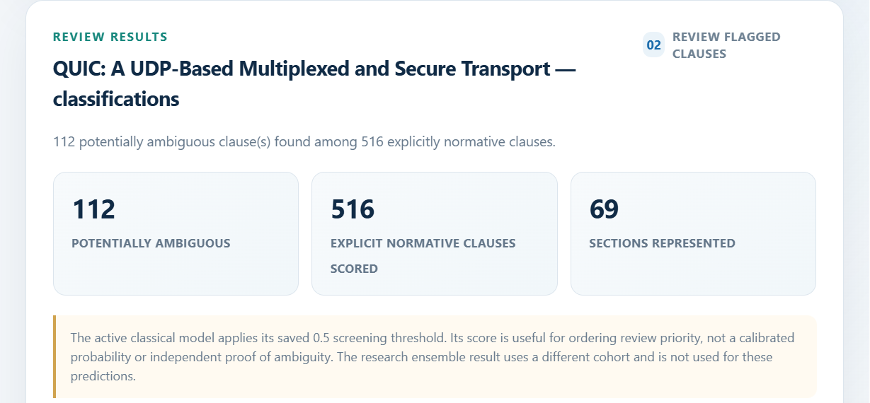
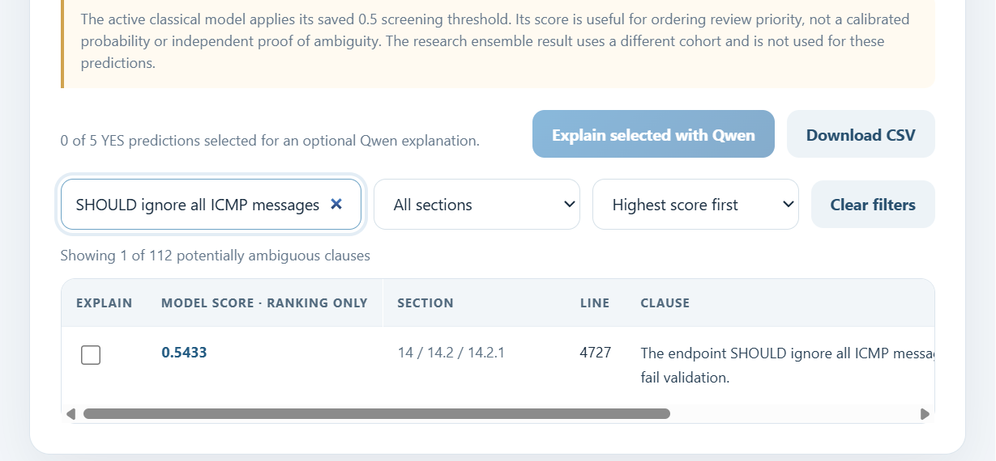
INTERFACE
GUI example: RFC 9000 review results
Local scan summary
Overview · RFC 9000
112
516
69
potentially
ambiguous
normative clauses
scored
sections
represented
Example ranked suggestion
Line 4727 · Section 14.2.1 · score 0.5433
“The endpoint SHOULD ignore all ICMP messages that fail validation.”
Filtered suggestion · one of 112 flagged clauses
Scores rank clauses for review; they are not calibrated probabilities or ambiguity verdicts. This capture also had a scikit-learn artifact/runtime version warning.
GUI screenshots: local scan of corpus/raw/rfcs/RFC9000.txt; model scores are screening ranks.
17 | 20

Slide 18
NEXT STEPS
What evidence would earn a stronger claim?
01
02
03
04
Build an expert reference
Stabilize estimates
Finish open RQs
Create a new holdout
Stratified sample; independent double annotation and adjudication.
Repeat selected transformers across seeds; compare common labels and folds.
Implement conditional LLM routing; measure calls, latency, cost, calibration, and explanations.
Pre-register unseen families or later time-sliced revisions for one final test.
The next evaluation must be genuinely untouched and used once after the model and analysis plan are frozen.
Source: paper/README.md, author action items; results/final_summary/conclusions.md.
18 | 20

Slide 19
TAKE-HOME
The contribution is a careful path from draft text to review
A promising research-stage prioritization aid—not an autonomous ambiguity judge.
Revision-aware corpus and explicit temporal information boundaries
Family-aware evaluation across classical ML, transformers, and local LLM hybrids
Honest reporting of uncertainty, label limits, and the consumed project holdouts
The next milestone is independent evidence—not a more complicated model.
Project status and claim boundary: README.md; paper/main.tex.
19 | 20

Slide 20
QUESTIONS
Discussion
Questions?
Selected context
RFC 2119 / RFC 8174 — normative keywords
Where should the boundary sit between automated triage and human judgment?
Davis & Goadrich (2006) — PR curves and ROC
Saito & Rehmsmeier (2015) — PR under imbalance
Pawagi et al. (2025) — RFCScope
Thank you · School of Computing, Queen's University
Full bibliography and methods: paper/main.tex and paper/references.bib.
20 | 20

