Slide 1








Machine Learning
project
Course: Machine Learning – Semester 472
Lecturer: Dr. Rayed Ghazawi
Authors:
Faris Ghazi Al-Ahmadi
Abdulrahman Ghazi Al-Qurashi
Osama Al-Zahrani
Issa Al-Fahmi

Slide 2


Problem Definition & Objectives
Problem:
Customer churn is a major telecom issue. Acquiring new customers costs 5–7x more than retaining existing ones.
Objective:
Predict customers likely to churn
Identify key churn drivers
Build & compare ML models
Provide actionable business insights

Slide 3
Dataset Overview
Source: Kaggle – Telco Customer Churn Dataset
Property | Value
Records | 7,043
Features | 21
Target | Churn (Yes/No)
Churn Rate | 26.54%
Features include: Demographics, Account info (tenure, contract, charges), Services used

Slide 4

Methodology Workflow
Data Gathering → Data Cleaning → EDA → Preprocessing → Train/Test Split → Model Training → Evaluation → Insights
Split | Size | Percentage
Training | 5,634 | 80%
Testing | 1,409 | 20%
Stratified split to maintain churn distribution

Slide 5
Data Cleaning & Preprocessing
Cleaning Steps:
Preprocessing Pipelines:
Converted TotalCharges to numeric
Filled missing values with mean
Removed customerID
Encoded target: Churn = 1, No Churn = 0
Numerical: Median imputation + StandardScaler
Categorical: Most frequent imputation + OneHotEncoder

Slide 6
Models & Evaluation Metrics
Models Selected:
Evaluation Metrics:
Logistic Regression (baseline, interpretable)
Random Forest (ensemble, handles non-linearity)
Accuracy
Precision
Recall
F1-Score
ROC-AUC
Confusion Matrix
5-Fold Cross-Validation

Slide 7
EDA
Key Findings
Churn Rate: 26.54% (1,869 churned / 5,174 loyal)
Top Insights
Avg tenure (churned): 18 months vs 37.6 months (loyal)
Month-to-month contract churn: 42.7%
Paperless billing churn: 33.6% vs Traditional: 16.3%
Two-year contract churn: 2.8%

Slide 8
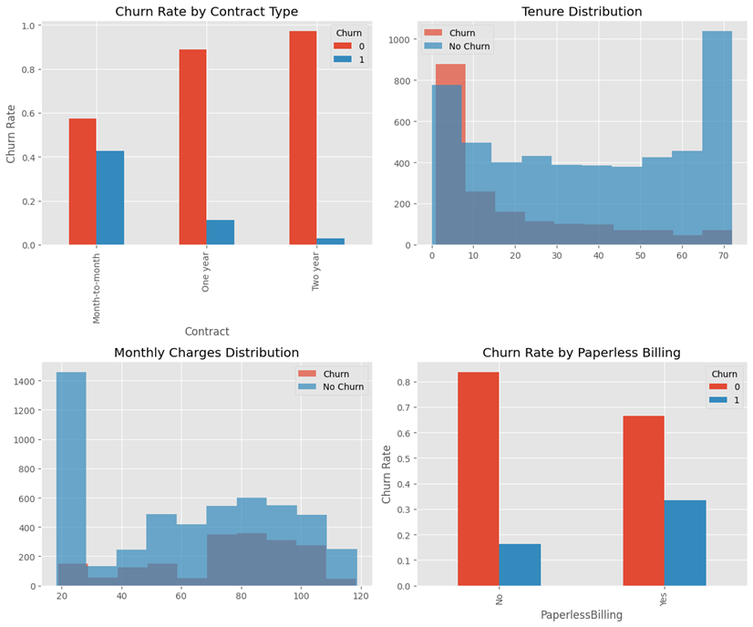

Slide 9
Model Performance Comparison
Model | Test Acc | Precision | Recall | F1 | ROC-AUC
Logistic Regression | 80.6% | 65.7% | 55.9% | 60.4% | 84.2%
Random Forest | 78.6% | 62.2% | 49.2% | 54.9% | 82.4%
Best Model: Logistic Regression ✅

Slide 10
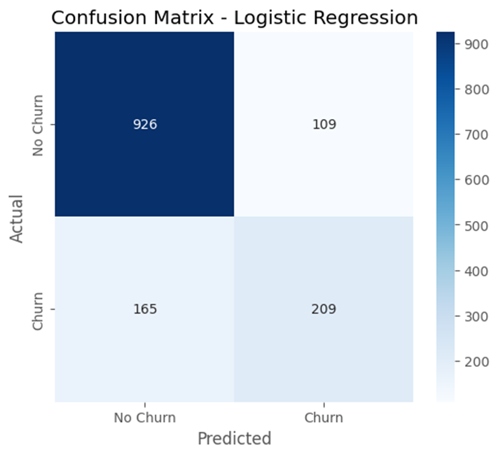
Best Model – Logistic Regression
Confusion Matrix Summary:
Class | Precision | Recall | F1-Score | Support
No Churn | 0.85 | 0.89 | 0.87 | 1,035
Churn | 0.66 | 0.56 | 0.60 | 374
Average | 0.80 | 0.81 | 0.80 | 1,409
Interpretation: Identified 56% of actual churners

Slide 11
Cross-Validation Results
(5-Fold)
Fold | Accuracy
1 | 81.2%
2 | 80.1%
3 | 79.8%
4 | 80.5%
5 | 80.5%
Mean | 80.42%
Std | 1.42%
✅ Low standard deviation → Model is stable and generalizable

Slide 12
Why Logistic Regression Won
Aspect | Logistic Regression | Random Forest
Train Accuracy | 80.6% | 99.8%
Test Accuracy | 80.6% | 78.6%
Overfitting | None | Severe (21% gap)
Conclusion: Random Forest memorized training data → failed to generalize.

Slide 13
Business Insights
Insight 1 – Contract Type
Month-to-month customers: 42.7% churn (15x higher)
➡️ Offer long-term contract incentives
Insight 2 – Customer Tenure
Churned: 18 months avg tenure | Loyal: 37.6 months
➡️ Create first-year retention program (calls, surveys, rewards)

Slide 14

Business Insight 3
Paperless Billing
Finding:
Paperless billing churn: 33.6%
Traditional billing churn: 16.3%
Recommendation:
Improve digital customer experience:
Proactive support
Personalized offers
Seamless service integration

Slide 15
Conclusion &
Recommendations
Summary:
    Best model: Logistic Regression (80.6% accuracy, 84.2% ROC-AUC)
    Top churn drivers: Month-to-month contracts, short tenure, paperless billing
Recommendations:
Priority | Action | Impact
High | Long-term contract incentives | Reduce churn 20–30%
High | First-year retention program | Increase LTV
Medium | Improve digital experience | Address paperless churn

Slide 16
References
[1] IBM. (2020). Telco Customer Churn Dataset. Kaggle. https://www.kaggle.com/datasets/blastchar/telco-customer-churn
[2] Hastie, T., Tibshirani, R., & Friedman, J. (2009). The elements of statistical learning.‏
[3] Kuhn, M., & Johnson, K. (2013). Applied predictive modeling (Vol. 26, p. 13). New York: Springer.‏
[4] Pedregosa, F., Varoquaux, G., Gramfort, A., Michel, V., Thirion, B., Grisel, O., ... & Duchesnay, É. (2011). Scikit-learn: Machine learning in Python. the Journal of machine Learning research, 12, 2825-2830.‏
[5] Verhelst, T., Caelen, O., Dewitte, J. C., Lebichot, B., & Bontempi, G. (2019, November). Understanding telecom customer churn with machine learning: from prediction to causal inference. In Benelux Conference on Artificial Intelligence (pp. 182-200). Cham: Springer International Publishing.‏

Slide 17

Thank
You
For Your Attention

