Slide 1

Fashion Store
DEPI Graduation Project
Under the supervision of the engineer : ashraf sadek

Slide 2
Group
Zakarya Hamdy Zakarya Abdulaziz
Mohamed Taha Alam Eldden Amer
Osama Bahi Eldin Mohamed
Marina Raafat Zakher Ibrahim
Safaa Adlan Eldesuki

Slide 3
Introduction

Slide 4
Overview
Objective:
Build a fashion store platform for browsing, adding items to a cart, and completing purchases.
Key Features:
Product display
Shopping cart functionality (stored in database)
Checkout and payment integration

Slide 5
Tech Stack
Frontend: React, useContext , HTML, CSS, JavaScript
Backend: Node.js, Express.js
Database: MongoDB

Slide 6
Project Architecture
Frontend: React components for displaying products, shopping cart, and checkout.
State Management: useContext for managing user session and authentication.
Backend: Node.js API for handling requests (e.g., fetching products, managing the cart, processing orders).
Database: MongoDB stores product details, shopping cart, and order history.

Slide 7
Database

Slide 8
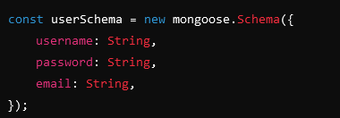
User Schema
Purpose: Stores user information for authentication and profile management.

Slide 9
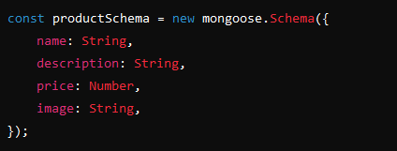
2. Product Schema
Purpose: Contains details about the products available for purchase.

Slide 10
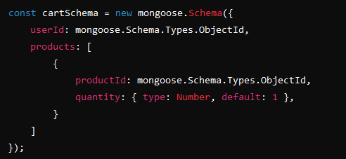
3. Cart Schema
Purpose: Manages the shopping cart for each user, linking products with quantities.

Slide 11
Backend

Slide 12
Backend Technologies
Technologies: Node.js, Express.js
Functionality:
API for handling requests (e.g., fetching products, managing the cart, processing orders).
Communicates with MongoDB to store and retrieve data.

Slide 13
API Endpoints
1.Users
2. Products
3. Cart

Slide 14
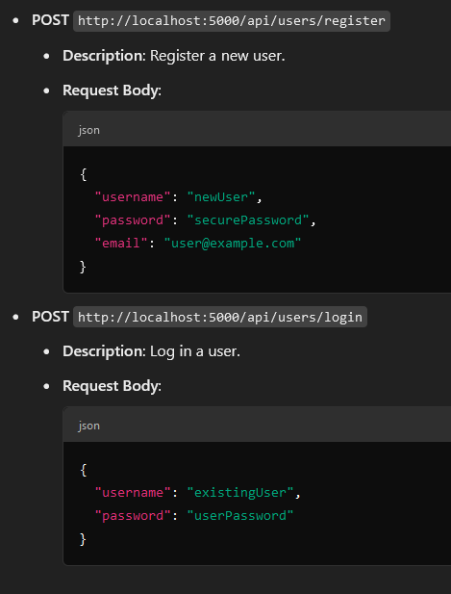
1. Users API

Slide 15
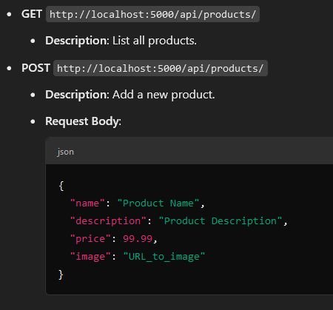
2. Products API

Slide 16
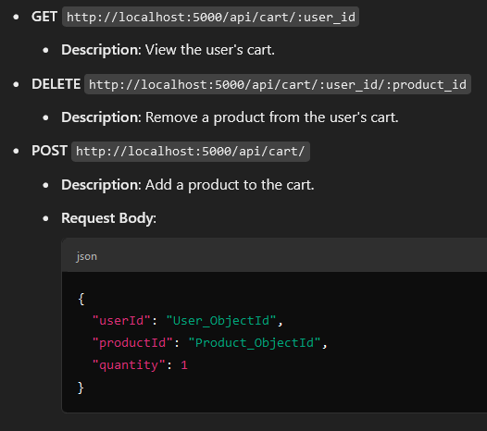
3. Cart API

Slide 17
Frontend

Slide 18
Frontend Technologies
Technologies: React, HTML, CSS, JavaScript
Functionality:
User interface for displaying products, managing the cart, and handling user interactions.

Slide 19
Key Functionalities
Product Listing and Detail Pages:
Displays products with details such as name, price, and description.
Shopping Cart:
Add items to the cart, which is stored in MongoDB for persistence.
Checkout:
Order summary, shipping details, and payment processing.

Slide 20
User State Management
useContext:
Managing user login status and ensuring the cart is linked to the user session.
Why useContext:
Simplifies user state management across components compared to Redux.

Slide 21
Pages
Home Page
Login Page
Register Page
Cart Page
About Page
Contact Us Page

Slide 22
Home Page
Description: Displays a list of products with options to view details and add items to the cart.
Features:
Product images, names, and prices.
"Add to Cart" button for each product.

Slide 23
Login Page
Description: Enables users to log in to their accounts.
Features:
Input fields for username and password.
"Login" button and link to the Register page for new users.

Slide 24
Register Page
Description: Allows new users to create an account.
Features:
Input fields for username, password, and email.
"Register" button to submit the form.

Slide 25
Cart Page
Description: Displays the items added to the user's cart.
Features:
List of products in the cart with quantities and total price.
Option to remove items and proceed to checkout.

Slide 26
About Page
Description: Provides information about the company, its mission, and values.
Content:
Brief history and overview.
Team or founder information.

Slide 27
Contact Us Page
Description: Allows users to reach out for inquiries or support.
Features:
Contact form (name, email, message).
Company contact details (phone number, email).

Slide 28
Future Improvements

Slide 29
Checkout System
Description: Implement a streamlined checkout process to enhance user experience.
Features:
Order summary.
User input for shipping details.

Slide 30
Payment System
Description: Integrate a secure payment gateway.
Benefits:
Supports various payment methods (credit/debit cards, digital wallets).
Ensures secure transactions for user peace of mind.

Slide 31
Secure Sessions
Description: Enhance user security during sessions.
Improvements:
Implement token-based authentication (e.g., JWT).
Enable session expiration and renewal.

Slide 32
Admin Portal
Description: Create an interface for admins to manage products and orders.
Features:
Add, edit, and delete products.
View order history and manage user accounts.

Slide 33
UI/UX Improvements
Description: Refine the user interface and experience to meet the customer needs better.
Approach:
Conduct user surveys and analyze feedback.
Make design updates to improve usability and aesthetics.

Slide 34
Thank You

