Slide 1

IBM Data Science Course
Supervised by: Eng. Sherif Said

Slide 2

Text Classification: Stroke Prediction
The project presented by :
Osama Mohamed Megahed
Mayar Magdy Morkos
Ahmed Hesham Mohamed
Ebraheem Ragab Mohamed
Kareem Abdelfattah
Data Used: https://www.kaggle.com/datasets/fedesoriano/stroke- prediction-dataset
Samsung Innovation Campus Chapter 6. Machine Learning – Part II /98

Slide 3

Agenda
About our project
Design Thinking
Problem Definition and Suggested Solution The main Objective
About the Data
Data Preprocessing and Text Manipulation EDA
Modeling Recommendation
Samsung Innovation Campus Chapter 6. Machine Learning – Part II /98

Slide 4
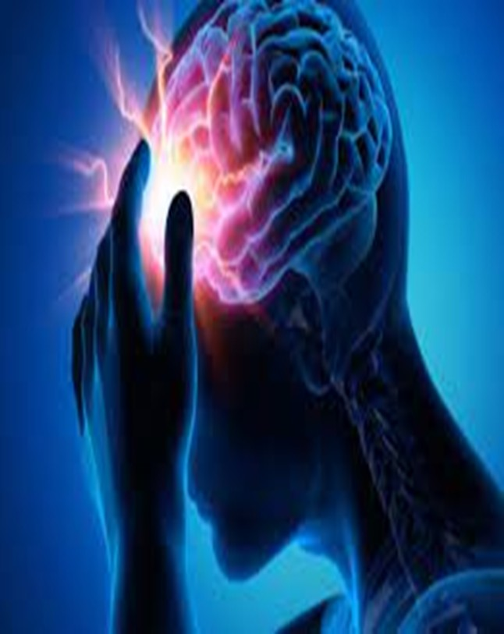
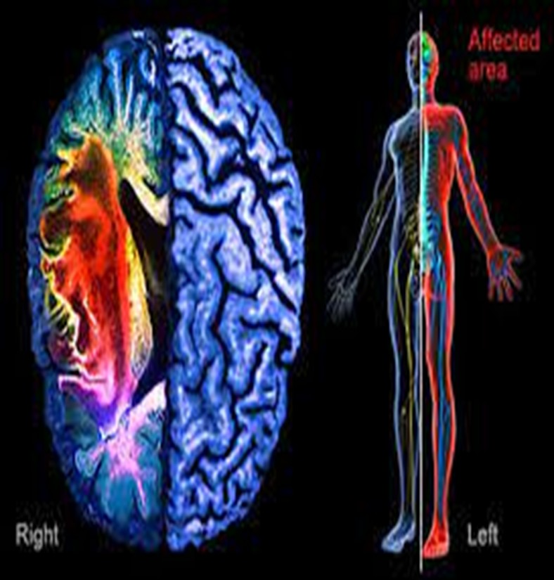
Stroke Prediction
Samsung Innovation Campus Chapter 6. Machine Learning – Part II /98

Slide 5
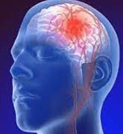
Step 1: Defining the problem
According to the World Health Organization (WHO), Stroke is the second leading cause of death worldwide, responsible for approximately 11% of all deaths.
A Stroke occurs when the blood supply to the brain is cut off or reduced, preventing brain tissue from receiving oxygen and nutrients, so brain cells begin to die within minutes.
The Strokes are a medical emergency and prompt treatment is crucial. Early action can reduce brain damage and other complications.
Samsung Innovation Campus Chapter 6. Machine Learning – Part II /98

Slide 6
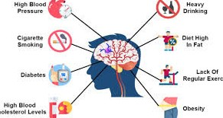
Step 2: Problem Statement
Improper treatment of people likely to have a stroke can have serious health consequences, including brain damage and death
This data set is used to predict whether a patient is likely to have a stroke based on input parameters such as gender, age, various diseases, and smoking status.
Each row of data provides relevant
information about the patient.
Samsung Innovation Campus Chapter 6. Machine Learning – Part II /98

Slide 7

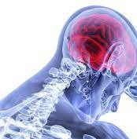
Objective
Understand what are the reasons that cause a stroke in people.
Visualize the relationships between various healthy and unhealthy habits for stroke.
Predict the probability of stroke with the best model and hyperfit parameters.

Slide 8
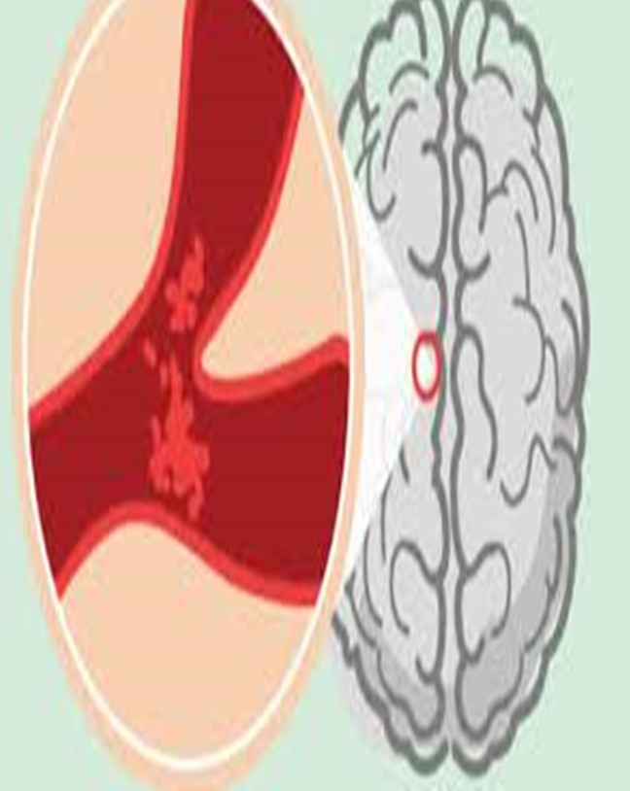
Target
🏷 stroke: 1 if the patient had a stroke or 0 if not. Clinical features for predicting stroke events:

Slide 9
Available Features
🔢 id: Unique identifier.
🔤 gender: "Male", "Female" or "Other".
🔢 age:: Age of the patient.
🔤 hypertension: 0 if the patient doesn't have hypertension, 1 if the patient has hypertension.
🔤 heart_disease: 0 if the patient doesn't have any heart diseases, 1 if the patient has a heart disease.
🔤 ever_married: "No" or "Yes".
🔤 work_type: "Children", "Govt_jov", "Never_worked", "Private" or "Self-employed".
🔤 Residence_type: "Rural" or "Urban".
🔢 avg_glucose_level: Average glucose level in blood.
🔢 bmi: Body mass index.
🔤 smoking_status: "formerly smoked", "never smoked", "smokes" or "Unknown".

Slide 10

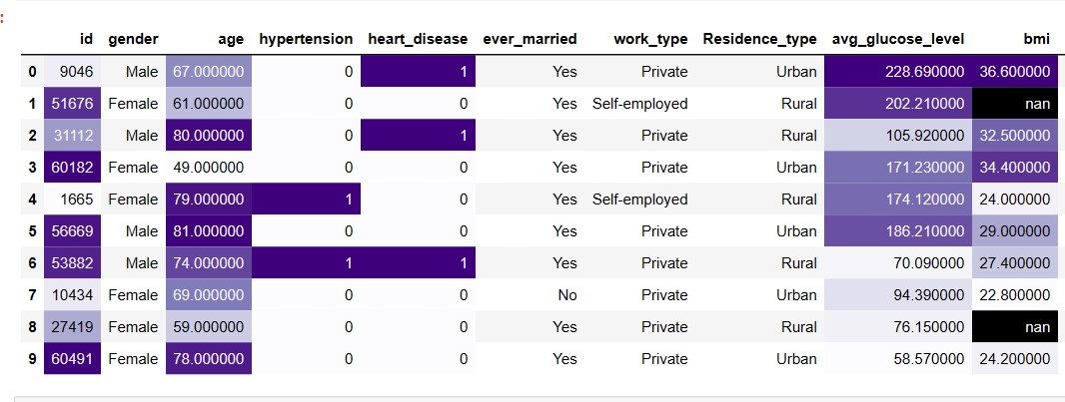
Introducing Data
Data Info:
{5110 Rows X 12 columns}

Slide 11
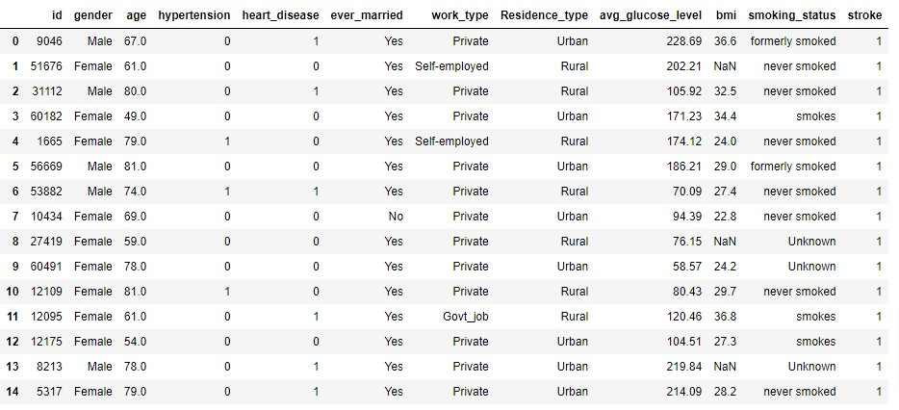
Introducing Data
1. first 15 rows
Samsung Innovation Campus Chapter 6. Machine Learning – Part II /98

Slide 12
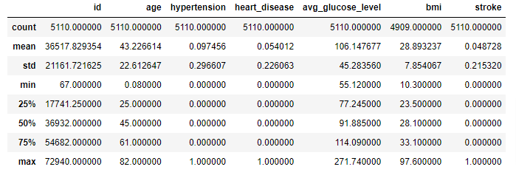
2. stats about our dataset
EDA
Samsung Innovation Campus Chapter 6. Machine Learning – Part II /98

Slide 13
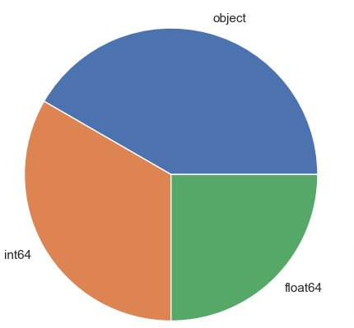
4. the various data types of the dataset
EDA
Samsung Innovation Campus Chapter 6. Machine Learning – Part II /98

Slide 14
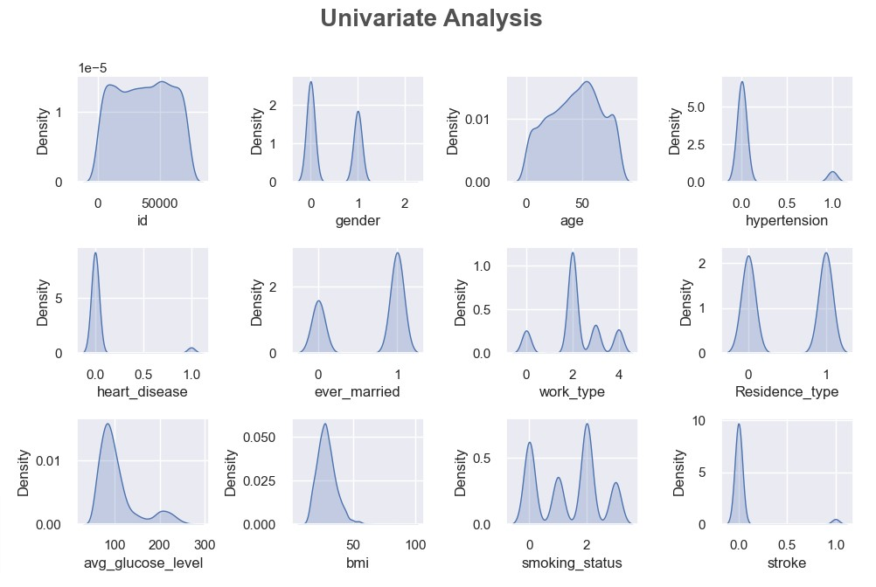
5. a simple visualization of all of the features
EDA
Samsung Innovation Campus Chapter 6. Machine Learning – Part II /98

Slide 15
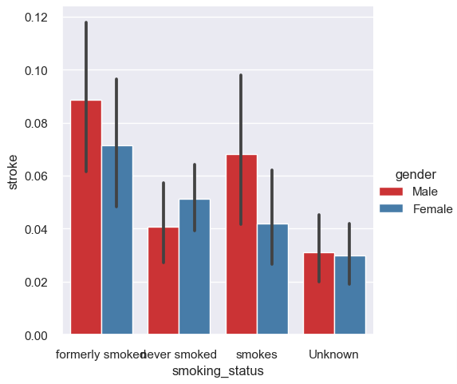
6. displaying the gender and the relation with the other features
EDA
Samsung Innovation Campus Chapter 6. Machine Learning – Part II /98

Slide 16
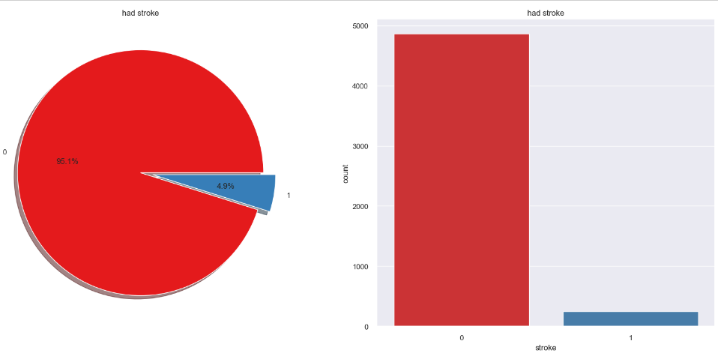
7. the target column: stroke
EDA
Samsung Innovation Campus Chapter 6. Machine Learning – Part II /98

Slide 17
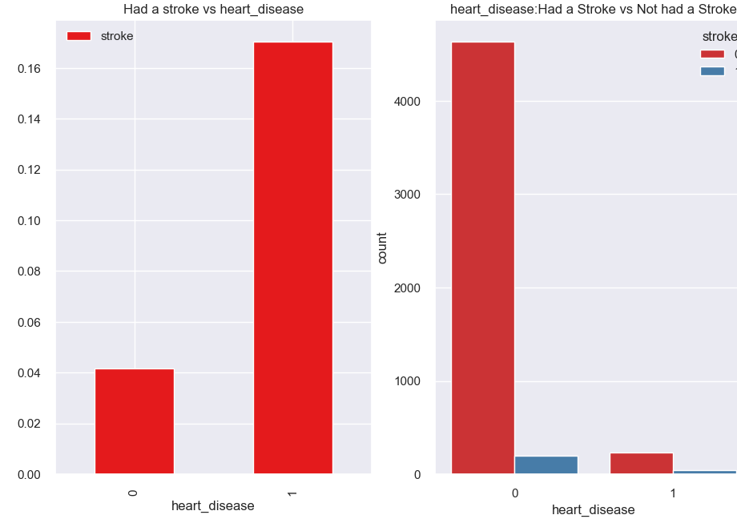
8. displaying the heart disease and the relation with having a stroke
EDA
Samsung Innovation Campus Chapter 6. Machine Learning – Part II /98

Slide 18
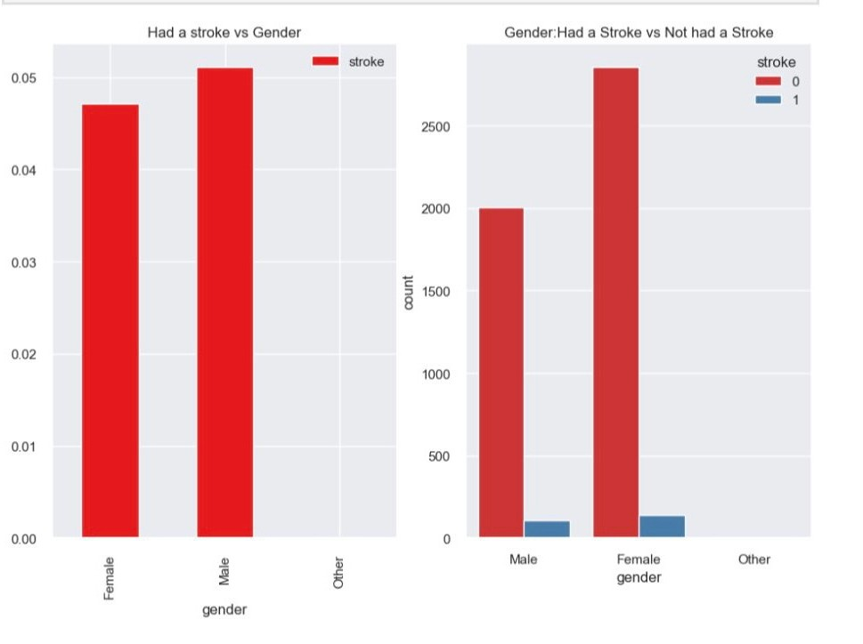
EDA
9 - How many of people in the data had a gender and relation between gender and stroke ?

Slide 19
EDA
10 - What is one person in gender other ?

Slide 20
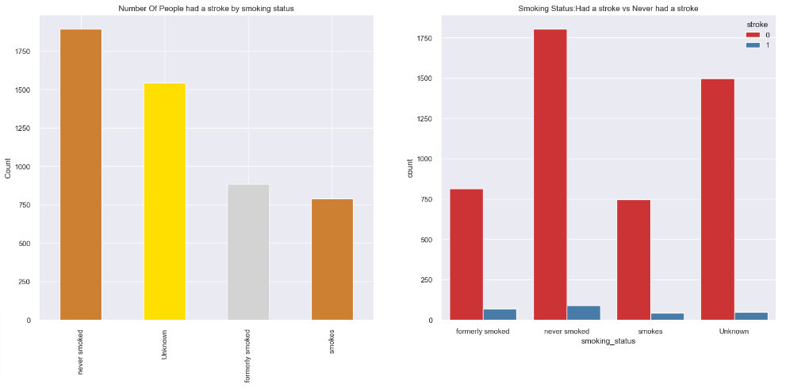
12. smoking status and its relation with having a stroke or not
EDA
Samsung Innovation Campus Chapter 6. Machine Learning – Part II /98

Slide 21
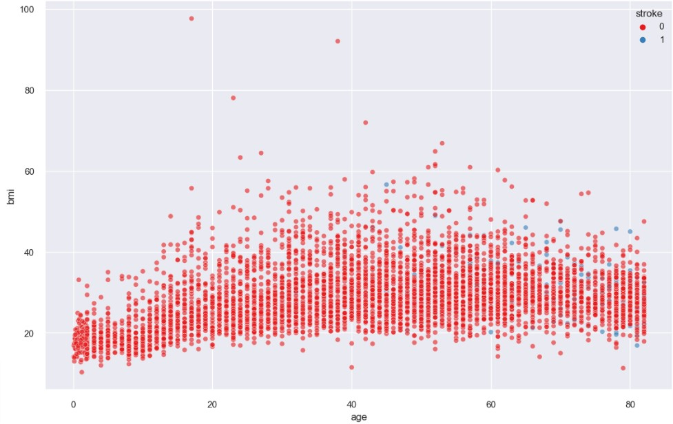
13. what relation between BMI and age effect in stroke?
EDA

Slide 22
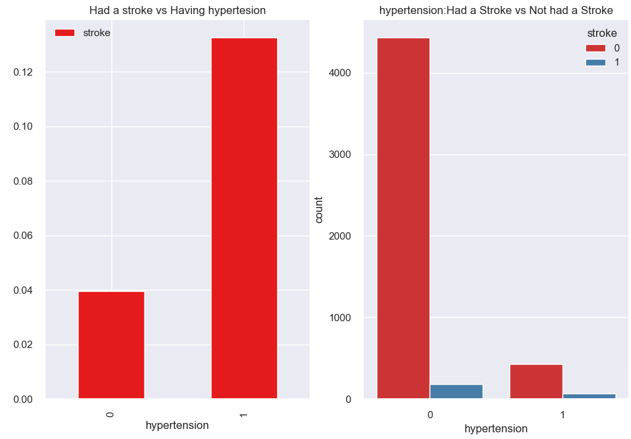
14. what relation between hypertension and having a stroke or not?
EDA
Samsung Innovation Campus Chapter 6. Machine Learning – Part II /98

Slide 23
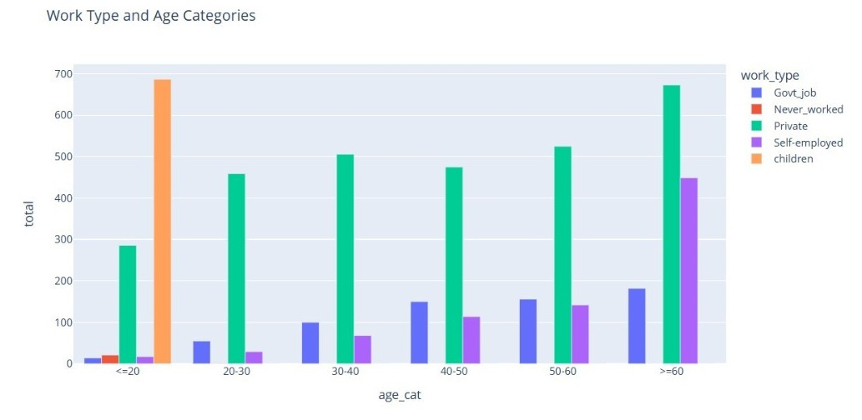
EDA
15- what effect age in work_type?
.
Samsung Innovation Campus Chapter 6. Machine Learning – Part II /98

Slide 24
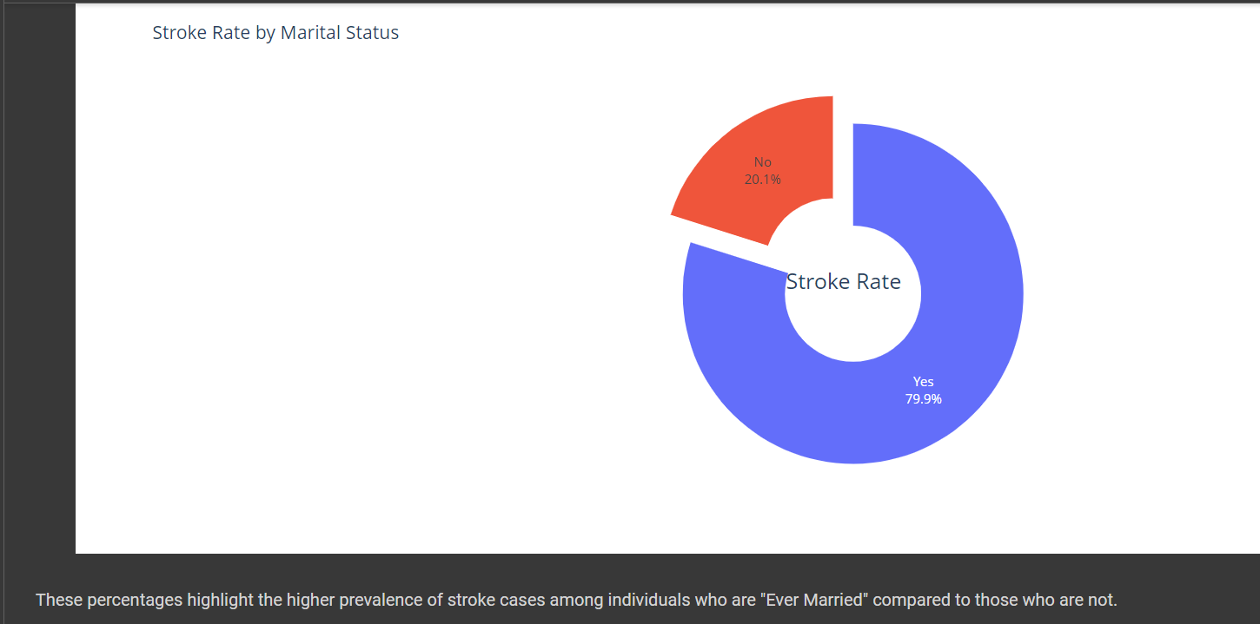
EDA
We should not get married for the sake of our LIFE.
.

Slide 25
Assumptions.
🟢 Validated: Advancing Age is a significant risk factor for the development of a Stroke.
🟢 Validated: Patients with an advanced age and with a BMI have a higher risk of having Stroke.
🟡 Not Proven: Smokers with a high BMI have a higher risk of having a Stroke.
🟢 Validated: Patients with hypertension and heart disease are more likely to have a Stroke compared to those without these conditions.
🟢 Validated: Patients with elevated blood glucose levels have a higher risk of suffering a stroke compared to those with normal blood glucose levels.
🟢 Validated: Patients who live in urban areas are at higher risk of having a Stroke than those who live in rural areas.
🔴 Invalid: Married Men have an increased risk of having a Stroke than Married Women.

Slide 26
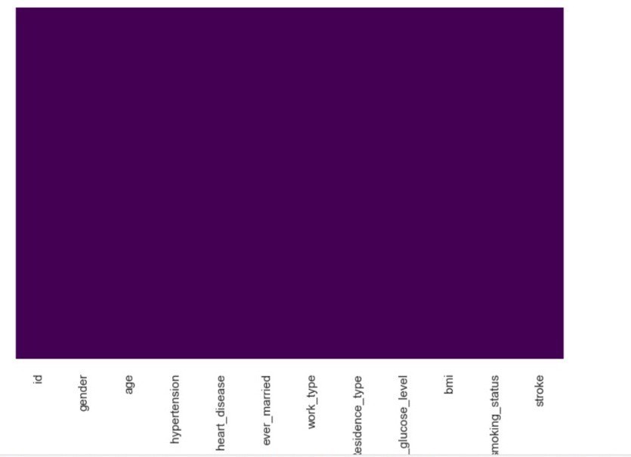
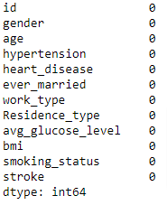
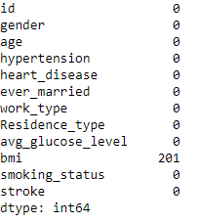
Data Preprocessing
1. Handling the missing values in the BMI column
Samsung Innovation Campus Chapter 6. Machine Learning – Part II /98

Slide 27

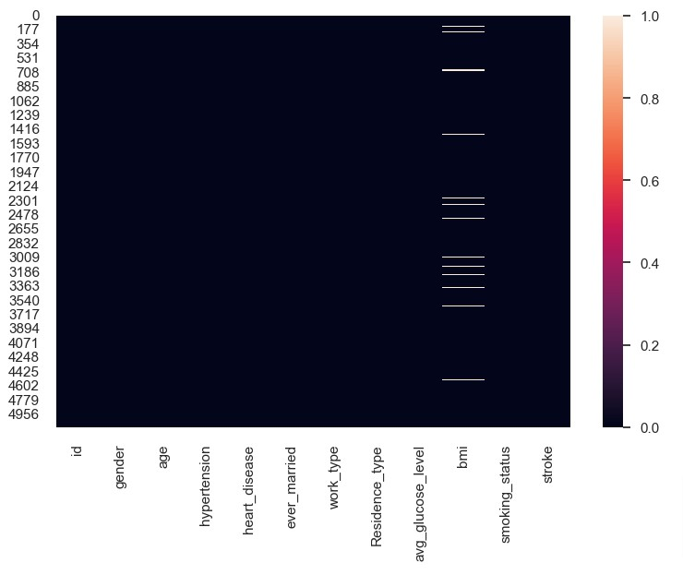
Data Preprocessing
missing values before and after
Before
After
Samsung Innovation Campus Chapter 6. Machine Learning – Part II /98

Slide 28
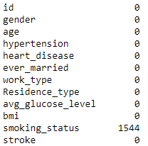
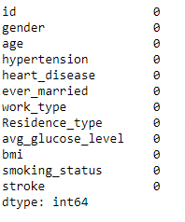

Data Preprocessing
2. Handling the unknown values in the smoking status column
turning the known values to null values and then getting rid of it
Samsung Innovation Campus Chapter 6. Machine Learning – Part II /98

Slide 29
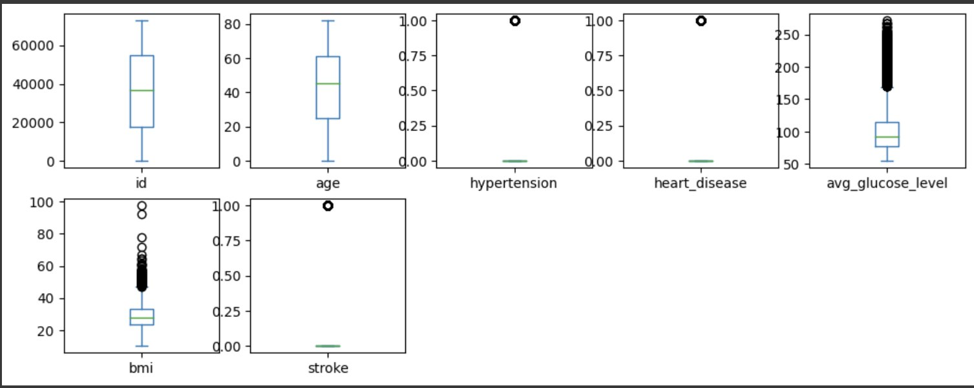
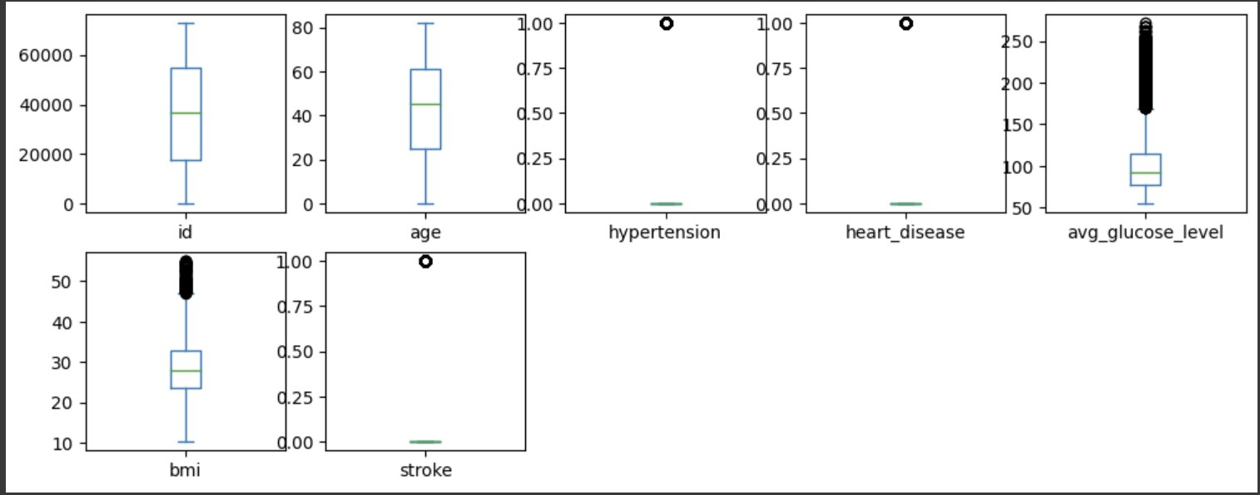
Data Preprocessing
3. Outliers before and after
Before
After

Slide 30
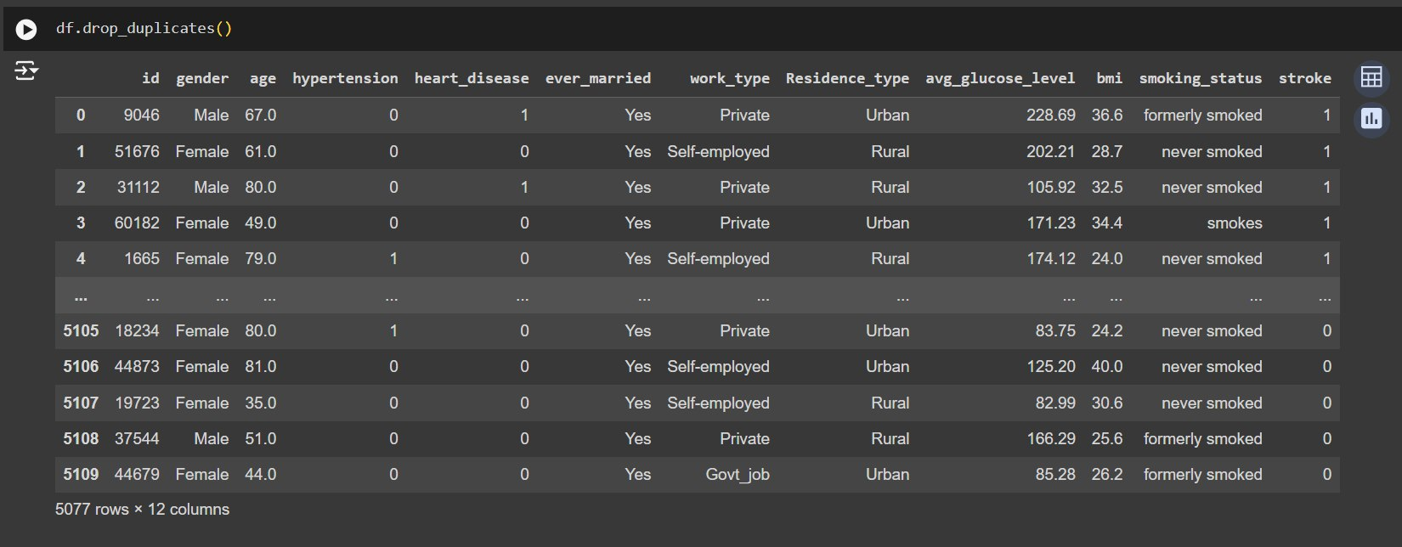
Data Preprocessing
4. Handling Duplicate Values

Slide 31
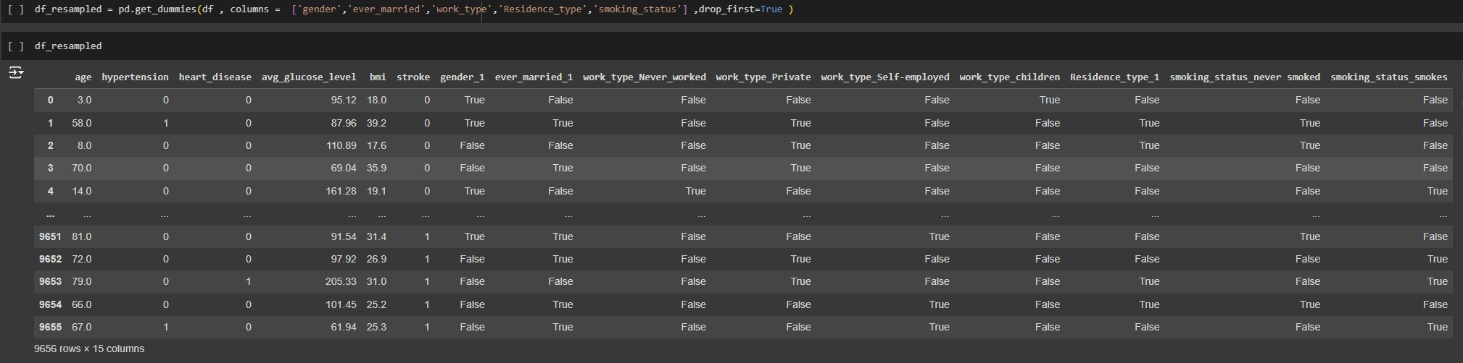
Data Preprocessing
5. Encoding using get_dummies

Slide 32
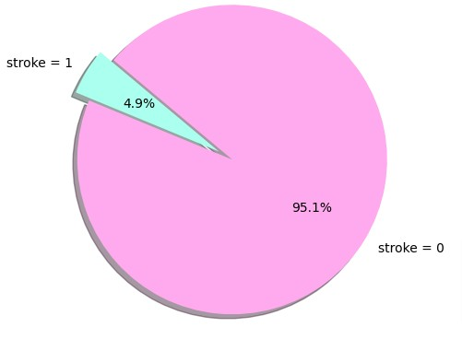
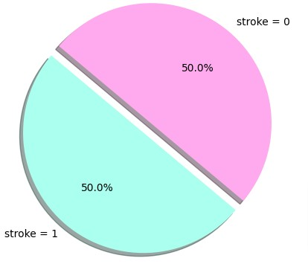
Data Preprocessing
7. sampling the target column: stroke
Samsung Innovation Campus Chapter 6. Machine Learning – Part II /98

Slide 33


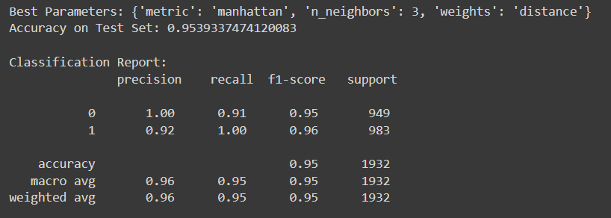
1- KNN CLASSIFIER

Slide 34


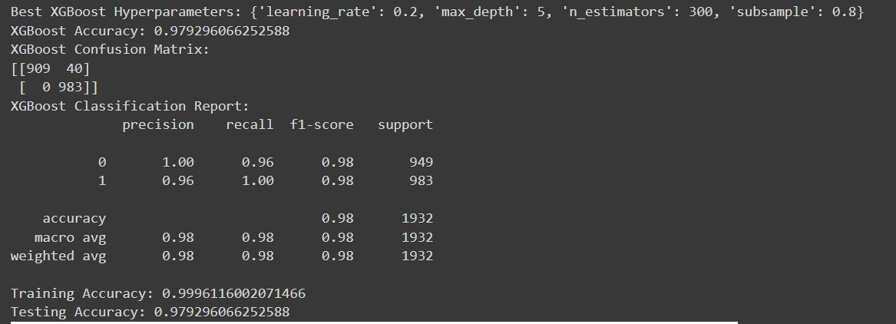
2-XGBOOST MODEL EVALUTION

Slide 35
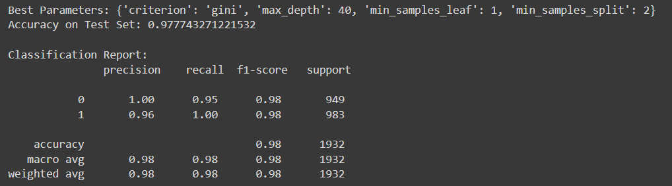
3- DECISION TREE CLASSIFIER

Slide 36

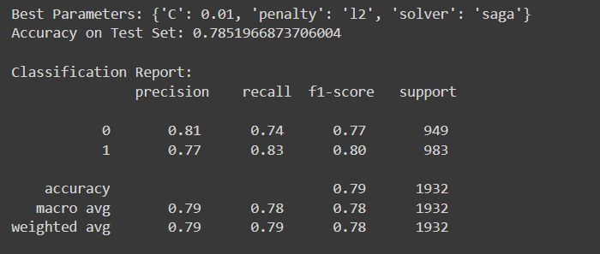
4-LOGISTIC REGRESSION MODEL EVALUTION

Slide 37

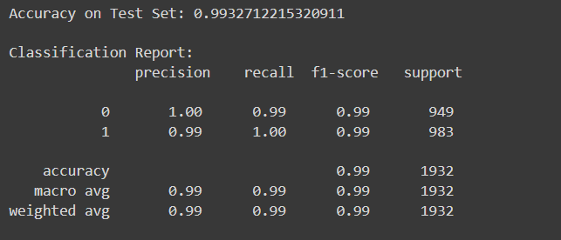
VOTING EVALUTION

Slide 38

Thank you !

