Slide 1
Journal
Journal for Journalists
V1.0.0

Slide 2
Description
Journal is a WebApi Application that you can use it as a Journalist to post your Journals and your essays that there is a specific side to the authors to have to Put, Delete, Update their posts
Journal has an admin that can modify on users (Update-Delete-Add) and can see the posts also but without editing it and some kinds of admins has privilege to connect on Database (Database Administrator)
Business User is one of the most important user of our system to be able to add authors and articles that are written with these authors.

Slide 3
How To Use Program (Journal App)
When you start the program will have a login.
If you an existing-user you can log-in with your username and password
If you are not existing user you will have to Register an account to enjoy it’s features.
You can Register by entering your details in text fields (First Name, Last Name, Email, Phone Number,… etc.)
There is two types of windows Admin Page and Business User Page, it will open depending on the logging user type.

Slide 4
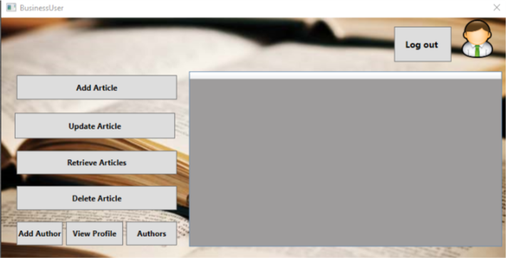
How To Use Program (Journal App) (Cont’d)
If you login on the system and your type Business User, window in fig 1.0 will open for you and you will have some options like :
Add Article.
Add Author.
Update Article.
Delete Article.
View Profile.
Retrieve Articles.
Get All Authors (Authors)
Fig 1.0

Slide 5
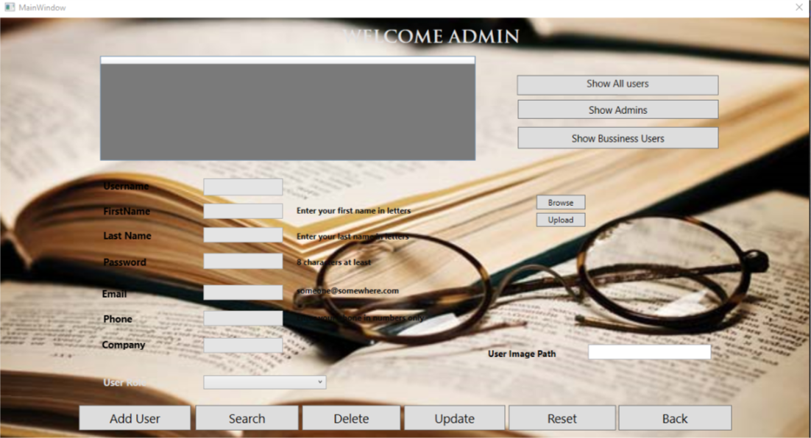
How To Use Program (Journal App) (Cont’d)
If you login on the system and your type Admin, window in fig 2.0 will open for you and you will have some options like :
Add Article.
Add Author.
Update Article.
Delete Article.
View Profile.
Retrieve Articles.
Get All Authors (Authors)
Fig 2.0

Slide 6
How To Use Program (Journal App) (Cont’d)
If you login on the system and your type Admin, window in fig 2.0 will open for you and you will have some options like :
Add Article.
Add Author.
Update Article.
Delete Article.
View Profile.
Retrieve Articles.
Get All Authors (Authors)
Fig 2.0

Slide 7
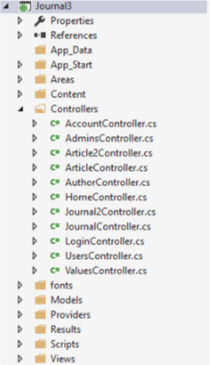
Contents of Journal
Journal Desktop-Application is worked with MVC Designed Pattern that have Controllers to be able to connect on the data base and control your functions that receive and send data over the web using Web APi (.NET)

Slide 8
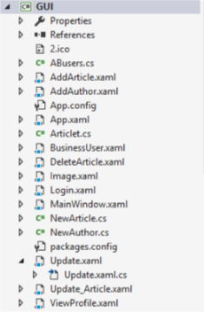
Contents of Journal (Cont’d)
Journal Desktop-Application has multiple WPF Classes to can Generate the data and features in a symbols and to can communicate with the user through User Interface (UI) for that has classes in fig 3.0 with subclass for clicking buttons
Exmp : If you click Add Article button in Business User Window will open Add Article Window to add one.

Slide 9
Journal Desktop-Application Tools
Visual studio Community 2015
Visual studio Community 2017
SQL SERVER STUDIO 2012
Fiedler V 5.0.1.2017

