Slide 1

Autonomous Football Robot
Integrating Computer Vision, STM32 Microcontrollers, and Bipedal Kinematics

Slide 2
The true sign of intelligence is not knowledge but imagination.
"
"
— Albert Einstein

Slide 3
Project Overview
We designed and built an autonomous robot capable of detecting a football, navigating towards it using bipedal locomotion, and executing a dynamic kick.
visibility
settings_input_component
memory
Real-Time Computer Vision
Processing high-resolution video streams to identify and track the football target.
Serial Communication
Bridging the gap between high-level Python logic and low-level physical actuation via STM32.
Motor Control Loops
Precise PWM generation to orchestrate bipedal kinematics and dynamic movements.

Slide 4







Hardware Architecture
Vision
Brain
Muscles
A smartphone camera captures high-resolution video streams over a local network, replacing embedded modules for better flexibility.
The STM32F401 microcontroller acts as the central hub, reading serial commands and orchestrating PWM signals.
Six SG90 micro servos provide the necessary torque to drive the hips, knees, and ankles of the bipedal leg assemblies.

Slide 5
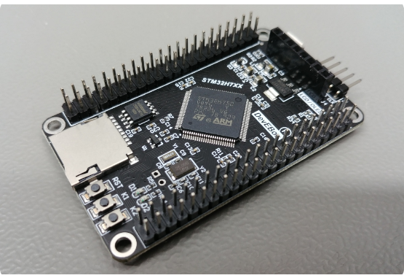
The STM32F401 Core
•
Powered by an ARM Cortex-M4 running at high clock speeds, enabling rapid execution of control loops.
•
Handles robust asynchronous serial communication at a baud rate of 115200.
•
Utilizes hardware timers to generate extremely precise PWM signals for all 6 servos simultaneously.
•
Serves as the bridge between high-level Python logic and low-level physical actuation.

Slide 6
Precision Actuation
6
Bipedal Mechanics
To achieve stable bipedal walking and kicking, we require multiple degrees of freedom. Three servos are assigned to each leg, functioning as the hip, knee, and ankle joints.
SG90 Servos
This configuration allows shifting the center of gravity laterally and generating forward momentum.

Slide 7

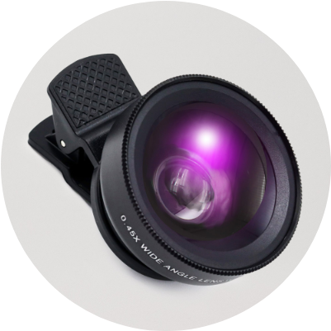
Mobile Vision
Smartphone Streaming
By leveraging an external smartphone camera, we offload image capture from the local system. OpenCV establishes a video capture stream, allowing the Python script to continuously fetch new frames.
This provides superior optics and frame rates compared to standard low-cost embedded cameras.

Slide 8
Software & Computer Vision

Slide 9
CV Pipeline
2. Pre-process
4. Track
Apply an 11x11 Gaussian blur to reduce high-frequency noise and artifacting.
Extract contours, find the largest enclosed circle, and calculate its center point.
1. Capture
3. Segment
Read raw BGR frames from the camera feed and mirror them for alignment.
Convert to HSV space and apply binary masking targeting the ball's color profile.

Slide 10


Color Detection
The HSV Space
Contour Extraction
Instead of RGB, we use Hue, Saturation, and Value space. We defined our lower bounds as [20, 70, 70] and upper bounds as [45, 255, 255]. This isolation ensures the vision pipeline only triggers on the target ball's specific wavelength regardless of lighting shadows.
After thresholding, `cv2.findContours` maps the edges. We implement an area filter (>1500 px) to ignore background noise. Once verified, `cv2.minEnclosingCircle` mathematically derives the X/Y coordinates and the pixel radius of the target.

Slide 11
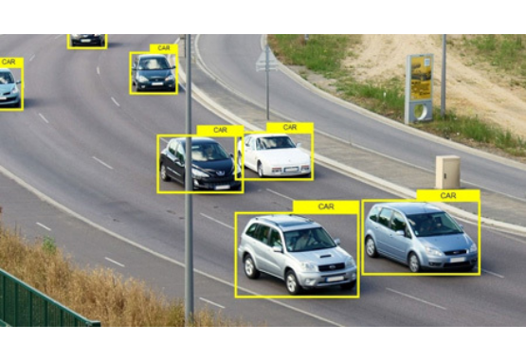


Distance Estimation
To know when to kick, the robot must gauge depth without lidar. We achieve this purely via optical mathematics.
By knowing the real-world diameter of the ball (6.7cm) and calibrating the camera's focal length (700), we calculate physical distance inversely proportional to the radius in pixels.

Slide 12
Decision Matrix
Vision State | Mathematical Condition | Robot Action | Serial Cmd
Ball on Left | Center X < Frame_Center - 80 | Pivot counter-clockwise | L
Ball on Right | Center X > Frame_Center + 80 | Pivot clockwise | R
Ball Centered & Far | Centered AND Distance >= 25cm | Execute Walk Cycle | F
Ball Centered & Close | Centered AND Distance < 25cm | Execute Kick Sequence | K

Slide 13
PC to MCU Interface
Python scripts compute the logic locally and push single-byte character strings (L, R, F, K) down the USB serial port.
Operating at a 115200 baud rate ensures commands are evaluated instantly, reducing end-to-end latency.
The STM32 `loop()` continuously monitors `Serial.available()`, acting immediately when a new state instruction arrives.
Only state changes are broadcasted. If the target remains centered and far, 'F' is sent once, avoiding serial buffer overflow.

Slide 14
Firmware & Kinematics

Slide 15
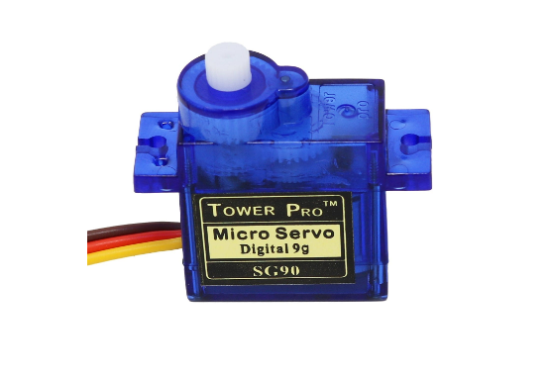
Controlling the Servos
Sending a servo directly from 90° to 135° in a single command causes violent jerks, entirely destabilizing a bipedal structure.
We engineered a `moveAll()` function that acts as a custom smoothing interpolator. It compares the target angle to the current angle for all 6 servos, incrementing or decrementing by 1° inside a fast loop.
A built-in micro-delay creates a controlled, organic sweeping motion for every step.

Slide 16


Bipedal Stances
Neutral Stance
Walking Cycle
To remain upright, the robot sets default angles: Right Hip 90°, Knee 90°, Ankle 70°. Left Hip 90°, Knee 90°, Ankle 90°. This asymmetrical ankle mapping accounts for mechanical tolerances and offsets center of mass safely.
The forward walk requires sequentially tilting ankles to shift weight to one leg, lifting the opposite hip/knee, and swinging it forward. This two-part synchronous sequence (Right step, then Left step) ensures forward thrust.

Slide 17







Movement Primitives
Forward
Turn Left
Turn Right
Dynamic balancing act. Hip and knee joints mirror each other in opposing phases to generate linear forward motion.
Hip joints both shift to 110/70 simultaneously while planted. Pulling back resets position, rotating the chassis CCW.
Inverse of the left turn. Asymmetrical hip rotation leverages the foot grip to pivot the robot's heading clockwise.

Slide 18
The Kick Sequence
2. Cock Back
4. Knee Snap
Right hip pulls back (to 115°). Potential energy is loaded into the stance.
Right knee fully extends, striking the ball. System delays and returns to neutral.
1. Plant & Lean
3. Hip Swing
Left leg servos adjust (Ankle to 135°) to shift the entire center of mass heavily onto the left foot.
Right hip snaps forward violently (to 55°) directly overriding the smoothing function.

Slide 19
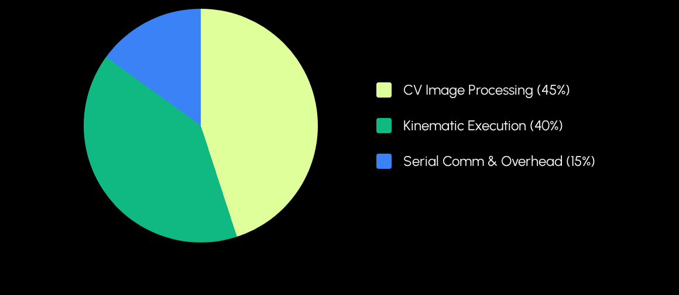
Loop Timing Budget
The heavy lifting is equally split between the Python-based OpenCV filtering array and the physical execution time required by the servos' micro-delays on the STM32.

Slide 20
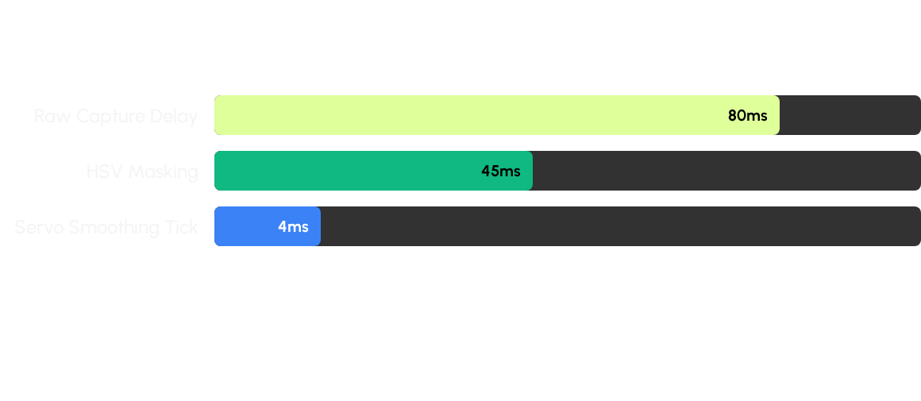
Latency Optimization
Applying Gaussian Blur allowed us to drop contour extraction complexity, saving significant frame processing time. The servo movement is kept at an ultra-low 4ms delay to ensure rapid responsiveness.

Slide 21
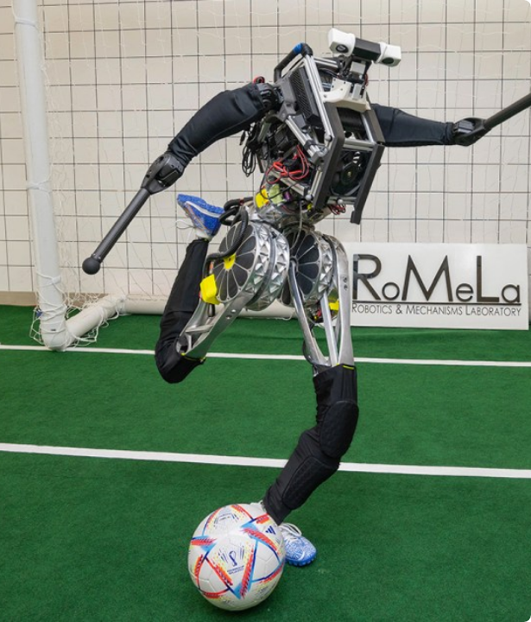
Project Success
We achieved seamless harmony between high-level Python computer vision operations and bare-metal C++ embedded actuation.
The system successfully identifies targets, continuously calculates distance algorithms, maneuvers via bipedal mechanics, and scores.

Slide 22
Thank You
For exploring our Autonomous Football Robot.

