Slide 1
Translationese All the Way Down
Auditing what "supports Twi" means in social media NLP resources
Gideon Elorm Glago · 22128981
DCIT 316: Computational Models for Social Media Mining · University of Ghana
https://github.com/osamabinIaggin/dcit316-final-project

Slide 2
The claims
Twi is supported, according to the people who built the tools
Google Translate added Twi and Ewe in 2022.
Meta's NLLB-200 covers both. Its benchmark, FLORES-200, lists twi_Latn, aka_Latn and ewe_Latn.
AfriSenti, AfriHate and MasakhaNER 2.0 all list Twi.
From Accra, it looks as if the tools exist. This project checks what they do with Twi as people write it online.

Slide 3
Scope
Three research questions
RQ1 (accountability). What do the resources that claim Twi disclose about which Twi, where the text came from, who labelled it and how much they agreed?
RQ2 (distribution). How far is the text those claims are measured on from Twi on social media?
RQ3 (capability). How do the tools a Ghanaian analyst would reach for perform on natively written Twi tweets, against a baseline trained on Twi?

Slide 4
Finding 1 · coverage
Ga, the language of Accra, is in none of it
Language | FLORES-200 | MasakhaNER 2.0 | AfriSenti | AfriHate | Google Tr. | NLLB-200
Twi / Akan | yes (2 files) | yes | yes | yes | yes | yes
Ewe | yes | yes | no | no | yes | yes
Ga | no | no | no | no | no | no
Ewe has benchmarks but no social media data at all. Ga has nothing to evaluate on and nothing to train on.

Slide 5
Finding 2 · provenance
The Twi benchmarks are translations into Twi
Corpus | Natively written? | Tokens using ɛ/ɔ | Texts writing 3 for ɛ | Mean tokens
FLORES-200 twi_Latn | No, translated English Wikipedia | 28.5% | 0.1% | 25.3
MasakhaNER 2.0 twi | No, MAFAND-MT translated news | 34.6% | 0.0% | 23.4
AfriSenti twi (tweets) | Yes | 5.6% | 42.5% | 9.3
FLORES Twi vocabulary covers 15% of the word types in the tweets.
FLORES aka_Latn and twi_Latn are separate translations: 8 of 2009 lines identical. Neither says which dialect it is.

Slide 6
Finding 3 · accountability
What the documentation lets you check
Criterion | FLORES-200 | AfriSenti | AfriHate | MasakhaNER 2.0
A1 Language referent precise | no dialect named | no dialect named | no dialect named | merges 'Akan/Twi'
A2 Natively written | translated (Wikipedia) | YES - tweets | YES - tweets | translated (MAFAND-MT)
A3 Native-speaker annotators stated | human-verified translation | yes | yes, explicit | yes
A4 Agreement reported | n/a | yes, k=0.51 | yes, 0.46-0.81 | yes, k=0.932 POST-ADJUDICATION
A5 Compensation disclosed | not found | not found | yes - 'more than the minimum wage' | yes - all annotators remunerated
A6 Datasheet / data statement | not found | not found | not found | not found
No resource ships a datasheet. MasakhaNER's kappa is measured after adjudication; AfriSenti's is not, so the two numbers cannot be compared.

Slide 7
RQ3 · design
Method: five systems, one baseline, 949 test tweets
Data: AfriSenti Twi. Train 3,481, dev 388, test 949. C tuned on dev; test used once.
Baseline: TF-IDF (character 2-5 grams + words) with logistic regression, trained on Twi.
English-only: Twitter-RoBERTa, the tool an analyst reaches for by default.
Multilingual: XLM-T, zero-shot (trained on 8 languages, none of them Twi).
Translate then classify: NLLB-200 Twi to English, then the English model. Run twice, declaring the source as twi_Latn and as aka_Latn.
Metrics: macro-F1 with 95% bootstrap CI, McNemar against the baseline, and the share of positive or negative tweets called neutral.

Slide 8
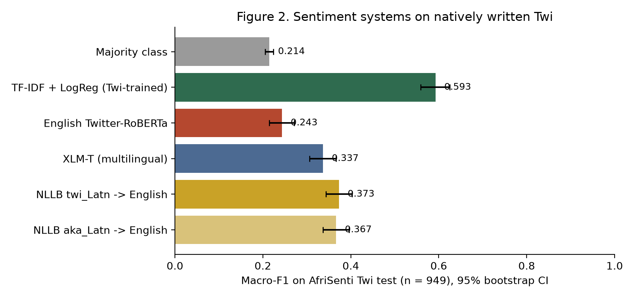
RQ3 · results
A small model trained on Twi beats every off-the-shelf system tested
Baseline 0.593
XLM-T 0.337
NLLB twi 0.373
English-only 0.243
Majority 0.214

Slide 9
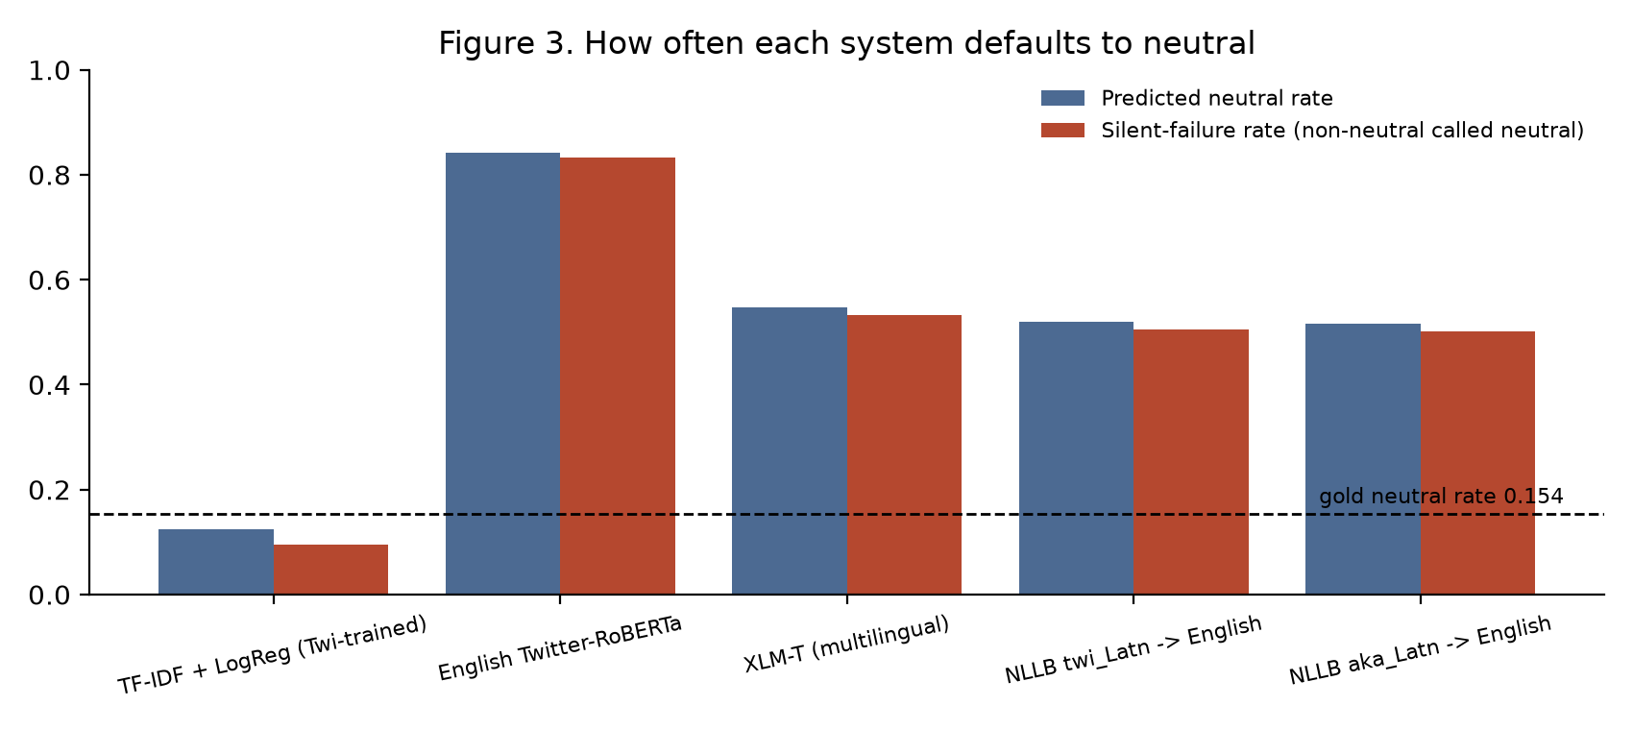
RQ3 · the silent failure
English-only tools turn Twi into neutral
Gold neutral rate: 15.4%
English-only predicts neutral 84.2% of the time
and calls 83.3% of positive or negative tweets neutral.
Its output carries no warning that anything went wrong.

Slide 10
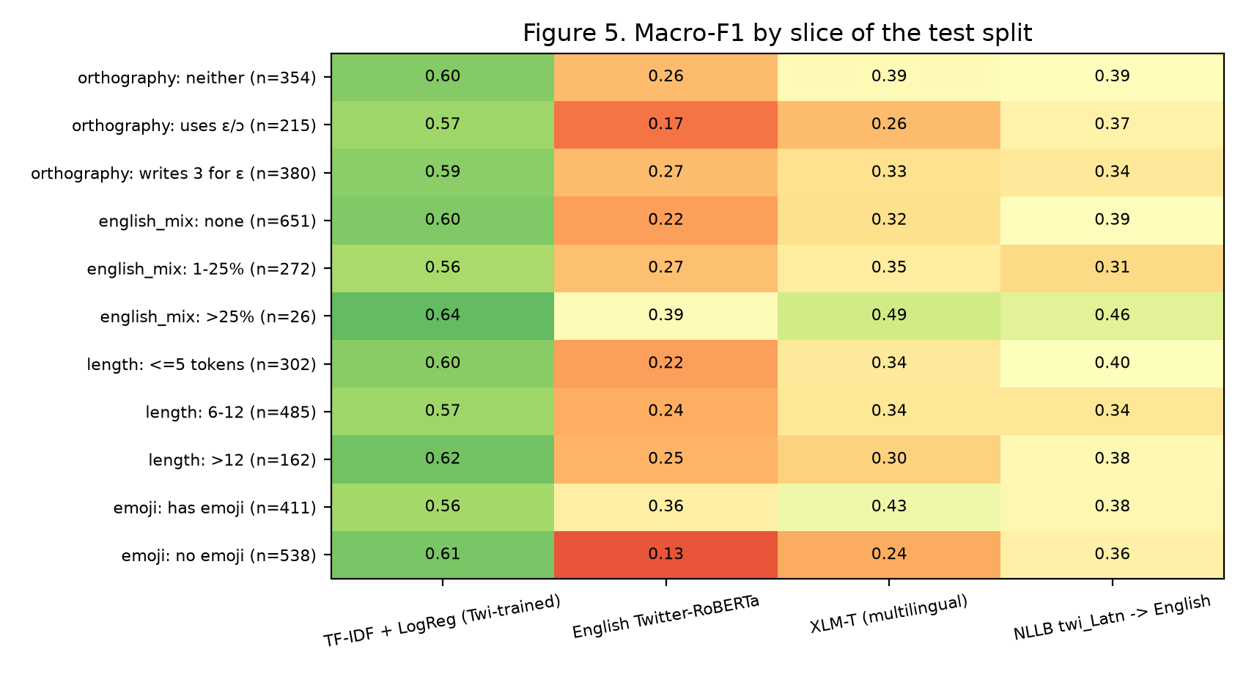
Error analysis
Where the systems break
Changing only the declared source (twi_Latn vs aka_Latn) changes the translation of 829 of 949 tweets and the final label of 243.
Tested by removing emoji: 98 of the English model's 125 non-neutral calls on emoji tweets turn neutral.
Rewriting 3 as ɛ stops NLLB copying it but does not significantly help the pipeline (p = 0.76); it does help XLM-T (p = 0.027).
132 tweets defeat the baseline, XLM-T and NLLB alike.

Slide 11
Responsible claims
Limitations
"Not reported" means not verifiable from the public record, not that the practice was absent.
I do not read Twi well enough to judge translations, so translation results are about sentiment lost, not translation errors.
One labelled Twi social corpus exists, with kappa 0.51. Every result inherits its label noise.
Google Translate was not tested (no API key). Ewe and Ga could not be evaluated: no data.

Slide 12
Conclusion
What Ghanaian social media mining needs next
Twi capability claims rest on text translated into Twi. The only natively written labelled corpus is 4,818 tweets, and off-the-shelf tools fail on it in a way that looks like neutrality.
On that corpus, a small model trained on Twi scored far above every off-the-shelf system tested.
Needed: a Ga corpus, a larger natively written Twi corpus, a convention for naming the variety, and agreement scores reported in comparable form.
Code, data manifests and notebooks: https://github.com/osamabinIaggin/dcit316-final-project

