Slide 1

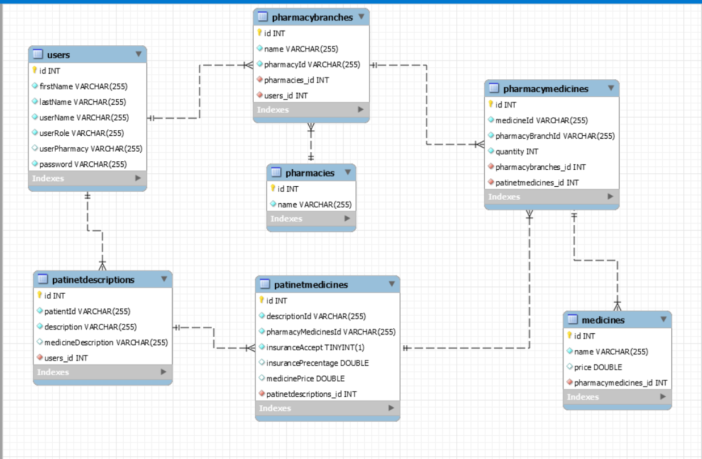
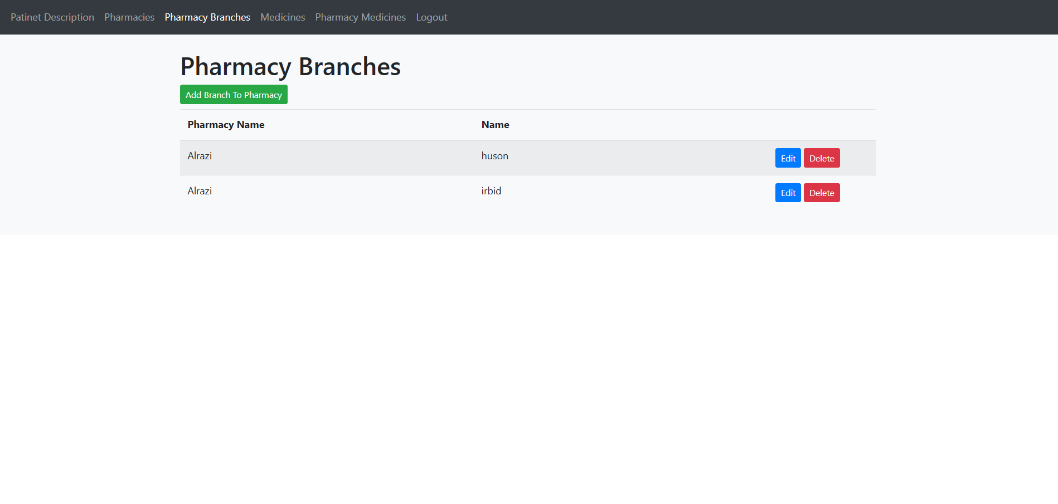
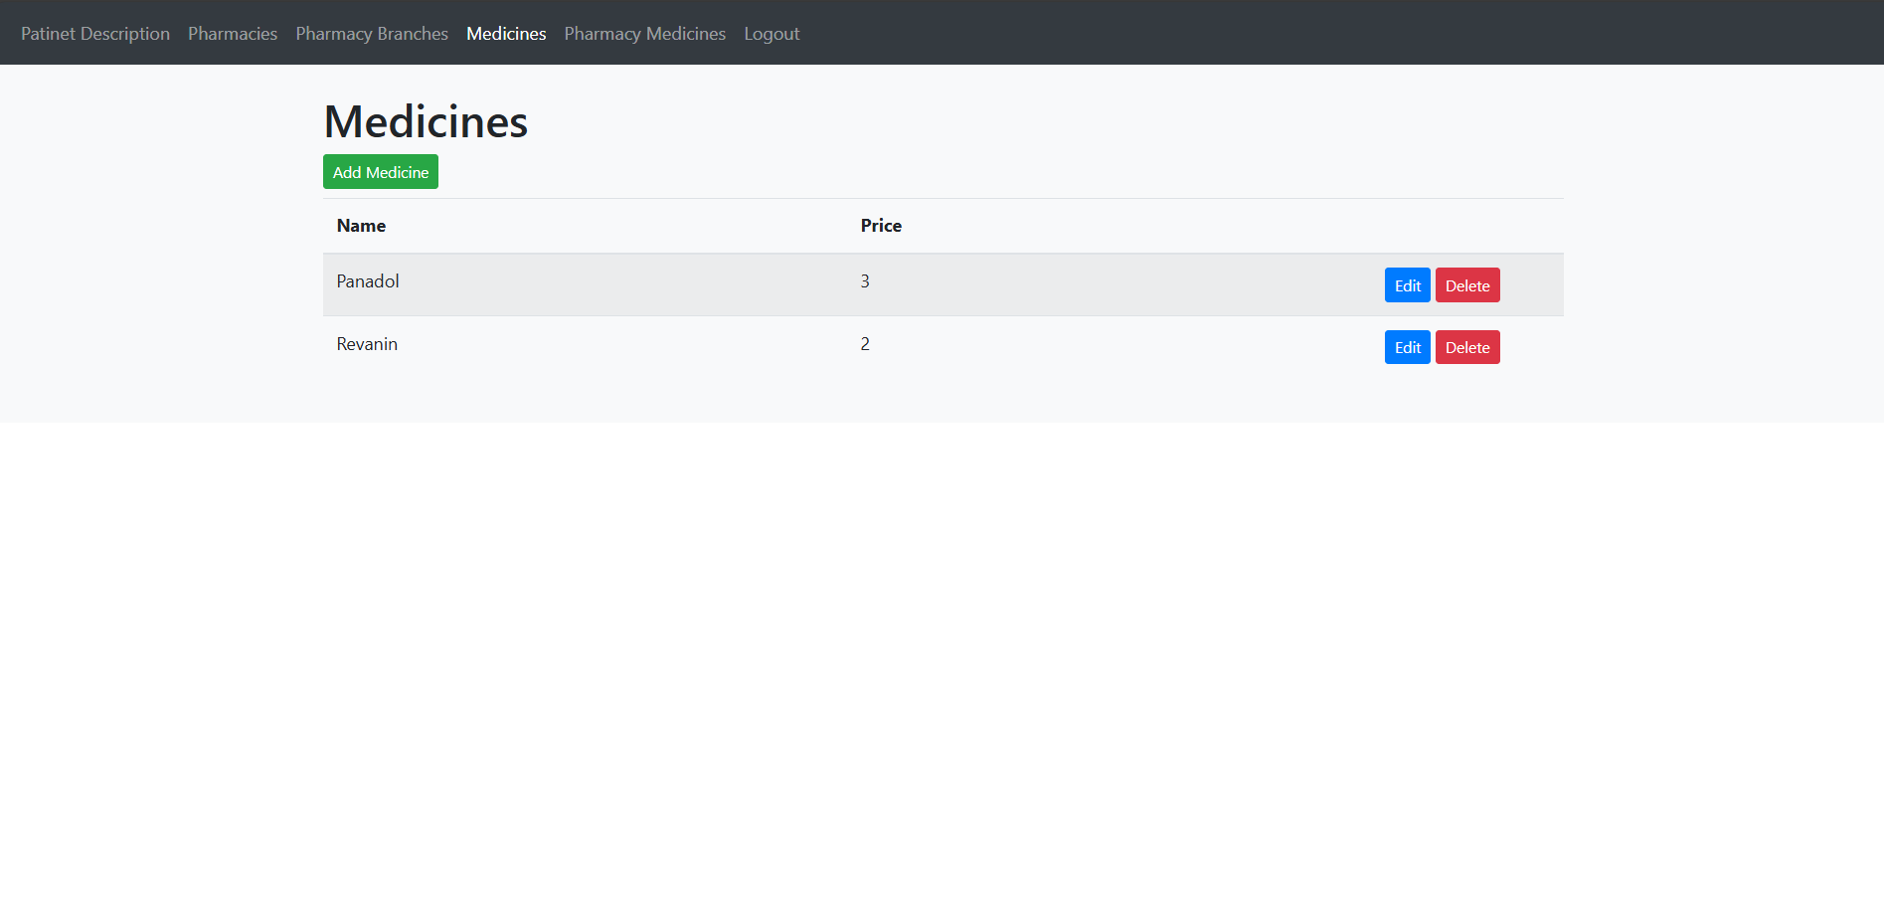
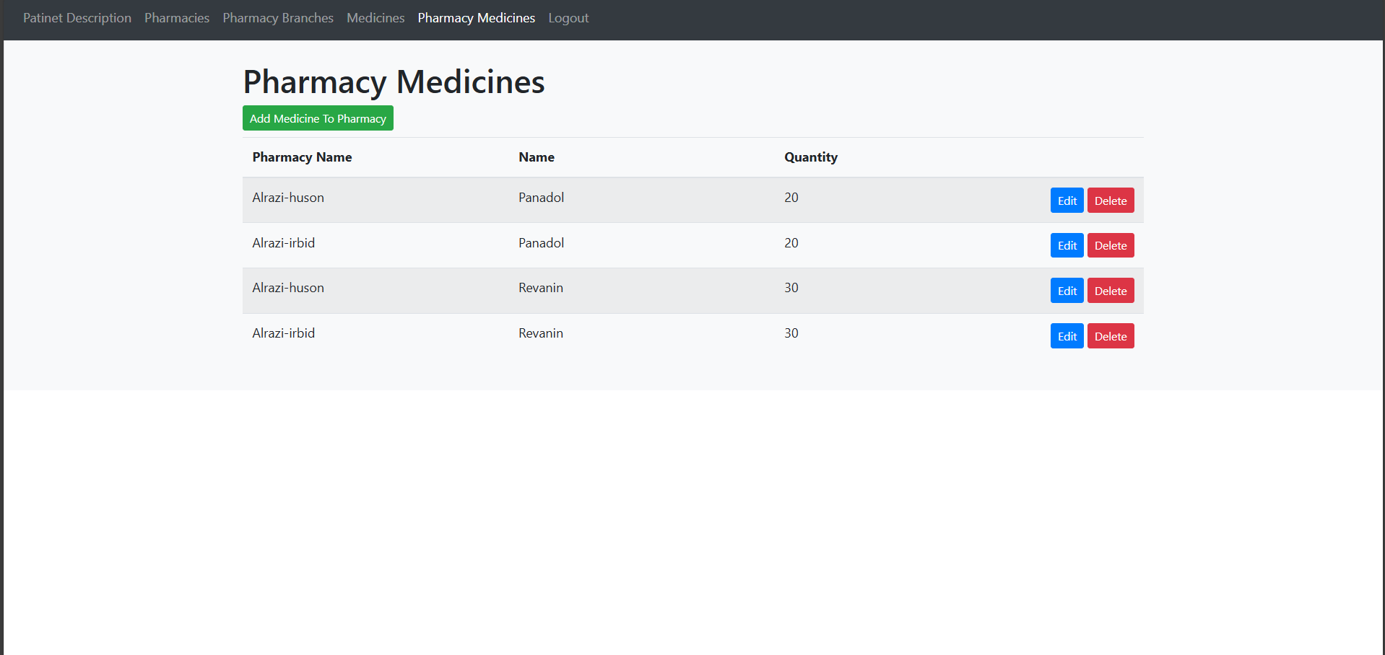
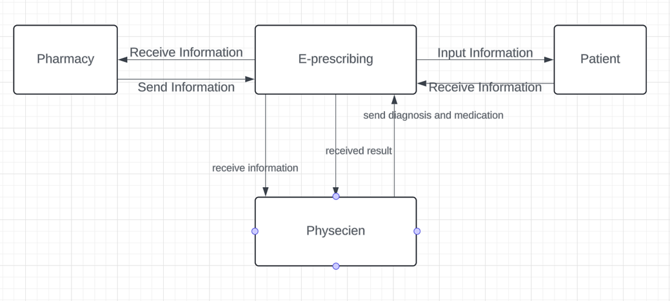
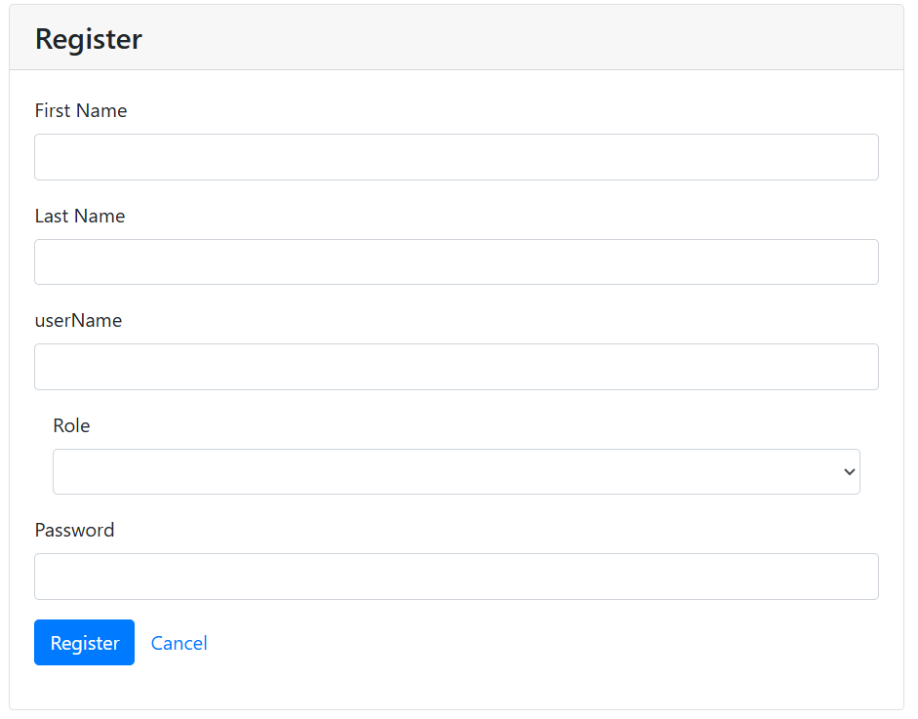
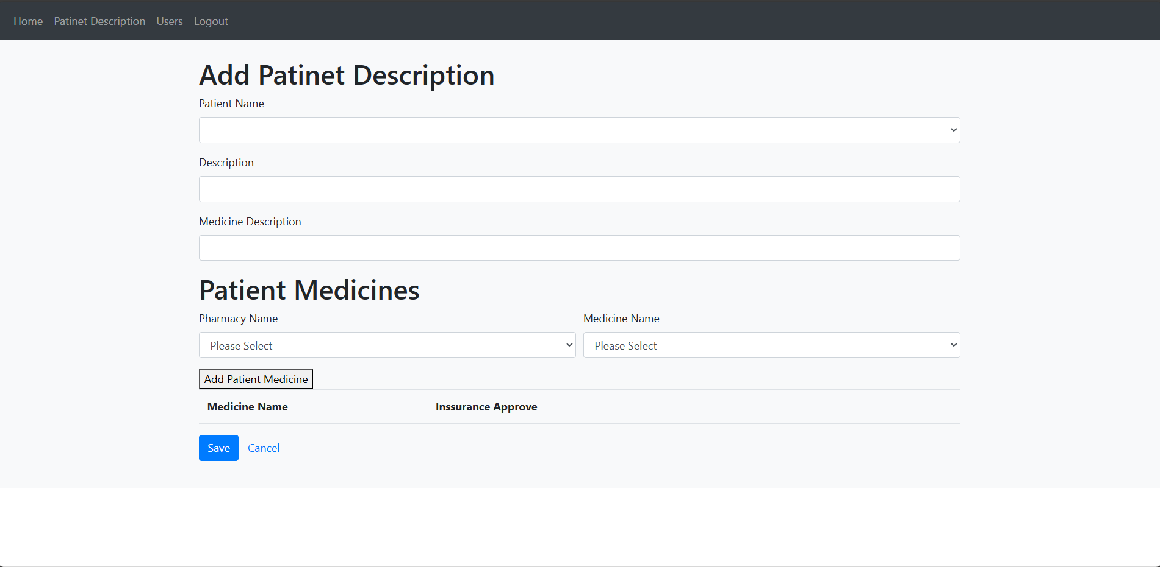
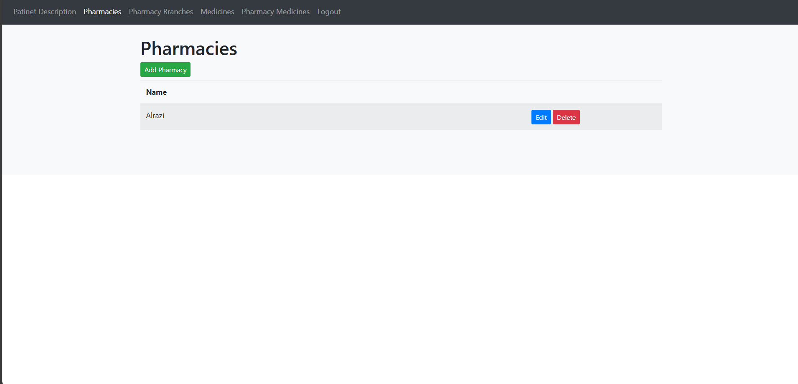
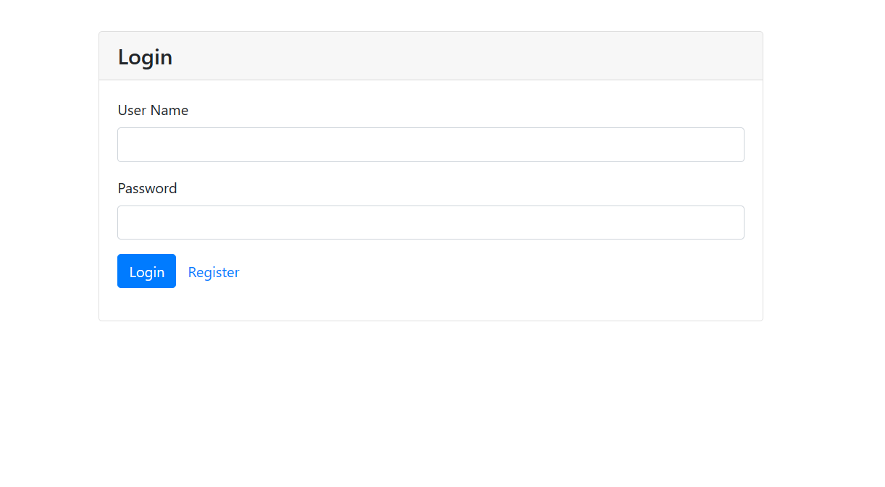
Electronic Prescribing Web Application
^{Osama Haddad}
Supervisor: Dr. Mahmoud Masadeh
Abstract
E-prescribing is a website system enables a prescriber(physician) to electronically send an accurate, error-free and understandable prescription directly to a pharmacy from the point-of-care and is an important element in improving the quality of patient care.
Figure 7: Page of pharmacy Branches for pharmacist.
Introduction
It is an idea based on an easy-to-use website Reduce medical errors, decrease pharmacy costs, improve both prescriber and refill requests pharmacy efficiency.
Eliminate handwriting interpretation errors, reduce phone calls between pharmacists and physicians, reduce data entry, and expedite prescription.
Figure 8: Page of medicines for pharmacist.
Figure 3: Database
Figure 9: Page of pharmacy medicines for pharmacist.
Implementation
I use visual studio code environment to edit bootstrap templet and create the main interface of our website. The website use HTML, CSS and TypeScript along with libraries like NodeJS as (front-end) technologies. As for (back-end) technologies the website uses TypeScript the main language and Angular and MySQL Workbench to create the database.
Figure 1: Workflow
Figure 4: Registration Page.
Design
Results and Discussion
In designing and implementing electronic prescriptions, the requirements of all stakeholder groups (such as pharmacists, physicians, and patients) must be carefully considered. In case of responding to user needs, the electronic prescription can improve the medication prescription process since users prefer the electronic prescription system that meets their professional needs. Physicians are the main users of the electronic prescription system and considering their clinical needs and priorities is essential for developing the National Electronic Prescription System.
The website provides a detailed explanation of the purpose of the site. It includes a navigation bar that contains links to other pages.
The strengths points : The website is open-source so that the developers can modify the website and improve it as they need.
The weaknesses points: Maybe the website has not easy loading of the webpage on mobile devices.
Figure 5: Add patient Description for physician
Conclusions
The electronic prescribing web app improves medication prescribing by enhancing accuracy, efficiency, and patient safety. It reduces errors, simplifies workflows, and supports healthcare providers in delivering quality care. This project highlights the crucial role of digital tools in modernizing healthcare and optimizing services.
Figure 2: Login Page.
Figure 6: Page of pharmacies for pharmacist
Hijjawi Faculty for Engineering Technology
Computer Engineering Department
Graduation Projects – second semester 2024

