Slide 1
SARS-Cov-2 Omicron variant vs Delta variant

Slide 2
Introduction
The out break of covid-19 in late 2019 has affected the world and people lives in many different aspects, whether in education, economics or in the quality of life itself the damage was unbearable.

Slide 3
SARS-CoV-2 which has caused the covid-19 has many variants. Alpha, beta, gamma, delta and omicron, the main purpose of this study is to compare between the following two:
Omicron Variant
Delta Variant

Slide 4
The data set used is from GISAID which is a public database for SARS-Cov2.

Slide 5
Comparison is done in three ways:
01
02
03
Creating a Phylogenetic Tree.
Getting the Chemical constituents.
Extracting the dissimilar regions.

Slide 6
Phylogenetic tree
It is a diagram that represents evolutionary relationships among organisms.
The pattern of branching in a phylogenetic tree reflects how species or other groups evolved from a series of common ancestors.

Slide 7
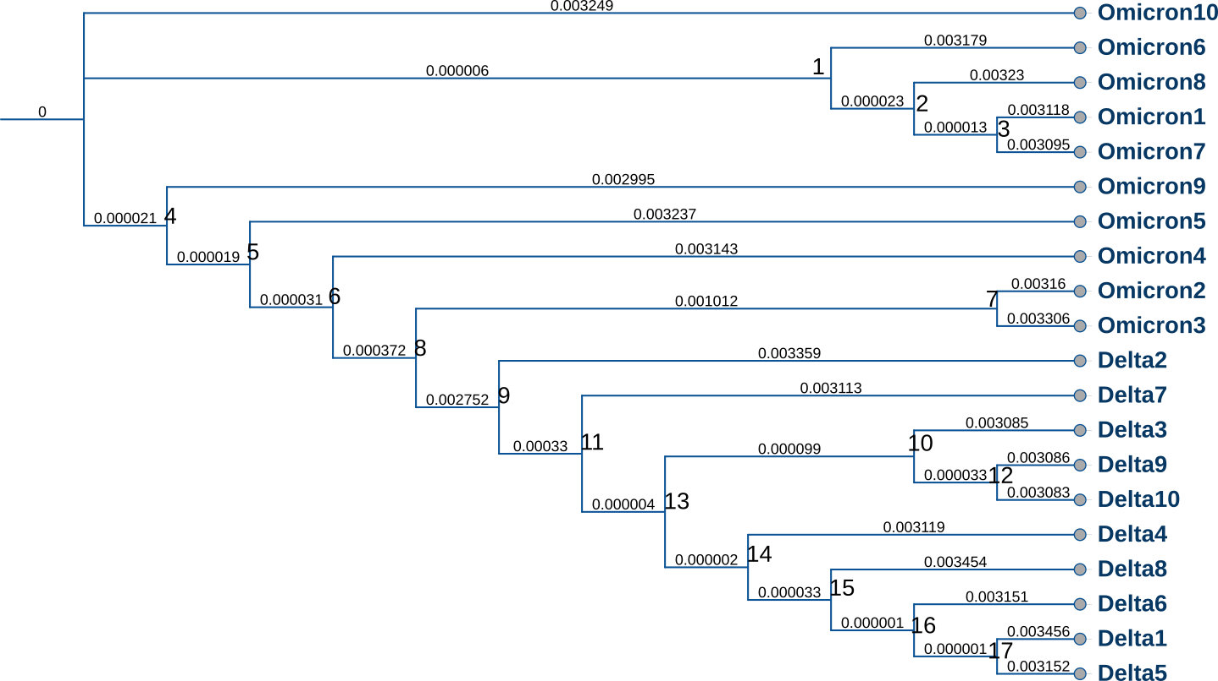

Slide 8
02.
Getting the Chemical constituents

Slide 9
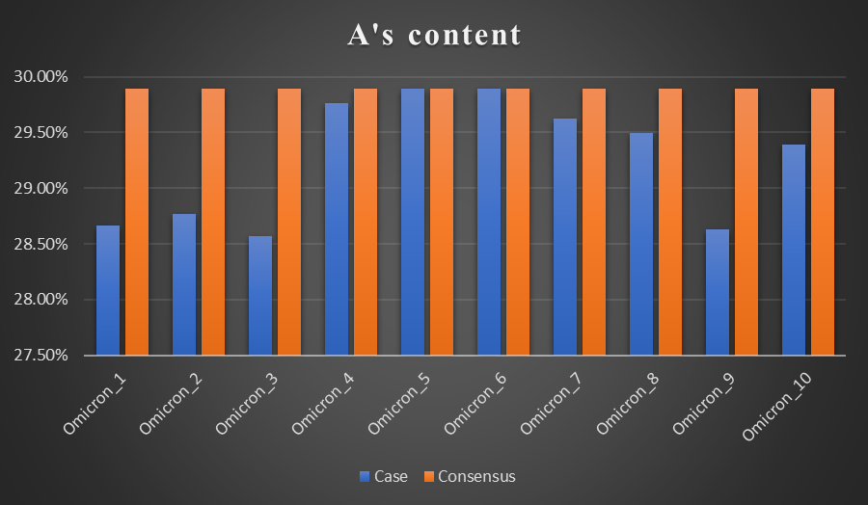
Findings
30%
60%
10%
Case
Consensus

Slide 10
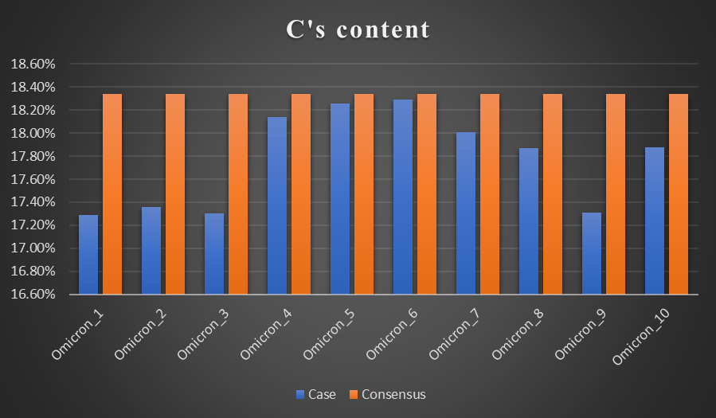
Findings
30%
60%
10%
Case
Consensus

Slide 11
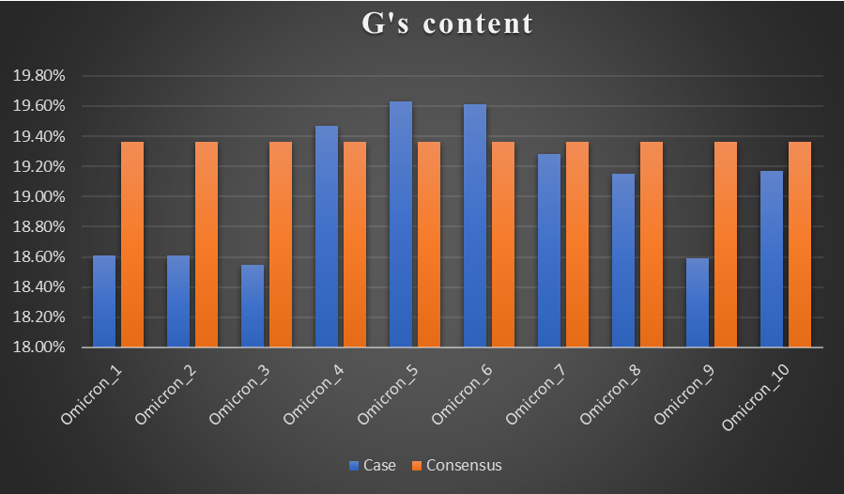
Findings
30%
60%
10%
Case
Consensus

Slide 12
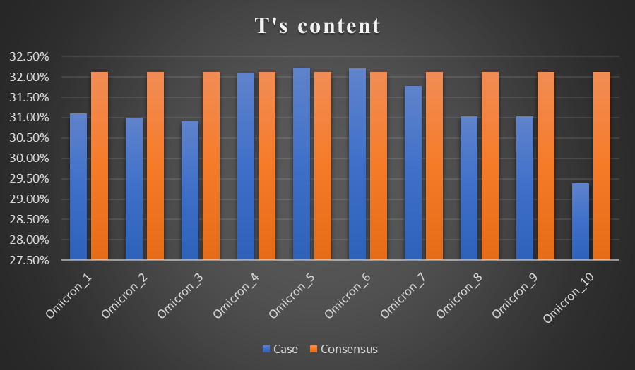
Findings
30%
60%
10%
Case
Consensus

Slide 13
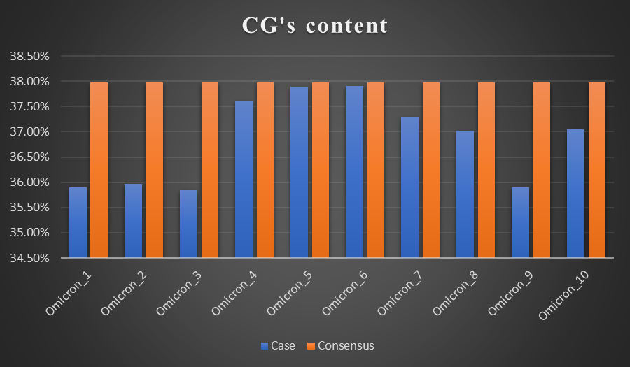
Findings
30%
60%
10%
Case
Consensus

Slide 14
02.
Extracting the dissimilar regions.

Slide 15


Similar vs Dissimilar
27612
2139
overall dissimilarity regions
overall similarity regions

Slide 16
Dissimilar Regions
Case seq. | percentage | Case seq. | percentage
Omicron1 | 4.99% | Omicron6 | 0.64%
Omicron2 | 4.94% | Omicron7 | 1.83%
Omicron3 | 5.35% | Omicron8 | 2.37%
Omicron4 | 1.17% | Omicron9 | 5.05%
Omicron5 | 0.65% | Omicron10 | 2.42%

Slide 17
Nucleotides dissimilarity
29%
A
C
24%
23%
G
T
23%

Slide 18
Conclusion
Low CG content
similarity between Omicron/Delta’s sequences
similarity between the delta virus and the Omicron mutant
Delta and Omicron are from the same family

Slide 19
Team (4)
osamah Faisal
Gufran Mohammed
Shuaib Abdulsalam
Yasmin Yasser

Slide 20

Thanks
Do you have any questions?

