Slide 1

1. System Architecture
A secure, scalable platform designed to support client users, workshop staff, real-time operations, and customer feedback in one connected workflow.
Client-facing message
Pioneer separates user access from core services through a high-availability entry point, helping the application remain reliable as demand grows.
Users & Roles
Load Balancer
Pioneer Platform
Feedback Loop
Super Admin, Customer, Mechanic, and workshop staff access the platform.
High-availability routing directs traffic to healthy services.
Frontend, backend API, real-time layer, and survey services.
Post-service surveys capture customer feedback through QR/link.
Designed for enterprise expectations: availability, scalability, role-based access, and measurable customer experience.
Pioneer Application | Client Showcase
Notes:
System Architecture slide.
[Sources]
- Mwasalat Holdings logo and brand colors were taken from the user-provided brand guide image: /mnt/data/759d0b96-383d-41e7-bbb2-83220387c06a.png.
- Pioneer architecture concepts were interpreted from the user-provided architecture image in this conversation.

Slide 2
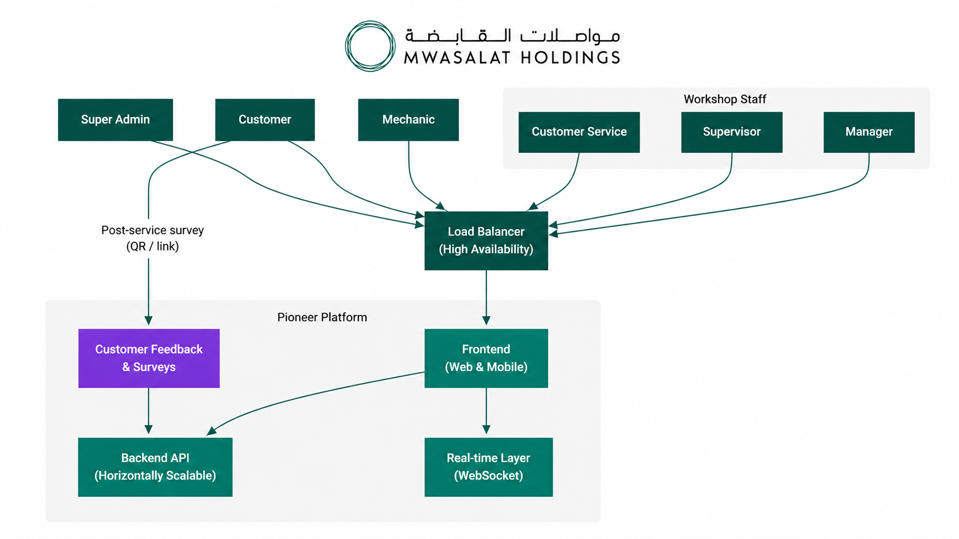
1. System Architecture
How each user group reaches Pioneer services and how service interactions are routed inside the platform.
Client walkthrough
1
Role-based access
Separate entry points for customer, admin, mechanic, and workshop teams.
2
High availability
Traffic is routed through a load balancer before reaching core services.
3
Core platform services
Web/mobile frontend connects to backend API and real-time WebSocket layer.
4
Customer insight
Post-service QR/link surveys feed directly into the Pioneer platform.
Reliable • Scalable • Measurable
Pioneer Application | Client Showcase
Notes:
System Architecture slide.
[Sources]
- Architecture diagram and labels are based on the user-provided/open architecture image generated in this conversation: /mnt/data/a_clean_corporate_architecture_diagram_on_a_white.png.
- Mwasalat Holdings logo and brand colors were taken from the user-provided brand guide image: /mnt/data/759d0b96-383d-41e7-bbb2-83220387c06a.png.

Slide 3
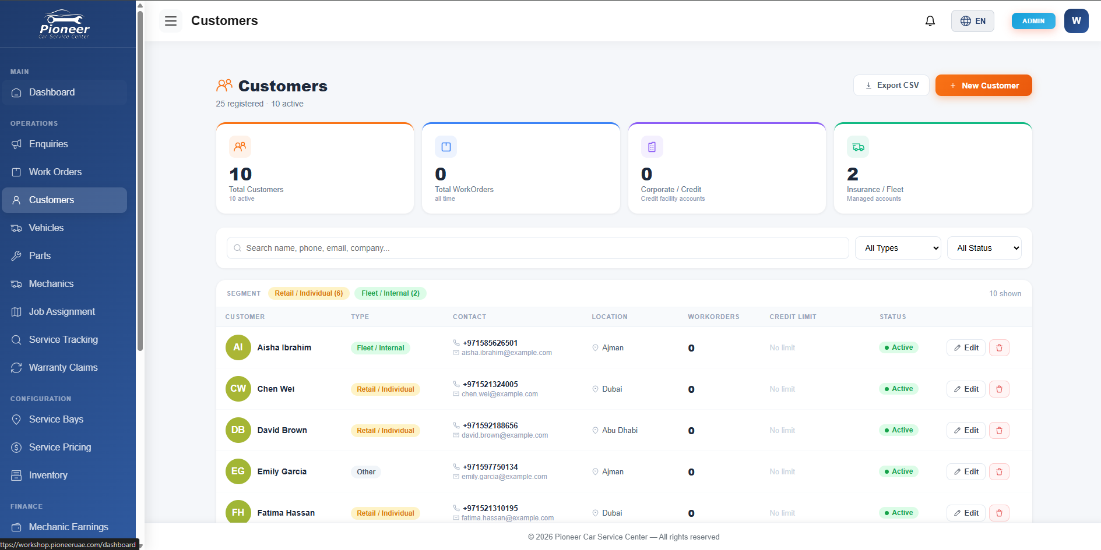
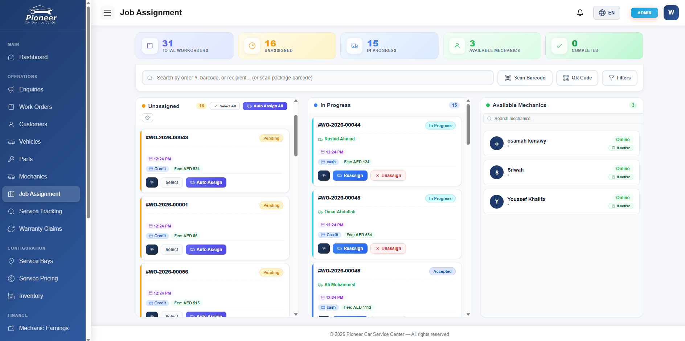
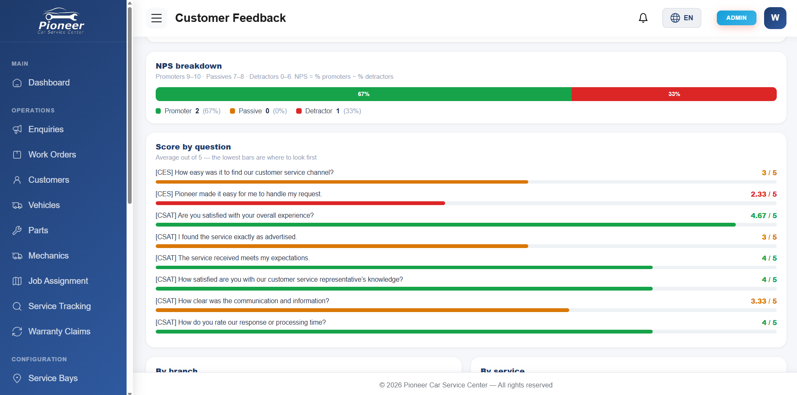
2. Application Screenshots
POS, ERP and CRM system descriptions and/or screenshots
Pioneer presents one enterprise workspace for customer records, work-order execution, mechanic assignment, and measurable customer experience.
CRM
ERP
Customer Experience
Customer management
Workshop operations
Feedback analytics
Centralized customer profiles, segments, contacts, locations, and account status.
Work order queue, job assignment, mechanic availability, and service execution tracking.
NPS, score by question, and service-level insights for continuous improvement.
Business view: one platform covering operations, customer relationship management, and post-service feedback reporting.
Pioneer Application | Client Showcase
Notes:
Application screenshots slide.
[Sources]
- Customer Feedback screenshot: /mnt/data/166ac57d-94a8-4e0c-a500-ec9f895f6403.png.
- Job Assignment screenshot: /mnt/data/17e2129c-e655-4d26-9cc1-5c15a9c3f923.png.
- Customers screenshot: /mnt/data/9cd78574-4f1d-4ed2-8dfc-3610629a8e7e.png.

Slide 4
2. Application Screenshots
Pioneer operational workspace
Screenshots demonstrate how client teams can manage customer accounts and coordinate work orders from a single application.
CRM: Customers
ERP: Job Assignment
Registered customer list, account segments, status, and export actions.
Work-order lanes, auto-assignment, mechanic availability, and progress status.
Pioneer Application | Client Showcase
Notes:
Operational screenshots slide.
[Sources]
- Customers screenshot: /mnt/data/9cd78574-4f1d-4ed2-8dfc-3610629a8e7e.png.
- Job Assignment screenshot: /mnt/data/17e2129c-e655-4d26-9cc1-5c15a9c3f923.png.

Slide 5
2. Application Screenshots
Customer feedback and service quality analytics
Pioneer converts post-service surveys into visible quality metrics for management and workshop teams.
What the client sees
NPS breakdown
Promoter, passive, and detractor distribution at a glance.
Question-level scoring
Highlights low-scoring service questions to prioritize action.
Branch/service insight
Supports operational follow-up by location and service type.
Business value: measurable customer experience and evidence-based service improvement.
Pioneer Application | Client Showcase
Notes:
Customer feedback screenshot slide.
[Sources]
- Customer Feedback screenshot: /mnt/data/166ac57d-94a8-4e0c-a500-ec9f895f6403.png.

Slide 6
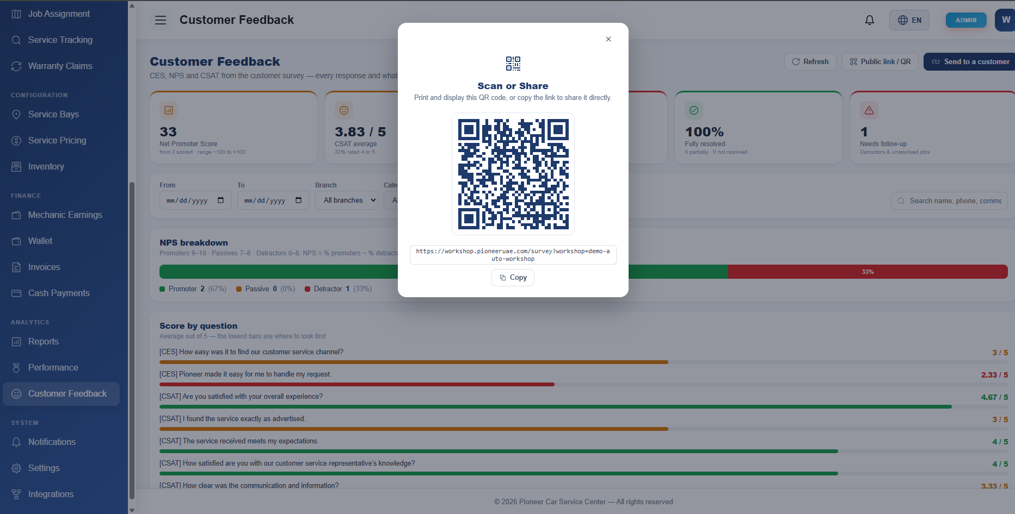
The Customer Feedback module provides a public QR/link that staff can print, display, or send directly to customers after service completion.
3. Customer Survey QR Code
Public survey link / QR
1
Open Customer Feedback
Admin or service team opens the feedback dashboard after a completed service.
2
Generate QR / public link
Pioneer displays a reusable QR code and URL for the workshop survey form.
3
Customer submits response
Responses feed back into NPS, CES and CSAT analytics for management review.
Pioneer Application | Client Showcase
6

Slide 7
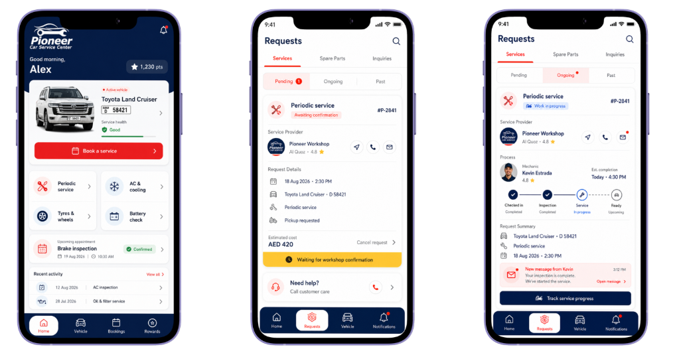
4. Customer Mobile App
Customer service, bookings, and live request tracking in one mobile experience
Book Services
Fast booking from vehicle profile
Manage Requests
Pending, ongoing, and past jobs
Track Progress
Live updates from workshop teams
Pioneer Car Service Center
Prepared for Mwasalat Holdings

Slide 8


Cybersecurity Operational Plan
What we operate today — executive summary & control architecture
EXECUTIVE SUMMARY
28
24×7
2
Enterprise-grade security operations, live today
Security controls operational
SOC monitoring & response
ISO frameworks certified
Governance & Risk
Identity & Access
Data & App Security
Config & control compliance
Security policy & procedure
Security awareness & training
Continuous compliance baselines
Authentication & authorization
Privileged access management
Secrets management
Identity lifecycle management
Data classification & DSAR
Encryption in transit & at rest
API security
SAST & DAST in the SDLC
Infrastructure Security
Threat Management
Monitoring & Response
Endpoint & network security
Cloud security
Email security
Mobile device management
Vulnerability management
Threat intelligence
Threat hunting & deception
AI-driven SOC
SIEM & log management
SOAR automation
Incident response
Threat analytics
ISO CERTIFICATIONS
ISO 27001 · Information Security
ISO 22301 · Business Continuity

Slide 9
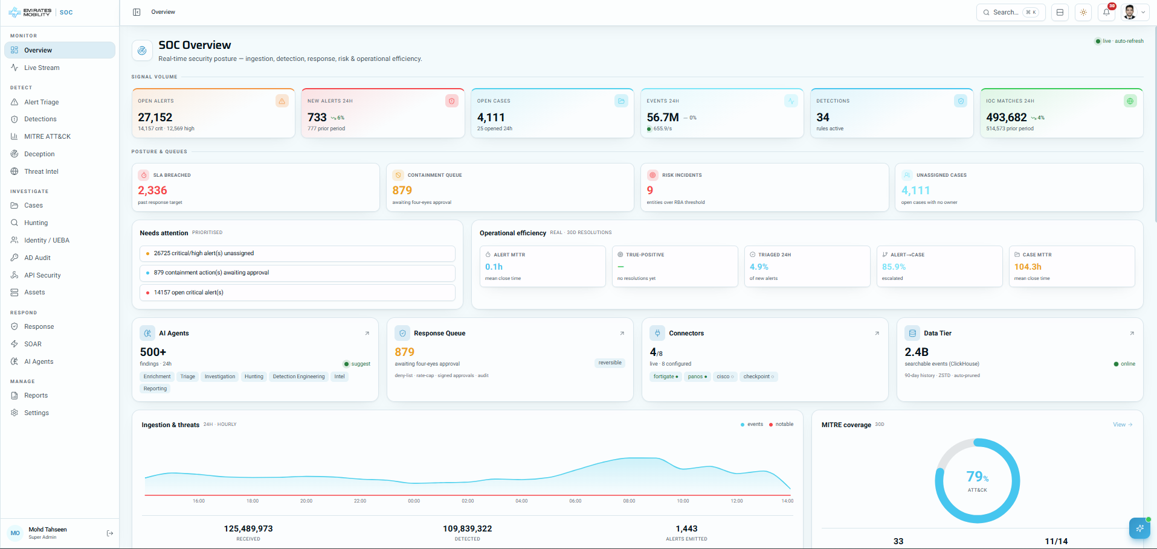
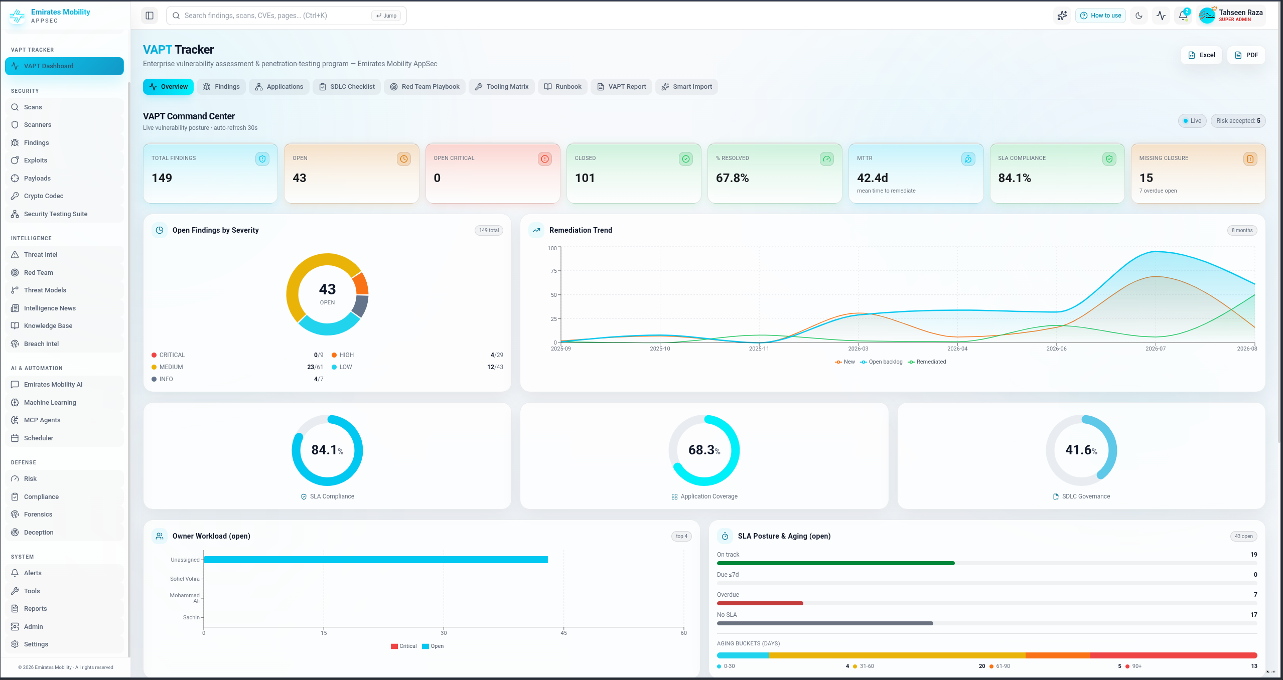
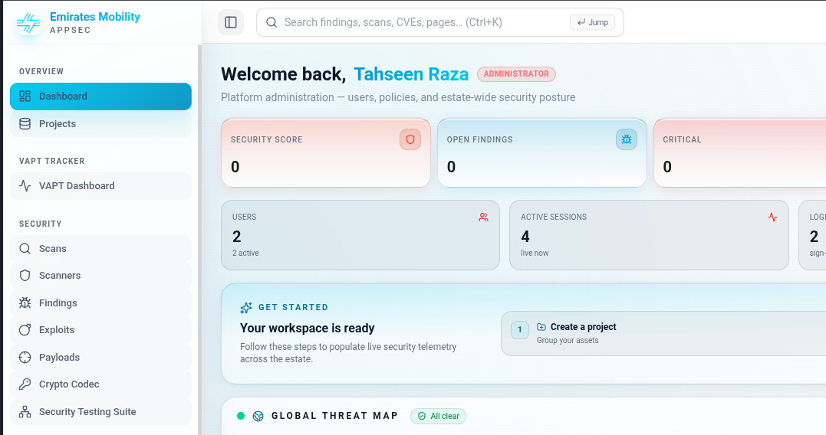
Certified Team & Pioneer Platform
Accredited people, a proven vendor stack and one operational console
Accredited security team
Pioneer Security Platform
Certified across audit, defence and offensive security
Single console for detection, response, risk and reporting
Full enterprise stack
Palo Alto, F5, Cisco, Microsoft and VMware certified
AI-assisted operations
Automation embedded in triage, enrichment and reporting
TEAM CERTIFICATIONS · 13
CISA
CompTIA CySA+
CEH
CompTIA Security+
Palo Alto Firewall
F5 Load Balancer
WAF
Cisco Certified
Microsoft Certified
VAPT Tracker
AppSec Command Centre
VMware Certified
DLP Administrator
CICM
AI Automation · orchestration & response engineering
Certifications maintained and re-assessed every cycle
Coverage across offensive, defensive and compliance domains
Vulnerability lifecycle, SLA posture and remediation trend
Estate-wide posture, threat intel and scan coverage

