Slide 1

Correlation and Regression
Chapter 9

Slide 2
§ 9.1
Correlation

Slide 3
Correlation
A correlation is a relationship between two variables. The data can be represented by the ordered pairs (x, y) where x is the independent (or explanatory) variable, and y is the dependent (or response) variable.
A scatter plot can be used to determine whether a linear (straight line) correlation exists between two variables.
y
2
x
Example:
2
4
6
x | 1 | 2 | 3 | 4 | 5
y | – 4 | – 2 | – 1 | 0 | 2
–2
– 4

Slide 4
Linear Correlation
y
y
As x increases, y tends to decrease.
As x increases, y tends to increase.
x
x
Negative Linear Correlation
Positive Linear Correlation
y
y
x
x
No Correlation
Nonlinear Correlation

Slide 5
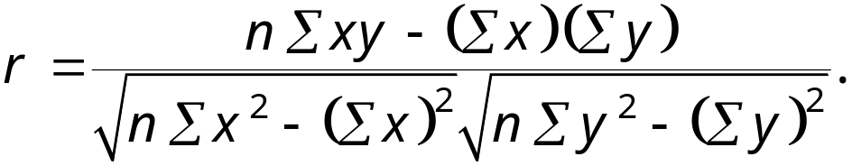
Correlation Coefficient
The correlation coefficient is a measure of the strength and the direction of a linear relationship between two variables. The symbol r represents the sample correlation coefficient. The formula for r is
The range of the correlation coefficient is −1 to 1. If x and y have a strong positive linear correlation, r is close to 1. If x and y have a strong negative linear correlation, r is close to −1. If there is no linear correlation or a weak linear correlation, r is close to 0.

Slide 6
Linear Correlation
y
y
r = −0.91
r = 0.88
x
x
Strong negative correlation
Strong positive correlation
y
y
r = 0.42
r = 0.07
x
x
Weak positive correlation
Nonlinear Correlation

Slide 7





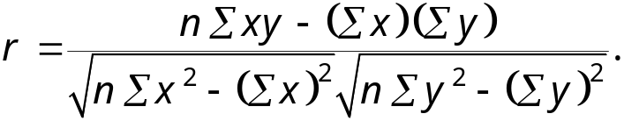
Calculating a Correlation Coefficient
Calculating a Correlation Coefficient
In Words In Symbols
Find the sum of the x-values.
Find the sum of the y-values.
Multiply each x-value by its corresponding y-value and find the sum.
Square each x-value and find the sum.
Square each y-value and find the sum.
Use these five sums to calculate the correlation coefficient.
Continued.

Slide 8





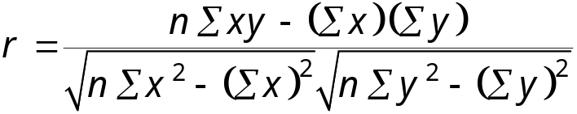
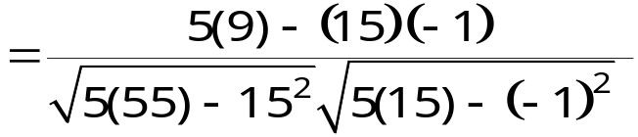
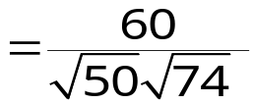

Correlation Coefficient
Example:
Calculate the correlation coefficient r for the following data.
x | y | xy | x² | y²
1 | – 3 | – 3 | 1 | 9
2 | – 1 | – 2 | 4 | 1
3 | 0 | 0 | 9 | 0
4 | 1 | 4 | 16 | 1
5 | 2 | 10 | 25 | 4
There is a strong positive linear correlation between x and y.

Slide 9
Correlation Coefficient
Example:
The following data represents the number of hours 12 different students watched television during the weekend and the scores of each student who took a test the following Monday.
a.) Display the scatter plot.
b.) Calculate the correlation coefficient r.
Hours, x | 0 | 1 | 2 | 3 | 3 | 5 | 5 | 5 | 6 | 7 | 7 | 10
Test score, y | 96 | 85 | 82 | 74 | 95 | 68 | 76 | 84 | 58 | 65 | 75 | 50
Continued.

Slide 10
Correlation Coefficient
Example continued:
Hours, x | 0 | 1 | 2 | 3 | 3 | 5 | 5 | 5 | 6 | 7 | 7 | 10
Test score, y | 96 | 85 | 82 | 74 | 95 | 68 | 76 | 84 | 58 | 65 | 75 | 50
y
100
80
60
Test score
40
20
x
2
4
6
8
10
Hours watching TV
Continued.

Slide 11





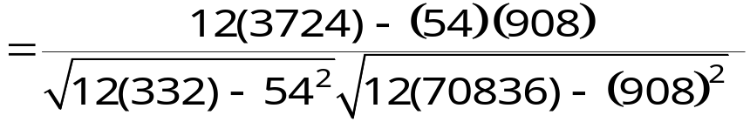

Correlation Coefficient
Example continued:
Hours, x | 0 | 1 | 2 | 3 | 3 | 5 | 5 | 5 | 6 | 7 | 7 | 10
Test score, y | 96 | 85 | 82 | 74 | 95 | 68 | 76 | 84 | 58 | 65 | 75 | 50
xy | 0 | 85 | 164 | 222 | 285 | 340 | 380 | 420 | 348 | 455 | 525 | 500
x² | 0 | 1 | 4 | 9 | 9 | 25 | 25 | 25 | 36 | 49 | 49 | 100
y² | 9216 | 7225 | 6724 | 5476 | 9025 | 4624 | 5776 | 7056 | 3364 | 4225 | 5625 | 2500
There is a strong negative linear correlation.
As the number of hours spent watching TV increases, the test scores tend to decrease.

Slide 12
Testing a Population Correlation Coefficient
Once the sample correlation coefficient r has been calculated, we need to determine whether there is enough evidence to decide that the population correlation coefficient ρ is significant at a specified level of significance.
One way to determine this is to use Table 11 in Appendix B.
If |r| is greater than the critical value, there is enough evidence to decide that the correlation coefficient ρ is significant.
n | α = 0.05 | α = 0.01
4 | 0.950 | 0.990
5 | 0.878 | 0.959
6 | 0.811 | 0.917
7 | 0.754 | 0.875
For a sample of size n = 6, ρ is significant at the 5% significance level, if |r| > 0.811.

Slide 13
Testing a Population Correlation Coefficient
Finding the Correlation Coefficient ρ
In Words In Symbols
Determine the number of pairs of data in the sample.
Specify the level of significance.
Find the critical value.
Decide if the correlation is significant.
Interpret the decision in the context of the original claim.
Determine n.
Identify α.
Use Table 11 in Appendix B.
If |r| > critical value, the correlation is significant. Otherwise, there is not enough evidence to support that the correlation is significant.

Slide 14
Testing a Population Correlation Coefficient
Example:
The following data represents the number of hours 12 different students watched television during the weekend and the scores of each student who took a test the following Monday.
The correlation coefficient r ≈ −0.831.
Hours, x | 0 | 1 | 2 | 3 | 3 | 5 | 5 | 5 | 6 | 7 | 7 | 10
Test score, y | 96 | 85 | 82 | 74 | 95 | 68 | 76 | 84 | 58 | 65 | 75 | 50
Is the correlation coefficient significant at α = 0.01?
Continued.

Slide 15
Testing a Population Correlation Coefficient
Example continued:
Appendix B: Table 11
r ≈ −0.831
n | α = 0.05 | α = 0.01
4 | 0.950 | 0.990
5 | 0.878 | 0.959
6 | 0.811 | 0.917
n = 12
α = 0.01
10 | 0.632 | 0.765
11 | 0.602 | 0.735
12 | 0.576 | 0.708
13 | 0.553 | 0.684
|r| > 0.708
Because, the population correlation is significant, there is enough evidence at the 1% level of significance to conclude that there is a significant linear correlation between the number of hours of television watched during the weekend and the scores of each student who took a test the following Monday.

Slide 16
Hypothesis Testing for ρ
A hypothesis test can also be used to determine whether the sample correlation coefficient r provides enough evidence to conclude that the population correlation coefficient ρ is significant at a specified level of significance.
A hypothesis test can be one tailed or two tailed.
H₀: ρ ≥ 0 (no significant negative correlation)
Left-tailed test
H_{a}: ρ < 0 (significant negative correlation)
H₀: ρ ≤ 0 (no significant positive correlation)
Right-tailed test
H_{a}: ρ > 0 (significant positive correlation)
H₀: ρ = 0 (no significant correlation)
Two-tailed test
H_{a}: ρ ≠ 0 (significant correlation)

Slide 17
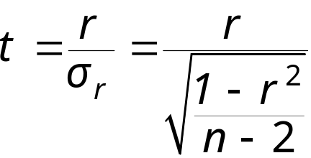
Hypothesis Testing for ρ
The t-Test for the Correlation Coefficient
A t-test can be used to test whether the correlation between two variables is significant. The test statistic is r and the standardized test statistic
follows a t-distribution with n – 2 degrees of freedom.
In this text, only two-tailed hypothesis tests for ρ are considered.

Slide 18
Hypothesis Testing for ρ
Using the t-Test for the Correlation Coefficient ρ
In Words In Symbols
State the null and alternative hypothesis.
Specify the level of significance.
Identify the degrees of freedom.
Determine the critical value(s) and rejection region(s).
State H₀ and H_{a}.
Identify α.
d.f. = n – 2
Use Table 5 in Appendix B.

Slide 19
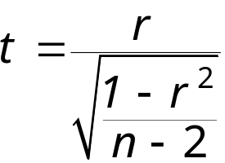
Hypothesis Testing for ρ
Using the t-Test for the Correlation Coefficient ρ
In Words In Symbols
Find the standardized test statistic.
Make a decision to reject or fail to reject the null hypothesis.
Interpret the decision in the context of the original claim.
If t is in the rejection region, reject H₀. Otherwise fail to reject H₀.

Slide 20
Hypothesis Testing for ρ
Example:
The following data represents the number of hours 12 different students watched television during the weekend and the scores of each student who took a test the following Monday.
The correlation coefficient r ≈ −0.831.
Hours, x | 0 | 1 | 2 | 3 | 3 | 5 | 5 | 5 | 6 | 7 | 7 | 10
Test score, y | 96 | 85 | 82 | 74 | 95 | 68 | 76 | 84 | 58 | 65 | 75 | 50
Test the significance of this correlation coefficient significant at α = 0.01?
Continued.

Slide 21
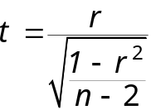
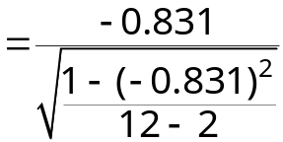


Hypothesis Testing for ρ
Example continued:
H₀: ρ = 0 (no correlation)
H_{a}: ρ ≠ 0 (significant correlation)
The level of significance is α = 0.01.
Degrees of freedom are d.f. = 12 – 2 = 10.
The critical values are −t₀ = −3.169 and t₀ = 3.169.
The standardized test statistic is
The test statistic falls in the rejection region, so H₀ is rejected.
t
−t₀ = −3.169
0
t₀ = 3.169
At the 1% level of significance, there is enough evidence to conclude that there is a significant linear correlation between the number of hours of TV watched over the weekend and the test scores on Monday morning.

Slide 22
Correlation and Causation
The fact that two variables are strongly correlated does not in itself imply a cause-and-effect relationship between the variables.
If there is a significant correlation between two variables, you should consider the following possibilities.
Is there a direct cause-and-effect relationship between the variables?
Does x cause y?
Is there a reverse cause-and-effect relationship between the variables?
Does y cause x?
Is it possible that the relationship between the variables can be caused by a third variable or by a combination of several other variables?
Is it possible that the relationship between two variables may be a coincidence?

Slide 23
§ 9.2
Linear Regression

Slide 24
Residuals
After verifying that the linear correlation between two variables is significant, next we determine the equation of the line that can be used to predict the value of y for a given value of x.
y
Observed y-value
d₂
For a given x-value,
d = (observed y-value) – (predicted y-value)
d₁
Predicted y-value
d₃
x
Each data point d_{i} represents the difference between the observed y-value and the predicted y-value for a given x-value on the line. These differences are called residuals.

Slide 25
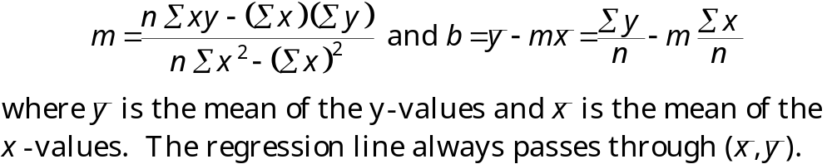
Regression Line
A regression line, also called a line of best fit, is the line for which the sum of the squares of the residuals is a minimum.
The Equation of a Regression Line
The equation of a regression line for an independent variable x and a dependent variable y is
ŷ = mx + b
where ŷ is the predicted y-value for a given x-value. The slope m and y-intercept b are given by

Slide 26
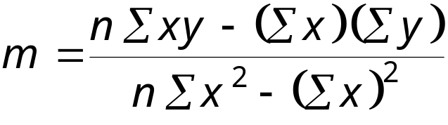
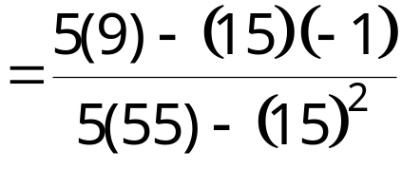
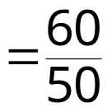

Regression Line
Example:
Find the equation of the regression line.
x | y | xy | x² | y²
1 | – 3 | – 3 | 1 | 9
2 | – 1 | – 2 | 4 | 1
3 | 0 | 0 | 9 | 0
4 | 1 | 4 | 16 | 1
5 | 2 | 10 | 25 | 4
Continued.

Slide 27
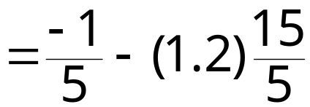


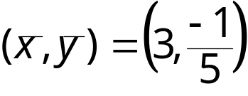
Regression Line
Example continued:
The equation of the regression line is
ŷ = 1.2x – 3.8.
y
2
1
x
−1
1
2
3
4
5
−2
−3

Slide 28
Regression Line
Example:
The following data represents the number of hours 12 different students watched television during the weekend and the scores of each student who took a test the following Monday.
a.) Find the equation of the regression line.
b.) Use the equation to find the expected test score for a student who watches 9 hours of TV.
Hours, x | 0 | 1 | 2 | 3 | 3 | 5 | 5 | 5 | 6 | 7 | 7 | 10
Test score, y | 96 | 85 | 82 | 74 | 95 | 68 | 76 | 84 | 58 | 65 | 75 | 50
xy | 0 | 85 | 164 | 222 | 285 | 340 | 380 | 420 | 348 | 455 | 525 | 500
x² | 0 | 1 | 4 | 9 | 9 | 25 | 25 | 25 | 36 | 49 | 49 | 100
y² | 9216 | 7225 | 6724 | 5476 | 9025 | 4624 | 5776 | 7056 | 3364 | 4225 | 5625 | 2500

Slide 29
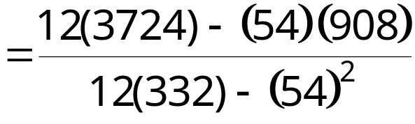

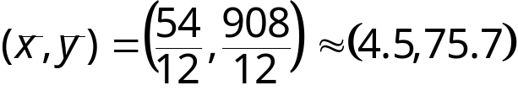
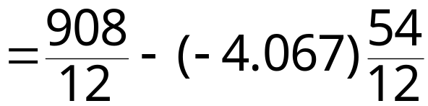

Regression Line
Example continued:
y
100
80
60
Test score
40
ŷ = –4.07x + 93.97
20
x
2
4
6
8
10
Hours watching TV
Continued.

Slide 30
Regression Line
Example continued:
Using the equation ŷ = –4.07x + 93.97, we can predict the test score for a student who watches 9 hours of TV.
ŷ = –4.07x + 93.97
= –4.07(9) + 93.97
= 57.34
A student who watches 9 hours of TV over the weekend can expect to receive about a 57.34 on Monday’s test.

Slide 31
§ 9.3
Measures of Regression and Prediction Intervals

Slide 32






Variation About a Regression Line
To find the total variation, you must first calculate the total deviation, the explained deviation, and the unexplained deviation.
y
(x_{i}, y_{i})
Unexplained deviation
Total deviation
(x_{i}, ŷ_{i})
Explained deviation
(x_{i}, y_{i})
x

Slide 33
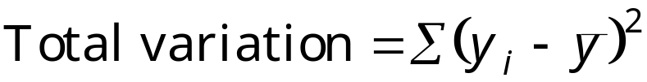

Variation About a Regression Line
The total variation about a regression line is the sum of the squares of the differences between the y-value of each ordered pair and the mean of y.
The explained variation is the sum of the squares of the differences between each predicted y-value and the mean of y.
The unexplained variation is the sum of the squares of the differences between the y-value of each ordered pair and each corresponding predicted y-value.

Slide 34
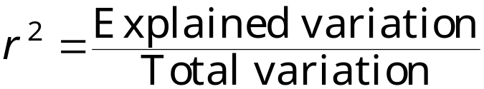


Coefficient of Determination
The coefficient of determination r² is the ratio of the explained variation to the total variation. That is,
Example:
The correlation coefficient for the data that represents the number of hours students watched television and the test scores of each student is r ≈ −0.831. Find the coefficient of determination.
About 69.1% of the variation in the test scores can be explained by the variation in the hours of TV watched. About 30.9% of the variation is unexplained.

Slide 35
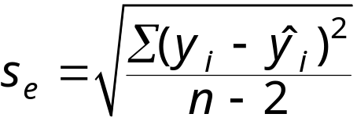
The Standard Error of Estimate
When a ŷ-value is predicted from an x-value, the prediction is a point estimate.
An interval can also be constructed.
The standard error of estimate s_{e} is the standard deviation of the observed y_{i} -values about the predicted ŷ-value for a given x_{i} -value. It is given by
where n is the number of ordered pairs in the data set.
The closer the observed y-values are to the predicted y-values, the smaller the standard error of estimate will be.

Slide 36
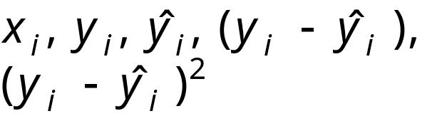


The Standard Error of Estimate
Finding the Standard Error of Estimate
In Words In Symbols
Make a table that includes the column heading shown.
Use the regression equation to calculate the predicted y-values.
Calculate the sum of the squares of the differences between each observed y-value and the corresponding predicted y-value.
Find the standard error of estimate.

Slide 37

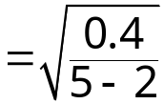

The Standard Error of Estimate
Example:
The regression equation for the following data is
ŷ = 1.2x – 3.8.
Find the standard error of estimate.
x_{i} | y_{i} | ŷ_{i} | (y_{i} – ŷ_{i} )²
1 | – 3 | – 2.6 | 0.16
2 | – 1 | – 1.4 | 0.16
3 | 0 | – 0.2 | 0.04
4 | 1 | 1 | 0
5 | 2 | 2.2 | 0.04
Unexplained variation
The standard deviation of the predicted y value for a given x value is about 0.365.

Slide 38
The Standard Error of Estimate
Example:
The regression equation for the data that represents the number of hours 12 different students watched television during the weekend and the scores of each student who took a test the following Monday is
ŷ = –4.07x + 93.97.
Find the standard error of estimate.
Hours, x_{i} | 0 | 1 | 2 | 3 | 3 | 5
Test score, y_{i} | 96 | 85 | 82 | 74 | 95 | 68
ŷ_{i} | 93.97 | 89.9 | 85.83 | 81.76 | 81.76 | 73.62
(y_{i} – ŷ_{i})² | 4.12 | 24.01 | 14.67 | 60.22 | 175.3 | 31.58
Hours, x_{i} | 5 | 5 | 6 | 7 | 7 | 10
Test score, y_{i} | 76 | 84 | 58 | 65 | 75 | 50
ŷ_{i} | 73.62 | 73.62 | 69.55 | 65.48 | 65.48 | 53.27
(y_{i} – ŷ_{i})² | 5.66 | 107.74 | 133.4 | 0.23 | 90.63 | 10.69
Continued.

Slide 39

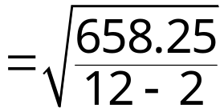

The Standard Error of Estimate
Example continued:
Unexplained variation
The standard deviation of the student test scores for a specific number of hours of TV watched is about 8.11.

Slide 40
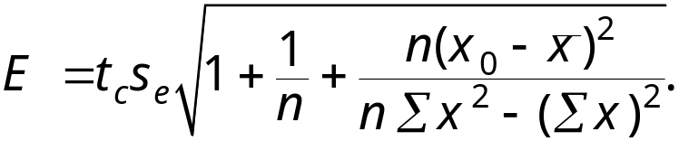
Prediction Intervals
Two variables have a bivariate normal distribution if for any fixed value of x, the corresponding values of y are normally distributed and for any fixed values of y, the corresponding x-values are normally distributed.
A prediction interval can be constructed for the true value of y.
Given a linear regression equation ŷ = mx + b and x₀, a specific value of x, a c-prediction interval for y is
ŷ – E < y < ŷ + E
where
The point estimate is ŷ and the margin of error is E. The probability that the prediction interval contains y is c.

Slide 41

Prediction Intervals
Construct a Prediction Interval for y for a Specific Value of x
In Words In Symbols
Identify the number of ordered pairs in the data set n and the degrees of freedom.
Use the regression equation and the given x-value to find the point estimate ŷ.
Find the critical value t_{c} that corresponds to the given level of confidence c.
Use Table 5 in Appendix B.
Continued.

Slide 42
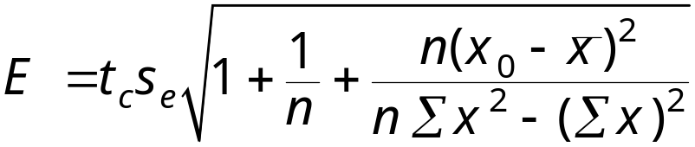
Prediction Intervals
Construct a Prediction Interval for y for a Specific Value of x
In Words In Symbols
Find the standard error of estimate s_{e}.
Find the margin of error E.
Find the left and right endpoints and form the prediction interval.
Left endpoint: ŷ – E Right endpoint: ŷ + E
Interval: ŷ – E < y < ŷ + E

Slide 43
Prediction Intervals
Example:
The following data represents the number of hours 12 different students watched television during the weekend and the scores of each student who took a test the following Monday.
Hours, x | 0 | 1 | 2 | 3 | 3 | 5 | 5 | 5 | 6 | 7 | 7 | 10
Test score, y | 96 | 85 | 82 | 74 | 95 | 68 | 76 | 84 | 58 | 65 | 75 | 50
ŷ = –4.07x + 93.97
s_{e} ≈ 8.11
Construct a 95% prediction interval for the test scores when 4 hours of TV are watched.
Continued.

Slide 44
Prediction Intervals
Example continued:
Construct a 95% prediction interval for the test scores when the number of hours of TV watched is 4.
There are n – 2 = 12 – 2 = 10 degrees of freedom.
The point estimate is
ŷ = –4.07x + 93.97
= –4.07(4) + 93.97
= 77.69.
The critical value t_{c} = 2.228, and s_{e} = 8.11.
ŷ – E < y < ŷ + E
77.69 – 8.11 = 69.58
77.69+ 8.11 = 85.8
You can be 95% confident that when a student watches 4 hours of TV over the weekend, the student’s test grade will be between 69.58 and 85.8.

Slide 45
§ 9.4
Multiple Regression

Slide 46
Multiple Regression Equation
In many instances, a better prediction can be found for a dependent (response) variable by using more than one independent (explanatory) variable.
For example, a more accurate prediction of Monday’s test grade from the previous section might be made by considering the number of other classes a student is taking as well as the student’s previous knowledge of the test material.
A multiple regression equation has the form
ŷ = b + m₁x₁ + m₂x₂ + m₃x₃ + … + m_{k}x_{k}
where x₁, x₂, x₃,…, x_{k} are independent variables, b is the y-intercept, and y is the dependent variable.
* Because the mathematics associated with this concept is complicated, technology is generally used to calculate the multiple regression equation.

Slide 47
Predicting y-Values
After finding the equation of the multiple regression line, you can use the equation to predict y-values over the range of the data.
Example:
The following multiple regression equation can be used to predict the annual U.S. rice yield (in pounds).
ŷ = 859 + 5.76x₁ + 3.82x₂
where x₁ is the number of acres planted (in thousands), and x₂ is the number of acres harvested (in thousands). (Source: U.S. National Agricultural Statistics Service)
a.) Predict the annual rice yield when x₁ = 2758, and x₂ = 2714.
b.) Predict the annual rice yield when x₁ = 3581, and x₂ = 3021.
Continued.

Slide 48
Predicting y-Values
Example continued:
a.) ŷ = 859 + 5.76x₁ + 3.82x₂
= 859 + 5.76(2758) + 3.82(2714)
= 27,112.56
The predicted annual rice yield is 27,1125.56 pounds.
b.) ŷ = 859 + 5.76x₁ + 3.82x₂
= 859 + 5.76(3581) + 3.82(3021)
= 33,025.78
The predicted annual rice yield is 33,025.78 pounds.

