Slide 1
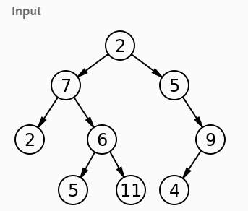

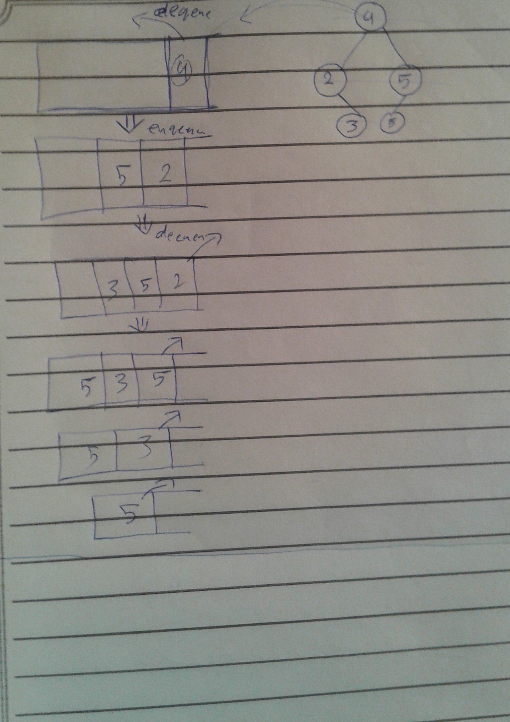
Problem domain
Write a breadth first traversal method which takes a Binary Tree as its unique input. Without utilizing any of the built-in methods available to your language, traverse the input tree using a Breadth-first approach, and return a list of the values in the tree in the order they were encountered.
Algorithm
1. create a queue class => enqueue the root value in the queue
2. itirate over the queue until the peek is null
3. store the dequeded value in variable
4. push its value into an arry
5. check if it has a left `true` => enqueue the left value
6. check if it has a right `true` => enqueue the right value
7. return the array
breadth_first(){
let breadth = new Queue();
let output = [];
breadth.enqueue(this.root);
while(breadth.peek()){
let front = breadth.dequeue();
output.push(front.value);
if(front.left){breadth.enqueue(front.left);}
if(front.right){breadth.enqueue(front.right);}
}
return output;
}
}
output
psudo
//breadth = new queue
// enqueue(root)
//while(bredth.peek())
//front = breadth.dequeu()
//if front.left => breadth.enquehe(front.left)
//if front.right => breadth.enquehe(front.right)

