Slide 1


Mansoura University Faculty of Computers and Information Department of Information Technology
Support Vector Machine

Slide 2
outline
Introduction into SVM.
What is the good decision boundary?
Margin.
support vectors.
Linear discriminant.
Linear separable case.

Slide 3
Introduction Into svm
Support vector machine(svm):
Is a set of related supervised learning methods for classification & regression.
Linear classifier.
Become popular because of its success in handwritten digital recognition.
Is an important method of kernel.

Slide 4
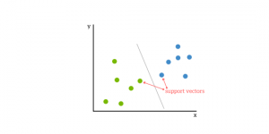
OBJECTIVES
Support vector machines (SVM) are supervised learning models with associated learning algorithms that analyze data used for classification and regression analysis.
SVMs are based on the idea of finding a hyperplane that best divides a dataset into two classes, as shown in the image below.

Slide 5
Linear Svm
Class 2
Output of algorithm is hyperplane which categorizes new data.
Class 1

Slide 6
Linear Classifiers
denotes +1
denotes -1
How would you classify this data?

Slide 7
Linear Classifiers
denotes +1
denotes -1
How would you classify this data?

Slide 8
Linear Classifiers
denotes +1
denotes -1
How would you classify this data?

Slide 9
Linear Classifiers
denotes +1
denotes -1
How would you classify this data?

Slide 10
Linear Classifiers
denotes +1
denotes -1
Any of these would be fine..
..but which is best?

Slide 11
Classifier Margin
denotes +1
denotes -1
Define the margin of a linear classifier as the width that the boundary could be increased by before hitting a datapoint.

Slide 12
Maximum Margin
denotes +1
denotes -1
The maximum margin linear classifier is the linear classifier with the, um, maximum margin.
This is the simplest kind of SVM (Called an LSVM)
Linear SVM

Slide 13
Maximum Margin
denotes +1
denotes -1
The maximum margin linear classifier is the linear classifier with the, um, maximum margin.
This is the simplest kind of SVM (Called an LSVM)
Support Vectors are those datapoints that the margin pushes up against
Linear SVM

Slide 14
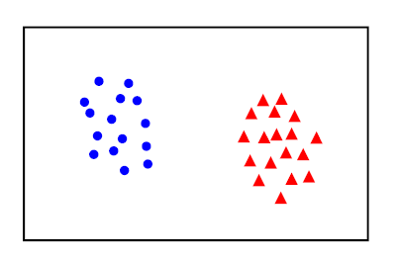
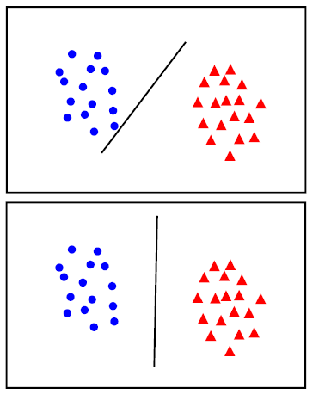
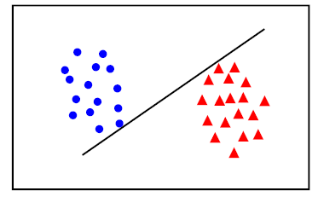
What is the good decision boundary

Slide 15
What is the good decision boundary?
Distance between hyperplane and the nearest data point are greatest as possible.
That is mean the decision boundary should be as far away from data of both classes as possible.
distance to the closest negative example = distance to the closest positive example.

Slide 16

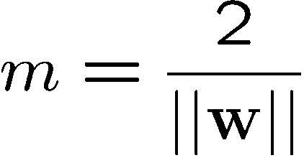



Large-margin Decision Boundary
The decision boundary should be as far away from the data of both classes as possible
We should maximize the margin, m
Distance between the origin and the line w^{t}x=-b is b/||w||
Class 2
m
Class 1

Slide 17
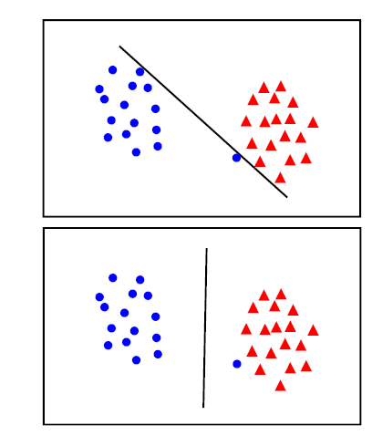
Linear separable case
The points can be linearly separated but there is very narrow margin.
But possible the large margin solution is butter ,one even though one constraint is violated.
In general, there is a trade off between the margin and the number of mistakes on the training data.

Slide 18
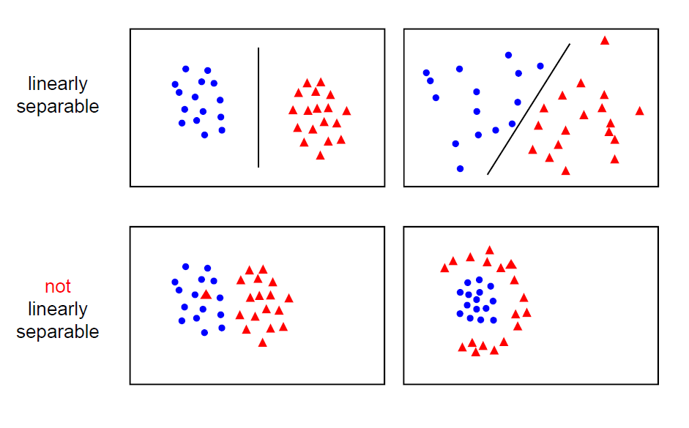
Linear separable case
Data are clean , if there exist at least one line that will separate classes by putting all class 1 point on one side of line and all class 2 point on anther side of hyperplane.

Slide 19
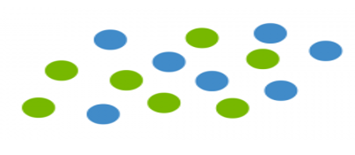
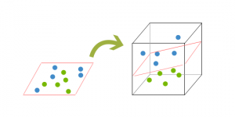
Non-Linear separable case
Data are rarely clean .so almost dataset become overlapping.
Dataset doesn’t allow classification by linear classifier.
A dataset will often look more like the jumbled balls below which represent a linearly non separable dataset.
In order to classify a dataset .it’s necessary to move away from a 2d view of the data to a 3d view. This is known as kernelling.

Slide 20

Examples of Kernel Functions
Polynomial kernel with degree d
Radial basis function (RBF) kernel with width σ
Sigmoid with parameter κ and θ
Research on different kernel functions in different applications is very active
Notes:
Despite violating Mercer condition, the sigmoid kernel function can still work

Slide 21
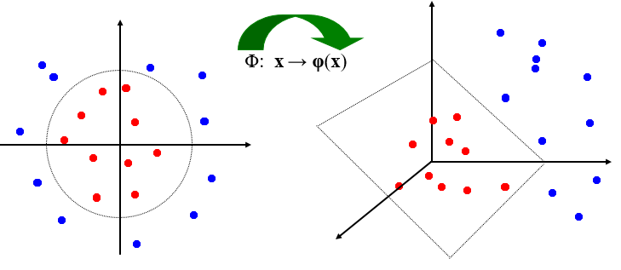
Kernel trick
If every data point is mapped into high-dimensional space via some transformation
Φ: x → φ(x) becomes:

