Slide 1
Course: AI
By:
Nermeen Nader& Yasmine Alsakar

Slide 2
Outline
Classification Meaning.
Classification Algorithms.
Euclidian Distance Theory
KNN Theory.
.How does KNN work?
KNN Programming.
User defined function.
Built-in function.

Slide 3
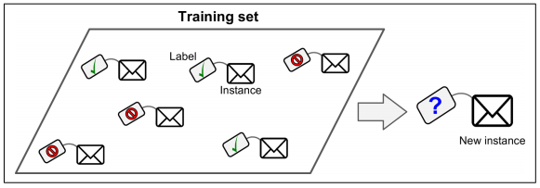
Classification Meaning
A typical supervised learning task. We use the training dataset to get better boundary conditions that could be used to determine each target class. Once the boundary conditions are determined, the next task is to predict the target class.

Slide 4
Classification Algorithms
Neural Networks.
Decision Trees.
Support Vector Machine(SVM).
K- Nearest Neighbors(KNN).

Slide 5
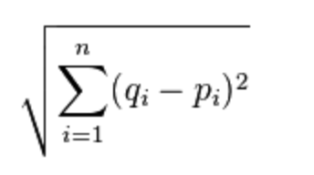
Euclidian Distance Theory
There are various ways to compute distance on a plane, many of which you can use here, but the most accepted version is Euclidean Distance, named after Euclid, a famous mathematician who is popularly referred to as the father of Geometry, and he definitely wrote the book (The Elements) on it, which is arguably the "bible" for mathematicians. Euclidean distance is:
Type to enter a caption.

Slide 6
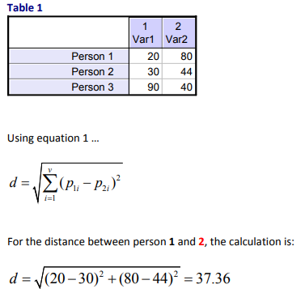
Euclidian Distance Example

Slide 7
KNN Theory
It is a simple algorithm that stores all available cases and classifies the new data or case based on a similarity measure.
K is the number of nearest neighbors .
An industrial application of KNN is a recommender system (amazon).

Slide 8
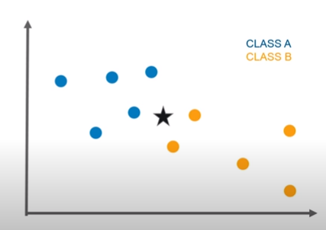
How does KNN work?
The star is a new point that we want to classify.

Slide 9
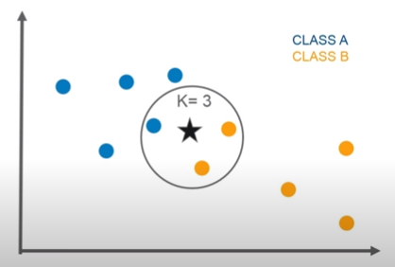
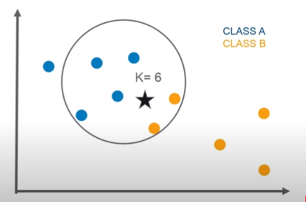
How does KNN work?
K is the number of the nearest neighbors.

Slide 10
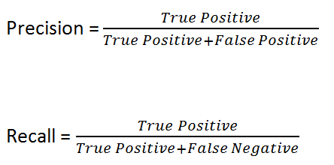
Metrics

Slide 11
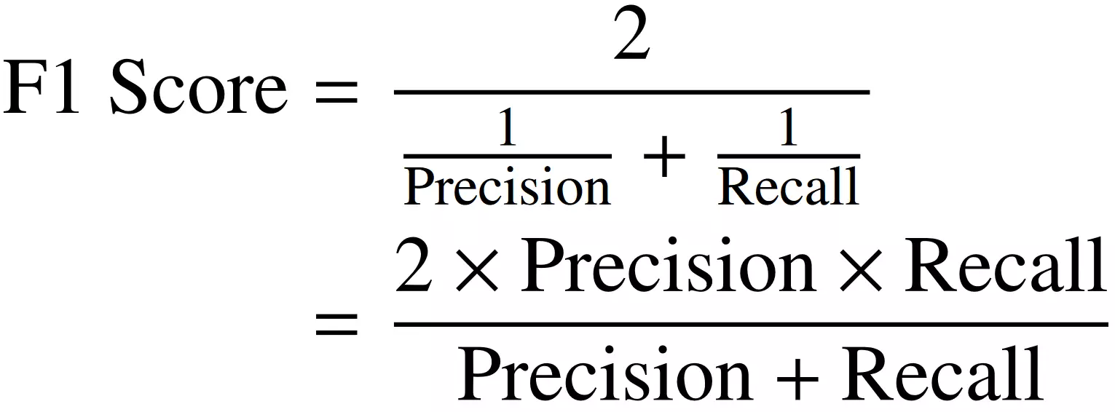
Metrics

Slide 12
What is Naive Bayes Classifier?
Naive Bayes is a statistical classification technique based on Bayes Theorem. It is one of the simplest supervised learning algorithms. Naive Bayes classifier is the fast, accurate and reliable algorithm. Naive Bayes classifiers have high accuracy and speed on large datasets.
Naive Bayes classifier assumes that the effect of a particular feature in a class is independent of other features. For example, a loan applicant is desirable or not depending on his/her income, previous loan and transaction history, age, and location. Even if these features are interdependent, these features are still considered independently. This assumption simplifies computation, and that's why it is considered as naive. This assumption is called class conditional independence.

Slide 13
