Slide 1


Mansoura University Faculty of Computers and Information Department of Information Technology
Kmeans
Naira Elazab

Slide 2
Outline
Clustering Meaning.
K-means Steps.
K-means Program.

Slide 3
What is Cluster Analysis?
Partitioning a set of data objects into subsets or clusters
objects in a cluster are similar, yet dissimilar to objects in other clusters
Goal: discovery of previously unknown groups within the data
Notes:
Applications of outlier detection include the detection of credit card fraud and the monitoring of criminal activities in electronic commerce.

Slide 4
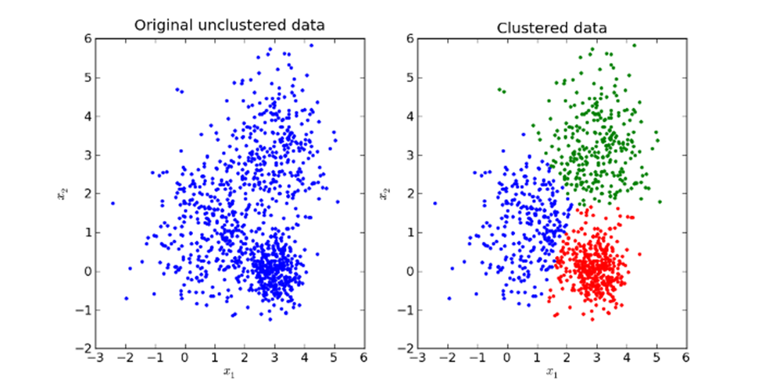
Clustering
Clustering: is a technique that groups similar data points such that the points in the same group are more similar to each other than the points in the other groups. The group of similar data points is called a Cluster.

Slide 5
K-Means – A Centroid-Based Technique
Divide dataset into k clusters
Clusters are represented by their centroids
A centroid is a cluster’s center point
In k-means → centroid is mean of points within cluster
Each object x in cluster has a distance from centroid c_{i} → dist(x, c_{i})
x is assigned to most similar cluster → C_{i} with min dist(x, c_{i})
Cluster means are updated, then assignment is repeated

Slide 6
K-Means

Slide 7
K-Means

Slide 8
K-Means

Slide 9
K-Means

Slide 10
K-Means

Slide 11
k-Means: Step-By-Step Example
The following data set consisting of the scores of two variables on each of seven individuals:
Subject | x | y
1 | 1.0 | 1.0
2 | 1.5 | 2.0
3 | 3.0 | 2.0
4 | 5.0 | 7.0
5 | 3.5 | 5.0
6 | 4.5 | 5.0
7 | 3.5 | 4.5
This data set is to be grouped into
two clusters.

Slide 12
Define the initial cluster means, giving:
 | Individual | Mean Vector (centroid)
Group 1 | 1 | (1.0, 1.0)
Group 2 | 4 | (5.0, 7.0)
2. The remaining individuals are now examined in sequence and allocated to the cluster to which they are closest, in terms of Euclidean distance to the cluster mean.

Slide 13
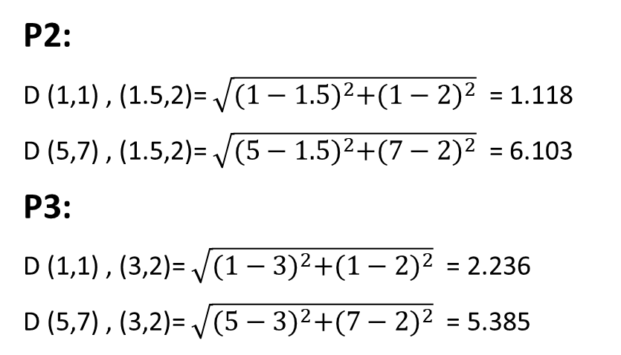
P2:
D (1,1) , (1.5,2)= $\sqrt{{(1−1.5)}^{2}+{(1−2)}^{2}}$ = 1.118
D (5,7) , (1.5,2)= $\sqrt{{(5−1.5)}^{2}+{(7−2)}^{2}}$ = 6.103
P3:
D (1,1) , (3,2)= $\sqrt{{(1−3)}^{2}+{(1−2)}^{2}}$ = 2.236
D (5,7) , (3,2)= $\sqrt{{(5−3)}^{2}+{(7−2)}^{2}}$ = 5.385
Subject | A | B | Group 1
2 | 1.5 | 2.0 | Group 1
3 | 3.0 | 2.0 | Group 1
5 | 3.5 | 5.0 | Group 2
6 | 4.5 | 5.0 | Group 2
7 | 3.5 | 4.5 | Group 1
Subject | A | B | Distance between point and centroid 1 (1,1) | Distance between point and centroid 2 (5,7)
2 | 1.5 | 2.0 | 1.118 | 6.103
3 | 3.0 | 2.0 | 2.236 | 5.385
5 | 3.5 | 5.0 | 4.716 | 2.5
6 | 4.5 | 5.0 | 5.315 | 2.061
7 | 3.5 | 4.5 | 4.301 | 4.743

Slide 14
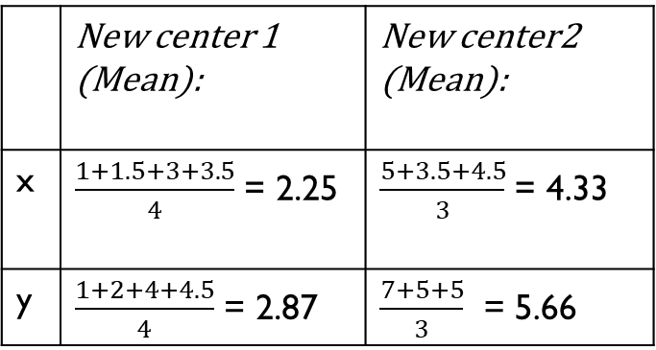
 | Individual | Mean (centroid)
Cluster 1 | 1, 2, 3,7 | (2.25, 2.87)
Cluster 2 | 4, 5, 6 | (4.33, 5.66)
Individual | Distance to mean (centroid) of Cluster 1 (2.25, 2.87) | Distance to mean (centroid) of Cluster 2 (4.33, 5.66)
1 | 2.24 | 5.72
2 | 1.14 | 4.62
3 | 1.35 | 2.12
4 | 4.96 | 1.49
5 | 2.46 | 1.06
6 | 3.09 | 0.68
7 | 2.05 | 1.42
 | New center 1 (Mean): | New center2 (Mean):
x | $\frac{1+1.5+3+3.5}{4}$ = 2.25 | $\frac{5+3.5+4.5}{3}$ = 4.33
y | $\frac{1+2+4+4.5}{4}$ = 2.87 | $\frac{7+5+5}{3}$ = 5.66

Slide 15
Current
 | Individual | Mean (centroid)
Cluster 1 | 1, 2, 3 | (1.83, 1.66)
Cluster 2 | 4, 5, 6,7 | (4.125, 5.375)
Previous
 | Individual
Cluster 1 | 1, 2, 3,7
Cluster 2 | 4, 5, 6
Individual | Distance to mean (centroid) of Cluster 1 (1.83, 1.66) | Distance to mean (centroid) of Cluster 2 (4.125, 5.375)
1 | 1.02 | 6.21
2 | 0.47 | 4.27
3 | 1.02 | 3.55
4 | 6.21 | 1.84
5 | 3.73 | 0.72
6 | 4.27 | 0.53
7 | 3.29 | 1.84
Previous
 | Individual | Mean (centroid)
Cluster 1 | 1, 2, 3 | (1.83, 1.66)
Cluster 2 | 4, 5, 6,7 | (4.125, 5.375)
Current
 | Individual
Cluster 1 | 1, 2, 3
Cluster 2 | 4, 5, 6,7

