Slide 1

optimization

Slide 2
Minimum and maximum : local and global

Slide 3
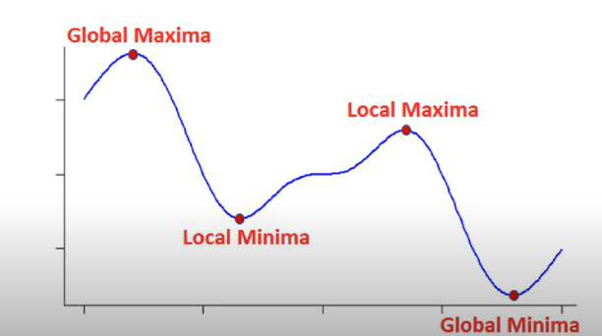

Slide 4

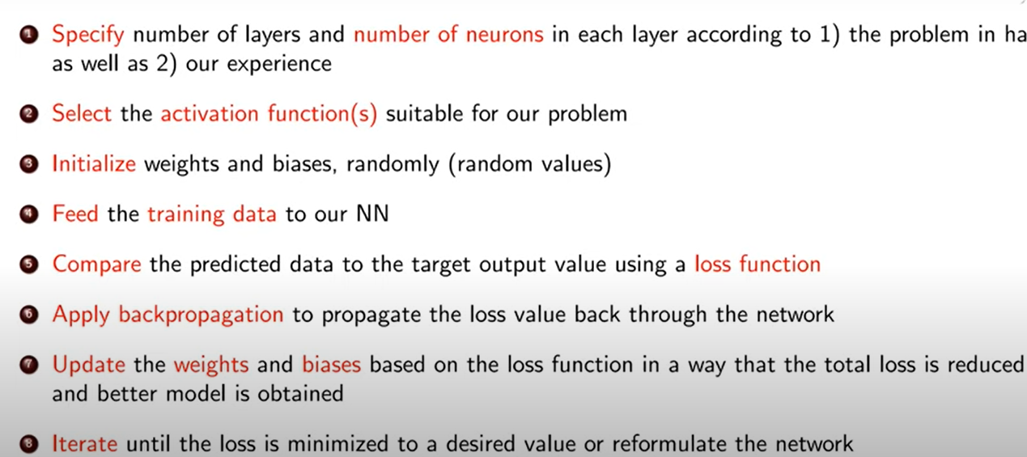
The learning Algorithm

Slide 5
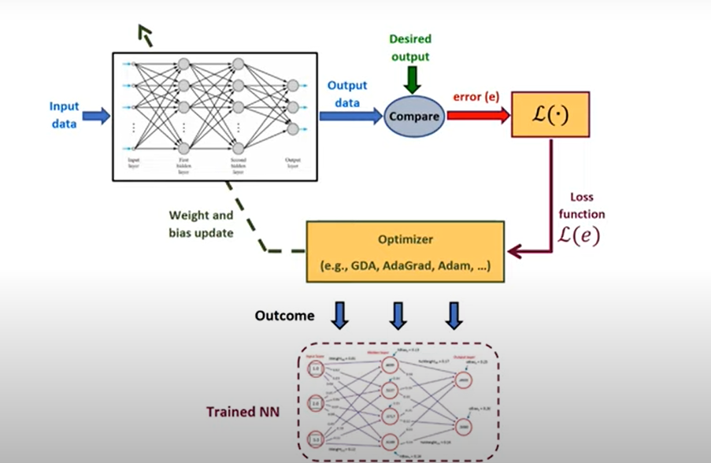
Learning Algorithm

Slide 6
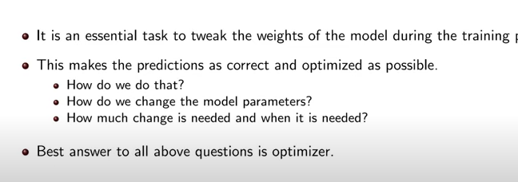
Optimizer

Slide 7
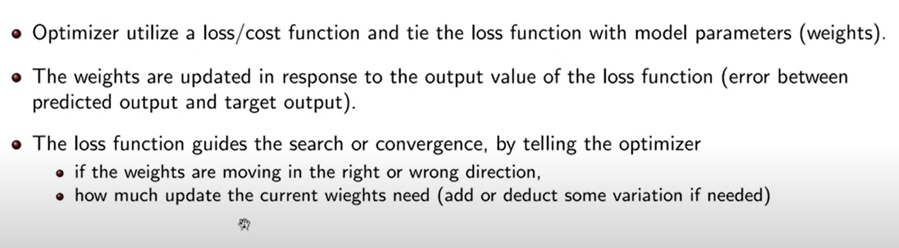
What does an optimizer do?

Slide 8
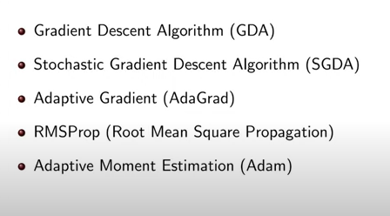
Types of optimizers.

Slide 9
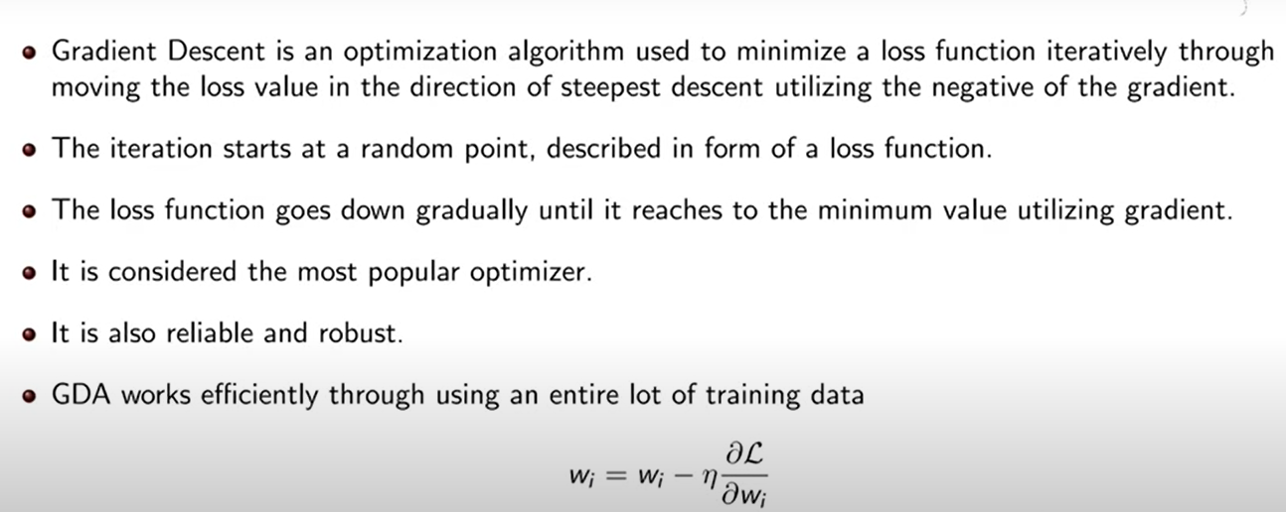
Gradient decent algorithm GDA

Slide 10
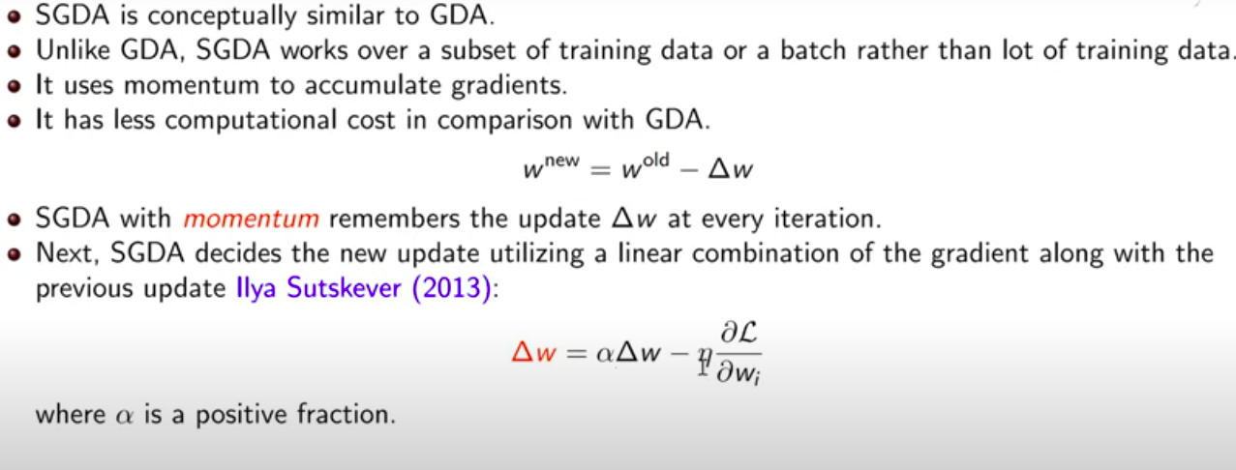
Stochastic gradient decent algorithm SGDA

Slide 11
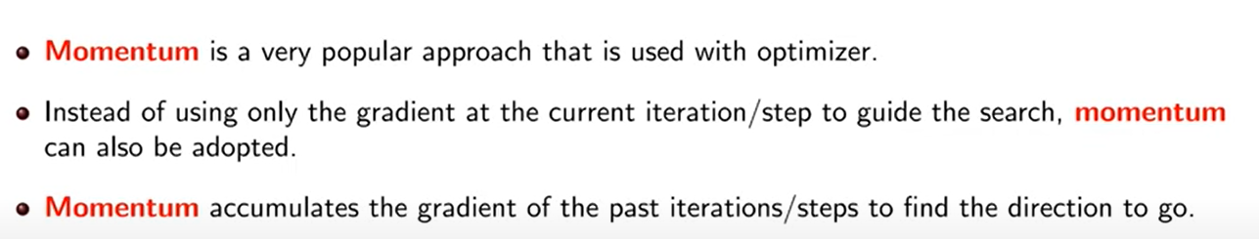
Momentum

Slide 12
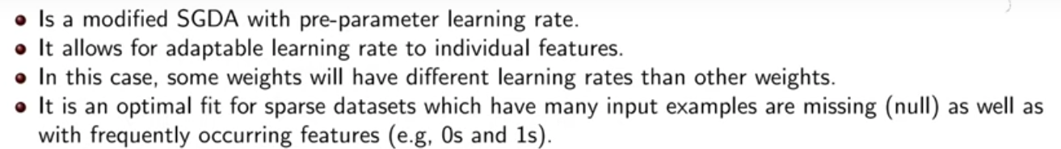
AdaGrad

Slide 13
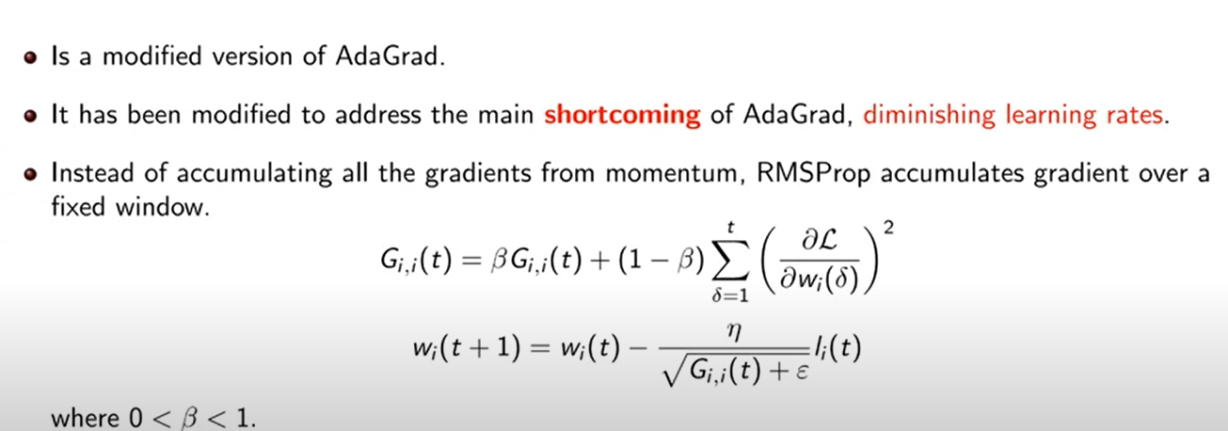
Root mean square (RMS propagation)

Slide 14
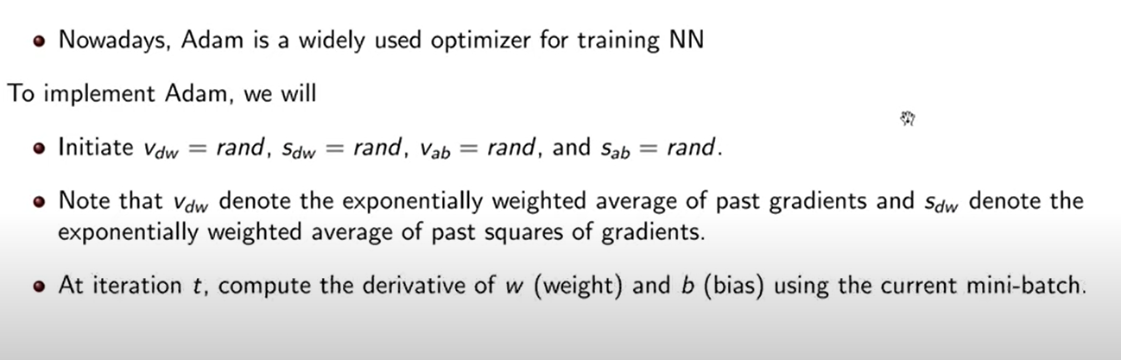
Adaptive moment Estimation (Adam)

Slide 15
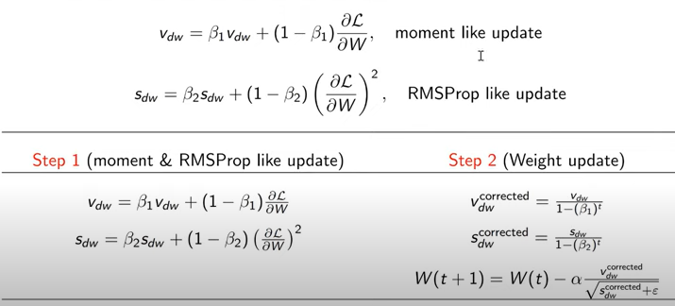
Adaptive moment Estimation (Adam) with no bias

Slide 16
Adaptive moment Estimation (Adam) with no bias

Slide 17
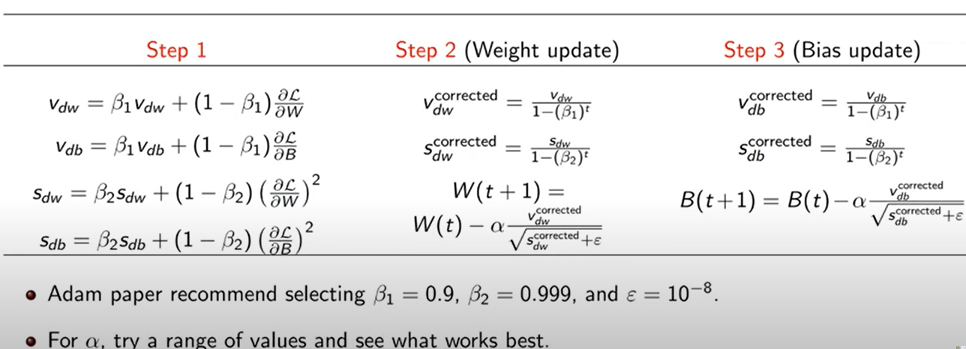
With weight and bias

