Slide 1
Gender pay gap lab
Osama Saleh

Slide 2
1.Summarize the main findings of your analysis of the gender pay gap in the UK.
Analysis of the gender pay gap in the UK revealed significant insights.
Identified and examined the ten largest UK companies with notable gender pay gaps.
Found that companies headquartered in London have a higher median pay gap compared to those in other cities.
Highlighted a concerning trend in the education sector, with schools exhibiting a high average median pay gap.
Uncovered a correlation between company size and gender pay gap, indicating smaller companies tend to have larger pay gaps.
Emphasized the complex nature of gender pay gap dynamics in the UK.
Called for further investigation and proactive measures to promote workplace equity and inclusivity.

Slide 3
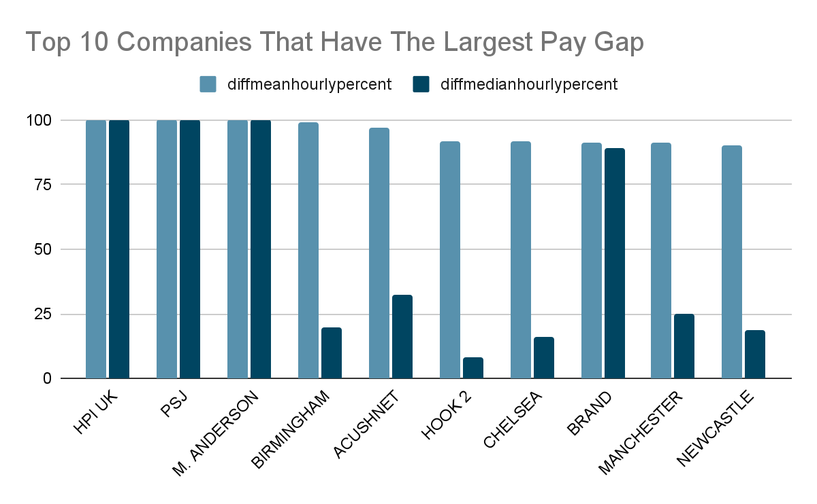
2. Produce visualizations to support your conclusions

Slide 4
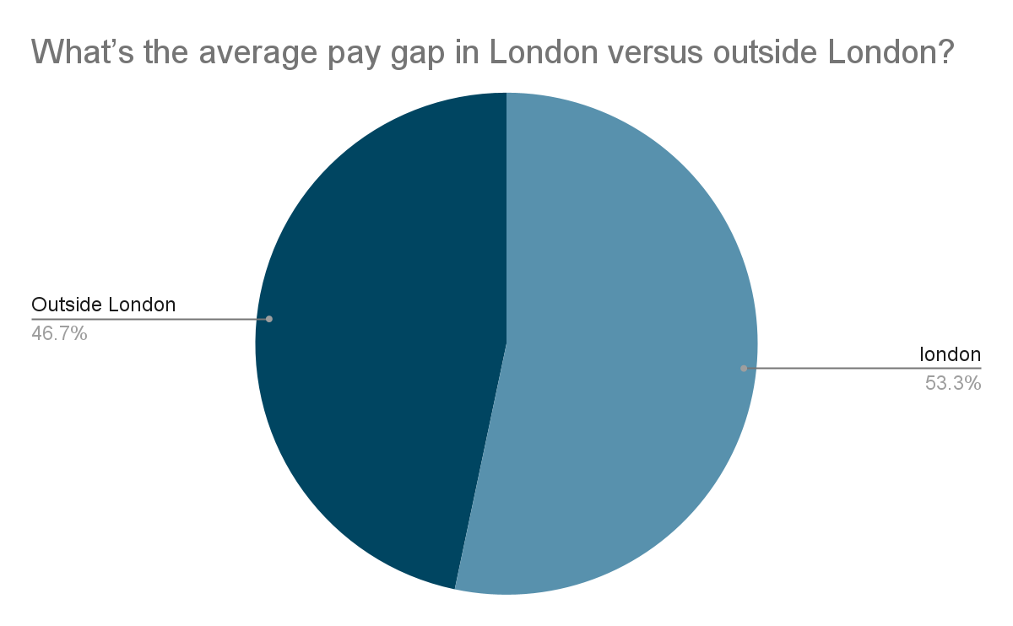

Slide 5
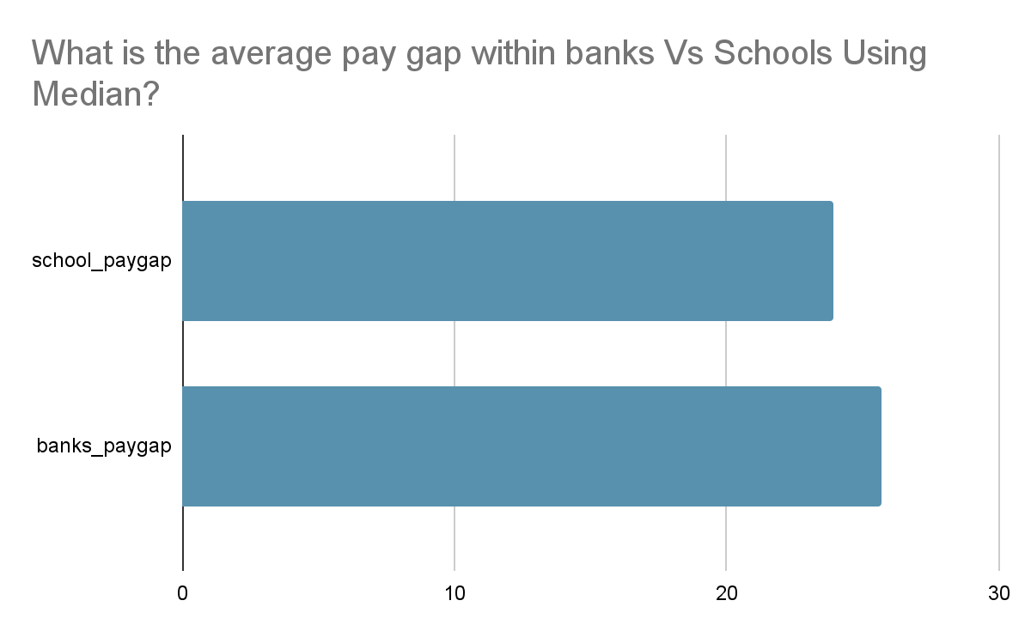

Slide 6
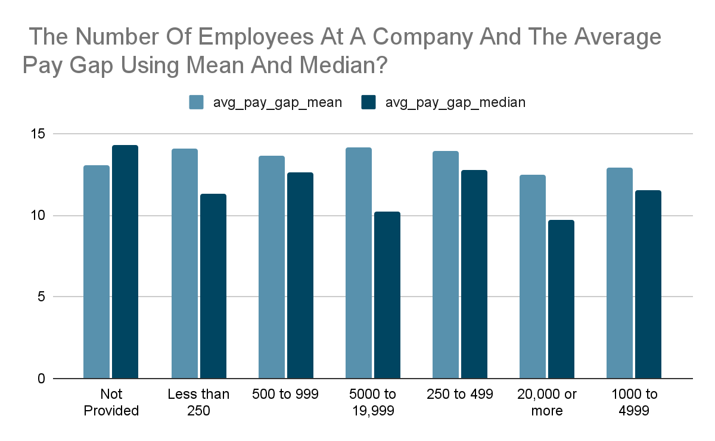

Slide 7
3. Describe any limitations of your analysis, and caveats around how your findings should be used or interpreted.
Data quality issues and potential biases in the sample should be considered. Additionally, limitations of the metrics used, such as DiffMedianHourlyPercent, should be acknowledged.
The analysis focuses on reported data and does not account for unreported or misrepresented information.
Interpretation should be cautious due to the complexity of factors influencing pay gaps, including job roles, seniority levels, and industry norms.

Slide 8
4.Recommendations for Data Collection Improvement
Implement measures to ensure timely submission of data to meet reporting deadlines.
Encourage companies to provide URLs for transparency and ease of access to gender pay gap information.
Enhance data collection methods to capture additional relevant variables that could provide deeper insights into the drivers of pay gaps, such as job categories, education levels, and tenure.

