Slide 1
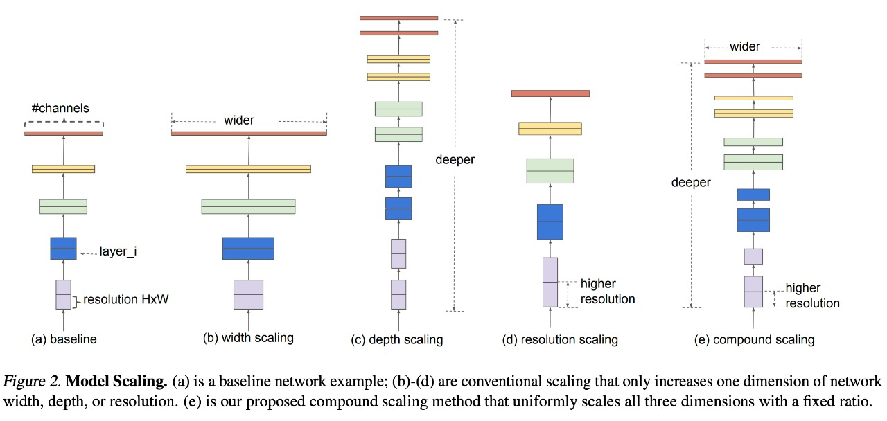
Architecture used in the paper:
The encoder model uses EfficientNetB7, which occupies a lot of image classification SOTA.
EfficientNet is a model that achieves SOTA by a method called Compound Scaling, and is based on DW (Depthwise Convolution), which divides features by channel and calculates them.
Compound Scaling refers to finding the optimal efficiency by adjusting the model width, model depth, and input image resolution in the basic model as shown in the following picture the optimized value shows the best performance in terms of computational amount and accuracy

Slide 2
Dataset Details:
The Dataset contains chest x-rays images. This Dataset was prepared from various datasets like the datasets combined accordingly (Yes ; same images removed in dataset using VisiPics). It has 4 types of Lungs Diseases and a folder of Normal Lungs. the dataset augmented with factor 6 so there are basically 10000 images.

Slide 3
Implementation Details:
According to the paper:
first thing is that we didn’t augment our data because it's already augmented We have used EfficientNetB0 as a pre-trained model (Transfer learning): consists of taking features learned on one problem, and leveraging them on a new, similar problem. For instance, features from a model that has learned to identify motorcycles may be useful to kick-start a model meant to identify bicycles. The most common incarnation of transfer learning in the context of deep learning is the following workflow: 1-Take layers from a previously trained model. 2-Freeze them, so as to avoid destroying any of the information they contain during future training rounds. 3-Add some new, trainable layers on top of the frozen layers. They will learn to turn the old features into predictions on a new dataset. 4-Train the new layers on your dataset. A last, fine-tuning: which consists of unfreezing part of the model we obtained above, and re-training it on the new data with a very low learning rate. This can potentially achieve meaningful improvements, by incrementally adapting the pretrained features to the new data.

Slide 4
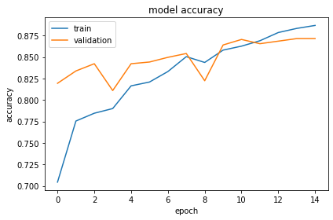
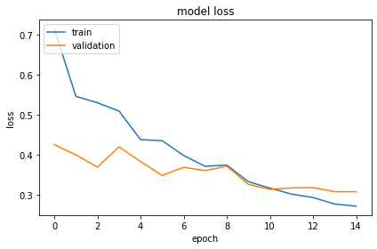
Results and visualizations:
1-Before fine tuning:

Slide 5
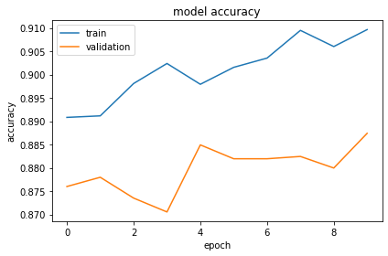
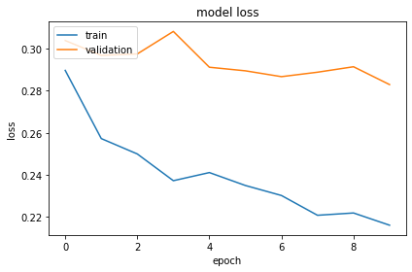
2-After fine tuning:

Slide 6
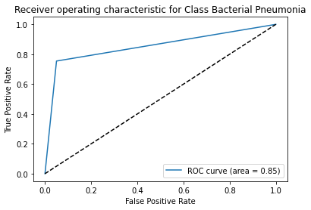
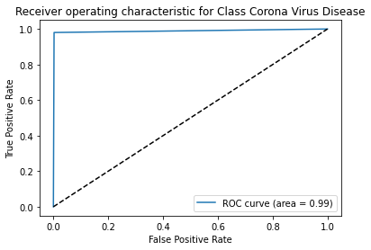
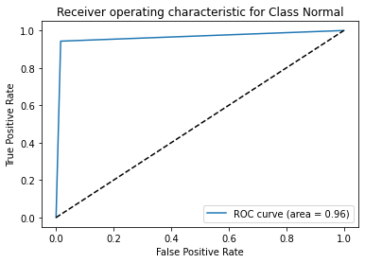
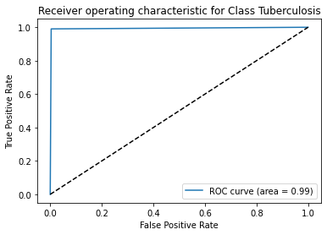
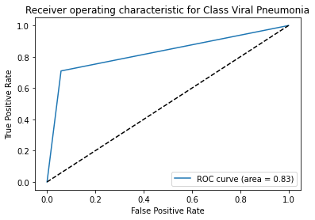
Roc Curves:

Slide 7
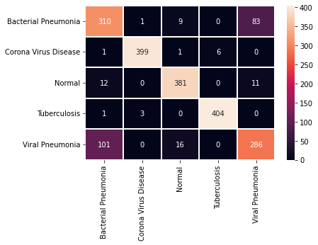
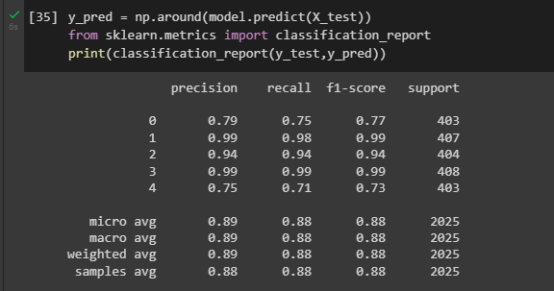
Confusion Matrix:
Classification Report:

Slide 8
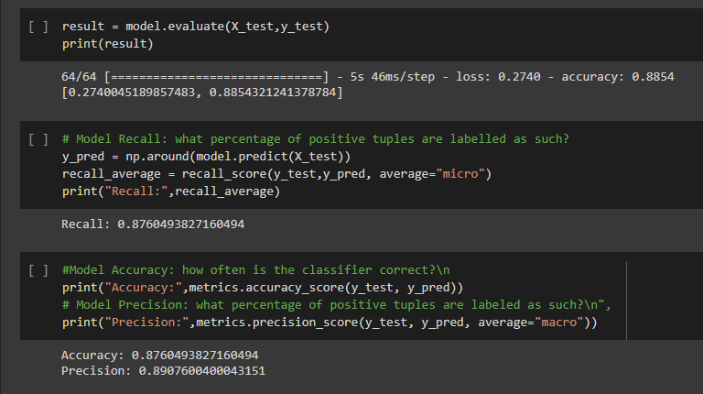
Results:

