Slide 1
Intro to Computer Vision
With OpenCV & Python

Slide 2
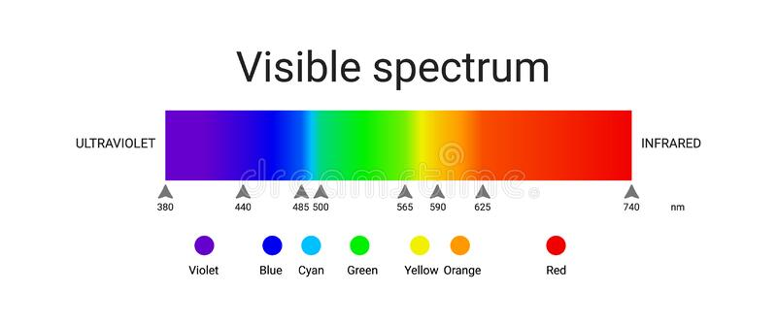
Defining an Image
An image is a 2D perception of light.
Humans tend to perceive light as a continuous wave.
Visible light, tends to have colors based on their wavelength.
All colors can be obtained using 3 primary colors, Namely RGB.

Slide 3
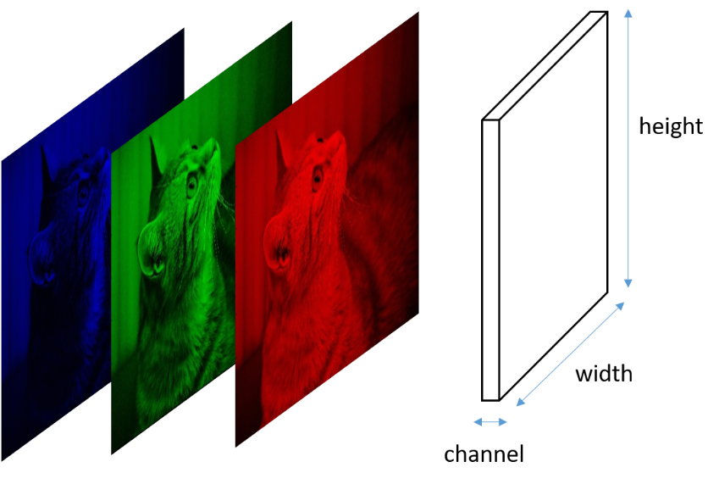
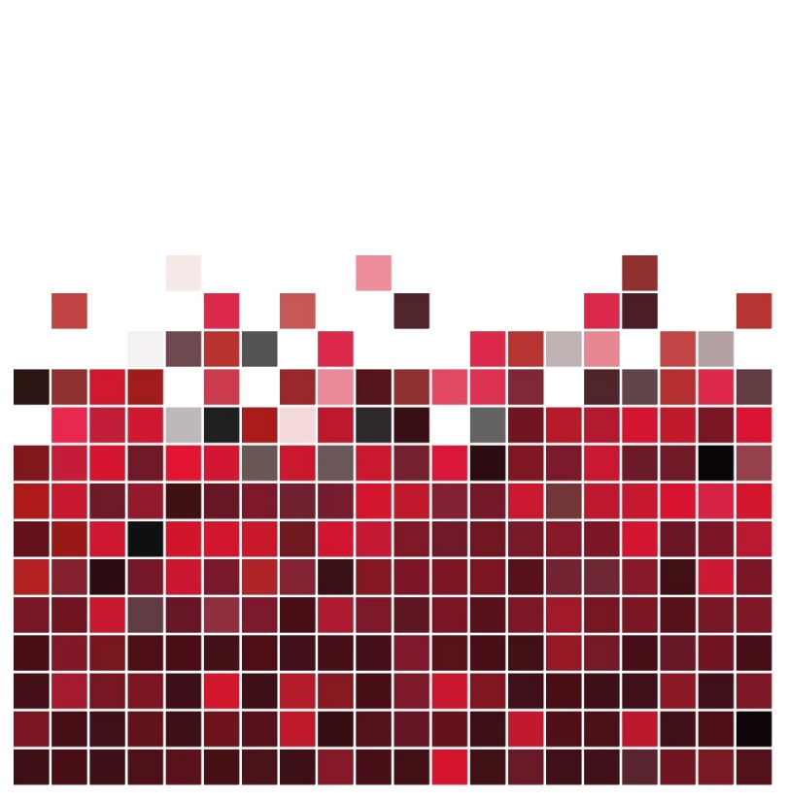
How Computers Perceive Images (DIP)
An image is a 2D, array with discrete Intensities of light at a certain moment.
All colors are combination of Red, Green and Blue, called RGB Channels.
Simply Put, colored images are 2D arrays with one layer for each color.

Slide 4
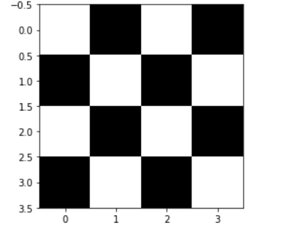

Example
[[1,0,1,0], [0,1,0,1], [1,0,1,0], [0,1,0,1]]

Slide 5
Next
Coding Session Numpy Matplotlib.pyplot Ploting Images B&W
RGB
Filters Brightness, Contrast
Application Edge Detection,
Open CV
Applications Of CV
Face Detection with Open CV

