Slide 1
Modernized Packaging Tutorial and
Practical Challenges of DEP-5
Osamu Aoki
<osamu@debian.org>

Slide 2
Maintainers’ Guide (Josip, 1999-)
Debhelper: 2 → 4
Tool of choice: dh_make (1998-)
Tutorial example source with “Makefile”
Longum iter est per praecepta, breve et efficax per exempla
(It's a long way by the rules, but short and efficient with examples).
FYI: Osamu’s activity
printtool patch (1999)
DR as DD (2002-)

Slide 3
Maintainers’ Guide (Osamu, 2005-2017)
Debhelper: 4 → 7 (dh7-syntax)
Debiandoc-sgml → docbook-xml
  PDF building including translations
Po4a based translation
  Many translation addition with UTF-8
Ad-hoc additions:
  multi-arch path handling
  Dpkg 3.0(quilt)
  DEBIAN/symbols support
  library package name convention
  helper contents for autotools, pbuilder, …
Becoming messy

Slide 4
Challenges for Updating “Packaging Tutorial”
Insufficient “Packaging Tool” documentation
  uscan …
Lack of some “Packaging Tool” functionality
  uscan/uupdate → extendable
  dh_make/licensecheck → non-intuitive for extension
Moving target for “Packaging requirements”
  Use of full featurs of dh7
  Autotools, gettext, Cmake, setuptools.py, …
  dpkg 3.0(quilt) (this is also multiple upstream tarball)
  Multiple binary packages
  substvar
  Multiarch (2013)
  Reproduceble build (2017)
Need to leverage external pointers

Slide 5
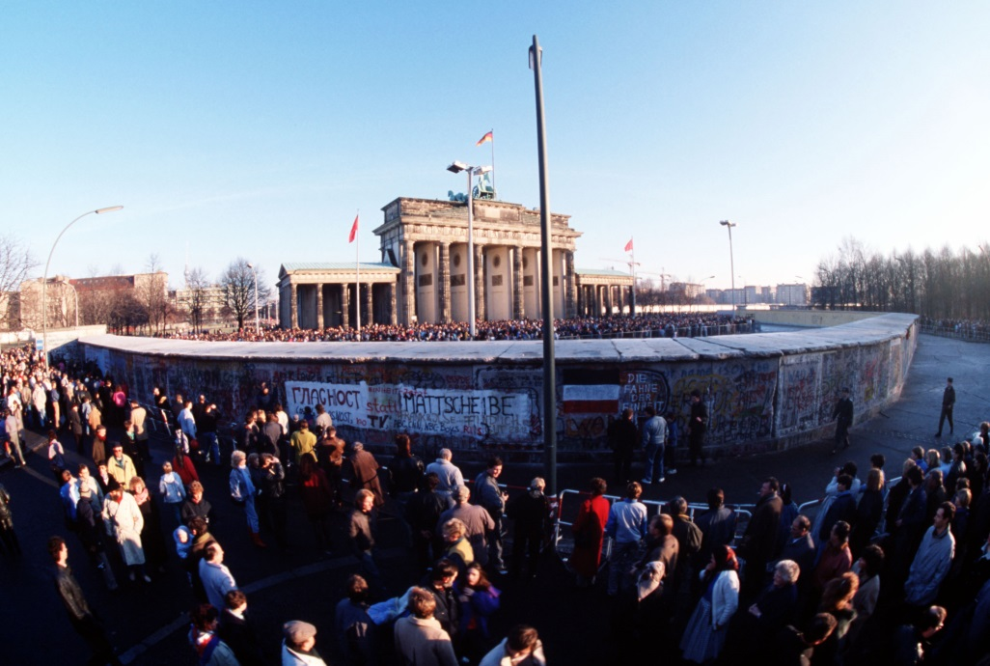
How do we move forward?
Update “Packaging Tutorial”
  Ad hoc fix isn't good for the structural problem!
  Fix the root causes! (update package scripts if needed!)
The wall needs to be challenged :-)

Slide 6
uscan/uupdate
Part of devscripts
Written in Perl/Shell → rooms for improvement!
  Updated its manpage POD
  Support version in the FTP directory
  Support Amazon AWS or Subversion repository with a generic solution
  Support multiple upstream tarballs
  Support flexible PGP/GPG signature file locations
  Support git repo (github) → in progress

Slide 7
debmake = dh_make + (licensecheck) + α
(2017-)
Written in python3 with minimalist design
  Support dh7 syntax
  Support Multiarch
  Support arbitrary binary package combinations
  Support substvar
  Detect the upstream build system
  Internal verification while package is build
DEP-5 copyright template generator
  Full license text string match
  License extraction relies on some heuristics
  Auditing of license changes possible
  but not-perfect
Missed Jessie (2015) due to RC.

Slide 8
DEP-5 (2012, Policy: 2017)
https://www.debian.org/doc/packaging-manuals/copyright-format/1.0/
Establishes a standard, machine-readable format for debian/copyright files within Debian packages to facilitate automated checking and reporting of licenses for packages and sets of packages.

Slide 9
DEP-5: Benefits
Human reviewer (FTP mater) friendly
  Regular and um-ambiguous format
Proof of the careful source review by the initial packager
Enable automatic license incompatibility checks (GPL <-> SSLeasy)
…

Slide 10
Practical Challenges of DEP-5
Initial
implementation
No active enforcement for consecutive uploads
  Labor intensive tasks w/o proper tools
    No automatic check on PTS like “watch”, “vcs-git”
    No easy check via lintian
File format limitations
  MIT license may come in many variant texts
  License assignment text may be expressed differently
    file name reference may be embedded
DEP-5 doesn’t dictate:
  rules to store machine generated template
  method to track previous human decisions
  method to detect license check mismatch

Slide 11
Practical Challenge: XORG source
Full license text is usually included in each source file for MIT (X) and ISC style licenses
There are many variant texts of these licenses
xorg-xserver: non-DEP-5 copyright file:
The following is the 'standard copyright' agreed upon by most contributors,
and is currently the canonical license preferred by the X.Org Foundation.
This is a slight variant of the common MIT license form published by the
Open Source Initiative at http://www.opensource.org/licenses/mit-license.php
…
The following licenses are 'legacy': usually MIT/X11 licenses with the name
of the copyright holder(s) in the license statement,
but also some BSD-like licenses.
…
debmake program comes with over 180 test cases of license texts and 75 of them are the variants of MIT-like licenses.

Slide 12
Autotools files
These come in PERMISSIVE licenses.
Practically, no human packagers seriously make DEP-5 entries with pedantic precision.
  Relaxing policy seems to cause resentments
debmake automatic DEP-5 template file generator was pedantic in its initial version
  Relaxed as default behavior
  Kept pedantic behavior if requested by “-P”.

Slide 13
Copyright Review Tools
https://wiki.debian.org/CopyrightReviewTools
What is the most reliable way to enforce repeated check?
licensecheck (originally in devscripts) (Perl)
  scan-copyrights from libconfig-model-dpkg-perl (licensecheck as BE) (Perl)
  license-reconcile (licensecheck as BE) (Perl)
  cme (libconfig-model-dpkg-perl as BE) (Perl)
  licensecheck2dep5 from cdbs (licensecheck as BE) (Perl)
dh-make-perl (Perl) – Only for Perl source
debmake –cc and debmake –k (Python3)
decopy using python-debian (Python3)
licensee from ruby-licensee (Ruby)

Slide 14
licensecheck etc. (stretch)
Source
Some pre-process
License partial text match
License text type
DEP-5 output
This avoids noise.
I may be incorrect on some details
I first saw this in CDBS. Good idea!
Some people store auto generated DEP-5 output in the source package under debian/*.
Clean since details are not matched and hidden.
Good for GPL2.0+ assignment etc.

Slide 15
debmake (stretch)
Source
Extract license section
License text type
License full text match
DEP-5 output
This is a bit greedy side and tends to include extra lines
“debmake -k” can check license change
You must list the generic file patterns before the specific exceptions.
Messy due to the extra text and require lots of manual edits.
Good for auditing details since actual copyright assignment texts are extracted and reported as group.

Slide 16
debmake (next step?)
Should I use
licensecheck?
Source
License text type
License full text match
Extract license section
Config. data
Trim extra text
License text type
(cleaned)
Store this auto generated file in the source package
DEP-5 output
Trim log

Slide 17
“Packaging Tutorial” should/shouldn’t
“Packaging Tutorial” should provide:
  big picture of packaging
  typical workflow of packaging
  practical examples of packaging
“Packaging Tutorial” shouldn’t provide:
  corner cases of packaging
  policy/developer reference details
  manpage type content for other packages
  end-user tutorials

Slide 18
debmake-doc = maint-guide reorganized
(2017-)
“Modern Packaging Tutorial”
Use “debmake” to keep it simple
  No more “dh_make”
Provide full access to the tutorial examples for all binary package cases.
  Makefile/autotools/CMake/setuptools.py/…
  gettext
Add few more key topics but avoid bloating
contents by using external pointers

Slide 19
Packaging examples in debmake-doc
4. Simple example
  hello.c + Makefile
8. More example
  Cherry-pick templates
  No Makefile (shell, CLI)
  Makefile (shell, CLI)
  setup.py (Python3, CLI)
  Makefile (shell, GUI)
  setup.py (Python3, GUI)
  Autotools (single-binary)
  CMake (single-binary)
  Autotools (multi-binary)
  CMake (multi-binary)
  Internationalization
  Details

Slide 20
Updates to debmake-doc?
dh10
“VCS (standard)” → “VCS (gbp)”
“VCS (alternative)” → “VCS (single patch)”
Memo on policy required {post,pre}{rm,inst}
  smart debhelper behavior via dh_installdeb
Reporoducible build with $SOURCE_DATE_EPOCH
Font package example
More debug and trace hints?

Slide 21
Supplements

Slide 22
debmake (after DEBCONF17, in progress)
Source
License text type
License full text match
Extract license section
License text type
(scen)
Human reviw
License text type
(cleaned)
DEP-5 output

Slide 23
dh_make (1998-)
Single binary (s)
  The package will generate a single binary .deb package. It is the standard case, so if you don't know what to do, choose this.
Arch-Independent (i)
  The package will generate a single package that is arch-indepen‐ dent.
Library (l)
  The package will generate at least two binaries. One library package containing just the lib in /usr/lib and another *-dev_*.deb package containing documentation and C headers.
--docs
  Create a separate PACKAGE-doc binary package.

Slide 24
Drivers for Updating “Packaging Tutorial”
Release | release year | Key events
Sarge/3.1 | 2005 | pbuilder, debconf recommended, UTF-8 in changelog, COMPAT=4
Etch/4.0 | 2007 | cowbuilder, git-buildpackage, COMPAT=5
Lenny/5.0 | 2009 | Version with ~, UTF-8 everywhere, Multitarball, dpkg format “3.0(quilt)”, COMPAT=7
Squeeze/6.0 | 2011 | VCS-* introduced, COMPAT=8
Wheezy/7 | 2013 | Multiarch, VCS-*, mandatory build-arch and build-indep, COMPAT=9
Jessie/8 | 2015
Stretch/9 | 2017 | ddeb package, update config.sub and config.guess, Reporoducible build via SOURCE_DATE_EPOCH, COMPAT=10
Buster/10 | 2019? | ???

Slide 25
DEP-5: Paragraphs
There are 3 paragraphs:
Header paragraph (once)
Files paragraph (repeatable)
Stand-alone License Paragraph (optional, repeatable)
Any of these can have a “License” field.

Slide 26
DEP-5 “License” field
Formatted text, with synopsis.
In the header paragraph, this field gives the license information for the package as a whole, which may be different or simplified from a combination of all the per-file license information.
In a Files paragraph, this field gives the licensing terms for the files listed in the Files field for this paragraph.
In a stand-alone License paragraph, it gives the licensing terms for those paragraphs which reference it.
First line: an abbreviated name for the license, or expression giving alternatives (see the Short name section for a list of standard abbreviations). If there are licenses present in the package without a standard short name, an arbitrary short name may be assigned for these licenses. These arbitrary names are only guaranteed to be unique within a single copyright file.
If there are no remaining lines, then all of the short names or short names followed by license exceptions making up the first line must be described in stand-alone License paragraphs. Otherwise, this field should either include the full text of the license(s) or include a pointer to the license file under /usr/share/common-licenses. This field should include all text needed in order to fulfill both Debian Policy's requirement for including a copy of the software's distribution license (12.5), and any license requirements to include warranty disclaimers or other notices with the binary package.

Slide 27
debmake (next step?)
Should I use
licensecheck?
Source
License text type
License full text match
Extract license section
Config. data
Trim extra text
License text type
(cleaned)
Store this auto generated file in the source package
DEP-5 output
Trim log

