Slide 1
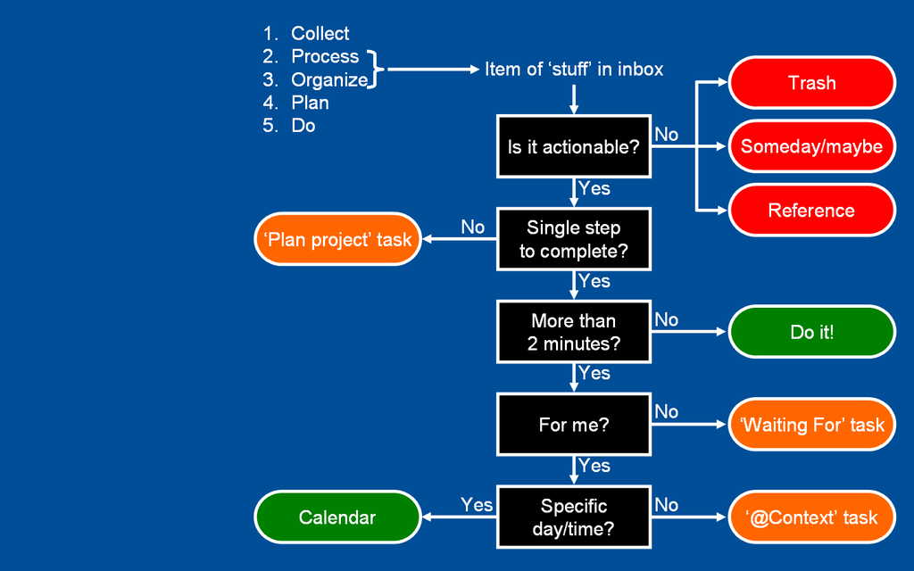
GTD (weekly) & Pomodoro (daily)
GTD: Perspective
Goal setting via reflection from 6 “horizens”
current actions
current projects
areas of responsibility
1–2 year goals
3–5 year goals
Life
-- weekly review
GTD: Control/Workflow
Capture
Clarify
Organize
Reflect
Engage
(Version 1)
Pomodoro Technique
Set TODO today list
Work on 25min.
  Break for 5 min.
Work on 25min.
  Break for 5 min.
Work on 25min.
  Break for 5 min.
Work on 25min.
  Break for 30 min.
If interrupted:
→ record and postpone.
If completed:
→ loop this process.

