Slide 1
Clean water access in the Mexican state of Morelos
Oscar Sanchez Christensen

Slide 2
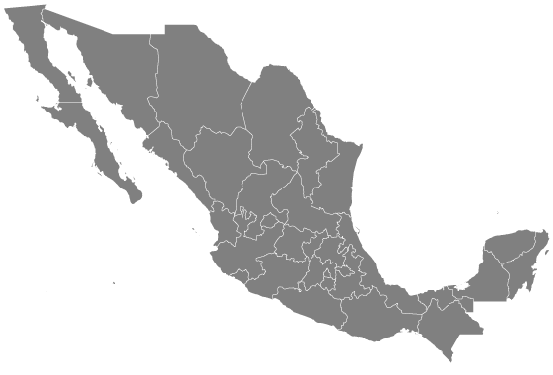
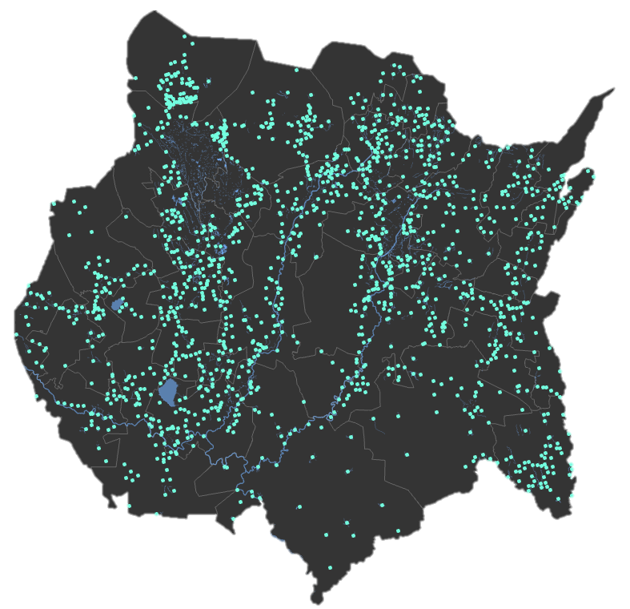
Why?
Discover which towns in Morelos have access to clean water and see if population correlates with cleanliness.

Slide 3
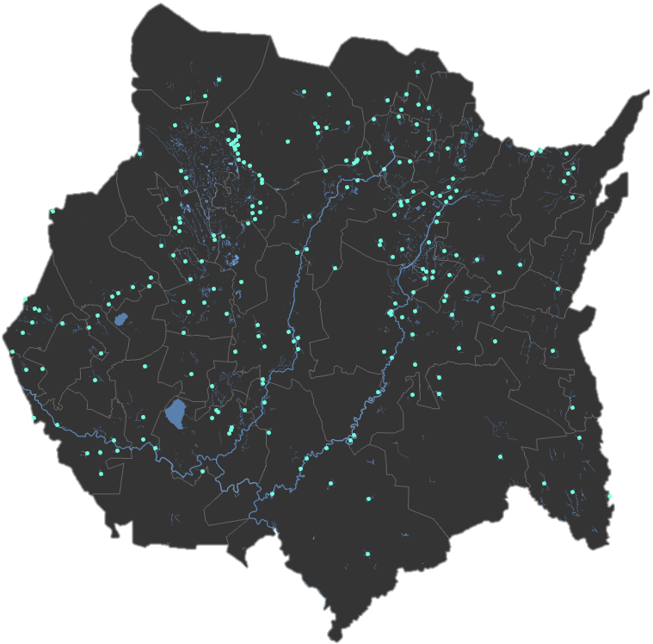
Selection of localities

Slide 4
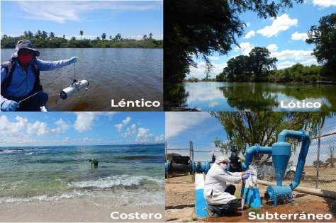
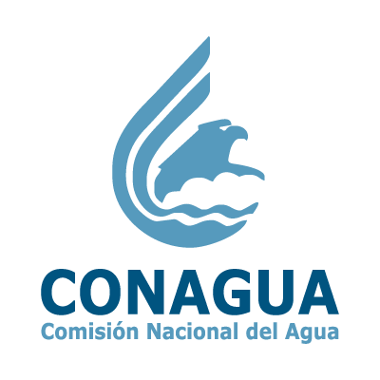
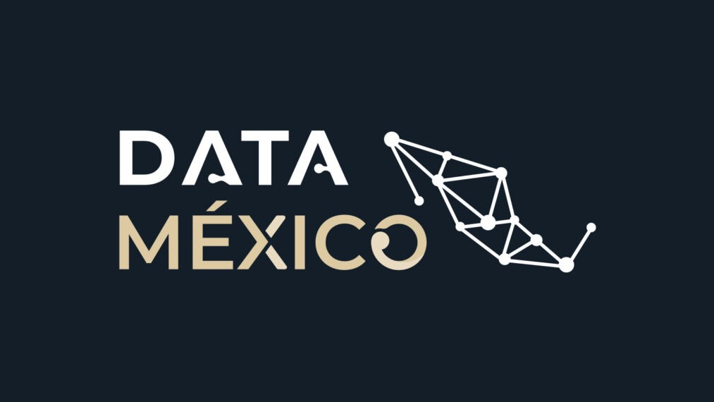

Data Sources
RENAMECA
  CONAGUA
    7251 test sites
      188 in Morelos
    446 unique data types
INEGI
  Population Data
  10-year Census
DATA Mexico
  Waterbodies

Slide 5
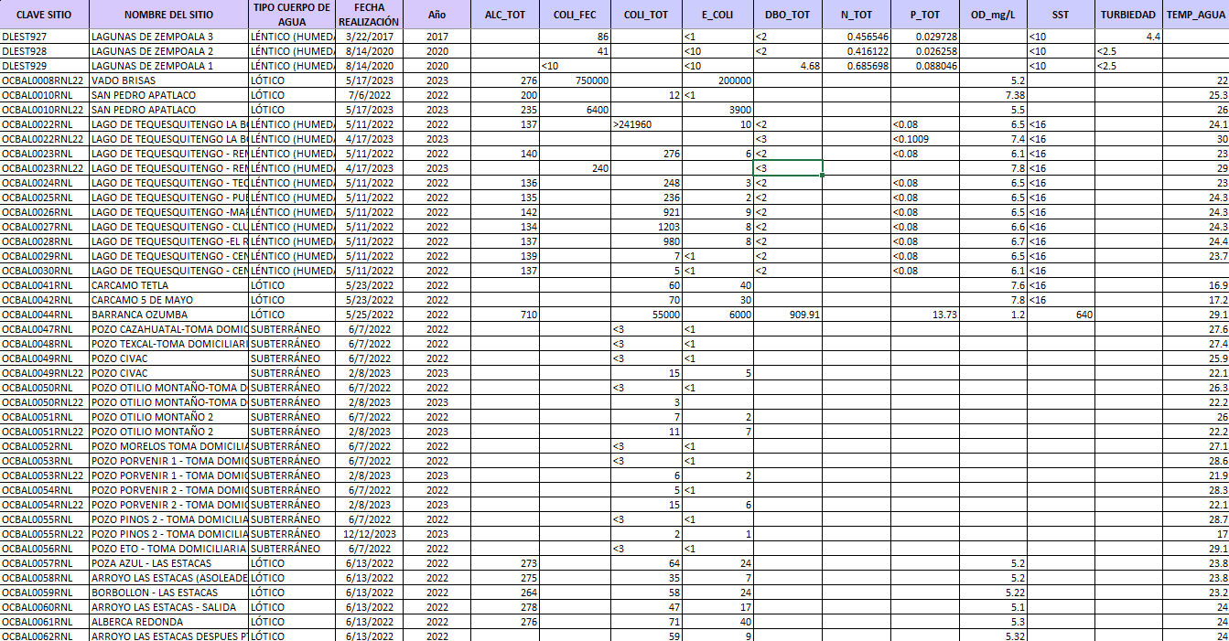
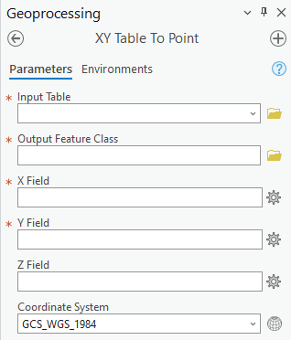
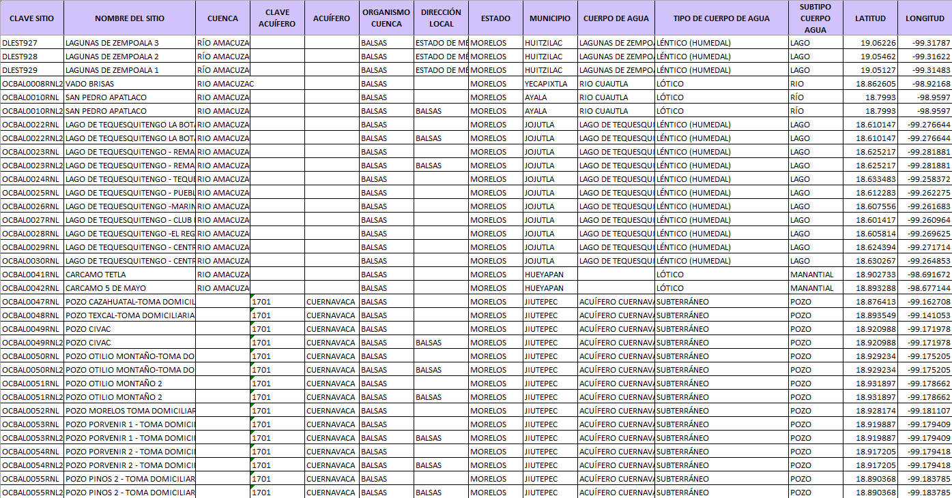
Data manipulation
Editing excel tables
Identifying clean vs dirty
XY Table to point
Add Join
Attributes | Alkalinity | Fecal coliforms | Escherichia coli | Oxygen Demand | Total Nitrogen | Total Phosphorus | Surface salinity | Dissolved Oxygen % | Total Suspended Solids | Turbidity | Water temperature
Clean | 20-200 mg/L | Below 200 CFU/100mL | Below 50 mg/L | Below 0.5 mg/L | Below 10 mg/L | Below 0.1 mg/L | Under 800 mg/L | Above 6 mg/L | Under 10 mg/L | Under 5 NTU | 20-25 Degrees Celcius

Slide 6
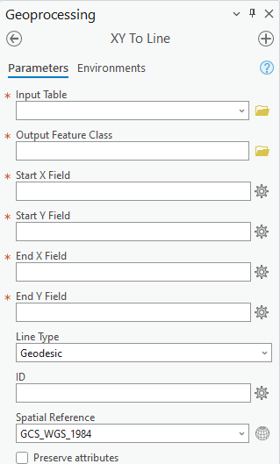
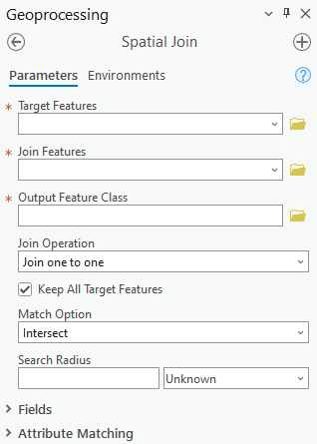
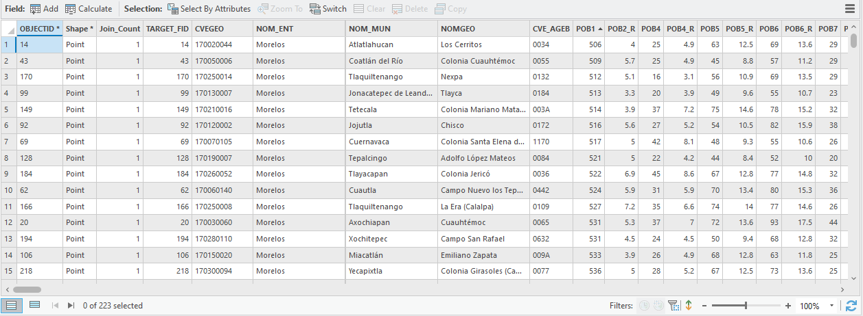
Identifying closest water source
Calculate geography
Spatial Join
XY to line

Slide 7
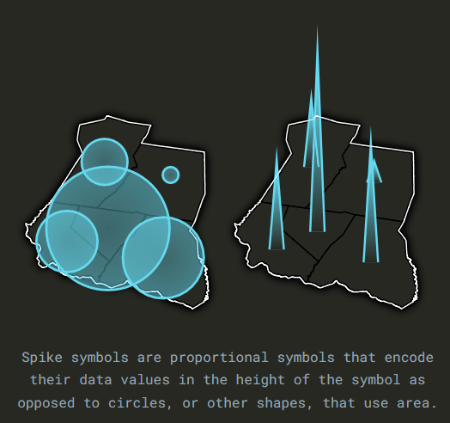
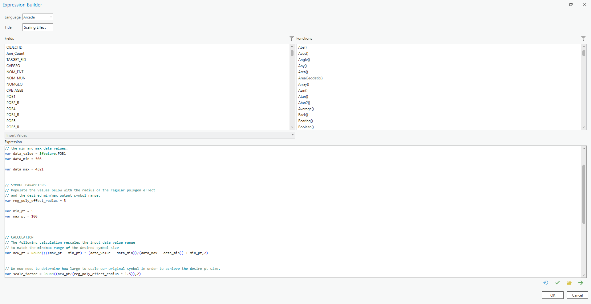
Creating a spike map
Symbol effects
  Scale and move
Arcade expressions
Drawing orders
Huge resource
  https://storymaps.arcgis.com/stories/805d12a871ff4882bbb51095e0bbe89d

Slide 8
