Slide 1
Artificial Intelligence (AI) Coursework – 24.1
Student Name: Osanda Fernando
Student No: COMScDS241P-019

Slide 2
AI-Based Salary Prediction System
Intelligent Salary Forecasting for HR Departments

Slide 3
Contents
Project Objectives
Methodology
Outcomes
Conclusion

Slide 4
Project Objectives
Develop an AI-powered salary prediction system for HR departments
Analyze multiple factors affecting salary expectations (Industry, Qualification, Work Preference, Additional Benefits)
Provide data-driven insight for salary negotiations
Optimize recruitment budget planning and resource allocation

Slide 5
Methodology
Data Collection
This dataset is synthetically generated using a GPT model to simulate the real-world scenarios.
Encoded the categorical and numerical data before passing to the model
Model Architecture
Fully connected neural network (41 input feature, 128 -> 64 -> 32 -> 1)
Training Process
Trained using ReLU activation and optimized loss functions
Explainability
Used SHAP analysis for interpretability and transparency of the model

Slide 6
Model Architecture
This is a feed-forward fully connected neural network designed for supervised learning task for Regression type problem.
Within the layers, used Batch Normalization and Dropout to improve training stability and generalization.
This is a three-layer model without the input and output layers.
Layer by layer used funnel pattern (41 input feature, 128 -> 64 -> 32 -> 1) to act as a compression mechanism encouraging the network to learn progressively.

Slide 7
Model Architecture
Input Layer
│
▼
Linear (input_size → 128) → BatchNorm1d(128) → ReLU → Dropout(0.2)
│
▼
Linear (128 → 64) → BatchNorm1d(64) → ReLU → Dropout(0.2)
│
▼
Linear (64 → 32) → BatchNorm1d(32) → ReLU → Dropout(0.2)
│
▼
Linear (32 → 1)
│
▼
Output

Slide 8
Training Process
For the training used 100 epochs, learning rate 0.001 and batch_size of 64
For loss calculation used mean squared error
As optimization algorithm used Adam optimizer
Use Early Stopping technique with patience 20

Slide 9

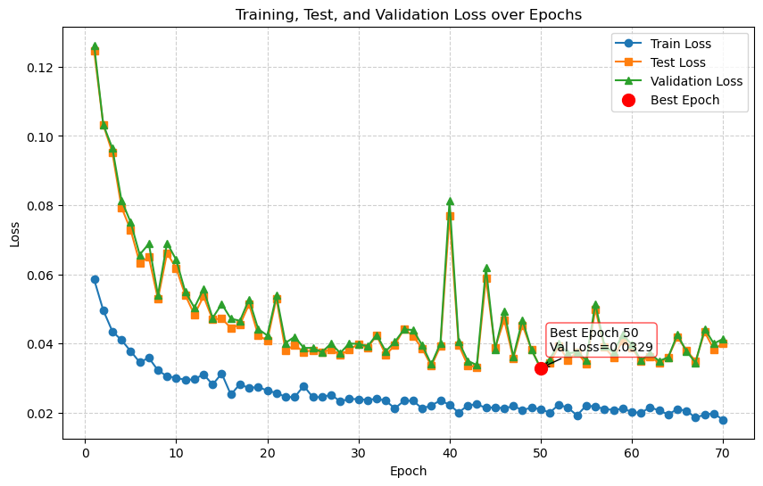
Training Process

Slide 10
Explainability
Use SHAP framework to expose the model transparency to user
For each user query for salary prediction, user able to see how features contribute to the predicted value.
Show global and local interpretability

Slide 11
Outcomes
Model Training
✅ Baseline model created
✅ Achieved working accuracy/loss
✅ Data patterns identified
Model Optimization
✅ Reduced overfitting (Dropout, BatchNorm)
✅ Stable convergence (Adam, LR tuning, EarlyStopping)
✅ Improved generalization
✅ Performance gains (RMSE)
Explainability
✅ Global insights (SHAP summary)
✅ Local insights (SHAP waterfall)
✅ Transparency for stakeholders
✅ Fairness checks
Business Value
✅ Trust in AI decisions
✅ Better decision-making
✅ Efficiency & reduced training time
✅ Scalable & deployable model

Slide 12
Outcomes
Salary Negotiations: HR’s can negotiate competitive salary ranges with candidates based on AI predictions
Budget Planning: Forecast hiring costs and understand investment requirements for qualified talent
Vendor Management: Optimize deals with outsource companies using data-driven salary benchmarks
Market Intelligence: Gain insights into candidate expectations across different experience levels

Slide 13
Key Benefits
Data driven decision making for salary offers
Competitive positioning in talent acquisition
Reduced negotiation time and improved efficiency
Better budget forecasting and cost control
Scalable across different roles and locations
Explainable decisions

Slide 14
Conclusion
Successfully implemented AI-based salary prediction system using deep learning
Model can provide explainability for every decision made through the system
Significant value for HR departments in negotiations and planning
System is scalable and adaptable to various organizations

