Slide 1
Flight Delay Prediction and Analysis Across U.S. Airports
Comp 333 Dr. Essam Mansour
Fall 2025
Group project Final Phase
Deadline December 3rd
By DataMinds Team members: Joel Mwamba, Karim Mikhaeil, Omar Sarayrah, Kabeya Ngoyi, Mohammed Al-Khateeb

Slide 2
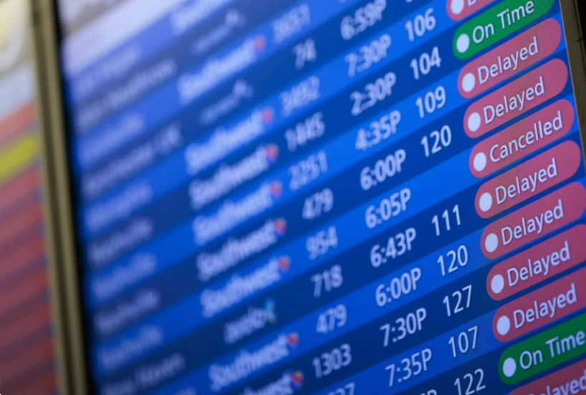
Topic and defined ML tasks Flight Delay Prediction and Analysis Across U.S. Airports
Topic: Predicting flight delays using historical U.S. flight-performance data.
Goal of the Project: To determine whether a flight is likely to be Delayed (1) or On Time (0) based on airport information, airline, time-related features, and different delay-cause values.
Machine Learning Task: This is a classification task, since the model predicts one of two categories:
Delayed
On Time
What We Are Looking For:
Patterns that explain why delays happen
Which airports/carriers are more delay-prone
How delay-cause categories (weather, NAS, late-aircraft, carrier delays) affect outcomes
Whether delay behavior can be predicted from the integrated dataset
Final Output: A trained model that takes flight details as input and predicts if the flight will be delayed.

Slide 3
Project Workflow
Data Collection Gathered multiple U.S. flight datasets from public sources (GitHub, Kaggle, RowZero, Mendeley).
Data Integration Merged the datasets into one unified table, standardized column names, fixed formats, and aligned schemas.
Data Cleaning Removed missing entries, handled outliers, corrected inconsistencies, and ensured stable data types.
Data Transformation Encoded categorical features, created the target variable (delayed), reduced attributes, and prepared train/test sets.
ETL & Visualization Built an Extract–Transform–Load workflow and created visuals showing delay patterns across airports, airlines, and causes.
Modeling Trained baseline and final Decision Tree models using raw vs cleaned data to measure improvement.
Deployment Added a prediction function that takes flight details and outputs “Delayed” or “On time,” showing how the model can be applied.

Slide 4
Systems & Tools Used
Google Colab: running code, cleaning data, training models
Python + Libraries: Pandas, NumPy, Scikit-Learn
Visualization Tools: Matplotlib, Seaborn
Storage: CSV files, Google Drive
Data Sources: GitHub, Kaggle, RowZero, Mendeley
Diagram Tools: Draw.io (ETL and workflow diagrams)
Excel: quick inspection and validation
Software: Jupyter Notebook

Slide 5
- Data Collection and preparation
Data Collection
Four major public datasets were gathered from GitHub, RowZero, Kaggle, and Mendeley.
Sources contained complementary information:
Flight schedules and delays
Airline identifiers
Airport metadata
Delay cause summaries
Weather and operational conditions
All datasets were imported into Python using automated directory scanning and bulk CSV loading.
Data Understanding & Profiling
Examined dataset shapes, column distributions, variable meanings, and key identifiers.
Identified inconsistencies across sources (e.g., naming conventions, date formats, delay definitions).
Investigated missing values, duplicate patterns, and schema misalignment.
Determined which datasets could be merged based on shared keys such as CARRIER_CODE, FL_DATE, ORIGIN, and DEST.
Data Preparation
Standardized schemas across all datasets to unify column names and formats.
Cleaned and normalized date/time fields for consistent interpretation.
Removed unnecessary or redundant variables that did not contribute to analysis goals.
Ensured compatibility between datasets by aligning airport and airline codes.
Prepared the integrated dataset for feature engineering and analysis.

Slide 6
- Data Integration
Project Goal Integrate multiple large-scale U.S. flight datasets into a unified, analysis-ready database suitable for delay analytics, visualization, and predictive modeling.
Why Integration Was Needed
Information was fragmented across multiple sources
Schemas and variable names were inconsistent
Important metadata (airline names, airport info) existed in separate files
A unified dataset enables complete delay analysis
Datasets Used
• GitHub Monthly Flight Data
12 CSV files (Jan–Dec)
~6.8M flight-level records
• RowZero Flight Dataset
Full operational records (date, delays, cancellations)
• Kaggle Airline Delay Causes
Monthly cause-level delay totals for carriers & airports
• Mendeley Weather + Flight Dataset
Temperature, wind, rain/snow indicators

Slide 7
- Data Integration
Integration Workflow
1. Automated File Loading
All 12 monthly flight files loaded using a systematic Python loop.
2. Schema Standardization
Unified naming conventions (e.g., CARRIER_CODE, ORIGIN, DEST).
Standardized date and time formats.
3. Metadata Enhancement
Merged in airline names using Airline.csv
Merged in airport details (city, state, coordinates)
4. Consolidation into a Master Table
Combined all flight records into a single DataFrame
Preserved consistent field meanings across sources
Key Benefits
Supports cross-dataset comparisons
Enables multi-dimensional delay analysis
Provides a complete picture of each flight (schedule → actual performance → delay breakdown)

Slide 8
- Data Cleaning
Initial Data Quality Challenges
1. Missing Values
DEP_TIME, ARR_TIME missing for cancelled flights
Delay cause fields missing in ~400k+ rows
CANCELLATION_CODE missing >90%
2. Inconsistent Formats
Dates in different formats
Times stored as integers (e.g., 1530 for 3:30 PM)
Carrier codes using multiple column names
3. Redundant or Irrelevant Data
Taxi times
Air time
Tail numbers
Sparse cancellation metadata
Fields not relevant to delay analysis or modeling
Cleaning Objectives
Ensure reliable, consistent, machine-readable data
Remove noise while preserving meaningful patterns
Prepare dataset for export and feature engineering

Slide 9
- Data Cleaning
Feature Selection Strategy
Retained only the fields that directly support:
Delay modeling
Airline/airport performance analysis
Temporal behavior
Operational insights
Kept Fields:
FL_DATE
CARRIER_CODE / CARRIER_NAME
ORIGIN / DEST
CRS_DEP_TIME / DEP_TIME
CRS_ARR_TIME / ARR_TIME
Delay components (carrier, weather, NAS, etc.)
CANCELLED
Feature Engineering
TOTAL_DELAY
Combines all delay contributors
Filled missing delay values with 0 for consistency
Allows ranking flights, carriers, and airports
Supports both regression and classification models
Resulting Dataset
Cleaned, standardized, and enriched
Contains only analytically meaningful variables
Ready for modeling, dashboards, and performance analysis

Slide 10

- Data Transformation
Examined all variables and verified data types
Ordinal encoding for categorical features
80/20 train-test split
Removed redundant and low-correlation features

Slide 11

- Challenges on data transformation
Encoding categorical features
Deciding on relevant features

Slide 12
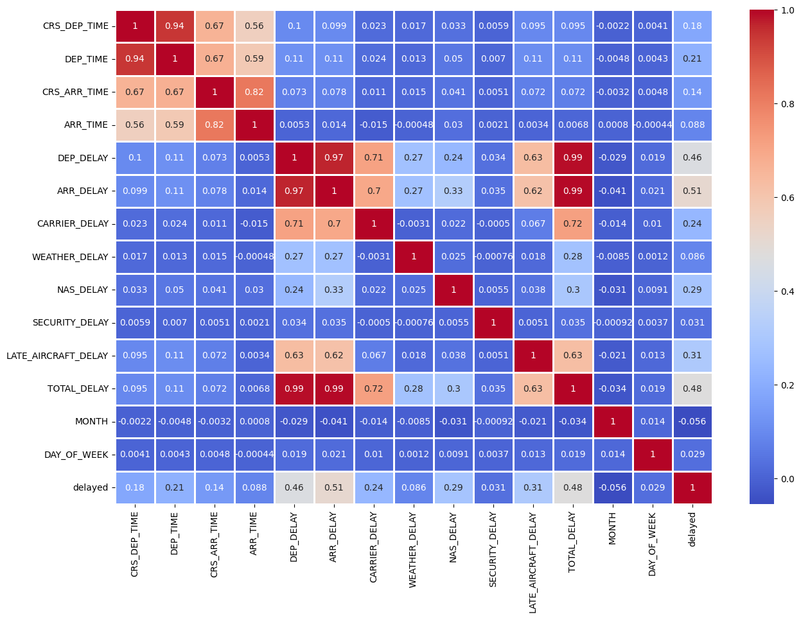
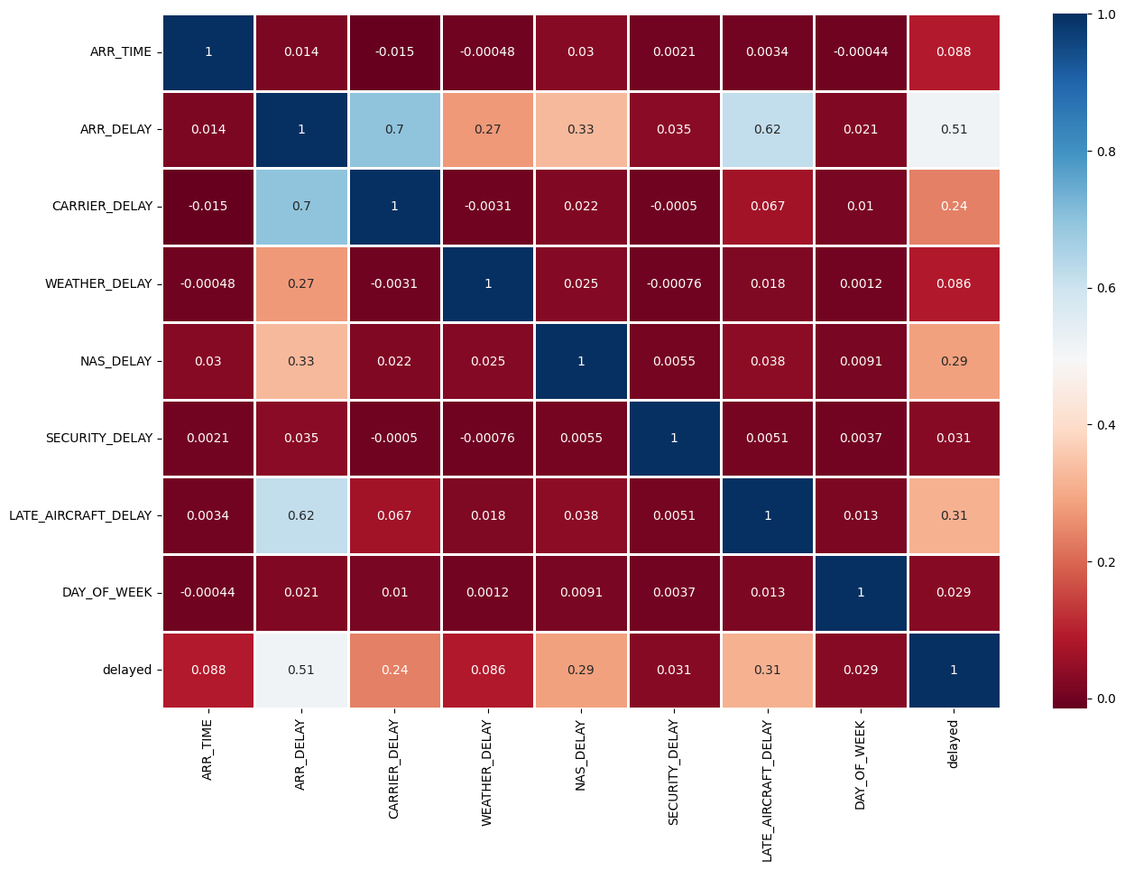
Correlation heatmap

Slide 13
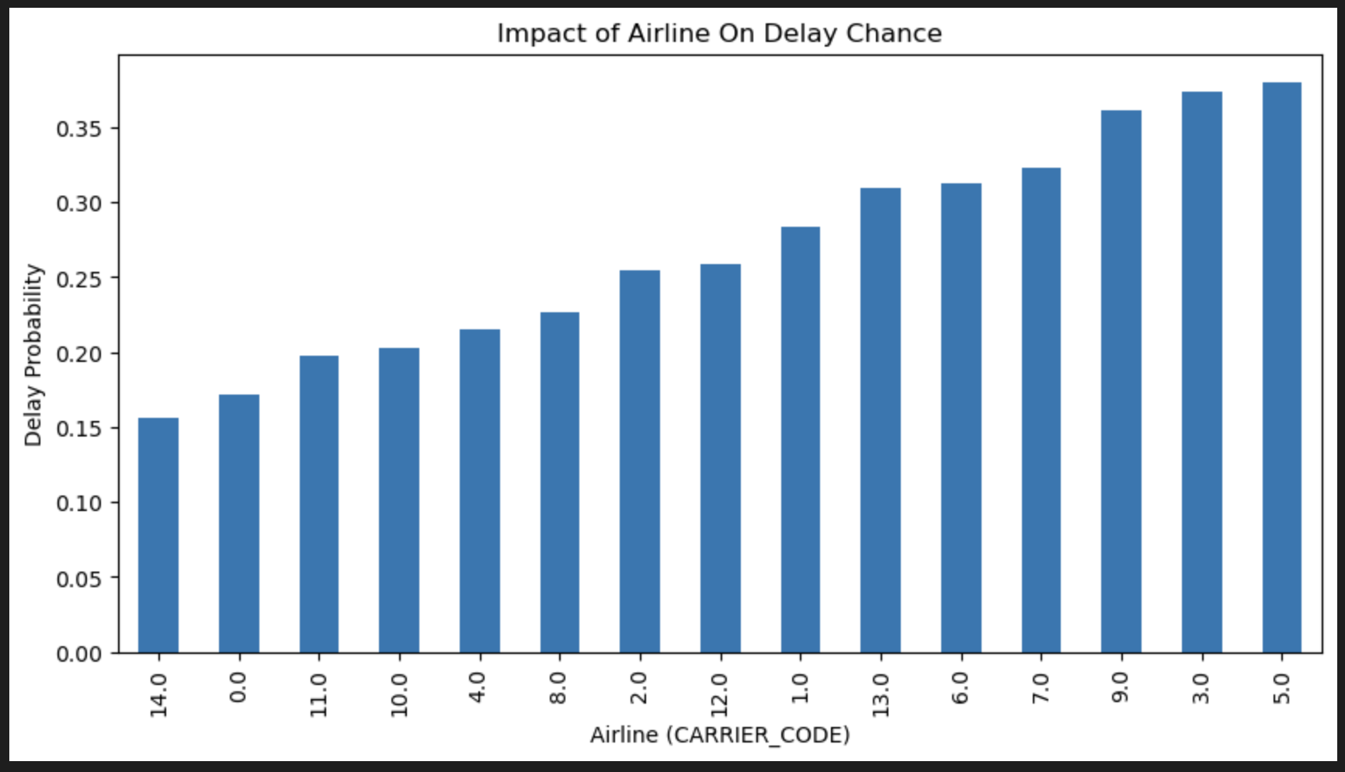
- Data visualization and ETL
Delay Probability by Airline (Bar Chart)
X-axis → Airline
Y-axis → Delay Probability
Conclusion:
Some Airlines experience greater delays than others.

Slide 14
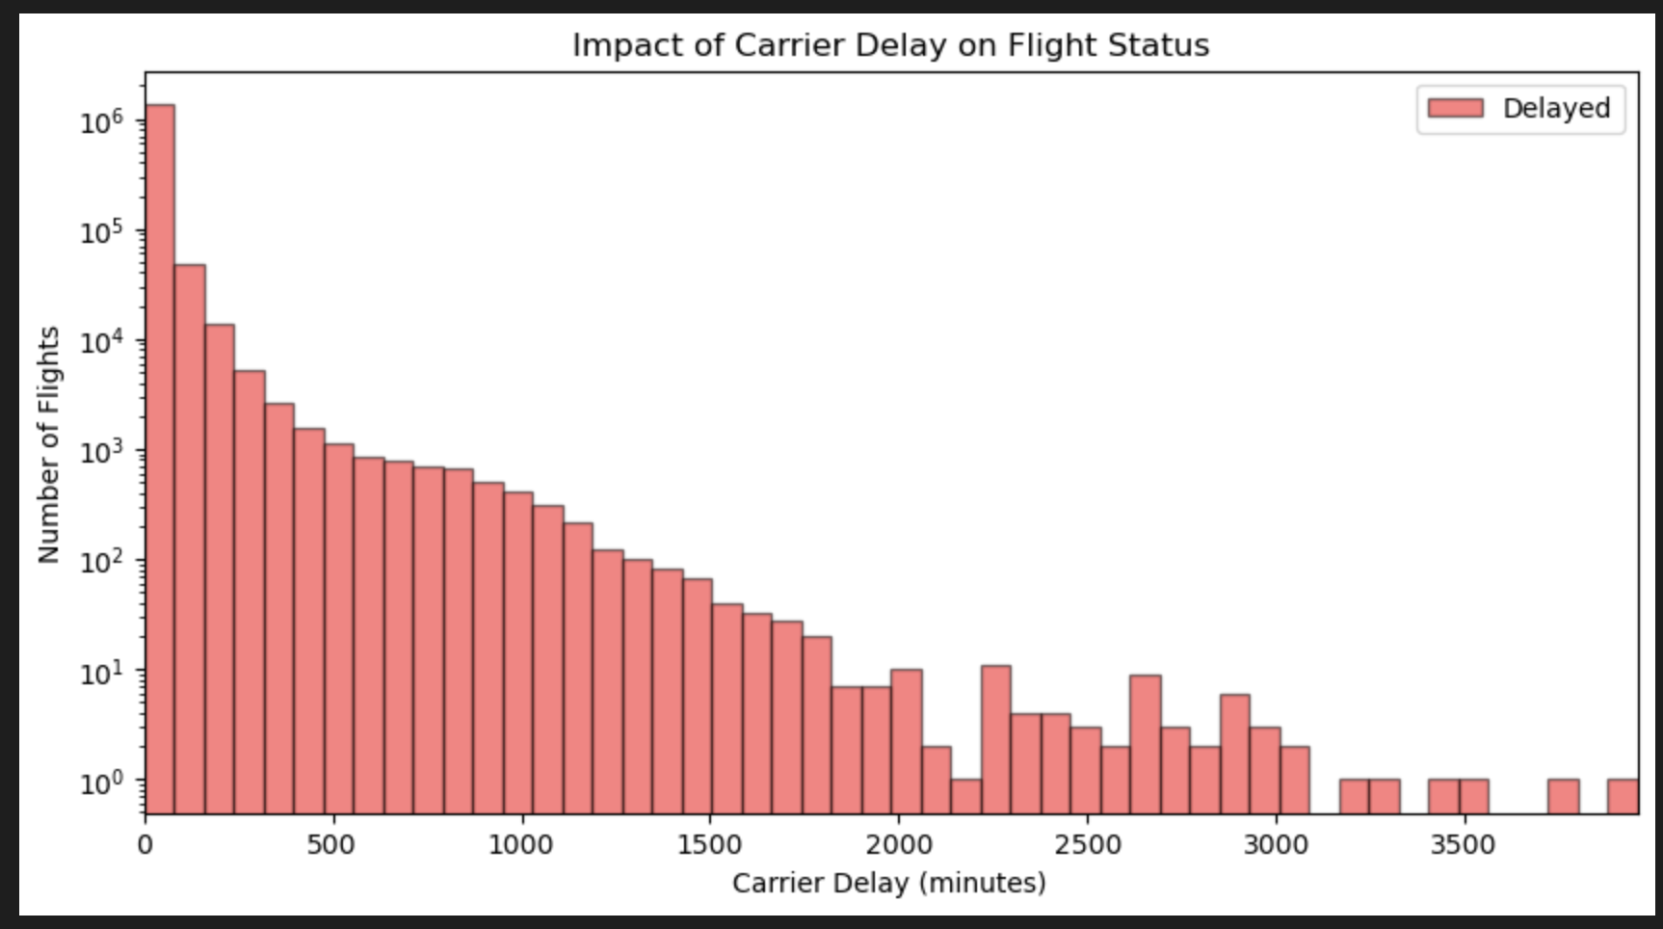
- Data visualization and ETL
Distribution of Carrier Delay Minutes (Histogram)
X-axis → CARRIER_DELAY (minutes)
Y-axis → Number of Flights
Conclusion:
Most flights leave on time but a large number experience delays as well

Slide 15
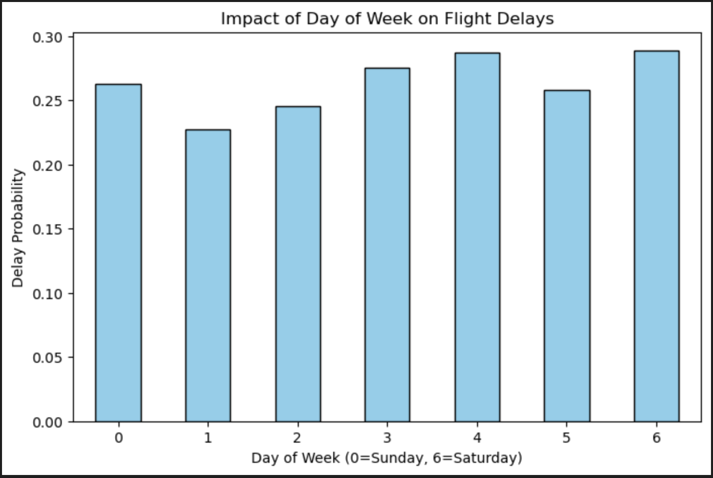
- Data visualization and ETL
Delay Rate by Day of The Week (Bar Chart)
X-axis → DAY_OF_WEEK (0=Sunday, 6=Saturday)
Y-axis → Delay Probability
Conclusion:
Delays are more likely to occur on Sundays, Wednesdays, Thursdays and Saturdays

Slide 16
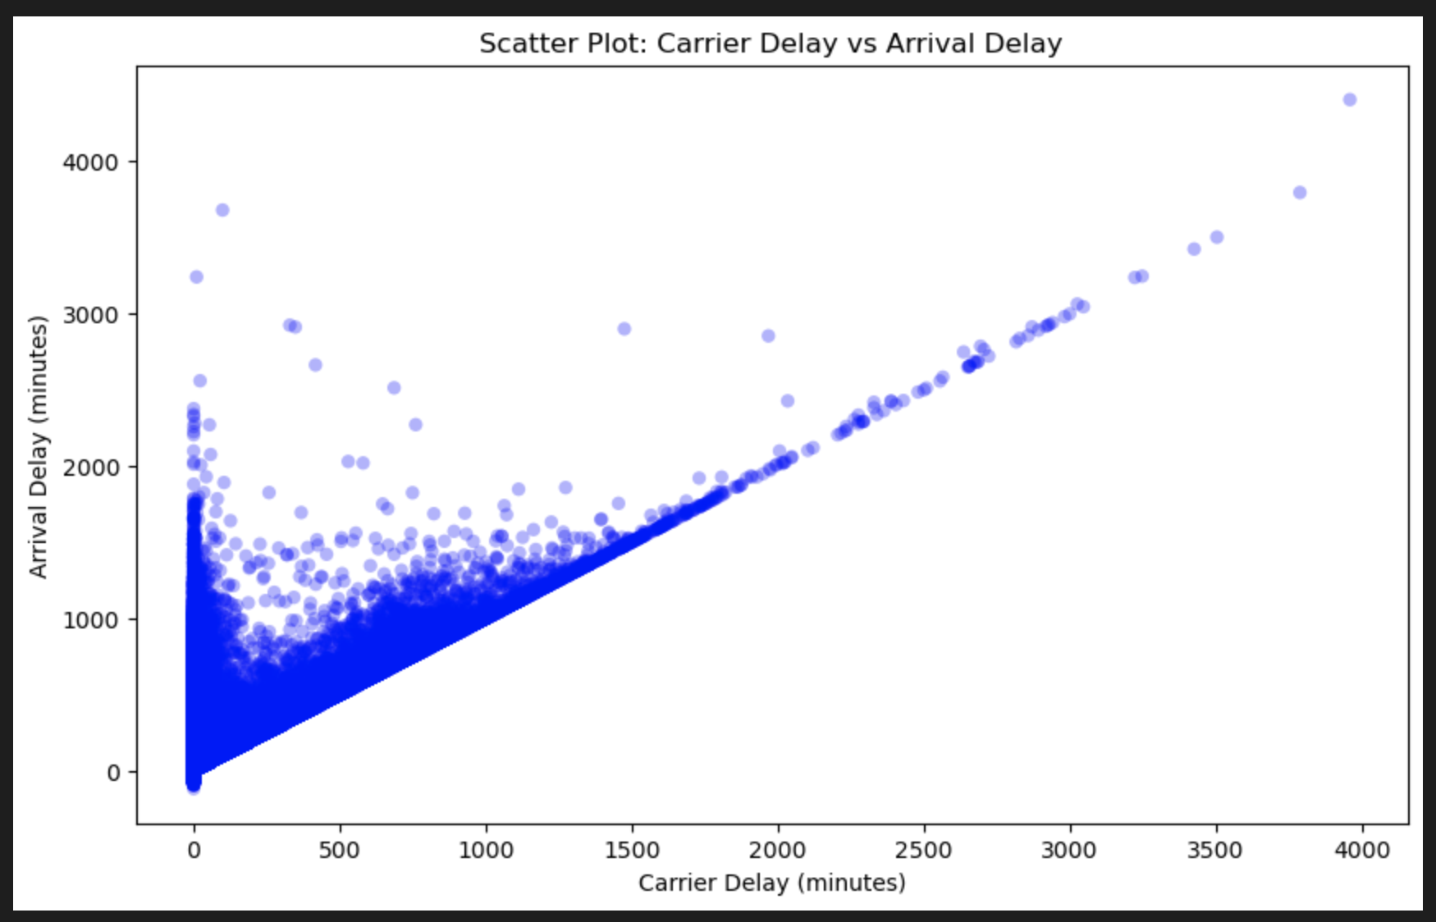
- Data visualization and ETL
Carrier Delay vs Arrival Delay (Scatter Plot)
X-axis → CARRIER_DELAY (minutes)
Y-axis → ARR_DELAY (minutes)
Conclusion:
Bigger shift towards Arrival Delay, Delay occurs as the airplane is about to land.

Slide 17
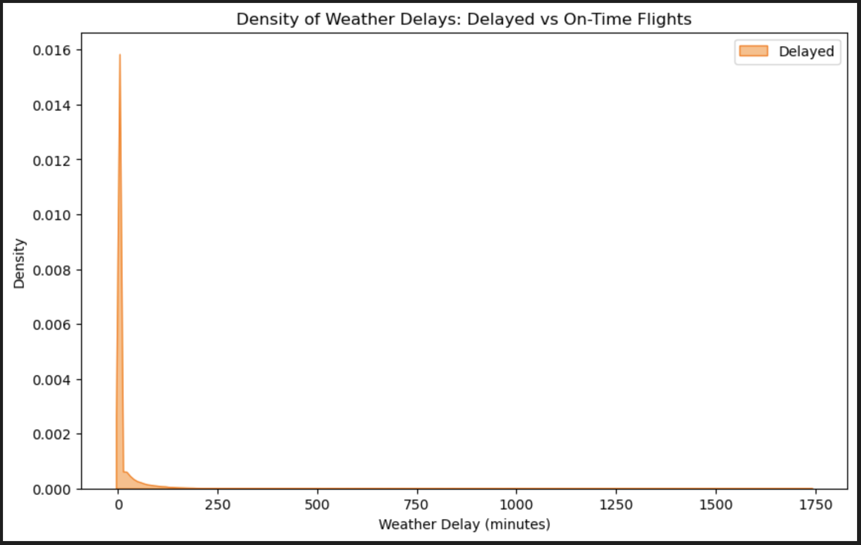
- Data visualization and ETL
Weather Delay Distribution (Density Plot)
X-axis → WEATHER_DELAY (minutes)
Y-axis → Density (Probability)
Conclusion:
Conclusion unlike what we thought weather-factor didn’t cause much delays on flights. Most flights managed to be on time.

Slide 18
Modelling and deploying the model with your application
1. Model Used
Decision Tree Classifier
Simple, fast, and works well with tabular flight data
Handles numerical + encoded categorical features
2. Baseline Model (Before Cleaning)
Trained on raw integrated dataset
Minimal encoding (Carrier, Origin, Destination, CRS Dep Time)
Accuracy: 0.78
F1 Score: 0.00
Low performance due to noise, missing values, and imbalanced labels
3. Final Model (After Cleaning & Transformation)
Trained on cleaned, encoded, and consistent dataset
Nulls removed, outliers reduced, proper encoding applied
Accuracy: 0.95
F1 Score: 0.91
Large improvement once data was fully prepared

Slide 19
Modelling and deploying the model with your application 2
4. Key Findings
Data cleaning and transformation had the biggest impact
Delay-related features (NAS, Late Aircraft, ARR_DELAY) were strong predictors
Decision Tree learned clear patterns in historical delays
5. Deployment
Built a prediction function that takes one flight’s details
Returns “Delayed” or “On Time”
Example outputs:
Example 1 → Delayed
Example 2 → On Time
6. Final Result
Full pipeline works end-to-end (integration → cleaning → transformation → modeling → prediction)
Model is accurate, consistent, and can be expanded with more features or advanced models later

