Slide 1







Unveiling Developer Trends: Insights from the 2019 Stack Overflow Survey
ONI Gabriel
December 9, 2024

Slide 2



OUTLINE
Executive Summary
Introduction
Methodology
Results
Visualization – Charts
Dashboard
Discussion
Findings & Implications
Conclusion
Appendix

Slide 3

EXECUTIVE SUMMARY
In the rapidly evolving global IT sector, staying abreast of technological advancements is crucial for maintaining competitiveness. This report leverages data analytics to highlight current and future trends in the demand for skills related to programming languages, databases, and other technologies. Additionally, it examines the demographics of technology sector professionals.
The data was collected, cleaned, subjected to exploratory analysis, and visualized on dashboards
Analysis show that JavaScript is currently the most popular programming language and is anticipated to remain so in the future
MySQL has the highest database usage at the moment

Slide 4

INTRODUCTION
This analysis report delves into the 2019 Stack Overflow Developer Survey dataset to uncover key insights and trends within the IT industry. By leveraging data analytics, this report aims to highlight current and projected trends in skills related to programming languages, databases, and other technologies. Furthermore, it examines the demographics of technology professionals to provide a comprehensive understanding of the developer landscape.
Utilizing data sourced from Stack Overflow, the data was meticulously collected, cleaned, and subjected to exploratory analysis. The findings are presented through visualizations on dashboards, offering a clear and informative view of the trends shaping the IT sector.

Slide 5

METHODOLOGY
Data Collection
Sources: Stack Overflow 2019 Developer Survey
Data Acquisition: Web scraping
Data Cleaning
Remove any duplicate entries.
Handle missing values by either imputing or removing them.
Standardize the data formats (e.g., date formats, text case).
Exploratory Data Analysis (EDA)
Descriptive Statistics:
Compute basic statistics (mean, median, mode, etc.).
Identify patterns and trends in the data.
Visualizations:
Create charts, graphs, and dashboards to illustrate key insights.
Use tools like Python (Matplotlib, Seaborn) or Tableau for visualizations.

Slide 6

RESULTS

Slide 7
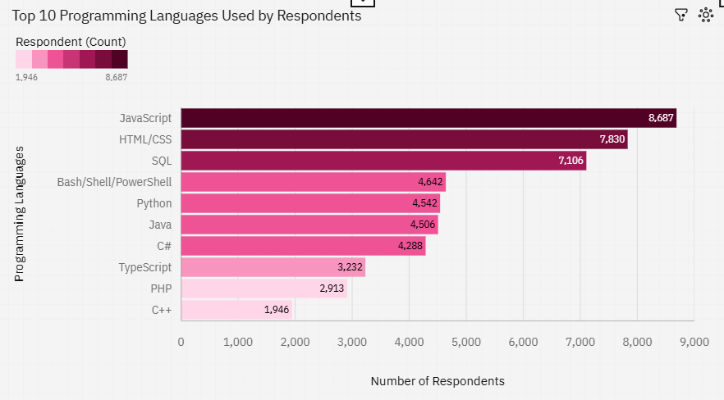
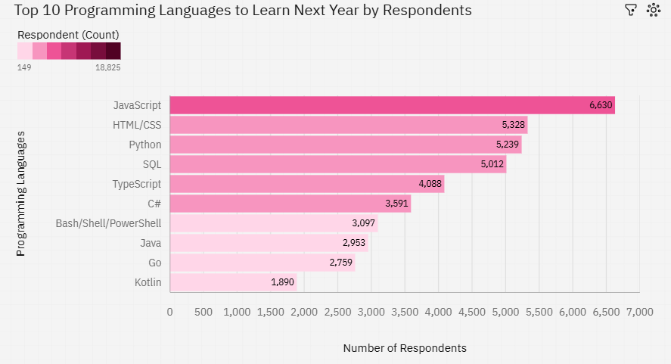
PROGRAMMING LANGUAGE TRENDS
Current Year
Next Year

Slide 8
PROGRAMMING LANGUAGE TRENDS - FINDINGS & IMPLICATIONS
Findings
Most respondents use JavaScript, followed by HTML/CSS and then SQL
Most respondents see JavaScript as the top language to learn in the future
Implications
Industry Demand and Skill Relevance: The fact that most respondents use JavaScript, followed by HTML/CSS and then SQL, implies that these technologies are highly relevant and in demand in the industry
Future Learning Trends: Since most respondents see JavaScript as the top language to learn in the future, it implies that JavaScript will continue to be a dominant language in the tech industry

Slide 9
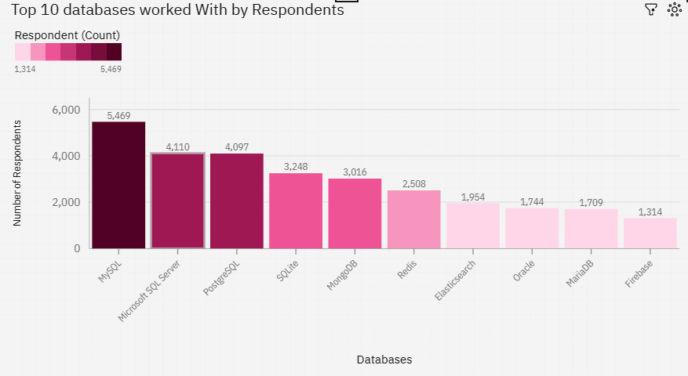
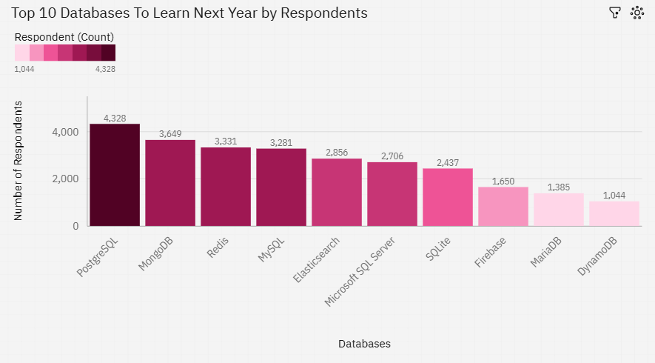
DATABASE TRENDS
Current Year
Next Year

Slide 10
DATABASE TRENDS - FINDINGS & IMPLICATIONS
Findings
Most respondents use SQL based databases with 5,469 using MYSQL, 4,110 using MS SQL Server and 4097 using PostgresSQL
NoSQL distributed NoSQL databases are also used but less
Most respondents see PostgresSQL and MongoDB as the databases to learn in future.
Implications
The majority of respondents using SQL-based databases (e.g., MySQL, MS SQL Server, PostgreSQL) suggests that these databases are well-established and widely adopted in the industry
The lower usage of NoSQL databases indicates that while they are recognized and utilized, they haven't achieved the same level of penetration as SQL databases
The preference for learning PostgreSQL and MongoDB suggests a shift towards more flexible and scalable database solutions

Slide 11

DASHBOARD
Data-Visualization-with-IBM-Cognos/Final Project.pdf at main · osareniho-oni/Data-Visualization-with-IBM-Cognos · GitHub

Slide 12
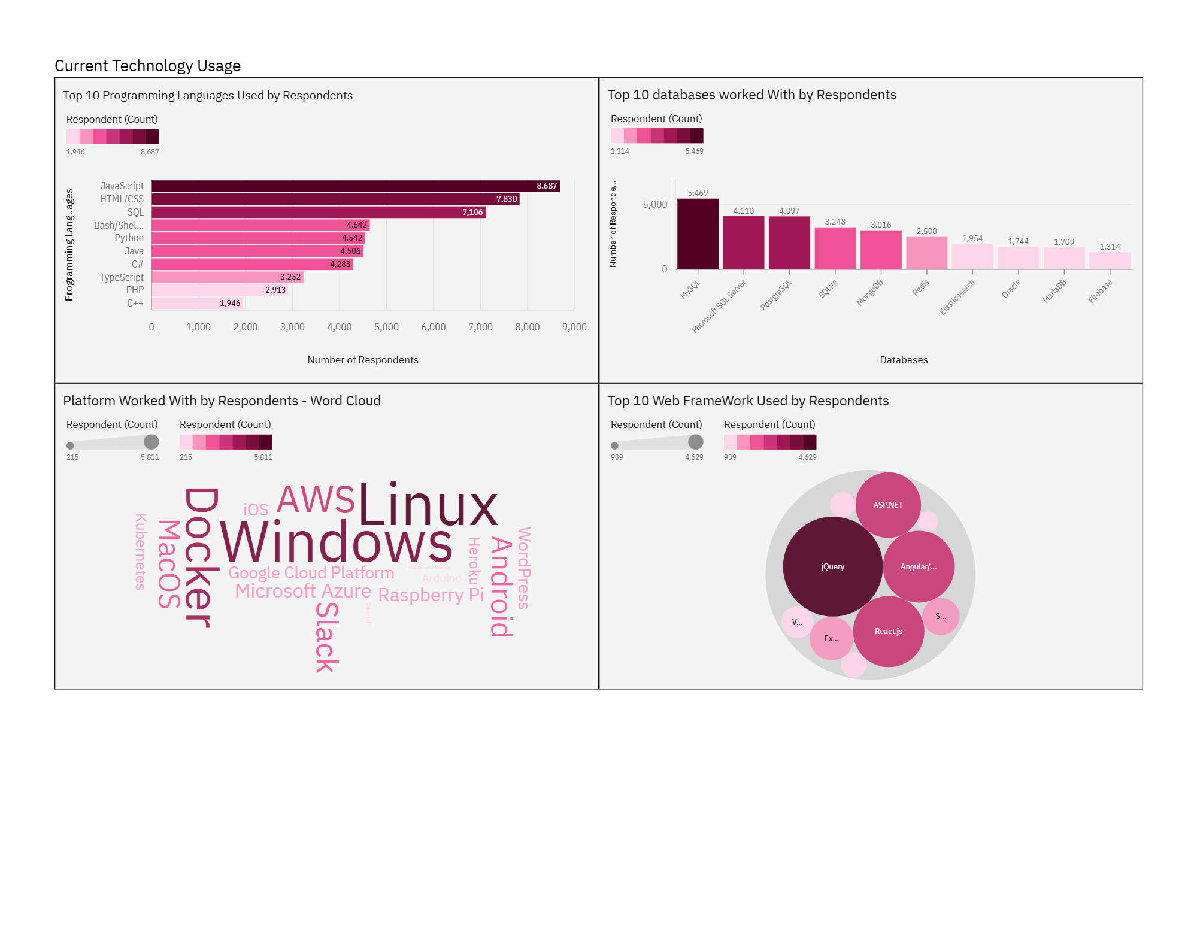
DASHBOARD TAB 1

Slide 13
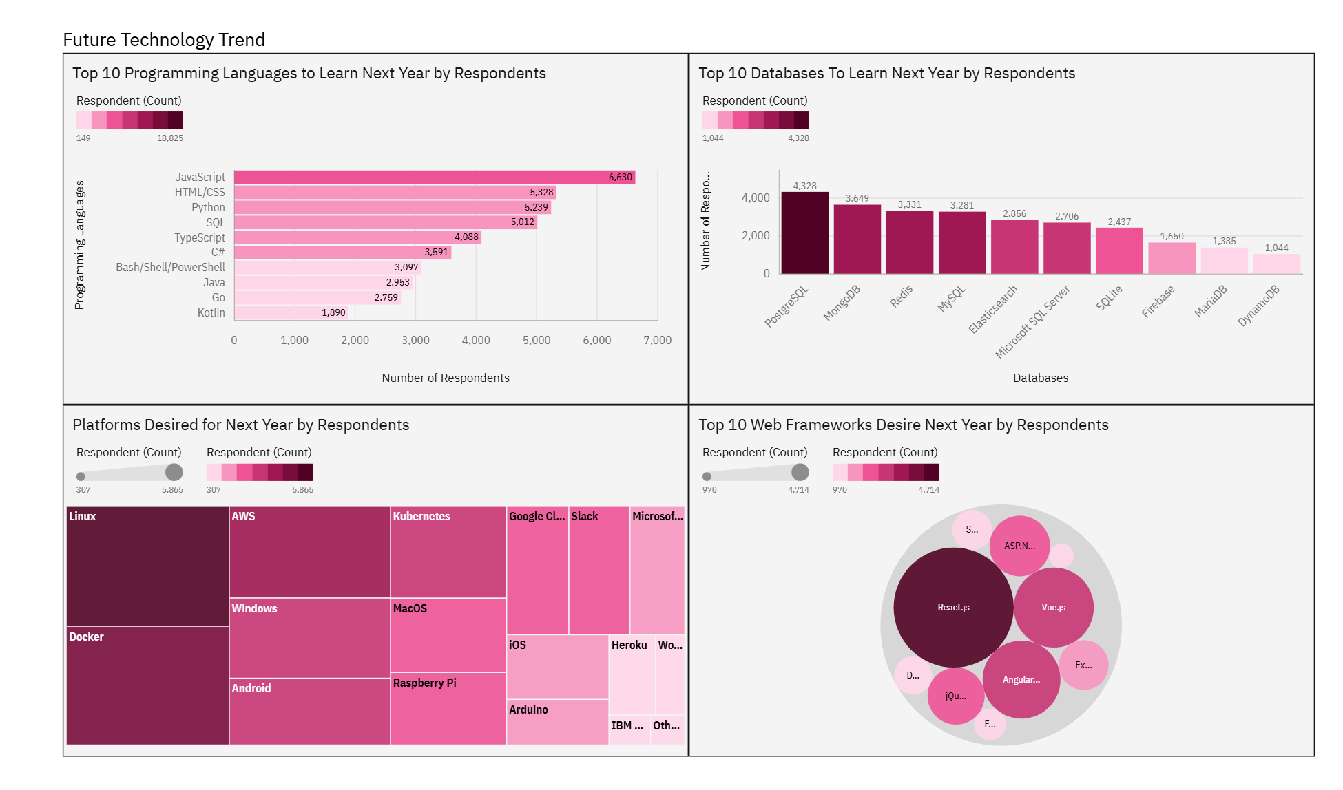
DASHBOARD TAB 2

Slide 14
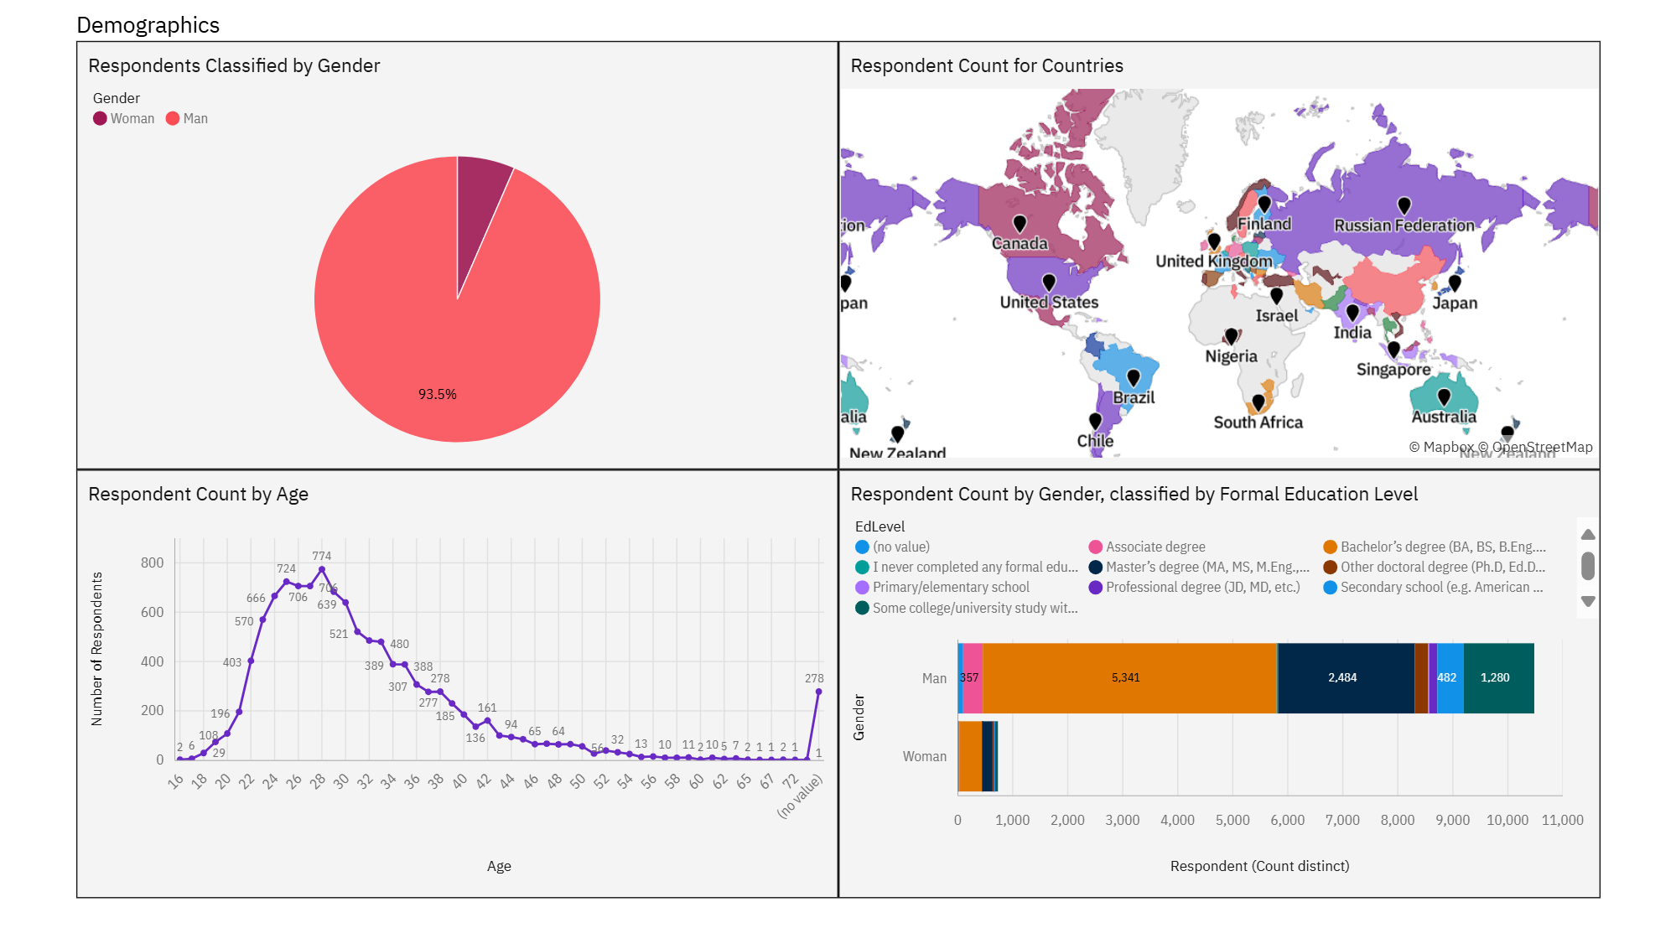
DASHBOARD TAB 3

Slide 15
DISCUSSION
Why is JavaScript the dominant language among developers?
How does the preference for JavaScript influence other areas of web development?
What factors contribute to the popularity of SQL-based databases like MySQL, MS SQL Server, and PostgreSQL?
Why are PostgreSQL and MongoDB gaining popularity as the databases to learn in the future?
What advantages do NoSQL databases like MongoDB offer compared to traditional SQL databases?
What are the challenges and opportunities associated with adopting new technologies like PostgreSQL and MongoDB?
What additional research is needed to understand the long-term impact of emerging technologies on the IT industry?

Slide 16
OVERALL FINDINGS & IMPLICATIONS
Findings
JavaScript remains the most widely used and sought after programming language
SQL databases remain the most widely used and sought after databases by developers
JQuery was the most used framework by respondents while React.js was the most desired for personal development
AWS, Windows, Linux and Docker are the most used platforms
Implications
High demand for JavaScript skills highlights its importance for career advancement
Emphasizing SQL skills in training programs remains essential
The use of JQuery and choice of React for future development re-emphasizes the dominance of JavaScript as a programming language

Slide 17

CONCLUSION
The analysis reveals:
JavaScript remains the most used and desired language, essential for web development.
SQL databases are widely trusted and used, highlighting their importance.
PostgreSQL and MongoDB are emerging as crucial technologies for future learning.
Frameworks: JQuery is still relevant for legacy systems, while React.jsis the future focus.
Platforms: AWS, Windows, Linux, and Docker are essential for versatile development.
Developers should focus on these technologies to stay competitive, and educational programs should include them to prepare students for industry demands.

Slide 18
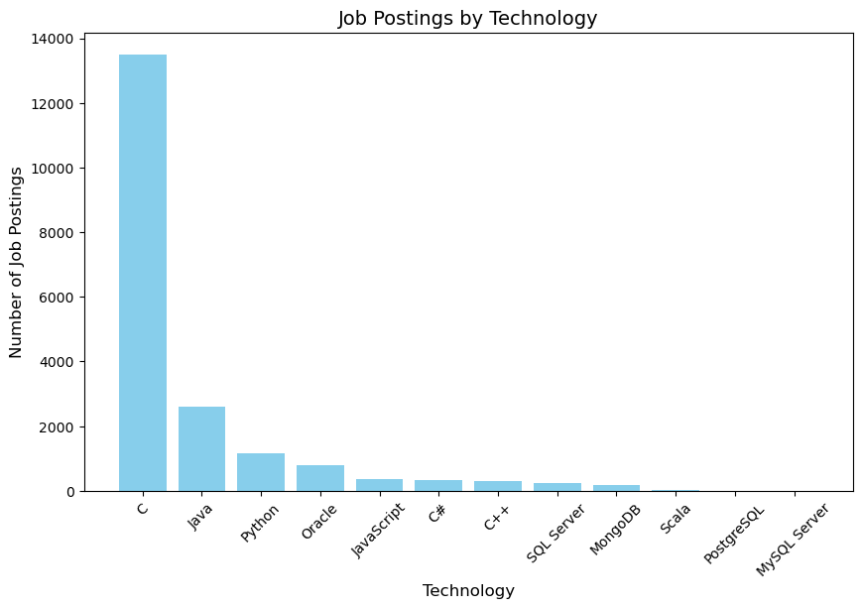
JOB POSTINGS

Slide 19
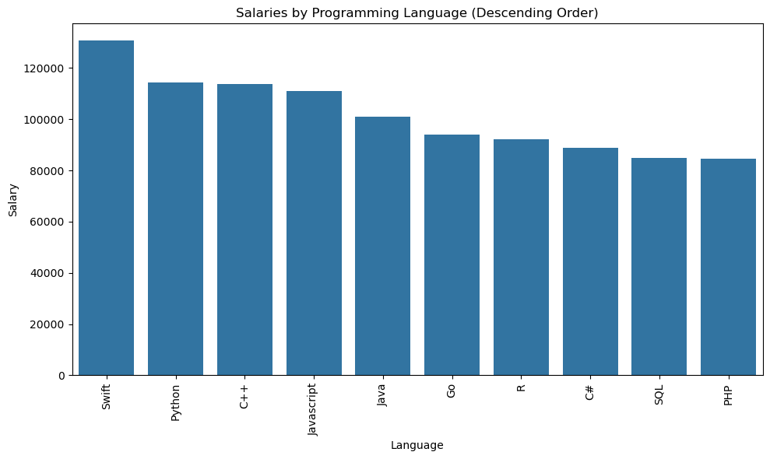
POPULAR LANGUAGES

