Slide 1
A Big Data Platform Integrating Compressed Linear Algebra with Columnar Databases
Vishnu Gowda Harish, Vinay Kumar Bingi, John A. Miller
Computer Science Department
University of Georgia
IEEE OSBD Workshop 2016

Slide 2
Outline
Introduction
Objective
Related Work
Supporting Compressed Linear Algebra in ScalaTion
Interoperability between Relations and Matrices
Extending Compressed Linear Algebra to Advanced Analytical Applications
Experiment Results
Conclusion
Future Work

Slide 3
Introduction
Data is growing at an ever increasingly rapid rate
There is an increasing demand for efficient storage and fast analytics
Approaches taken by Big Data Frameworks to satisfy this demand include
Parallel and Distributed Processing
Compression techniques
Integration of databases with computational frameworks

Slide 4
Objective
Key foundational components of Big data platforms include
Efficient Large Scale Storage
High Performance Linear Algebra
Apply compression techniques inspired by columnar relational databases
e.g., Run Length Encoding (RLE) as a compression technique for improving the space profile
Exploit parallel processing for improving the time profile for vector and matrix operations
Provide support for both serial and parallel implementations of RLE vectors and matrices in ScalaTion

Slide 5
Related Work
Data compression is widely adopted in the NoSQL databases world mainly column stores as they tend to achieve higher compression ratios
e.g., Apache Cassandra, C-Store, HP Vertica
Data compression is also adopted in analytical platforms like Spark SQL and Druid
There also has been prior work on integrating linear algebra in databases
SciDB, a fine-tuned database with an array based data model and support for linear algebra operations via Array Query Language (AQL) and Array Functional Language (AFL)
MADlib Analytics Library, linear algebra expressions are formulated via SQL and user defined functions
D. Kernert et al. ACM, 2014, integrates linear algebra into an in-memory columnar database by embedding matrices as part of the DDL and offers built in DML commands to process matrices

Slide 6

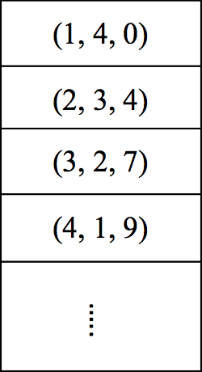
Supporting Compressed Linear Algebra in ScalaTion
RLE Vectors
Original sequence of values are replaced with Triplets (value, count, startPos)
Internally contains a ReArray to store the triplets. ReArray is an implementation of the ResizableArray trait provided in Scala
If the dense vector is compressed to an RLE vector of size C, where C is the number of triplets, then
Update takes O(C)
Random Access takes Log(C)
Original run of values
ReArray

Slide 7
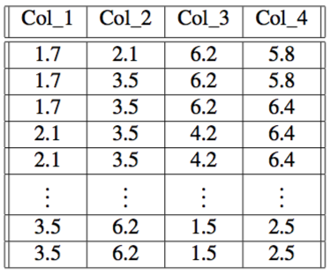
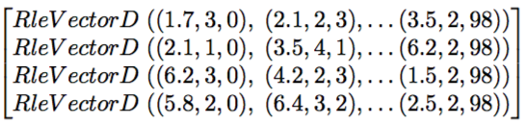
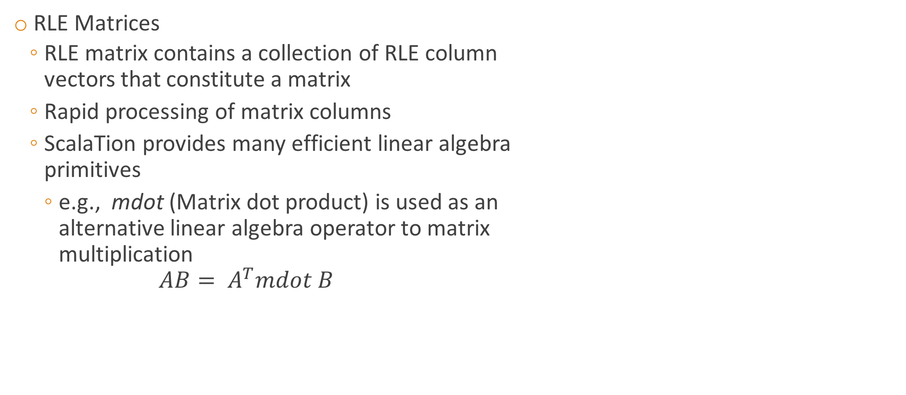
Supporting Compressed Linear Algebra in ScalaTion
RLE Matrices
RLE matrix contains a collection of RLE column vectors that constitute a matrix
Rapid processing of matrix columns
ScalaTion provides many efficient linear algebra primitives
e.g., mdot (Matrix dot product) is used as an alternative linear algebra operator to matrix multiplication $AB= A^{T}mdot B$
Relation
RleMatrixD

Slide 8

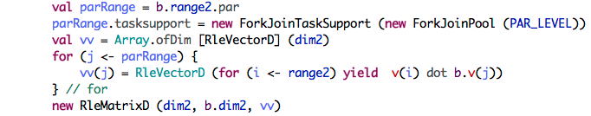
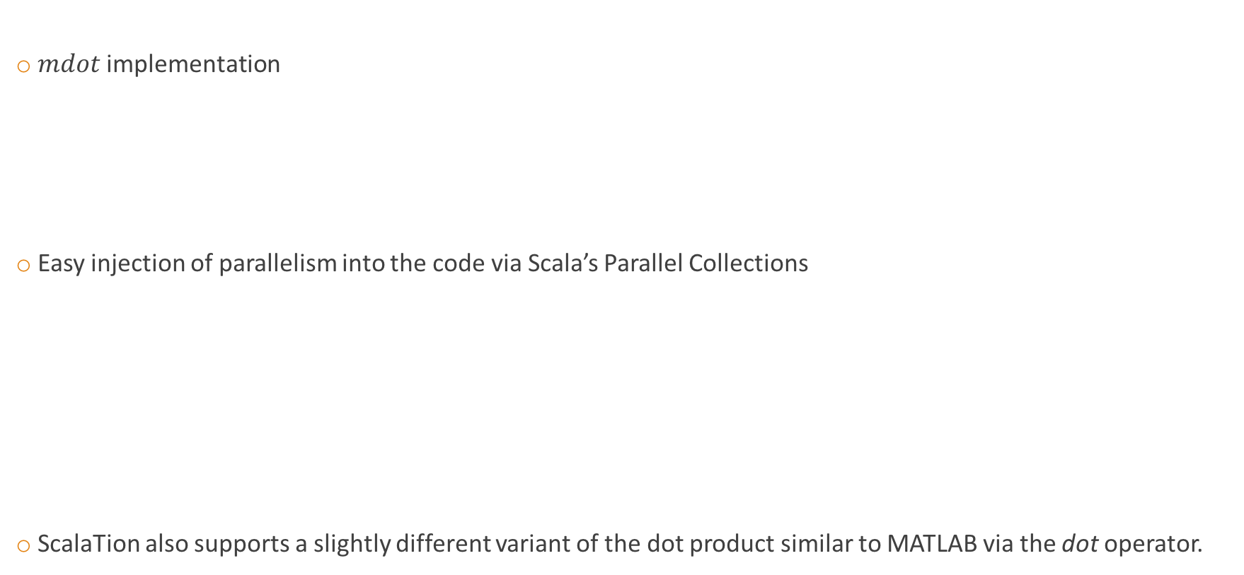
Matrix Dot Product
$mdot$implementation
Easy injection of parallelism into the code via Scala’s Parallel Collections
ScalaTion also supports a slightly different variant of the dot product similar to MATLAB via the dot operator.

Slide 9

Interoperability between Relations and Matrices
ScalaTion has the ability to extract matrices and vectors from relations, perform operations and then transform the result back to relations

Slide 10
Extending Compressed Linear Algebra to Advanced Analytical Applications
Compressed linear algebra can be used in advanced analytical applications to obtain performance gains
Advanced analytics usually deal with large amounts of data demanding an efficient approach in each step of the analytics
Computing the covariance matrix is required by advanced analytical techniques
Principal Component Analysis (PCA)
Portfolio management
Covariance matrix which when implemented using compressed linear algebra in ScalaTion, optimizes not just in computation but also in storage

Slide 11
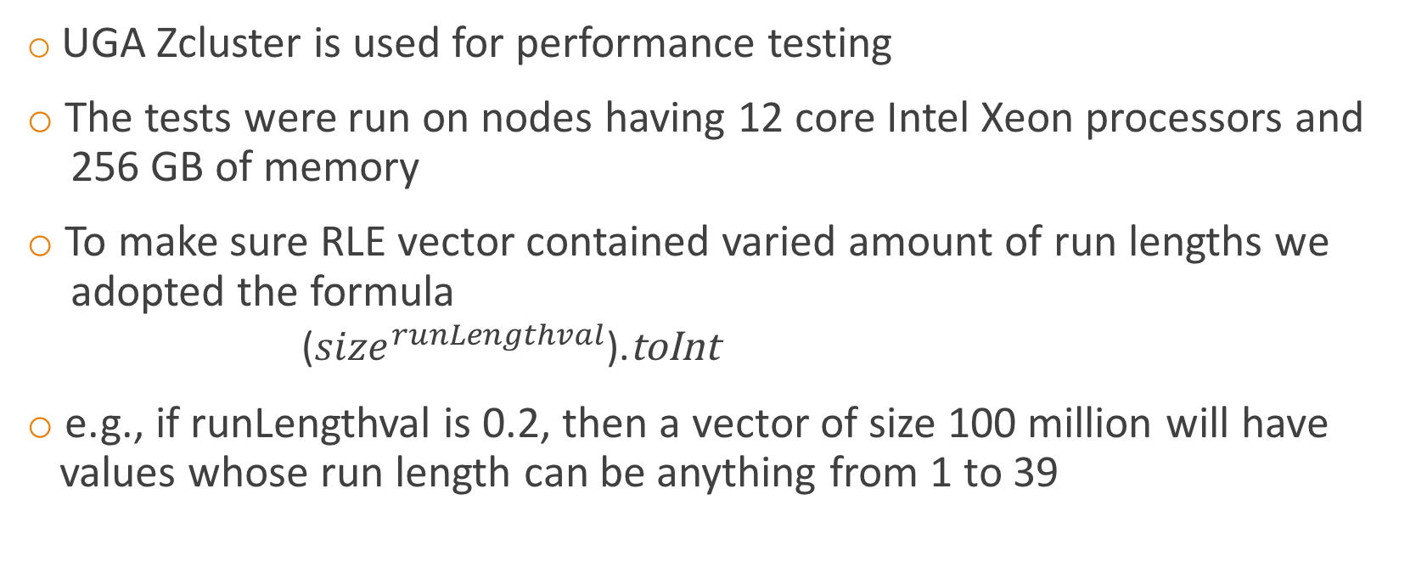
Experiment Results
UGA Zcluster is used for performance testing
The tests were run on nodes having 12 core Intel Xeon processors and 256 GB of memory
To make sure RLE vector contained varied amount of run lengths we adopted the formula
(${size}^{runLengthval}$).toInt
e.g., if runLengthval is 0.2, then a vector of size 100 million will have values whose run length can be anything from 1 to 39

Slide 12
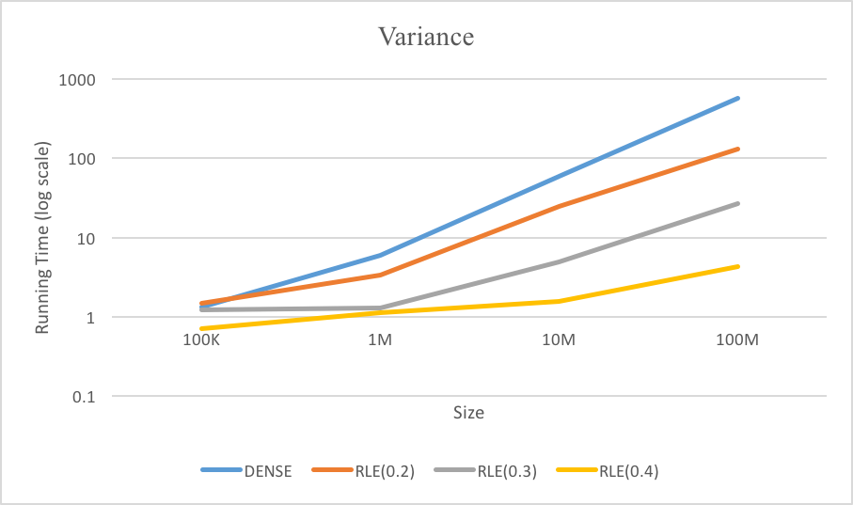
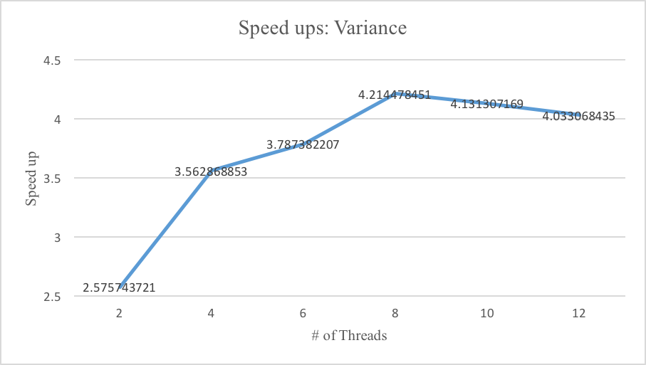
Vector Operation (Variance)

Slide 13
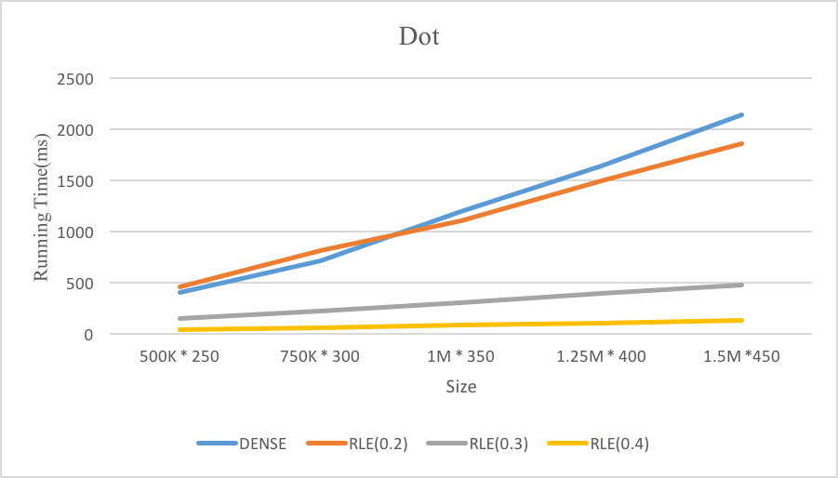
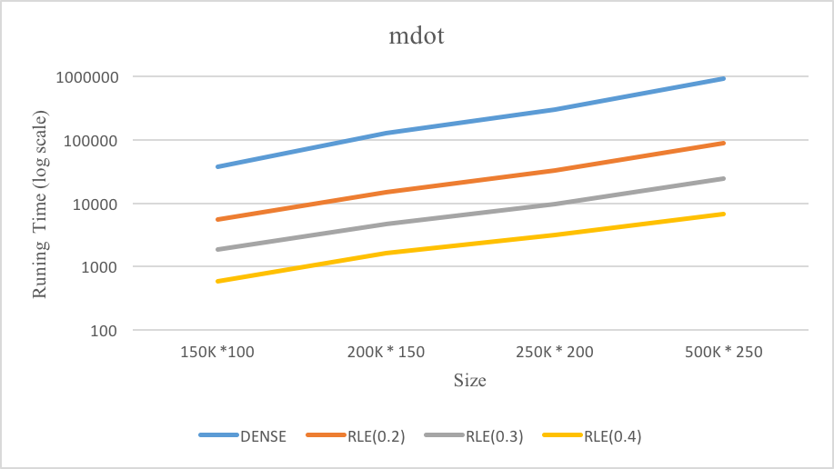
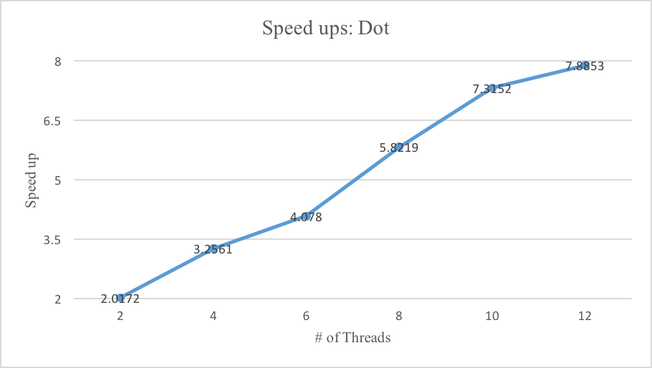
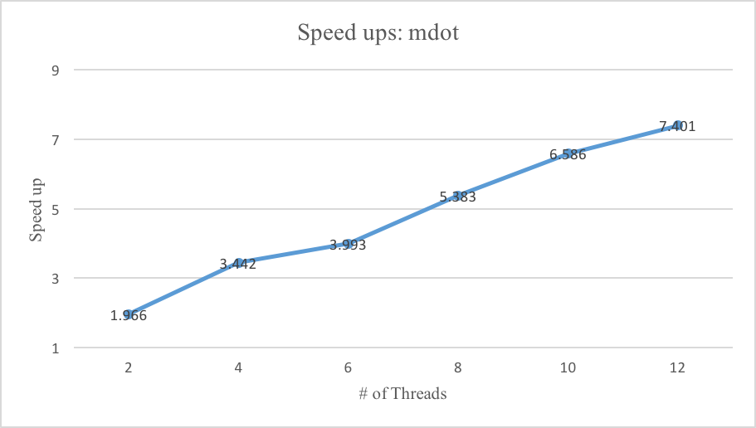
Matrix Operations (dot and mdot)

Slide 14
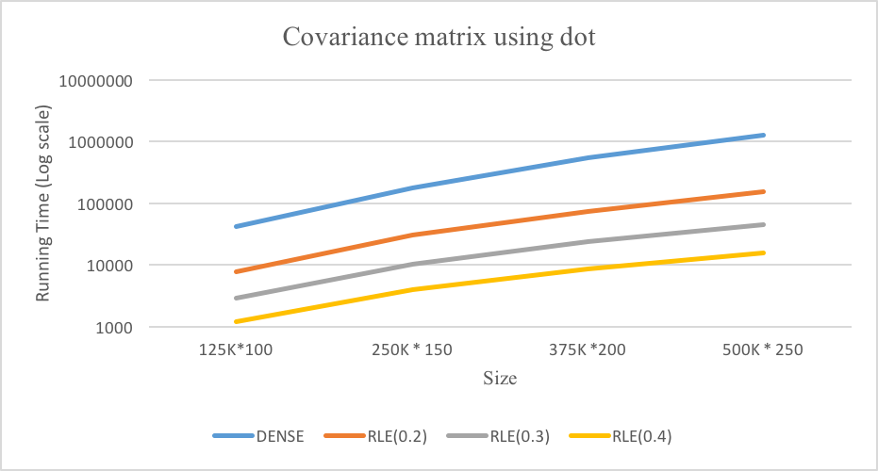
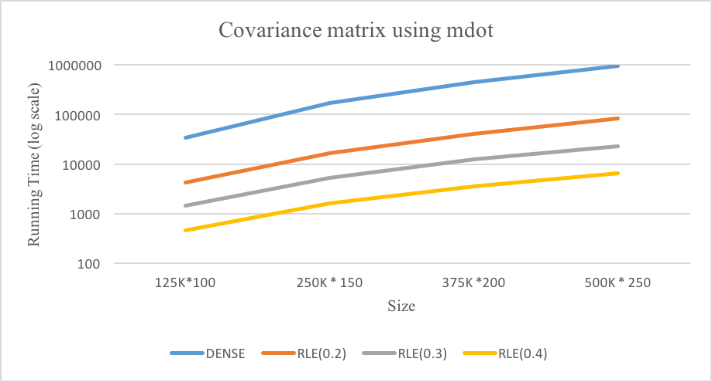
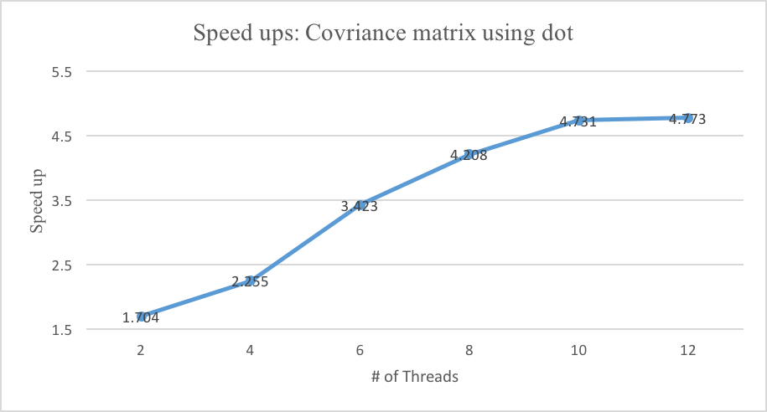
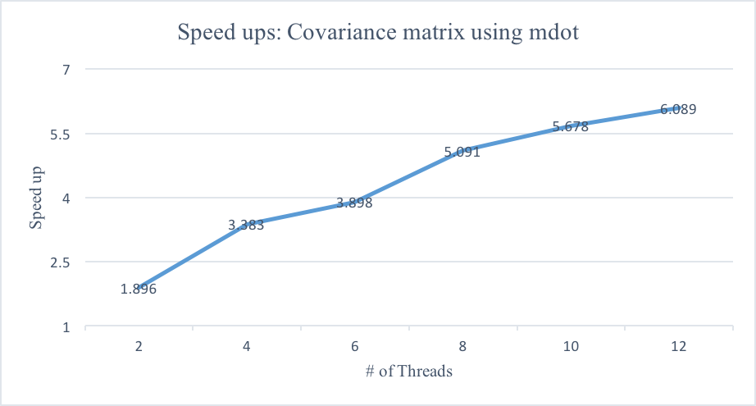
Covariance Matrix

Slide 15
Conclusion
Compression techniques (RLE) commonly used in columnar relational database databases are added to a comprehensive linear algebra package provided by the ScalaTion open source big data framework
Matrices and vectors can be stored with considerably less space and in some cases provide exceptional speed up
Integration of columnar relational and linear algebra provides efficient and convenient means for carrying out ad-hoc analytical studies
Showed how the use of the ScalaTion framework for parallel execution makes it easy to convert sequential codes to parallel implementations
http://cobweb.cs.uga.edu/~jam/scalation_1.2/README.html

Slide 16
Future Work
Supporting handling of distributed data in ScalaTion
Utilizing compression techniques in advanced predictive analytics
Faster update
ScalaTion can also be made to adopt Apache Arrow, an in-memory columnar data layer that can be shared across systems
Open source big data projects like Hadoop, HBase, and Spark are working with Apache Arrow

Slide 17
THANK YOU

