Slide 1
Content-based Recommendation for Podcast Items using Natural Language Processing Techniques
Dr Z. Xing, 28 November 2016
IEEE Big Data 2016

Slide 2
Introduction
Both the volume and heterogeneity of podcast content is extremely huge, which makes it operationally difficult to manually categorize or tag the items, thus manage them in a system for users to discover (user-friendly).
Unlike traditional MP3 format of music, where there is complete ID3 meta-data such as artist, genre, year of release, etc., podcast items usually do not have a complete set of features. However there are a lot of textual signals that we could utilize to shed lights on the content of the item
Subtleties, relationship of text/words can be conveyed in a mathematical format of word vectors, denoted as “embedding” in NLP field, both semantically and syntactically.
Here we built a tool for managing/recommending, specifically, large-scale Chinese podcast items using textual signals

Slide 3
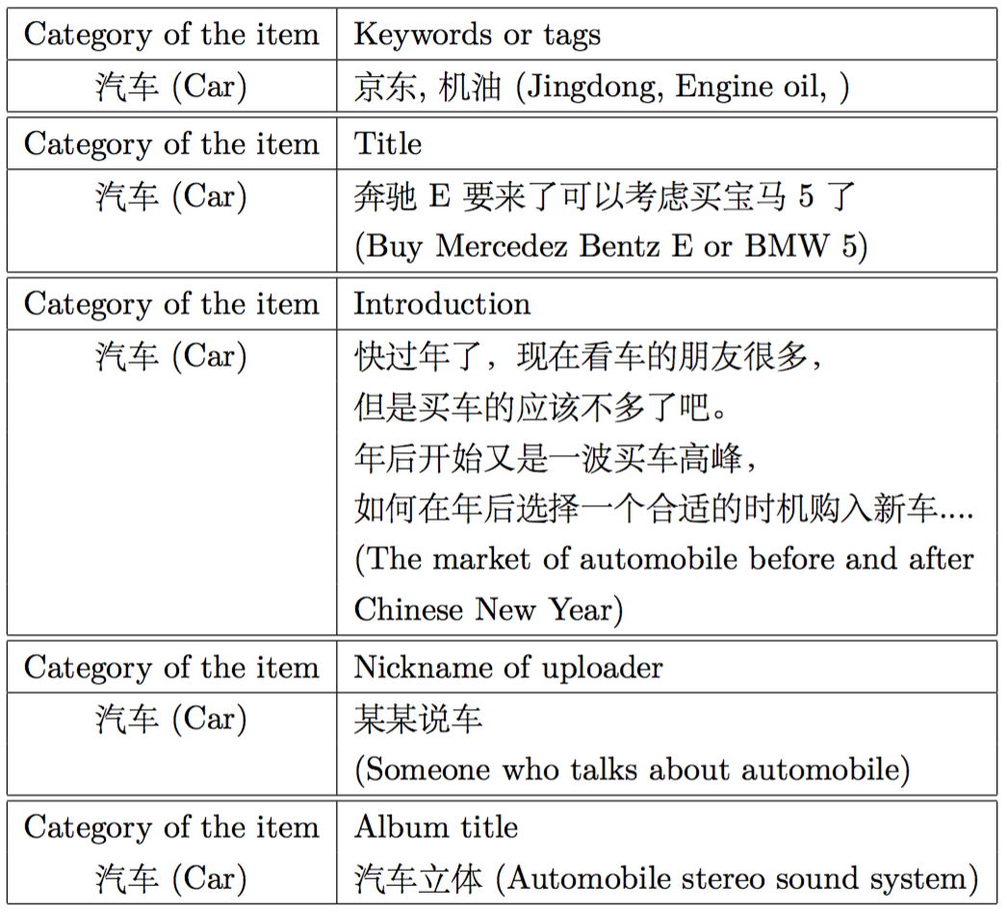
Textual signals in podcast data
Various textual signals can be utilized to predict the content of podcast items such as news, series of show, finance, IT, etc.
We have tried signals such as tags, keywords, title, introduction paragraph, nickname of announcer and album title
Since Chinese words are not separated by spaces, we had to run Conditional Random Field (CRF) tokenizer to segment the sentences into words
Huihsin Tseng, Pichuan Chang, Galen Andrew, Daniel Jurafsky and Christopher Manning. 2005. A Conditional Random Field Word Segmenter. In Fourth SIGHAN Workshop on Chinese Language Processing

Slide 4
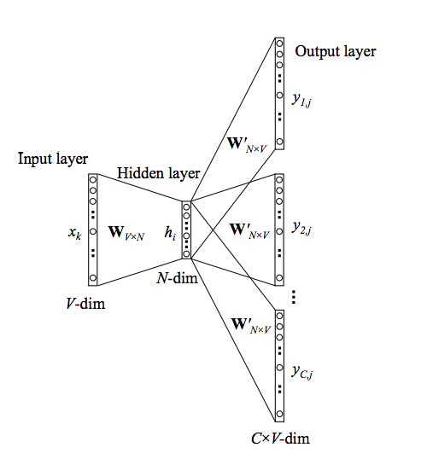


Skip-gram word model
Optimizing for the conditional probability
Three-layer neural network implementation: input layer one-hot encoded, linear propagation to hidden layer, sum over all prediction errors on all context words at output layer
context 1
p(context | word )
“weights-sharing”
word
context 2
context C
We have to go through every single word in the vocabulary to update the input/output vector W/W’ for each training instance

Slide 5

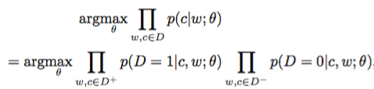


Negative sampling idea – word2vec
Negative sampling: reduce the number of output vectors that need to be updated
original formalisms in T. Mikolov NIPS paper from Google
+
Noise contrastive estimation (NCE)

Slide 6
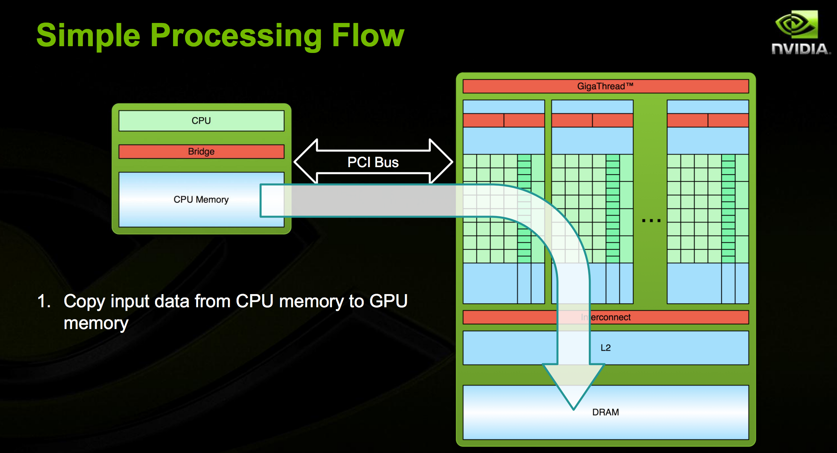
Implementation of SGNS in NVCC
304,001,680 words from input Chinese corpus
398,668 words retained in the vocabulary
rank of embedding = 400
training for 15 epochs, ~40 minutes using two GeForce GTX 1080 GPU cards
Device: GPU
int main(int argc, char **argv)
Host: CPU
// this is the line that launches all these CUDA kernels
device_sgns<<<numBlock,BLOCK_SIZE,shared_mem_usage >>>(sentence_num, layer1_size, layer1_size_aligned, window,negative,table_size, vocab_size, d_sen, d_table, d_syn0, d_syn1neg, d_random);
void __global__ device_sgns(…)

Slide 7
Word relationship & algebra
Word similarity/correlation, most similar to word ‘alphago’
'alphago’
'sedol', 0.6404393911361694
'kasparov', 0.5078040361404419
'deepmind', 0.5048749446868896
Word algebra, for example, microsoft + gmail - google = ?
'microsoft’ + 'gmail’ -'google’ =
'hotmail', 0.5333812236785889

Slide 8
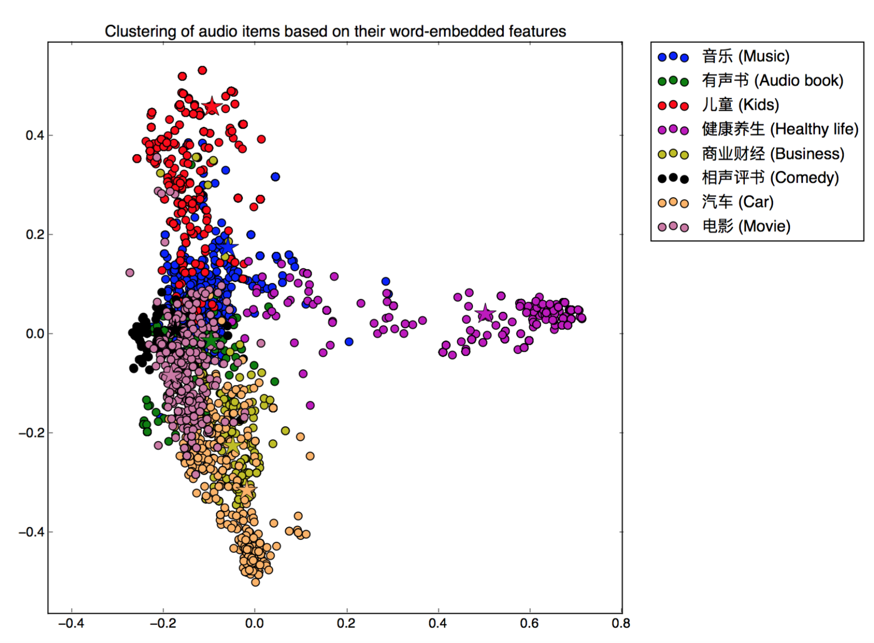
Aggregated item-based embedding
We can aggregate the individual word embedding (rank=400) thus form an item-based embedding
Using PCA for dimensionality reduction we can visualize the item clustering/similarities
For cross-validation purposes, we use the vendor provided categories as “ground-truth”, 8 categories of items are tested here

Slide 9
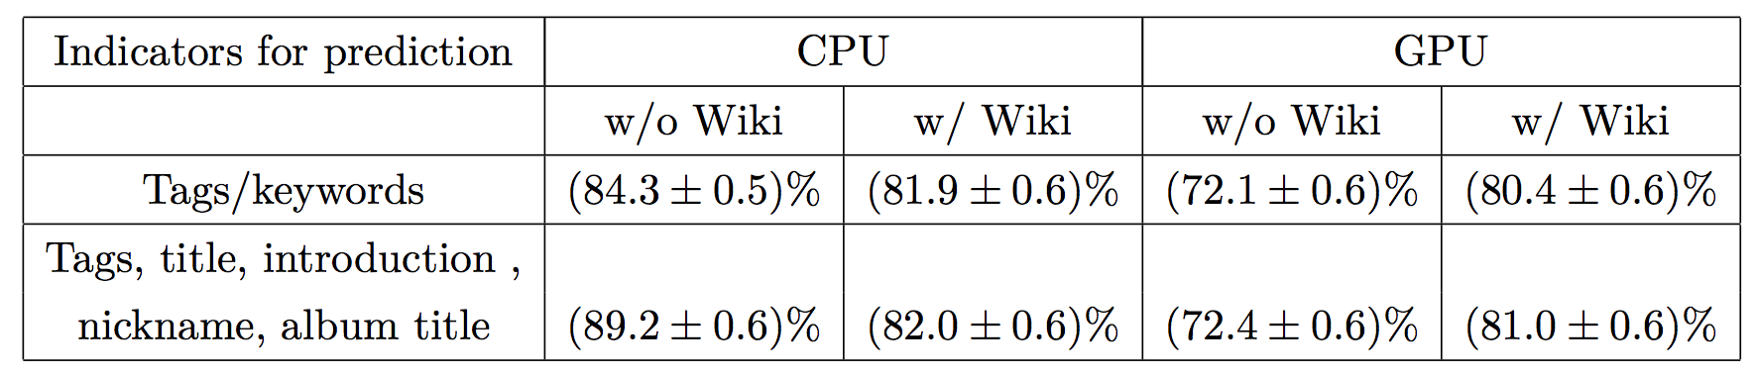
Classify the items using predefined tags
Essentially we can categorize the items based on any customized stands, in-house predefined categories/tags: “electric car”, “formula-E”, etc., categories, sub-categories, hot topics.
For cross-validation, we used vendor provided categories of “music”, “audio book”, “kids”, etc., and compare our predicted content with them

Slide 10
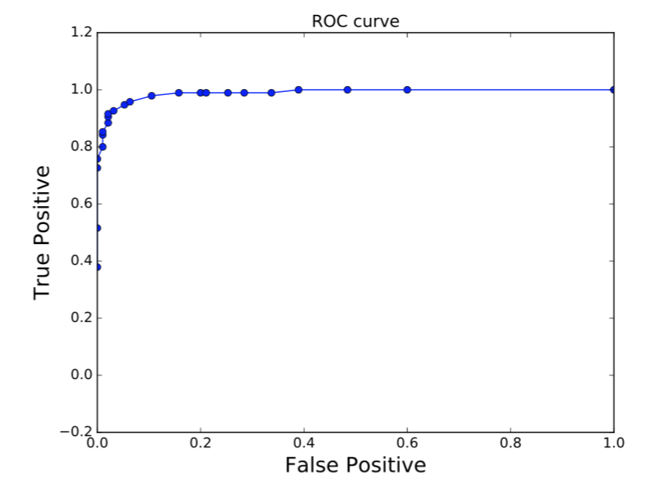
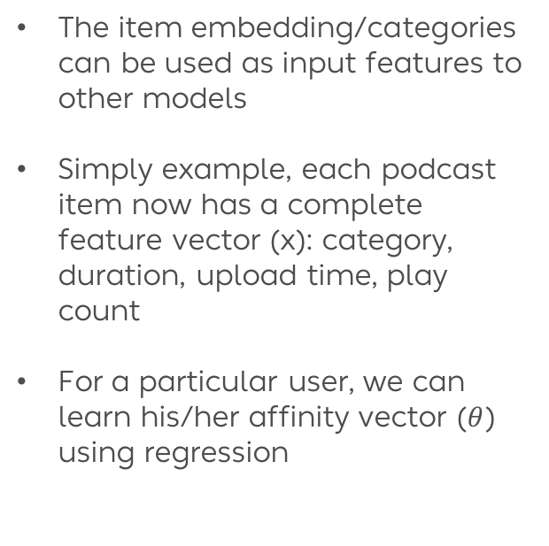

Use embedding as input feature to other models
The item embedding/categories can be used as input features to other models
Simply example, each podcast item now has a complete feature vector (x): category, duration, upload time, play count
For a particular user, we can learn his/her affinity vector ($θ$) using regression
note: AUC is close to perfect, because user’s uploaded items are relatively easy to predict
$${user interaction=\vec{θ}}_{u}∙{\vec{x}}_{i}$$

Slide 11
Conclusions
We are still investigating on producing item-to-item similarities rather than just classifying items into categories, sub-categories, hot topics, such as using bipartite maximum weighted graph matching (“assignment problem”)
Some other unsupervised deep learning algorithm that learns vector representations for variable length pieces of texts such as sentences and documents, Paragraph Vectors, etc.

Slide 13
Backup slides

Slide 14
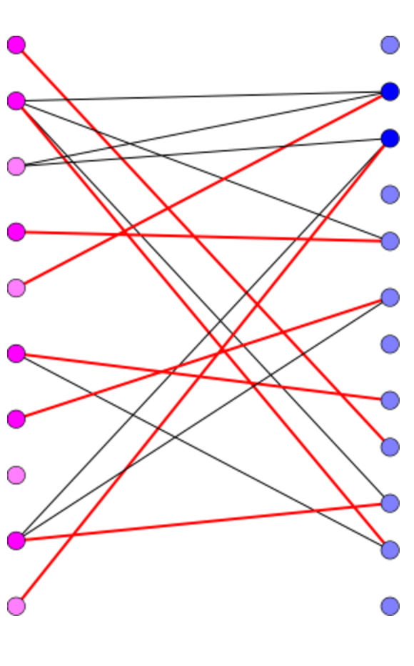
Content based recommendation
We can also recommend similar/best matched podcast items using bipartite maximum weighted graph matching algorithm (“assignment problem”)
source podcast
matched
podcast
We can find the best matched podcast items:
- 【 投资 理财 21 】 G20 、 美国 大选 、 深港 通 等 国内外 形势 对 投资 市场 的 影响 matching score: 3.46
- 中 美 情结 ： 特朗普 当选 对 中国 是 最 好 选择 吗 matching score: 3.04
….........
中 美
情结 特朗普 当选 对
中国 是
最 好 选择 吗
大选
胜利
对
中国
影响
- Election influences on domestic investment market
- Trump as president is good or bad for China
Election influences on China
- here the weights of edges are similarities of two word vectors, that belong to the two parties: “agents” and “tasks” in a typical “assignment” problem
Trump as president is good or bad for China

