Slide 1
Opportunities for Open Science with Big Data Analytics
Open Science in Big Data Workshop, Dec. 5, 2016 in conjunction with IEEE 2016 Big Data
Professor Ling Liu
School of Computer Science
Georgia Institute of Technology
lingliu@cc.gatech.edu
Acknowledgement: Slides are adapted and inspired from Prof. Carol Goble’s talk on Computational Science Reproducibility

Slide 2

Science as an Open Enterprise: Can it be reality
Science v.s. Publication
  What are their relationships?
Science:
  Confidentiality, P, National Security, Trade Secrete …
Publication:
  Paid Access v.s. Open Access
Value of Citation for Science
Value of Citation for Publication
replicate
repeat
rerun
re-compute
recreate
revise
redo
regenerate
re-examine
restore
reconstruct
review
recycle
reuse
repurpose
http://royalsociety.org/policy/projects/science-public-enterprise/report/

Slide 3
repeat
replicate
same experiment
same lab
same experiment
different lab
Open
Science
same experiment
different set up
different experiment
some of same
reproduce
reuse
Adapted from Drummond C Replicability is not Reproducibility: Nor is it Good Science, online
Peng RD, Reproducible Research in Computational Science Science 2 Dec 2011: 1226-1227.

Slide 4
Cases of negative incentives
Negative to authors of scientific publications if repeatability, replicability, reproducibility, and reusability (…) are not provided or supported
Negative in terms of what should be “open science”
Negative to the growing problematic papers in literature

Slide 5

Negative Incentive: Case 1
datasets
data collections
algorithms
configurations
tools and apps
codes
workflows
scripts
code libraries
services,
system software
infrastructure,
compilers
hardware
“An article about computational science in a scientific publication is not the scholarship itself, it is merely advertising of the scholarship. The actual scholarship is the complete software development environment, [the complete data] and the complete set of instructions which generated the figures.”
David Donoho, “Wavelab and Reproducible Research,” 1995
Morin et al Shining Light into Black Boxes
Science 13 April 2012: 336(6078) 159-160
Ince et al The case for open computer programs, Nature 482, 2012

Slide 6
hope over experience
Negative Incentive: Case 2
“an experiment is reproducible until another laboratory tries to repeat it.”
Alexander Kohn
even computational ones

Slide 7
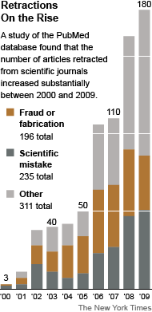
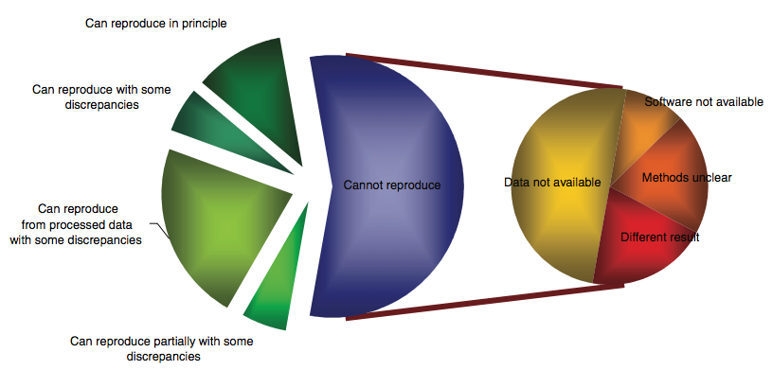
Negative Incentive: Case 3
replication gap
Out of 18 microarray papers, results
from 10 could not be reproduced
More retractions:
>15X increase in last decade
At current % > by 2045 as many papers published as retracted
Ioannidis et al., 2009. Repeatability of published microarray gene expression analyses. Nature Genetics 41: 14
Science publishing: The trouble with retractions http://www.nature.com/news/2011/111005/full/478026a.html
Bjorn Brembs: Open Access and the looming crisis in science https://theconversation.com/open-access-and-the-looming-crisis-in-science-14950

Slide 8
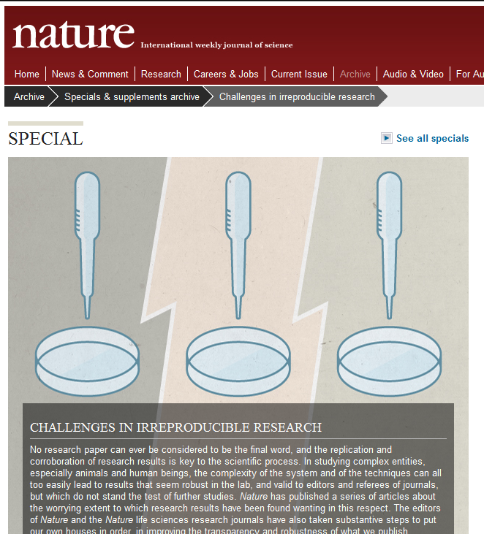
hand-wringing, weeping, wailing, gnashing of teeth.
Nature checklist.
Science requirements for data and code availability.
attacks on authors, editors, reviewers, publishers, funders, and just about everyone.
http://www.nature.com/nature/focus/reproducibility/index.html

Slide 9

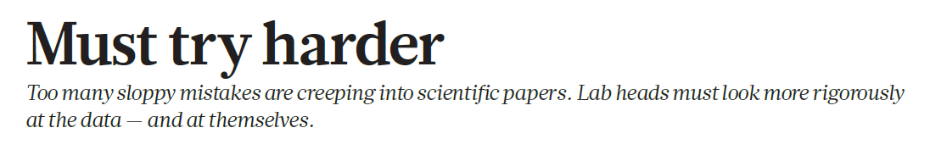
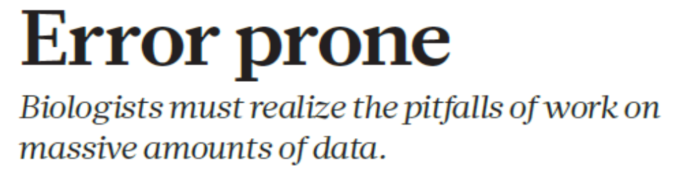
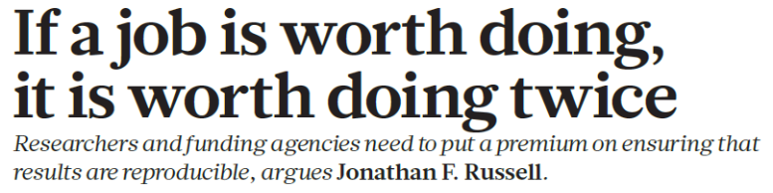
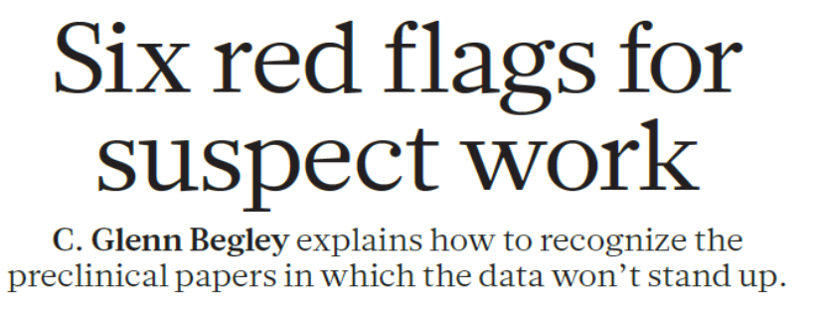
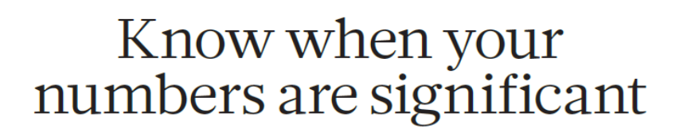
47/53 “landmark” publications could not be replicated
[Begley, Ellis Nature, 483, 2012]
Ioannidis JPA (2005) Why Most Published Research Findings Are False. PLoS Med 2(8): e124. doi:10.1371/journal.pmed.0020124
http://www.reuters.com/article/2012/03/28/us-science-cancer-idUSBRE82R12P20120328

Slide 10
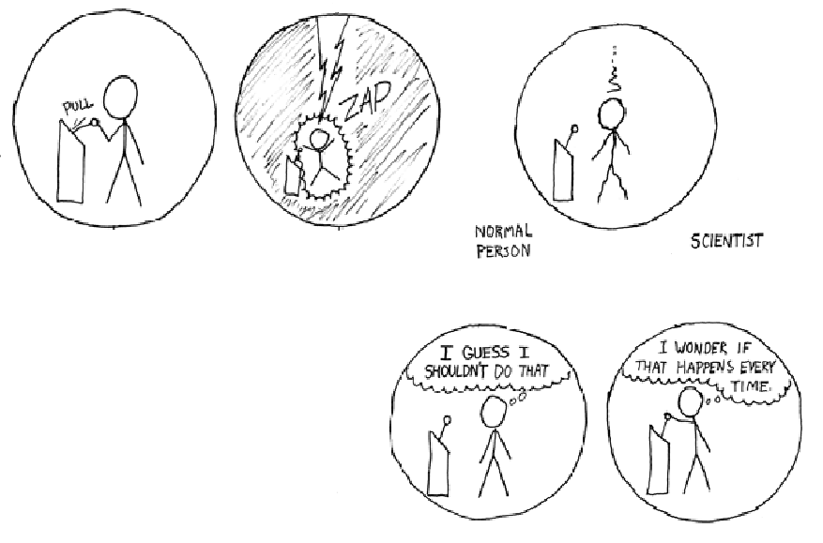
reproducibility a principle of the scientific method separates scientists from other normal people
http://xkcd.com/242/
Notes:
I

Slide 11

Use, reuse, replication, reproduction with provenance and linkage tracing
what is the point:
“no one will want it”
“blue collar science”
John Quackenbush
repeat
replicate
same experiment
same lab
same experiment
different lab
Open
Science
same experiment
different set up
different experiment
some of same
reproduce
reuse
“the questions don’t change but the answers do” Dan Reed

Slide 12

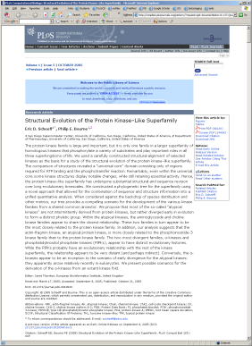
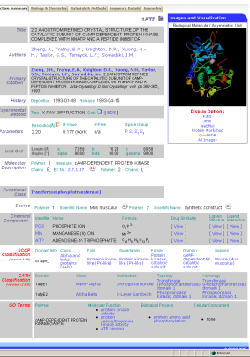
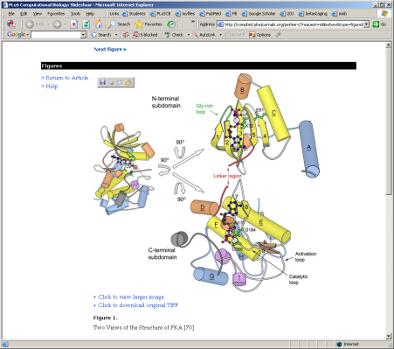
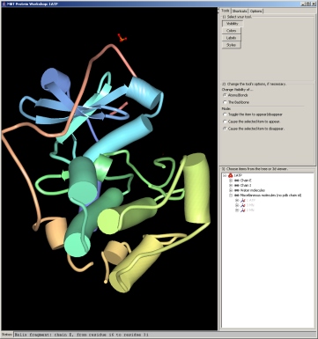
What can Big Data Analytics help?
Here is What I Want – The Paper As Experiment
0. Full text of PLoS papers stored
in a database
4. The composite view has
links to pertinent blocks
of literature text and back to the PDB
User clicks on thumbnail
Metadata and a webservices call provide a renderable image that can be annotated
Selecting a features provides a database/literature mashup
That leads to new papers
4.
1.
1. A link brings up figures
from the paper
3. A composite view of
journal and database
content results
3.
2.
2. Clicking the paper figure retrieves
data from the PDB which is
analyzed
[Phil Bourne]
PLoS Comp. Biol. 2005 1(3) e34

Slide 13

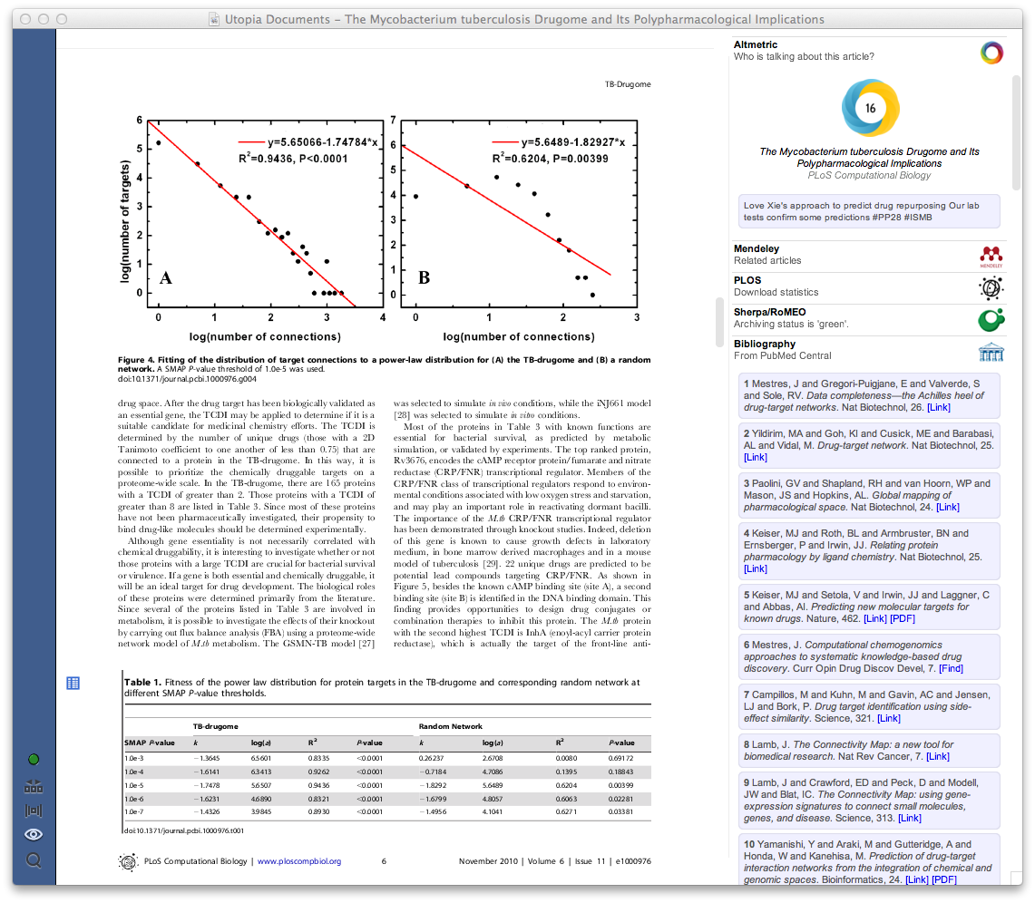
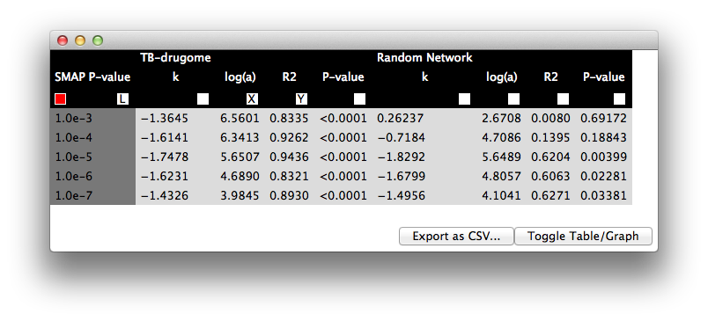
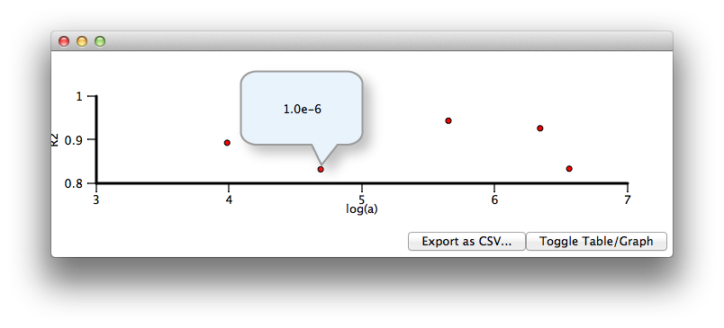
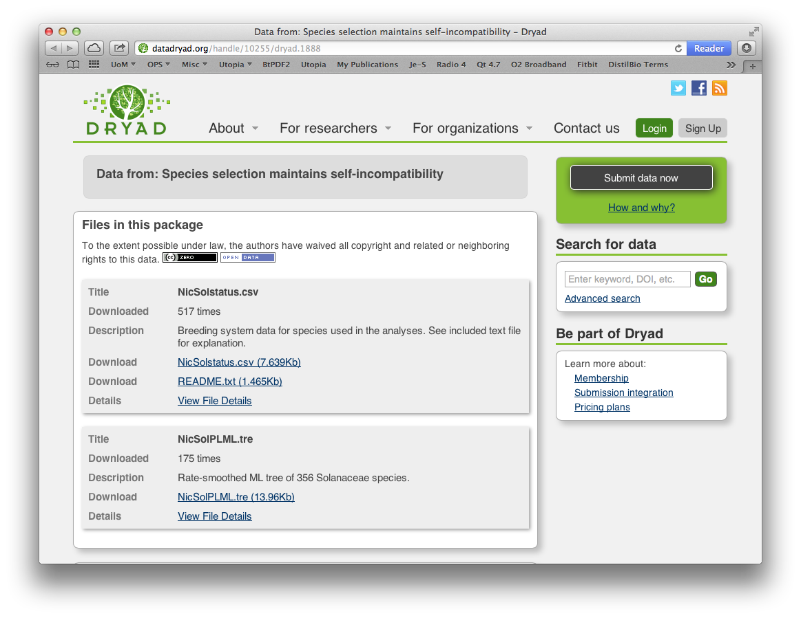
made reproducible
http://getutopia.com
[Pettifer, Attwood]

Slide 14
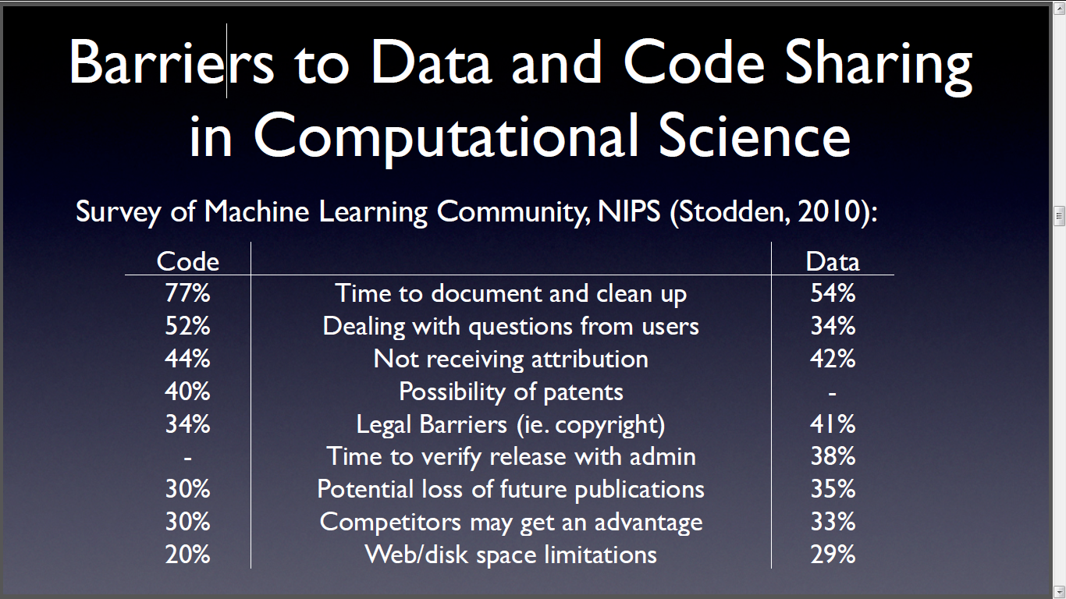
Victoria Stodden, AMP 2011 http://www.stodden.net/AMP2011/,
Workshop: Reproducible Research: Tools and Strategies for Scientific Computing
Special Issue Reproducible Research Computing in Science and Engineering July/August 2012, 14(4)

Slide 15
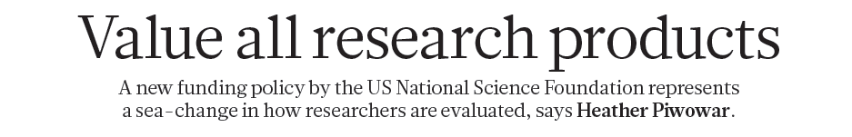
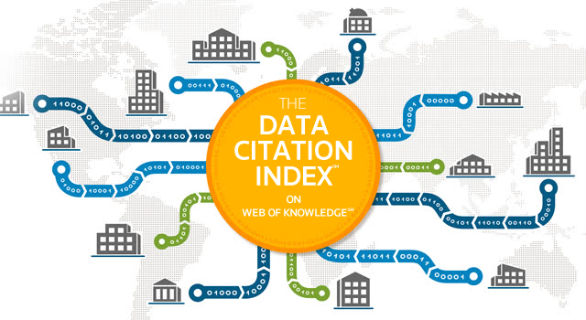



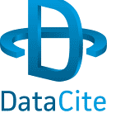
recognition
1 0 JA N UA RY 2 0 1 3 | VO L 4 9 3 | N AT U R E | 1 5 9
“all research products and all scholarly labour are equally valued except by promotion and review committees”

