Slide 1
3rd Open Science in Big Data Workshop
IEEE BigData 2018 Seattle, WA

Slide 2
What is Open Science?
“Open Science is the movement to make all scientific data, methods, and materials accessible to all levels of society”

Slide 3
What is Open Science?
Open Data
Open Source
Open Methods
Open Review
Open Access
Open Education

Slide 4
Big Data complicates Open Science
Open Data
Open Source
Open Methods
Open Review
Open Access
Open Education
Storing & sharing data
Many libraries & deps
Architectural problems
Size of projects
Complexity beyond 1 paper
Resources at students’ disposal
OSBD Workshop

Slide 5
Thanks
OSBD 2018

Slide 6
Program Committee
Suren Byna (Lawrence Berkeley National Lab)
Michael Cotterell (University of Georgia)
Alexander Herzog (Clemson University)
Krzysztof Kochut (University of Georgia)
Jaewoo Lee (University of Georgia)
Hanchuan Peng (Allen Institute)

Slide 7
Co-chairs
Shannon Quinn ( squinn@cs.uga.edu )
Nicole Lazar ( nlazar@stat.uga.edu )
Kyle Johnsen ( kjohnsen@uga.edu )
John Miller ( jam@cs.uga.edu )
Suchi Bhandarkar (suchi@cs.uga.edu )

Slide 8
Program
OSBD 2018

Slide 9
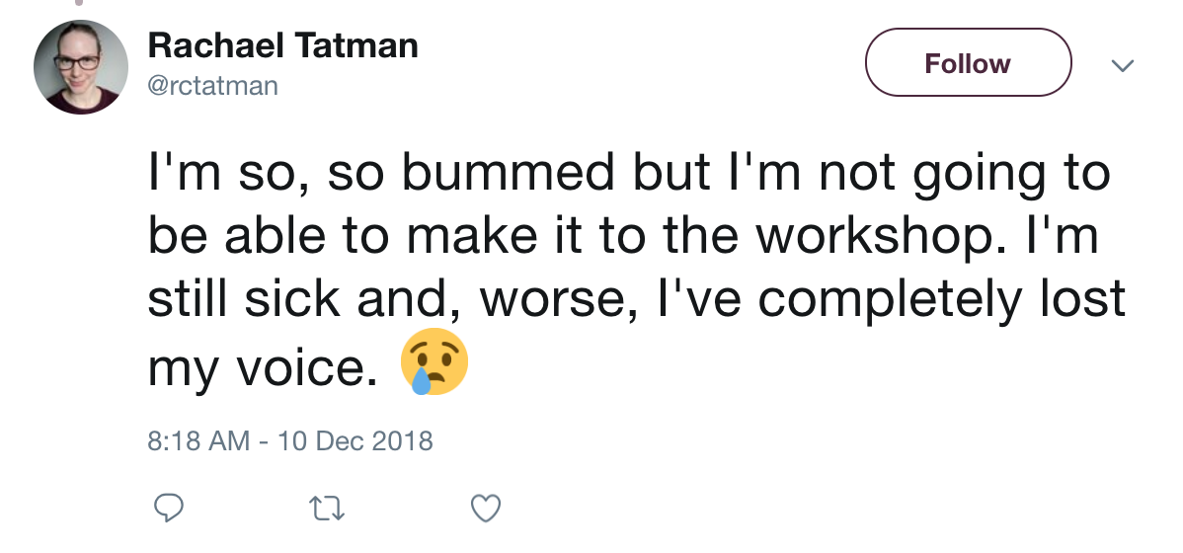
Invited keynote speakers
Prof. Su-In Lee (University of Washington) “Interpretable Machine Learning in Precision Medicine”
Katherine Scott (3Scan) “Automatic Segmentation and Quantification of TB Scale Volumetric Murine Brain Vasculature Data”
Dr. Rachael Tatman (Kaggle) “Setting Up Your Public Data for Success”
Get well soon!

Slide 10
Submitted talks
Ready to go before coffee break?
Sandro Fiore, Donatello Elia, Cosimo Palazzo, Alessandro D'Anca, Fabrizio Antonio, Dean Williams, Ian Foster, and Giovanni Aloisio Towards an Open (Data) Science Analytics-Hub for Reproducible Multi-Model Climate Analysis at Scale
Paulo Alencar, Donald Cowan, and Doug Mulholland The iEnvironment Platform: Developing an Open Science Software Platform for Integrated Environmental Monitoring and Modeling of Surface Water
Judith Cushing, Denise Lach, Chad Zanocco, and Jonathan Halama Scientific Visualization and Reproducibility for "Open" Environmental Science
Venkata Vemuri, Hunter Jackson, and Katherine Scott Automatic Segmentation and Quantification of TB Scale Volumetric Murine Brain Vasculature Data
Mojtaba Sedigh Fazli, Stephen A. Vella, Silvia N.J. Moreno, Gary E. Ward, and Shannon Quinn Toward Simple & Scalable 3D Cell Tracking
Yanjun Pu, Wenjun Wu, and Yong Han Parallelizing Bayesian Knowledge Tracing Tool For Large-scale Online Learning Analytics
Joshua Gardner, Miguel Andres-Bray, Christopher Brooks, and Ryan Baker MORF: A Framework for Predictive Modeling and Replication At Scale With Privacy-Restricted MOOC Data
Tal Shachaf, Alex Sim, Kesheng Wu, and Wilko Kroeger Detecting Anomalies in the LCLS Workflow

Slide 11
Final Remarks
OSBD 2018

Slide 12
In the spirit of Open Science…
Proceedings, slides, notebooks, and any other presentation materials will be archived under an MIT license on the OSBD GitHub repository: https://github.com/osbd/osbd-2018
Please send me your presentation materials after the workshop!
Wifi password is IEEE2018
Feedback is welcome! Contact the co-chairs directly.

Slide 13
Welcome!
OSBD 2018

