Slide 1
Introduction to Genertic Algorithm
Implus Tech
Osbert

Slide 2
Previously on Implus Tech Song…
Machine Learning by Yoga
Linear Regression
Partial Derivative
Gradient Descent

Slide 3

What is Genetic Algorithm?
The genetic algorithm is a method for solving both constrained and unconstrained optimization problems that is based on natural selection, the process that drives biological evolution.

Slide 4

What is Genetic Algorithm?
Genetic Algorithm is an algorithm that you want to know a good but not necessary the best result of a problem but are having zero idea how to get that – or maybe just you don’t want to admit you suck at algorithms so you pretend to be too lazy to implement one, so you give that elixir a try.

Slide 5
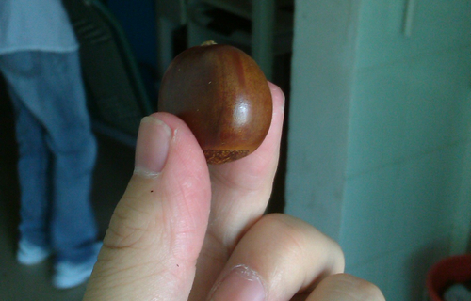
For Example(s)

Slide 6

Example 1: Divide the Loot
Robbers of m try to divide their loot of bank notes of n. They agree that each of them can get Q₁，Q₂，…Q_{m} bank notes respectively. But because the face value of the bank notes are different, they also want the average face value of the bank notes that fall into each robber’s pocket to be as close as possible. How to find a fair allocation solution?
What if we know there are only k different face values?

Slide 7
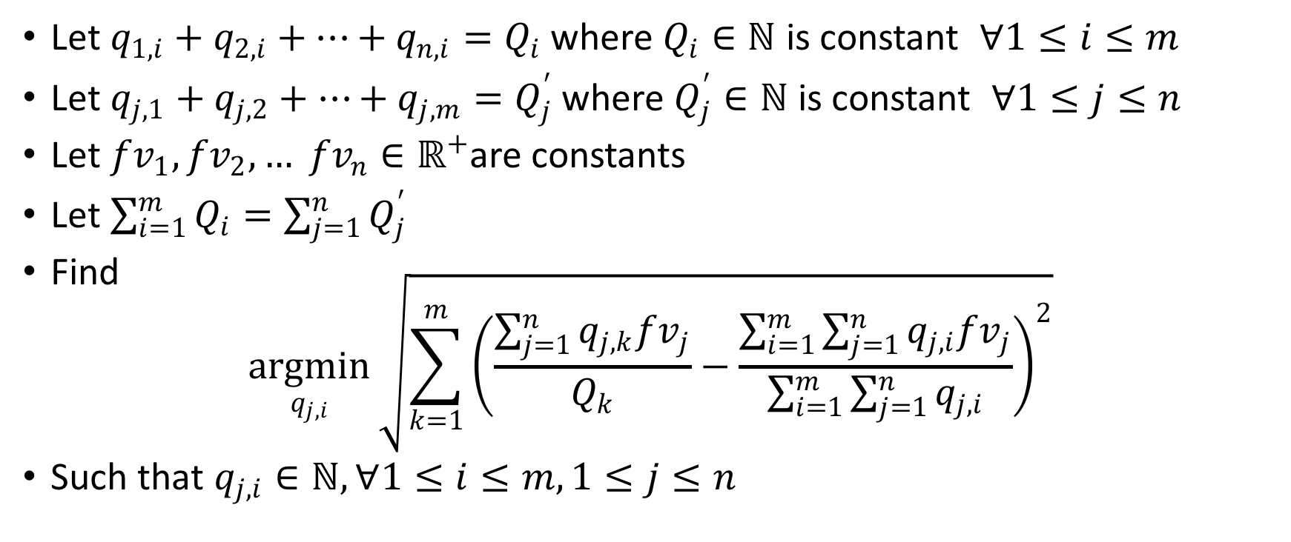
Everyone Loves Mathematical Representation!
Let $q_{1,i}+q_{2,i}+⋯+q_{n,i}=Q_{i}$ where $Q_{i}∈ℕ$ is constant $∀1≤i≤m$
Let $q_{j,1}+q_{j,2}+⋯+q_{j,m}=Q_{j}^{′}$ where $Q_{j}^{′}∈ℕ$ is constant $∀1≤j≤n$
Let ${fv}_{1},{fv}_{2},… {fv}_{n}∈ℝ^{+}$are constants
Let $\sum_{i=1}^{m}{Q_{i}}=\sum_{j=1}^{n}{Q_{j}^{′}}$
Find $\underset{q_{j,i}}{argmin}{\sqrt{\sum_{k=1}^{m}{{\left(\frac{\sum_{j=1}^{n}{q_{j,k}{fv}_{j}}}{Q_{k}}−\frac{\sum_{i=1}^{m}{\sum_{j=1}^{n}{q_{j,i}{fv}_{j}}}}{\sum_{i=1}^{m}{\sum_{j=1}^{n}{q_{j,i}}}}\right)}^{2}}}}$
Such that $q_{j,i}∈ℕ,∀1≤i≤m,1≤j≤n$

Slide 8
For the Sake of Time…
This is Linear Regression without the restriction of integer (i.e. life will be so much easier for the robbers if the face value of a broken bank note is proportional to its area)
Unfortunately with the restriction of integer, this problem is at least Integer Programming level, which is NP-hard
There might be tricks to play around, especially with the k face values, but I am too lazy to think about it (wink wink)

Slide 9

Introduction to Genetic Algorithm (For Real)
Mutate
Select
Eval and Sort

Slide 10
Introduction to Genetic Algorithm (For Real)
maxCandidateCount
Simulated Annealing ⬅
Mutation Intensity
Mutant Per Candidate
Mutate
Select
Mutation Strategy
maxGenerationCount
Eval and Sort
Fitness Function

Slide 11

Example 2: Compose Like Basch
Ad =>

Slide 12
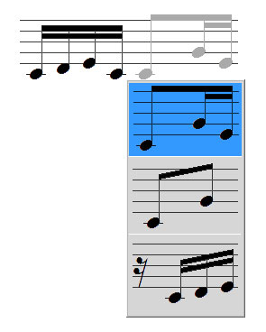
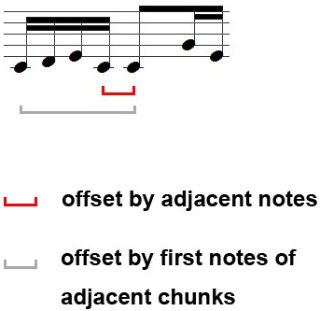
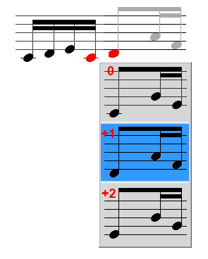
Encode Music with Chunk and Linkage
Chunk
(four 16th notes)
Linkage
Type
Offset
64 most common chunks from Bach’s fugues
offset can be
–2, –1, 0, +1, +2

Slide 13
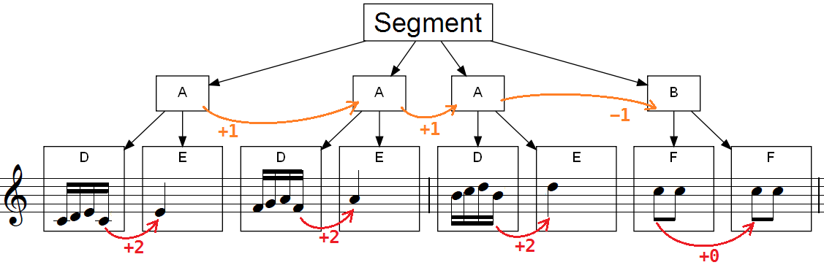



Encode Music with Chunk and Linkage
D:
E:
F:
D = ( (k (1 1)) (k (1 1)) (k (1 -2)) (k) )
E = ( (k) (r) (r) (r) )
F = ( (k (1 0)) (r) (k) (r) )

Slide 14
Encode Music with Chunk and Linkage
D:
E:
F:
A = D + E
= (G+ (Gml D +2) E )
B = F * 2
= (G* (Gmf F +0) 2 )

Slide 15
Encode Music with Chunk and Linkage
D:
E:
F:
Segment = A * 3 + B
= (G+ (Gml
(Gdx (G* (Gml A +1) 3) )
–1)
B )

Slide 16


Why Genetic Algorithm?
Search space too large
3.7 ×10¹⁴ possibilities for each segment
Rules too complicated
Does not require optimal solution
Time insensitive: offline application

Slide 17
Look Familiar?
Requirements
Solution
1
Generator
Y
100
Criteria Reached?
Candidates
N
1
Mutator
10
Select Best
Evaluator
Mutants
Scoreboard
Sort

Slide 18
Thank You!
Q & A

