Slide 1
Automated Fugue Generation
Yu Yue Yue Yang
supervised by
Prof Andrew Horner

Slide 2
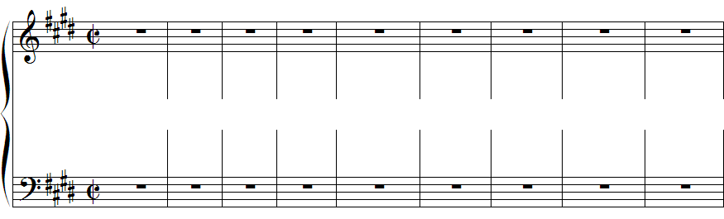
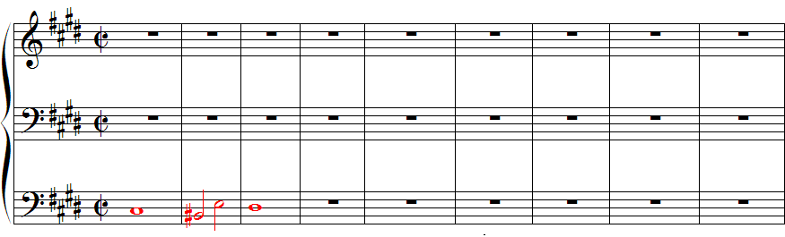
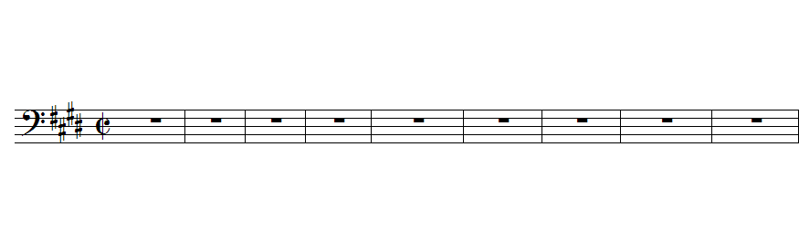
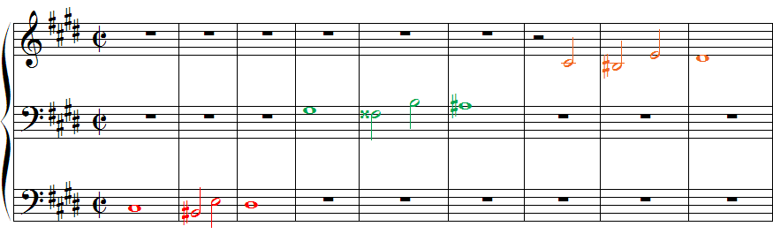
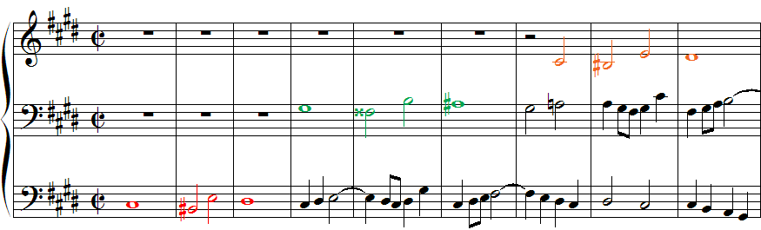

What is a Fugue?
A fugue is a musical composition of multiple voices
built on a subject (recurring theme)
that imitates itself frequently throughout the piece.
Fugue No.4 in C♯ minor, WTC Book I, J. S. Bach, BWV 849
Automated Fugue Generation
Fugue
Yu Yue Yue Yang
supervised by
Prof Andrew Horner
of multiple voices
Notes:
Before we introduce our objective,

Slide 3
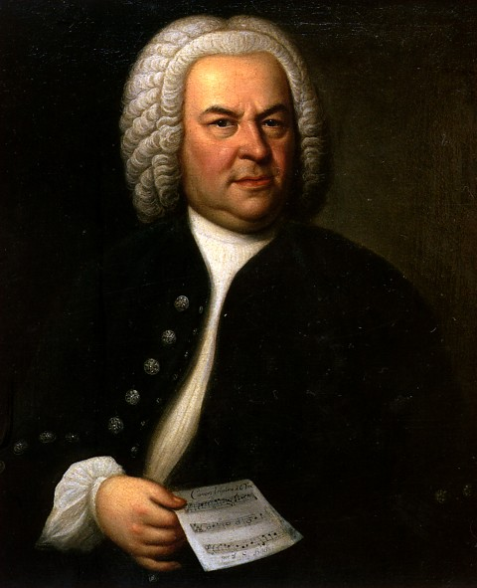

Objective
Design and build a system that generates three-voice fugues
Emulate the musical style of J. S. Bach, the famous Baroque composer

Slide 4

Outline
Design
Fugue Structure
Compositional Procedure
Segment Tree Structure
Bundle Optimization: Genetic Algorithm
Implementation
Results & Evaluation
Conclusion & Future Work

Slide 5
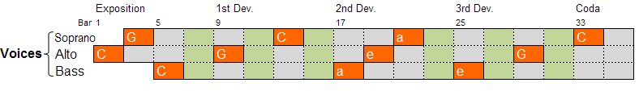
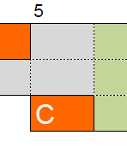
Design::Fugue Structure
Segment: a single-voice melody excerpt of fixed length (2 bars)
Bundle: a multi-voice excerpt of fixed length
Notes:
3 x n table, where each cell is a segment

Slide 6
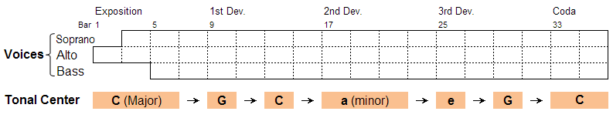
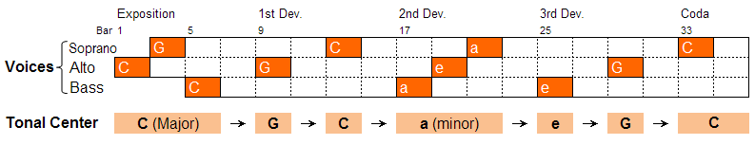
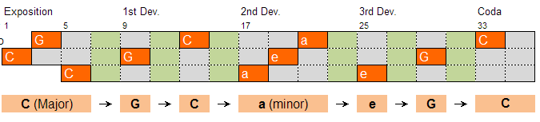
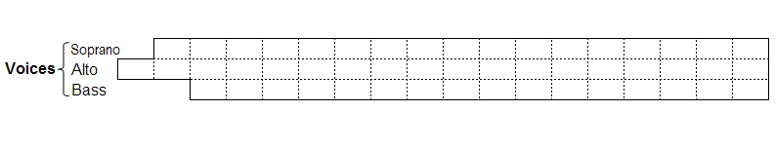
Design::Compositional Procedure
Get subject entry positions (voice, bar, key) from tonal center progression
Generate a subject using GA and replicate it at every subject entry position
Starting from 2nd bundle, incrementally determine each bundle using GA given its previous bundle
Notes:
3 x n table, where each cell is a segment

Slide 7
Design::Bundle Optimization Genetic Algorithm
Requirements
Solution
1
Generator
Y
100
Criteria Reached?
Candidates
N
1
Mutator
10
Select Best
Evaluator
Mutants
Scoreboard
Sort

Slide 8




Design::Bundle Optimization
Requirements
Fix the segment that contains subject entry
Generator
Produce 100 bundles
Each bundle: fix structure
Variable chunks & linkages
Soprano
Alto
Bass
A A A B
D E
F F
D:
E:
F:

Slide 9
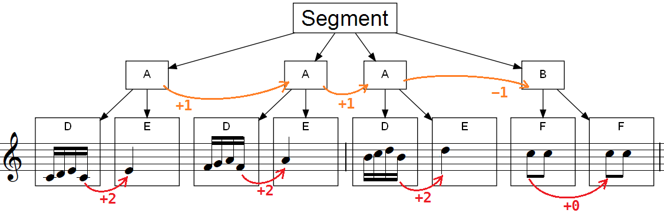
Design::GA::Segment Generation
Structure [Segment = AAAB, A = D + E, B = F + F]
Chunks [
], Linkages: +1, –1, +2, +0
D:
E:
F:

Slide 10
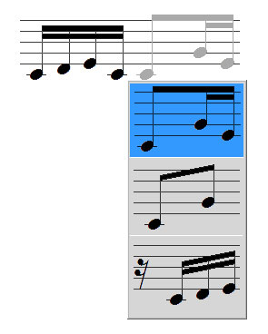
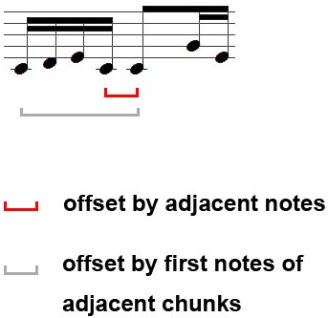
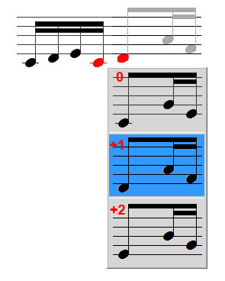
Design::GA::Segment Mutation
Chunk
(four 16th notes)
Linkage
Type
Offset
64 most common chunks from Bach’s fugues
offset can be
–2, –1, 0, +1, +2

Slide 11
Design::Tree Structure of Segment
Characteristics of Bach’s fugues
Chunk frequency conforms Zipf’s Law
Frequent repetition of chunks
Dominance of stepwise motion
Narrow down Search space
Search space of tree structure segment repr. 64 ³ × (2 × 5) ⁶ × 14 ¹ × 100 = 3.7 ×10¹⁴ chunk linkage starting pitch structure
Search space of naïve pitch sequence repr. 16 ³² = 3.4 ×10³⁸ pitch

Slide 12
Design::GA::Segment Evaluation
Intra-Voice
Range
Linkage between segments
Fitness to Chord
Inter-Voice
Voice Crossing & Voice Overlap
Rhythm & Chord unity (Counterpoint)

Slide 13
Design::Why GA?
Search space too large
3.7 ×10¹⁴ possibilities for each segment
Rules too complicated
Does not require optimal solution
Time insensitive: offline application

Slide 14
Implementation
Software
Analysis & Playback: Humdrum Toolkit
Generation: MIT-scheme
Platform: GNU/Linux

Slide 15
Implementation
Humdrum Toolkit
Used with humdrum format, a general-purpose text-based music score format
Excellent in music analysis
Used for collecting statistics from J.S. Bach’s works

Slide 16
Implementation
MIT-scheme
Scheme: ultimate solution to general sequence processing, especially language
MIT-scheme: scheme with enhanced functionalities

Slide 17
Implementation
Scheme representation
Relational representation aiming at minimize number of variables (for genetic algorithm)

Slide 18
Implementation
D:
E:
F:
D = ( (k (1 1)) (k (1 1)) (k (1 -2)) (k) )
E = ( (k) (r) (r) (r) )
F = ( (k (1 0)) (r) (k) (r) )

Slide 19
Implementation
D:
E:
F:
A = D + E
= (G+ (Gml D +2) E )
B = F * 2
= (G* (Gmf F +0) 2 )

Slide 20
Implementation
D:
E:
F:
Segment = A * 3 + B
= (G+ (Gml
(Gdx (G* (Gml A +1) 3) )
–1)
B )

Slide 21
Implementation
Dynamic Evaluators
Evaluators are prioritized; the higher level evaluators (e.g. fitness to Chord) get lower weight if the lower level evaluators (e.g. note range) do not reach a threshold
Evaluators behave differently in different phases of GA, e.g. heavier weight on range at the beginning, etc..

Slide 22

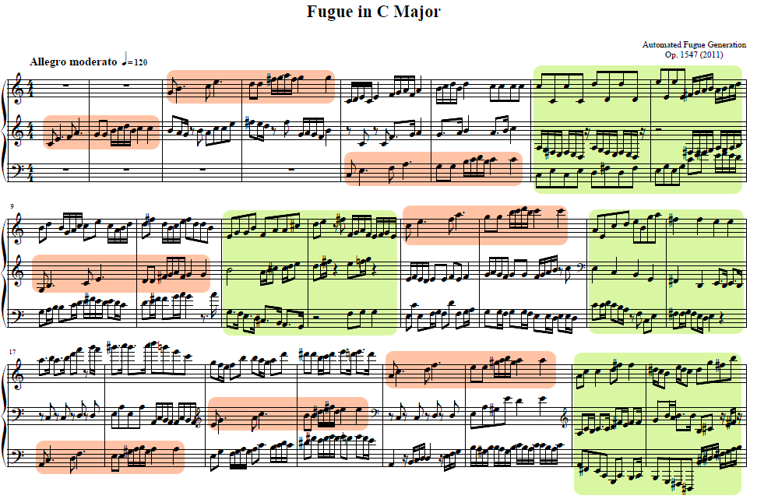
Result
Sample result of our program

Slide 23

Evaluation
Comparison with similar works
Eric Milkie, Joel Chestnutt : Fugue Generation with Genetic Algorithms (from Cornell) [1]
Prof David Cope: Well-Programmed Clavier [2]
Musically, significantly better than [1] but pale compared to [2]

Slide 24
Evaluation
Efficiency
Meter: 4/4
Shortest note: sixteenth note
Number of bars: 40
Estimated Time to compose one fugue: 1 hour on one 2.4GHz CPU

Slide 25
Evaluation
Aesthetic Quality
Make musical sense in general, occasionally with unnatural transitions
The introduction of musical concepts, such as repetition, imitation, tonal center and chord progression plot a vivid story line, compared to Cornell’s approach
Several assumptions are too rigid for the program to generate better solutions, such as two beats per chord, forced repetition pattern, etc.

Slide 26
Conclusion
Contribution
Build a system that can generate polyphonic music similar to fugues and inventions
Limitations
The results sound more “Pop-ish” than authentic Baroque fugues due to emphasis on chord
The forced repetition pattern design insulates local optima in the fitness landscape, making it difficult to reach better solutions

Slide 27
Future Work
Smoothing the Fitness Landscape
Extensive search + Pruning
1 3 r
Two different consonants in C Major, good choice
Good
1 3 4
3,4 clash dissonantly, sounds bad
Bad /
Potentially Good
1 3 5
All consonants are presented, ultimate choice.
Excellent!

Slide 28
Q & A
Thank you!

