Slide 1
PROGRAMMING LINGUISTIC RELATIVITY
Osbert@ImplusTech

Slide 2
In Case You Wonder…

Slide 3
It is called TAKAHASHI METHOD 高桥流简报法

Slide 4
What is PROGRAMMING LINGUISTIC RELATIVITY?

Slide 5
What is PROGRAMMING LINGUISTIC RELATIVITY?

Slide 6
What is LINGUISTIC RELATIVITY / DETERMINISM?

Slide 7
The Language You Speak Influences / Determines How You Think

Slide 8
LINGUISTIC DETERMINISM IS ☠

Slide 9
LINGUISTIC RELATIVITY IS EVERYWHERE

Slide 10

E.G.
e.g.

Slide 11
What are the names of the colors?

Slide 12

Chinese Speaker:
蓝色
蓝色

Slide 13
MY WIFE CALLS IT TIFFANY BLUE (But that’s irrelevant…)

Slide 14
English Speaker:
Blue
Blue
Turquoise?

Slide 15
Russian Speaker:
Голубой
синий
бирюзовый

Slide 16
CONSEQUENCE: RUSSIAN SPEAKERS HAVE BETTER ABILITY ON COLOR DISCRIMINATION

Slide 17
TL;DR LANGUAGE YOU USE LIMITS HOW YOU CAN THINK AND WHAT YOU CAN DO

Slide 18
Not necessarily A BAD THING

Slide 19
A Tribe whose language do not have the concept of LEFT or RIGHT

Slide 20
“Hey! An ant is walking on your LEFT leg!”

Slide 21
“Hey! An ant is walking on your leg that points to NorthEast !”

Slide 22
CONSEQUENCE: They have superpower of knowing directions anytime – even if they close their eyes

Slide 23
In Pure (Functional) Programming, you can only compute, you cannot mutate

Slide 24

HOW DOES THIS EVEN WORKS?!

Slide 25
You Don’t Write Iteration; You Write Recursion, and Compiler Translate that to Iteration

Slide 26
Actually Compiler Has Much More Freedom to Optimize for Pure Functional Programming

Slide 27
Tail Call Optimization Lazy Evaluation Immutability

Slide 28
IMMUTABILITY?!

Slide 29
Born Thread-Safe “Clone” by Sharing Pointer Good for HashTable Keys Easy for Equality Check

Slide 30
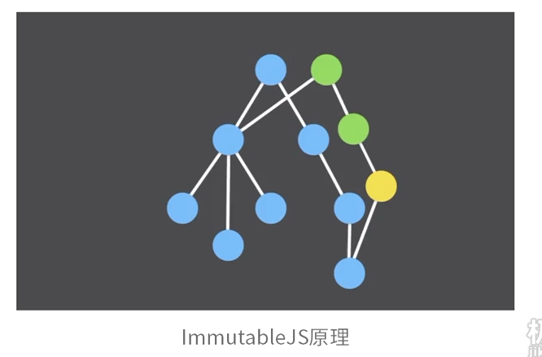

Slide 31
Not necessarily A BAD THING; But it is IMPORTANT TO KNOW ITS LIMITATION

Slide 32
BASIC don’t have For-Loop: HOW TO CODE?

Slide 33
USE GOTO

Slide 34
If a man is holding a hammer, everything looks like a nail

Slide 35
You will fail to appreciate tools in other PLs

Slide 36
E.G.
Another e.g.

Slide 37
What does it mean by ASYNC in JavaScript and GoLang?

