Slide 1
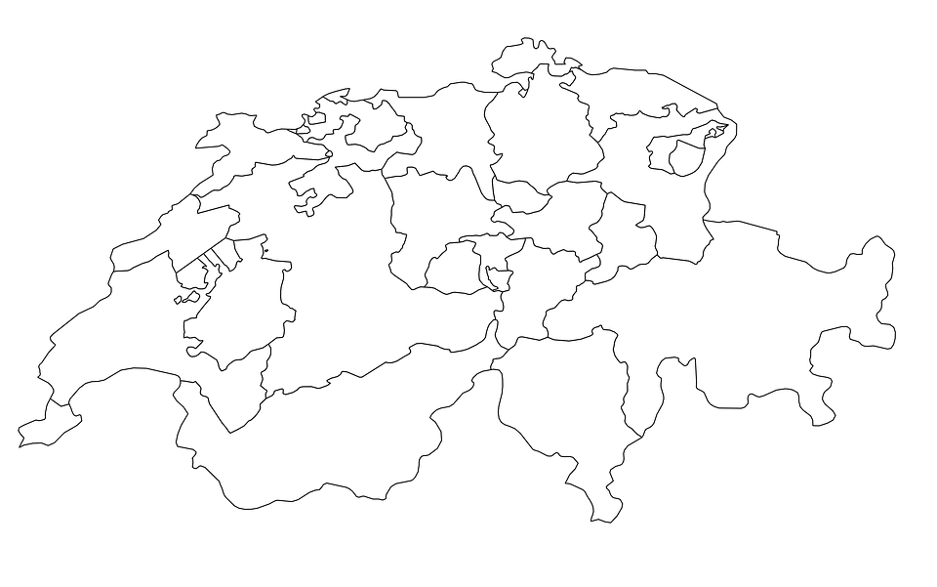

Frauenfeld
Härkingen
Route B
151km
~1.5h
Route A
163km
~1.75h
Daillens
Chur
Churwalden
Total
314km
~3.25h
Parcel Center
Sending Address
Receiving Address
Notes:
Today, the Swiss Post has three parcel centers in Switzerland. Hence, if a parcel is being sent for example from Churwalden to Chur, it will be transported first all the way to Frauenfeld, before coming back to Chur. The parcel will travel more than 300km even though, the distance between sending and delivery address is only about 10. This is not just inefficient and costly, but also ecologically not sustainable. By smartly applying technology, we have developed a solution to eliminate these drawbacks.

Slide 2
So we created padely. Padely allows us to deliver packages within 30km of the origin address substantially faster and cheaper than today!
Padely utilizes a network of people and companies to deliver packages. Trust is established with the delivery parties through Blockchain technologies, specifically by using staking on the Ethereum network, an immutable record history and a thorough KYC onboarding process.
So let’s look at our initial example again.

Slide 3

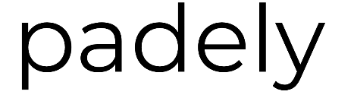
Customer needs
Carrier / Post issues
Flexibility of carriers to deliver at specific times and to specific places
ASAP delivery of goods
Parcel tracking and real-time status updates
Re-route parcels when temporarily or at short-notice not at home
Receive packages outside of standard business hours
Reduce number of cars / trucks in cities
Eco-friendly
High costs and legal requirement to deliver to all locations within Switzerland
Increasing parcel volumes: current infrastructure can only handle demands until 2020
Additional resources (up to 30%) are required during peak-times
All parcels move through the packaging and delivery centres across the country even if it needs to be delivered back to the same city
Each and every parcel is forced through the same process disregarding customer needs
Value Proposition
We deliver packages within 30 km on the same day at no additional costs through our padelee network
Increasing customer satisfaction is our priority (speed, usability, flexibility)
Traditional carriers save ~37% of costs and profits will increase by 10% (see Business Case in Readme)
We earn your TRUST by applying state-of-the art technologies and smart functionalities
Notes:
Let us introduce ‘padely’ – The Parcel Delivery Service that is here to revolutionize the industry! All checked-in packages at the post office will be scanned and if it needs to be delivered within a radius of 30 km, it will automatically be put on a marketplace for a defined price.
All registered ‘padelees’ – the drivers and riders that have been accepted to the network - can pick-up these parcels and deliver them to the recipients on the same day! This will save the traditional carriers on average 37% of costs per parcel and will increase profits for Post of about CHF 14m per year as of 2020. So let’s look, how ‘padely’ would change the delivery of the parcel from Churwalden to Chur.

Slide 4
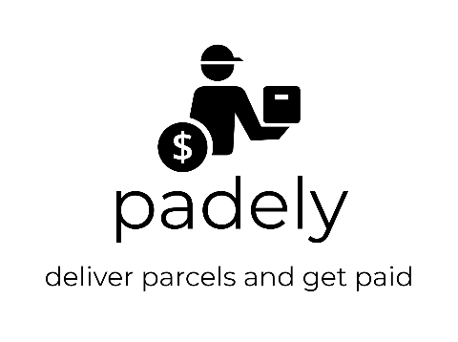

Frauenfeld
Frauenfeld
Frauenfeld
Frauenfeld
Härkingen
Total (as-is)
314km
~3.25h
- 303km
- 3h
Total (to-be)
11km
~15mins
Daillens
Chur
Churwalden
Parcel Center
Sending Address
Receiving Address
Notes:
The’padelee’ will pick-up the parcel or multiple parcels from the post office and will directly deliver them to the recipients without going to Frauenfeld first – saving more than 300km and 3hrs.

Slide 5
Using our ’padely’ network, someone will pick-up the parcel from the post office in Churwalden and take it directly to Chur without going to Frauenfeld first – saving more than 300km in travel.

Slide 6
DEMO
Home / Registration
Validation of ‘padelees’ (KYC process)
User gets notified of KYC completion
User to put stake into the network
Padelee search for parcels
Select the parcel
Parcel pick-up (QR Code)
In-transit (Show route)
Recipient signs for acceptance
Explorer?
Summary

Slide 7
1. Registration
When accessing the ‘padely’ website, the user is prompted to log-in or can click the ‘register’ button if not signed-up yet.
Upon completing the necessary fields, the user is asked to upload a document for verification, a recent utility bill or bank statement is sufficient, but for additional credibility a record of debt collection can also be uploaded

Slide 8
2. Validation of ‘padelees’ (KYC process)
The ‘Admin’ has an overview of all applicants that would like to become delivery persons
Upon checking the details of the open reqests and comparing it to the submitted documents, the admin validates or rejects the application

Slide 9
3. User gets notified of KYC completion
The user will receive a notification whether the “Know Your Customer” check was successful or not

Slide 10
4. User to put stake into the network
Assuming in our case, the KYC was successful, the user needs to transfer a defined amount into an ‘Escrow Account’ for security reasons.
The amount might increase or decrease based on the users rating (i.e. delivery history and feedback received by the customers). A higher rating also allows padelees to pick-up more parcels at once
This can be done by
1) entering the Ethereum public address or
2) alternatively, doing a simple account transfer via XYZ which will then be exchanged into Ether
Once the amount was received, the profile will be activated and the user can start selecting parcels for pick-up

Slide 11
5. Padelee search for parcels
The padelee enters the current location and destiny and all available parcels which are on or close to the users route, will be displayed
We intend to deploy an ML algorithm to predict the likelihood of a parcel being picked-up and to improve the parameters that define whether a parcel should be added to the ‘marketplace’

Slide 12
6. Select the parcel
The user can select the parcel(s) he or she wants to deliver and confirms to pick them up at the post office during opening hours
Thanks to a route optimisation algorithm (not yet deployed) the padelee can immediately see the impact on his journey in terms of detour time and kilometres as well as the money he / she will earn when delivering these parcels

Slide 13
7. Parcel pick-up (QR Code)
Upon reservation, a QR code will be generated and displayed in the app of the padelee
When arriving at the post office, the delivery person shows the QR code which will be scanned by the carriers/Post employee and if OK, the selected parcels will be handed-over to the padelee
At the same time, the change of ownership of the parcels is recorded on the Blockchain and the recipient will receive a notification including a link to track the live location of the package (given that the recipient has an account)
In case, the padelee does not collect the parcels during the opening hours of the post office, the packages will follow the “standard“ process to the parcel centre to ensure promised delivery times can be satisfied

Slide 14
8. In-transit (Show route)
The delivery person can start the navigation that was suggested by the route optimisation algorithm

Slide 15
9. Recipient signs for acceptance
On receipt, the customer signs on the app and triggers the change of ownership on the Blockchain from the delivery person to the recipient
This triggers the smart contract on the Blockchain to release the payment to the delivery person
The recipient receives a notification that the parcel was successfully delivered and the option to rate the padelee in terms of time, condition of the parcel and other factors
The padelee can continue on the suggested route to deliver the next parcel or if all parcels have been delivered, to the final destination

Slide 16
10. Payment / Cashout?
XX

Slide 17
11. Explorer?
XX

Slide 18
12. Summary

Slide 19
Team

Slide 20
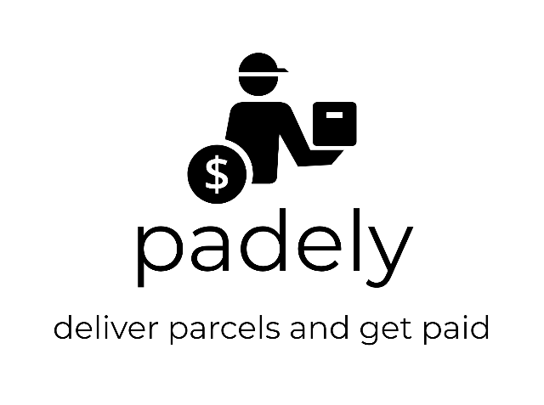
Thank you for your attention!
Sign up now!
Front-end: [LINK]
Username: [TBD] / PW: [TBD]
TBD: [LINK]
Username: [TBD] / PW: [TBD]
TBD: [LINK]
Username: [TBD] / PW: [TBD]

Slide 21

Sign up now!
CHF 200
CHF 200
Deposit
Deposit withdrawal
You
You
Escrow Account
Passive Account
Active Account
Passive Account

