Slide 1
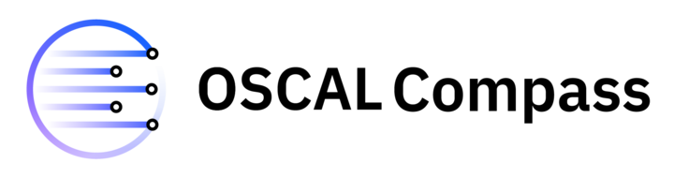
OSCAL-COMPASS Open Security Control Assessment Language Compliance Automated Standard Solution Vikas Agarwal, Lou DeGenaro, Manjiree Gadgil, Alejandro Leiva, Jenn Power, Anca Sailer, Takumi Yanagawa

Slide 2
Agenda
Compliance v/s Security
Compliance artifacts
Personas in compliance governance and lifecycle
OSCAL-COMPASS projects overview
Compliance Trestle
Compliance Agile Authoring
Compliance to Policy

Slide 3
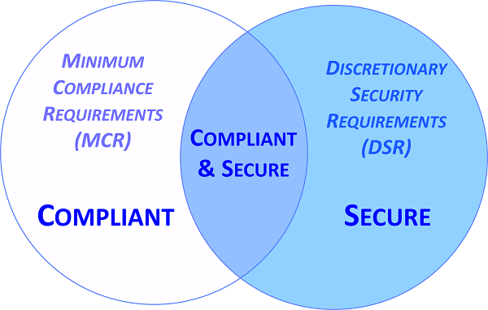
Compliance Modernization
COMPLIANCE (enforcement)
Best Practices become Mandatory Policy Requirements
Continuous compliance (enforcement) requires policy “as code” and process automation – compliance digitization
Applies at any level (infrastr., data, app, process)
Applies for any domain/app (security, finance, AI) Compliance4AI
COMPLIACE LIFE-CYCLE (all phases benefit from AI4Compliance)
Define and author controls (compliance as code)
Implement controls (tech, app specific)
Assess controls and enforce/provide results (tech, app specific; policy as code)
Audit and report
CUSTOM BESTPRACTICES
BUSINESS GUIDELINES OPERATIONAL RESILIENCY
AI BESTPRACTICES
ADHERENT
POLICY
GUARDRAILS

Slide 4
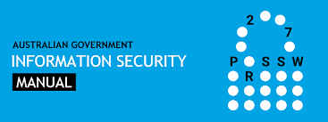

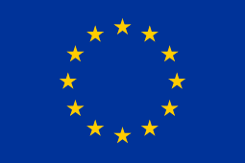
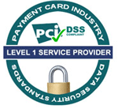

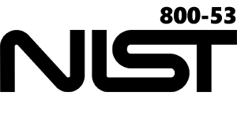
Compliance Artifacts and their Representation as code Regulatory compliance and Org Policy controls are implemented as rules (technical, operational, financial, data, or AI) and tested via rule engines or checks based on evidence
HIPAA (US)
COMP L I A NC E
Example regulatory standards and certifications:
COMP L I A NC E
A t O
P A C K AGE
Regulatory Compliance and Org Policies
ISM & E8 (AU)
EU
GDPR (EU)
PCI DSS Level 1
HIPAA
NIST 800-53
Regulation Specific: Controls
e.g., NIST 800-53 CONTROLS
SYSTEM AND COMMUNICATION PROTECTION (SC): NIST SC-7: Boundary Protection
MINIMIZE NEGATIVE IMPACT OF AI NIST AI RMF MG-2.2-005: Filter output for harmful or biased content, misinformation
GOV E RN A
NC E
NETWORK SECURITY
MODEL SERVING and MONITORING
Technology Specific:
Technical Control Implementations
w/ associated
policy RULES
procedures
Ensure Cloud Object Storage is enabled on private endpoints
Ensure Kubernetes ingress is enabled through Cloud Internet Services
Ensure VPC LBaaS is enabled through Cloud Internet Services
Ensure that model output has bias score of less than a threshold of 20%
Ensure that model output has harmful content score of less than a threshold of 10%
Ensure that model output has misinformation score of less than a threshold of 10%
R I S
K
Technology Specific:
test CHECKS scripts
If config.endpoint ≠ param return FAIL; else return PASS;
If model_out.bias <= param1 return PASS;
else return FAIL;
Technology Specific: EVIDENCE
"service_instance_id": "xxxxxxx-6c4f-4a62-a16d63903”, ”endpoint": ”private”, ”encrypt": ”KYOK”}

Slide 5


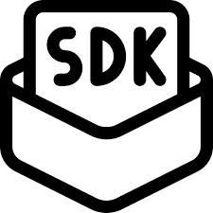
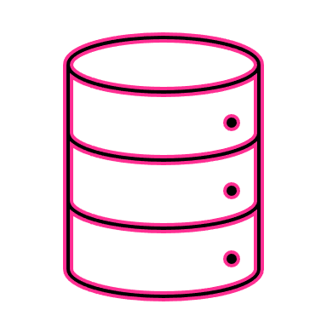
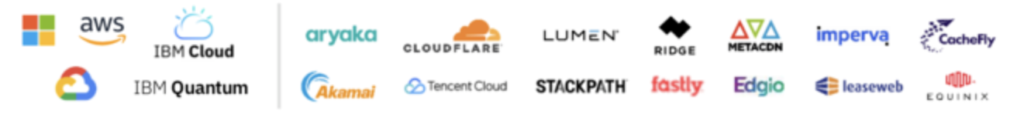
Compliance Governance, Lifecycle, Personas
A
Regulators define:
- regulations, standards, laws, catalogs
PCI, SOC2, NIST 800-53, FedRAMP, HIPAA
CIS benchmarks: IBM Cloud, OCP, Kube
- crosswalks mappings between regulations’ controls
System Owners select services & products, deploy apps, are responsible to ensure their compliance, define policy assessment plans and set compliance monitoring scans
Compliance Officers, Auditors,
System Operators examine the policy assessment results and apply remediations or deviations
E
F
Compliance Team select and tailor control profiles (aka baselines) to describe the compliance intent of their regulated organizations and environments
Governance Team
evaluate the controls performance, precision, and coverage
B
Organization Profiles,
Organization Crosswalks
Catalogs, Crosswalks
Predefined Profiles
Environment & Apps
Compliance Scope & Scans
Results
G
Compliance
Agile Authoring
Key Features
OSCAL artifact edit
GitOps workflows
Governance, Risk, Compliance (GRC) Center
Key Features
Policies, Risk, POAM
Deviations, Exceptions
Component Definitions, POAM Reference
(Products, Svcs, Processes)
C
Compliance2Policy (C2P), Exchange Protocol
Key Features
OSCAL based API
Trestle SDK based normalization plug-in
C2P
EP3
H
CISO-CTO Process Providers or Products & Services Providers define policies & procedures & POAM, and declare the controls implemented by their components (sw, hw, processes) through mapping to
policy rules (technical, operational, financial)
EP0
Business Owners and Risk Managers set context, assess, respond and monitor risk using the Plan of Actions and Milestones
Consume
[policy profile desired state &
inventory scope]
C2PEP1
C2P
EP2
Results &
Inventory update
Component Definitions
(Policy Validation or Enforcement Points)
&
Assessment Plans
policy Validation - Enforcement Points (PVPs - PEPs) w/ declarative & imperative policies
D
Ansible, Terraform OPA, ArgoCD DAY 1: CICD, apps, data, AI pipeline
Ansible, Auditree, Erictree, OPA
DAY 2: IaaS/PaaS/SaaS , apps, data, FS ops, AI
CEL, OPA Gatekeeper, Kyverno, OSCO
(Kubernetes Policies)
Policy Validators or Control Assessors declare the policy checks assessing in their policy validation or enforcement engines the policy rules declared by the Controls Providers or Owners; use the
pre-defined evidence data model
Evidence
Data Model or
Templates Spec
Evidence
Actual State

Slide 6

What is OSCAL?
Credit: NIST
OSCAL is the result of NIST and FedRAMP collaboration
OSCAL provides a common machine-readable language, expressed in XML, JSON and YAML for:
multiple compliance and risk management frameworks (e.g., SP NIST 800-53, ISO/IEC 27001&2, COBIT 5)
software and service providers to express implementation guidance against security controls (Component definition)
system owners to share how security controls are implemented in an actual environment (System Security Plans [SSPs])
sharing security assessment plans (System Assessment Plans [SAPs] )
sharing security assessment results/reports (System Assessment Results [SARs])
sharing plans of actions for remediations and mitigation
OSCAL provides a framework for automated traceability from selection of security controls through implementation and assessment, to plans of actions for remediations and mitigation
Traceability
IMPORT CATALOG
IMPORT PROFILE
IMPORT SSP
IMPORT AP
OSCAL
Catalog Model
OSCAL Assessment Plan Model
OSCAL Assessment Results Model
OSCAL
Profile Model
IMPORT PROFILE
Component Model
OPEN RISK
OSCAL SSP Model
IMPORT SSP
OPEN RISK
OSCAL Plan of Action and Milestones Model

Slide 7


OSCAL, Trestle, Agile Authoring, Compliance-to-Policy
https://pages.nist.gov/OSCAL/ https://github.com/oscal-compass https://github.com/oscal-compass/compliance-trestle
https://oscal-compass.github.io/compliance-trestle/
OSCAL is a NIST framework & language for managing compliance artifacts as code end-to-end
From selection of security controls through implementation and assessment
To plans of actions for remediations and mitigation
TRESTLE is an opinionated implementation of the OSCAL standard
Allows editing and manipulation of OSCAL documents while making sure the schemas are enforced
Provides an SDK
AGILE AUTHORING is a collaborative platform enabling various compliance personas to orchestrate their individual aspects of the compliance artifacts via an interface of their choice
Trestle-based GitOps automated workflow
Ensures artifacts consistency and traceability
COMPLIANCE_TO_POLICY is a GitOps extension as a pluggable bridge to normalize the policy administration in the policy validation tools
Bridge between compliance-as-code and policy-as-code

Slide 8
Trestle: An open-source OSCAL SDK
Trestle is an ensemble of tools that enables the creation, validation, and governance of documentation artifacts for compliance needs.
Git repository as a single source of truth for managing compliance artifacts, change history and approvals.
JSON format for representing OSCAL data and Python as the programming language for easy scripting and enforcing the schema.
Command line interface instead of GUI to expose its functionality for easy integration with CI/CD tools.
Markdown format for human users for easy reading and editing of structured documents with seamless conversion to OSCAL JSON and vice-versa.

Slide 9
Trestle Architecture
Governed regulatory control content authoring and approval workflows
Specialized Cloud / FedRAMP SSP Workflows
Format conversions to/from OSCAL
(e.g., spreadsheet, word doc, native artifacts)
Applications
Tasks and Transformers
Repository API
CLI
Markdown CLI
Plugins
(trestle-fedramp)
Editing / authoring
/ transformation
APIs and CLIs
OSCAL editing
Content authoring
Trestle repository
OSCAL adapter
Trestle Base
Core OSCAL models
Core Trestle

Slide 10
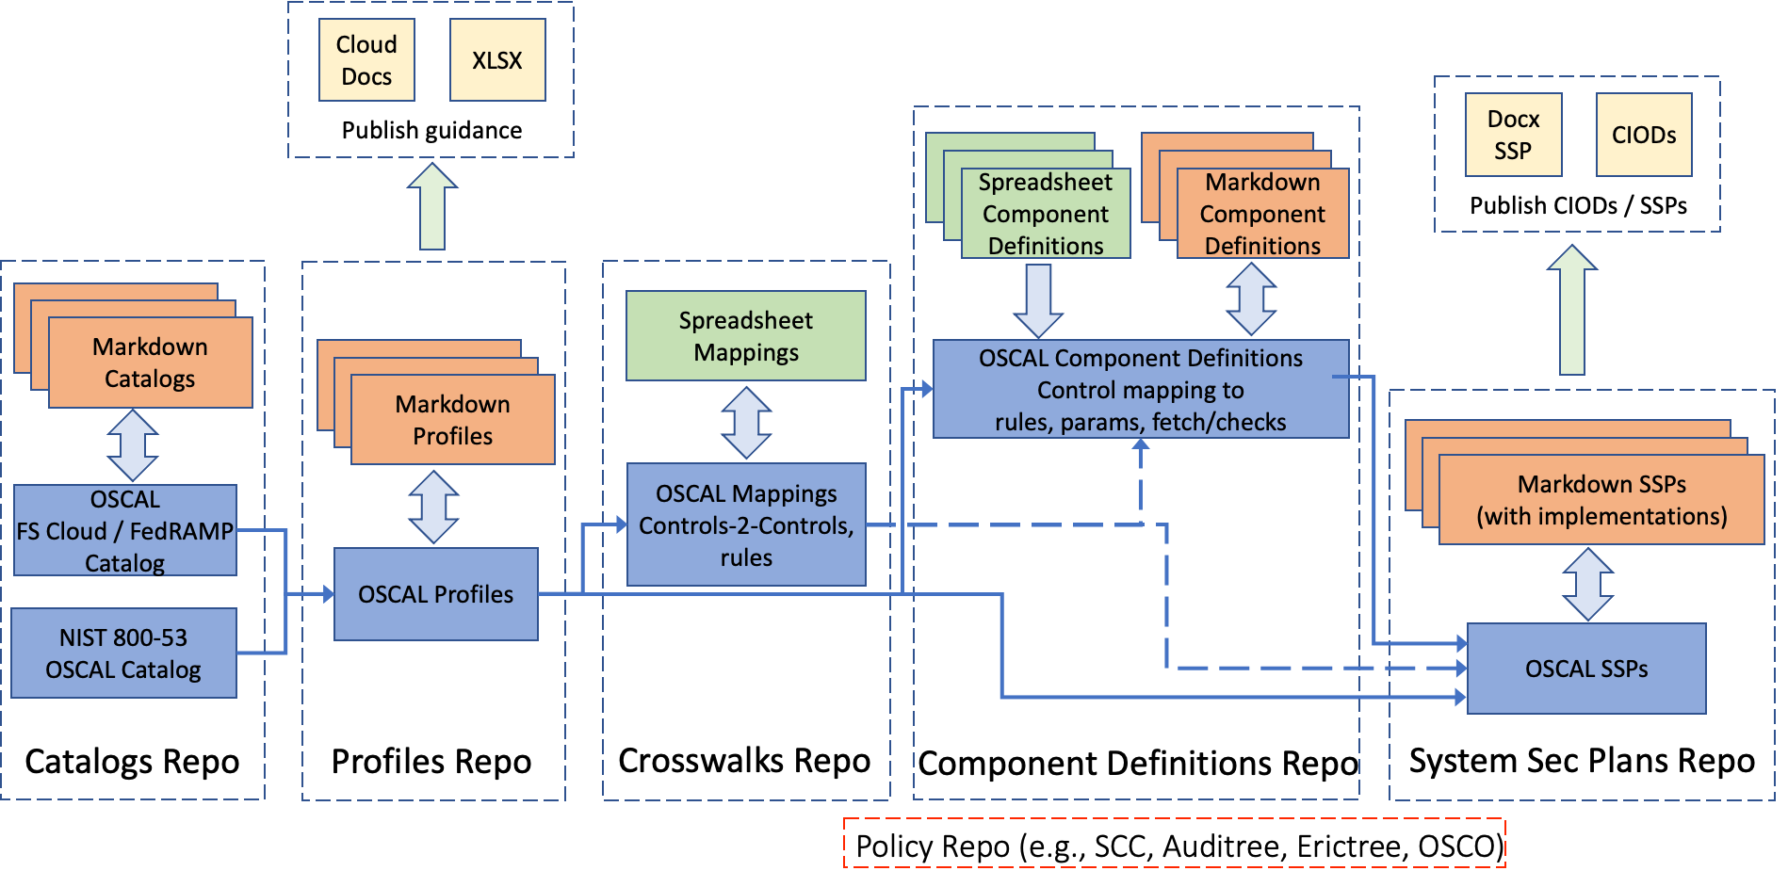
Agile Authoring: Collaborative Authoring Platform
Human friendly authoring /editing of compliance content
Structured and auditable workflow
Trigger automatic validation, updates, and deployments
Collaborative editing and review process through code review and approval process
Automatic semantic release management

Slide 11

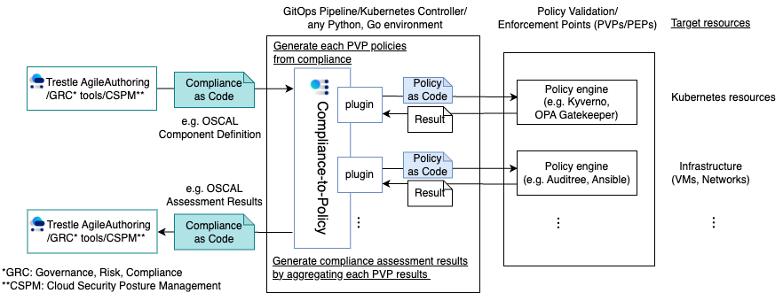
Compliance-to-Policy (C2P) and plugin architecture
Flexibility in choice of policy engines and compliance framework
Community-driven plugin extension

Slide 12
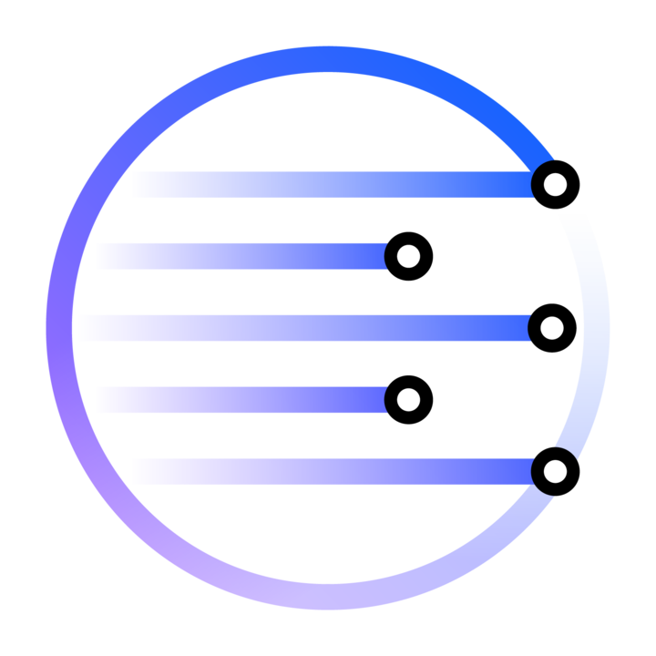
OSCAL Compass Community
Where To Start
Our community README.md
Our biweekly community calls
Decision Making
We strive for a consensus-based approach to encourage open discussion and collaboration on most project decisions.
We use a voting based approach when necessary or if consensus cannot be reached or in special circumstances.
Leadership
We have an Oversight Committee made up of maintainers across the projects and project representatives. Learn more at GOVERNANCE.md.
Contribution
We welcome contributions from everyone! Whether you're a seasoned developer or just starting out, we value your input. Learn more at CONTRIBUTING.md.

Slide 13
Keep up with Compass and Trestle
Community calls
OSCAL Compass community calls - https://docs.google.com/document/d/1XTYM7xnWlIqd-8Nn5-qtgvgk8kH3NSmYle5yZvaS7qs/edit#heading=h.6pq38r2red0n
Github organization
oscal-compass - https://github.com/oscal-compass
Blogs
Personas and Roles
Trestle SDK
Artifacts and Personas
Topologies of Compliance Policy Administration Centers
A Lack of Network Boundaries Invites a Lack of Compliance
Compliance to Policy for Multiple Kubernetes Clusters

