Slide 1

CNCF OSCAL Compass
Demo
Automated Compliance Posture
(using the OSCAL standard)

Slide 2
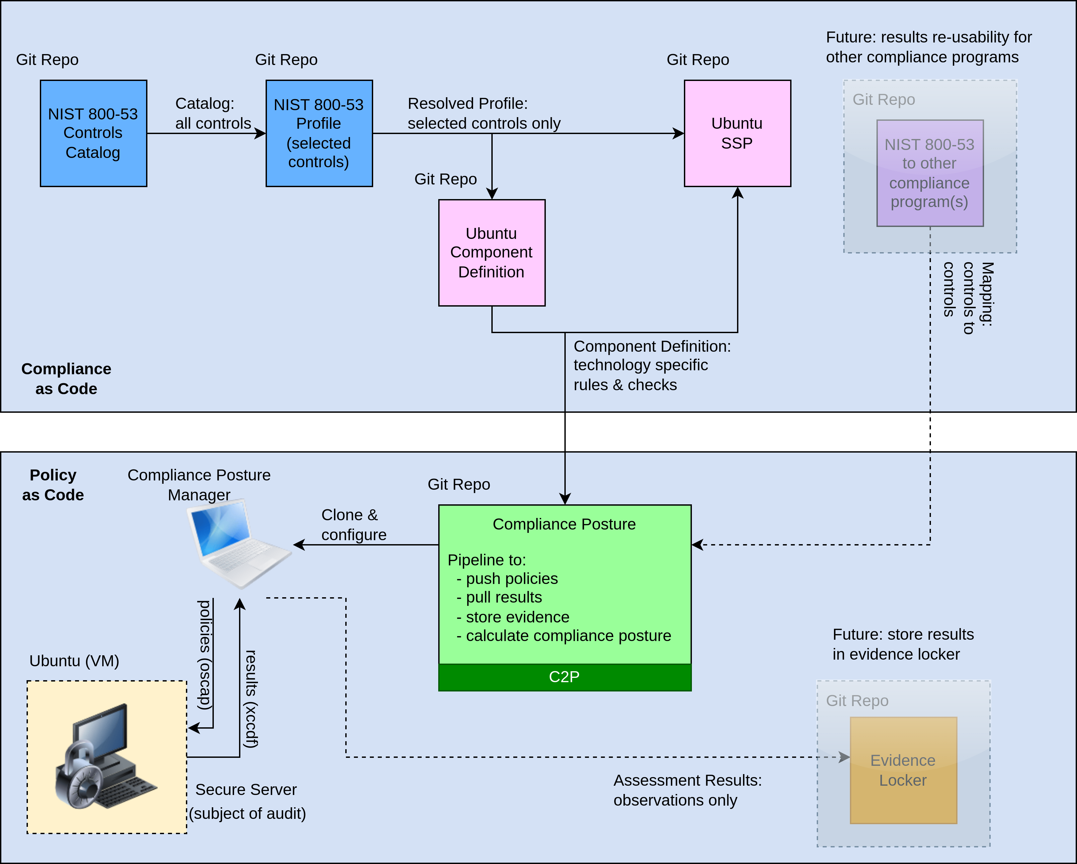
Overview:
1. OSCAL documents in Agile Authoring repos:
- NIST 800-53 Catalog
- NIST 800-53 Profile
- Ubuntu Component Definition
- Ubuntu SSP
2. compliance posture determination:
- clone repo
- spin up Ubuntu VM
- use C2P to deploy policies an retrieve results
- use component definition to calculate compliance posture

Slide 3
OSCAL Catalog
- Agile Authoring GIT repo for artifact management
- NIST 800-53 controls in OSCAL json format
- Complete set of controls
- No technology specific rules/checks
- Repo link: NIST_800-53_rev5/catalog.json

Slide 4
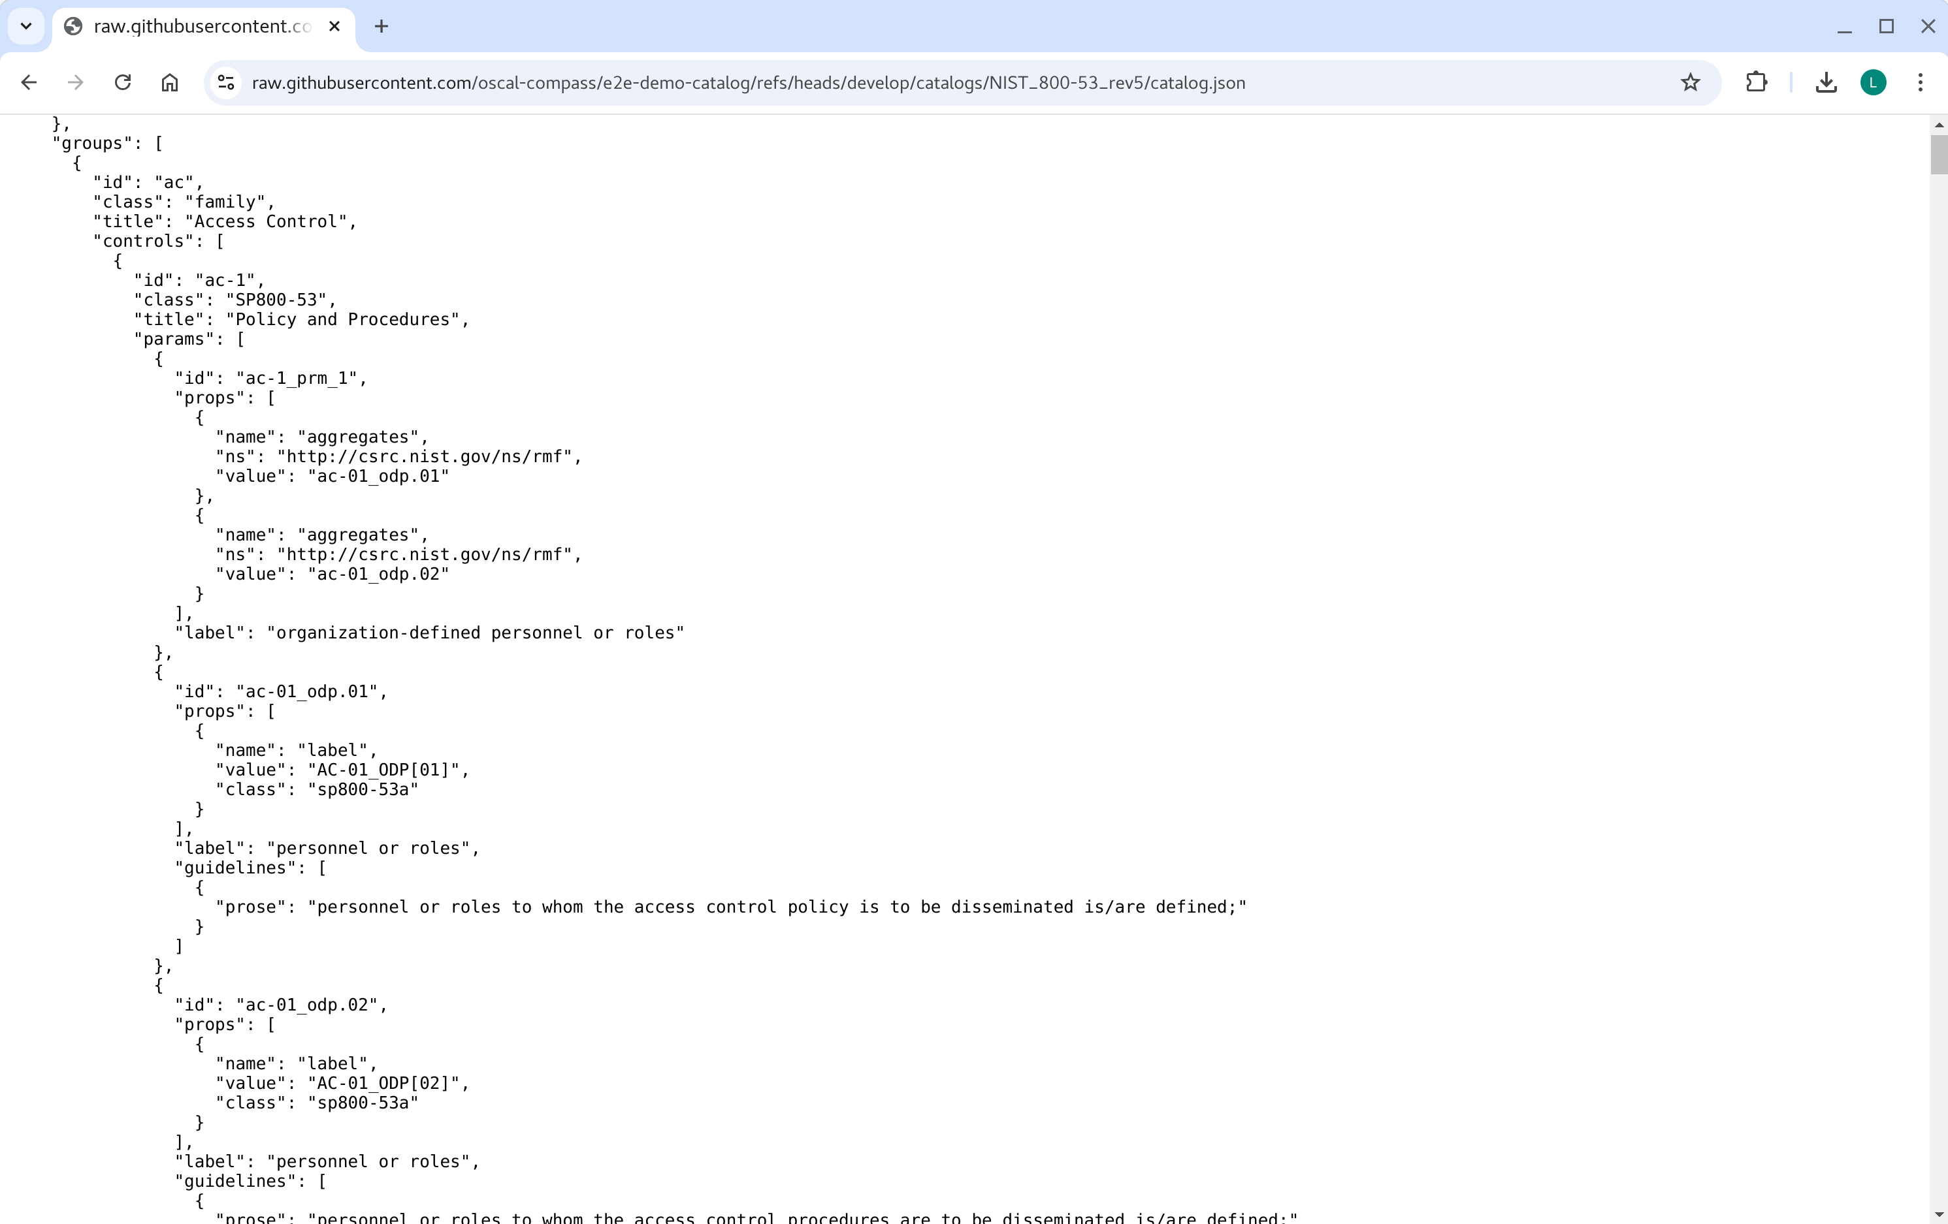
OSCAL Catalog (snippet)

Slide 5
OSCAL Profile
- Agile Authoring GIT repo for artifact management
- NIST 800-53 controls in OSCAL format
- Selected set of controls
- No technology specific rules/checks
- Repo link: NIST_800-53_rev5/profile.json

Slide 6
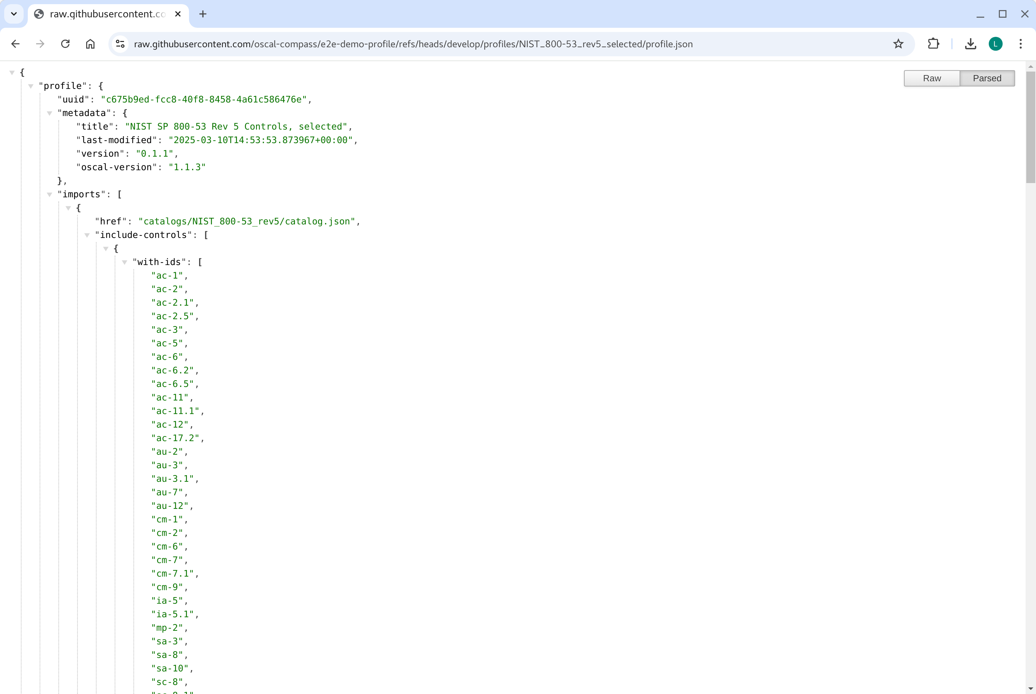
OSCAL Profile (snippet)

Slide 7
OSCAL Component Definition
- Agile Authoring GIT repo for artifact management
- Technology specific rules/checks (for Ubuntu)
- software CD comprises rules
- validation CD comprises checks
- Linkage from checks to rules to controls
- Repo links:
- software: Ubuntu_Linux_24.04_LTS/component-definition.json
- validation: oscap/component-definition.json

Slide 8
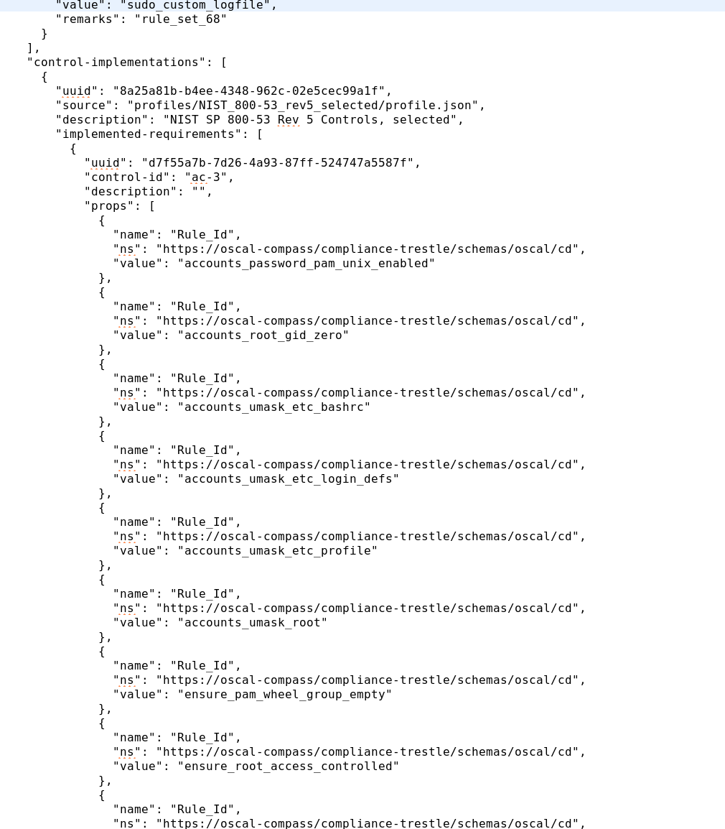
OSCAL Component Definition - software
Control
Rule

Slide 9
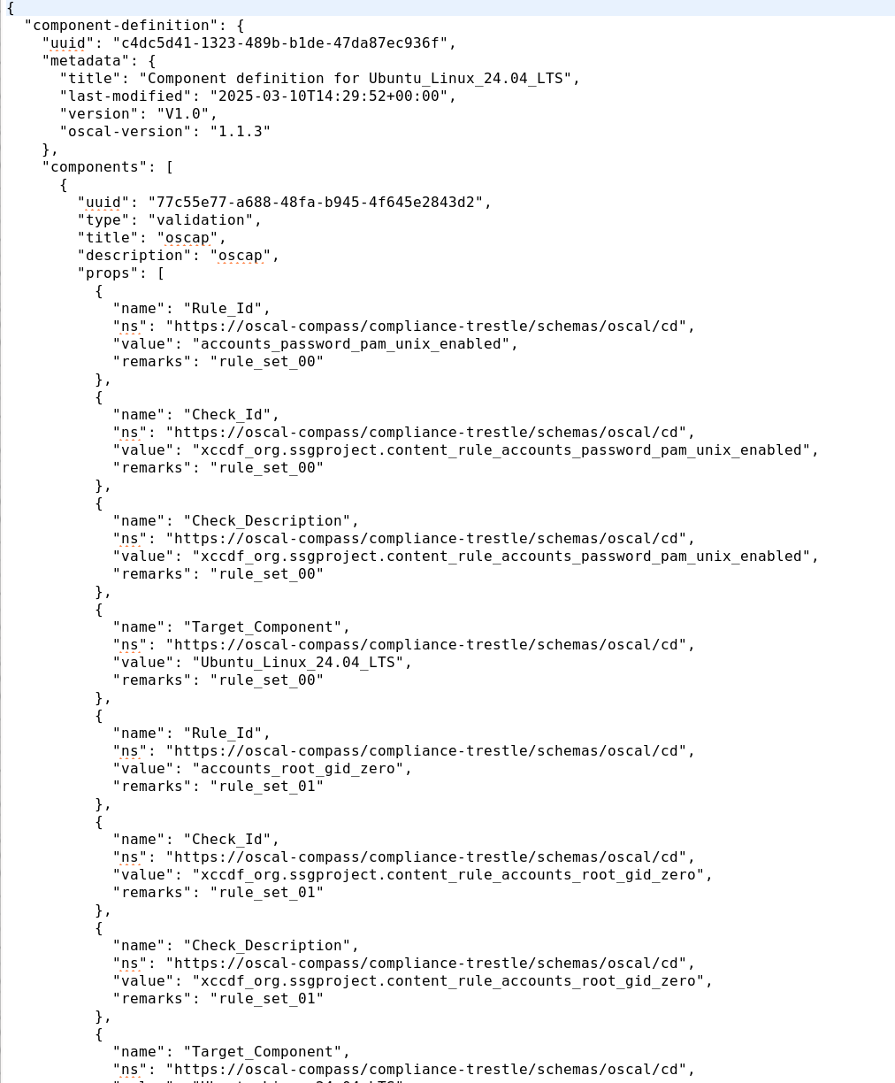
OSCAL Component Definition - validation
Rule
Check

Slide 10
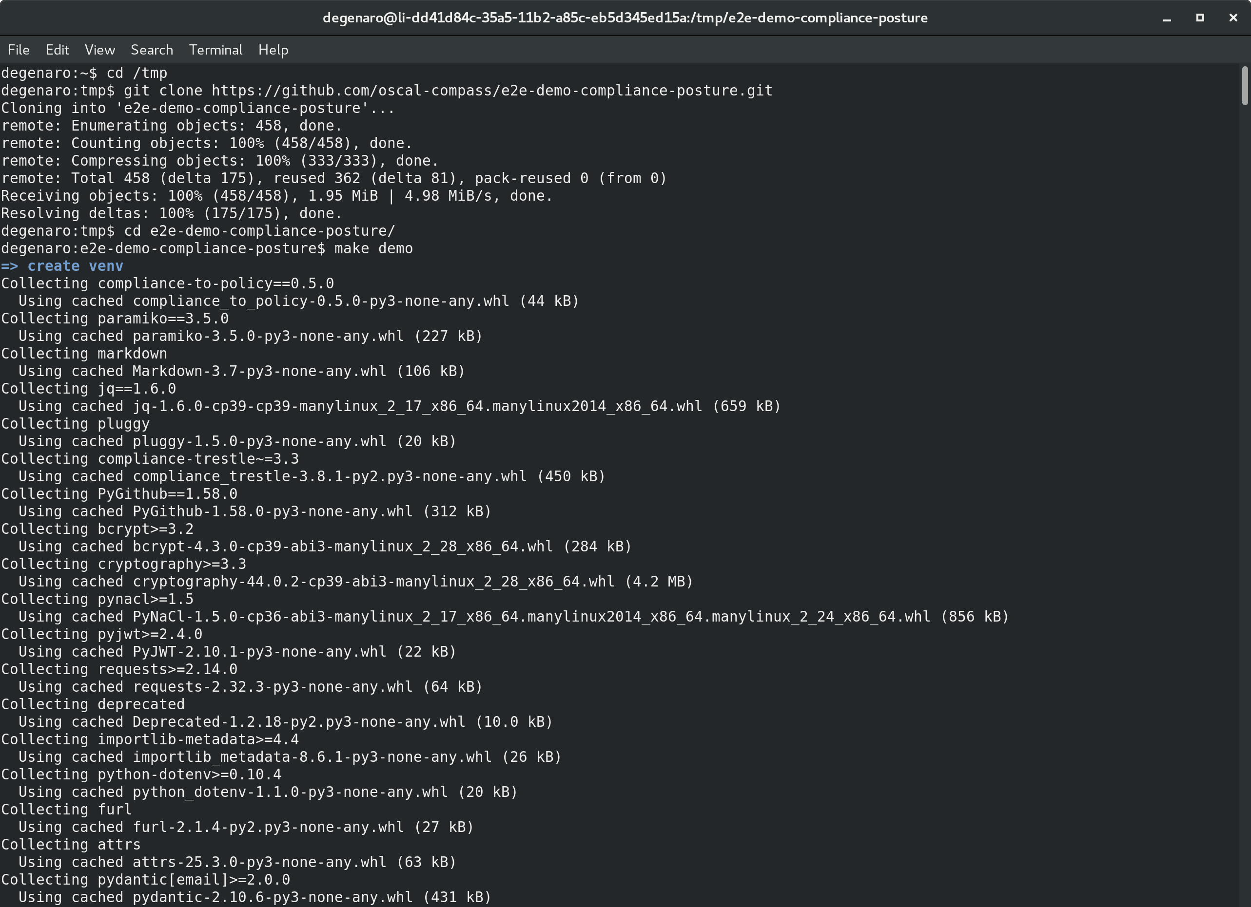
Download and start demo

Slide 11
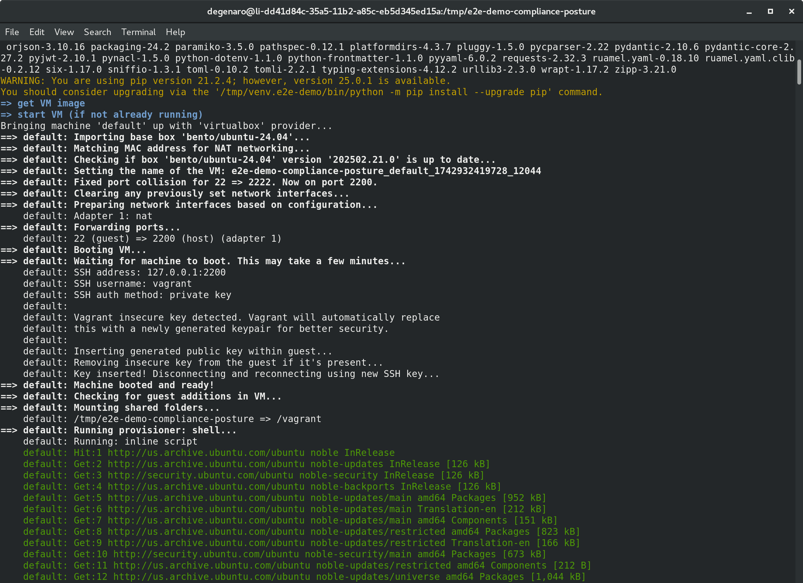
Ubuntu VM starting...

Slide 12
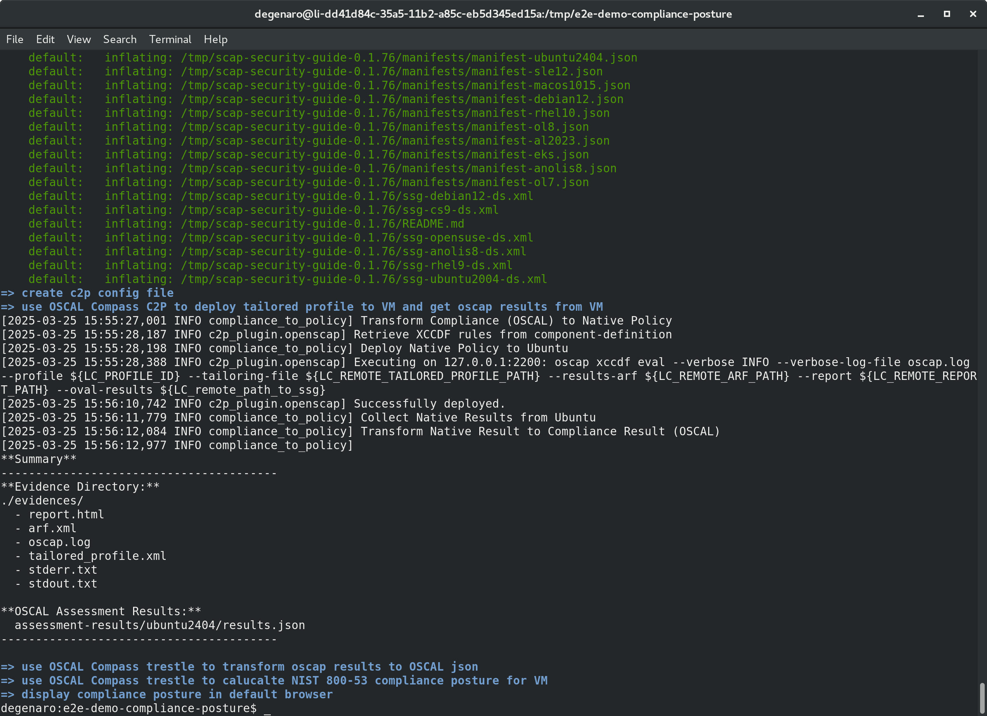
C2P push checks & pull results

Slide 13
Determine Compliance Posture & Display

Slide 14
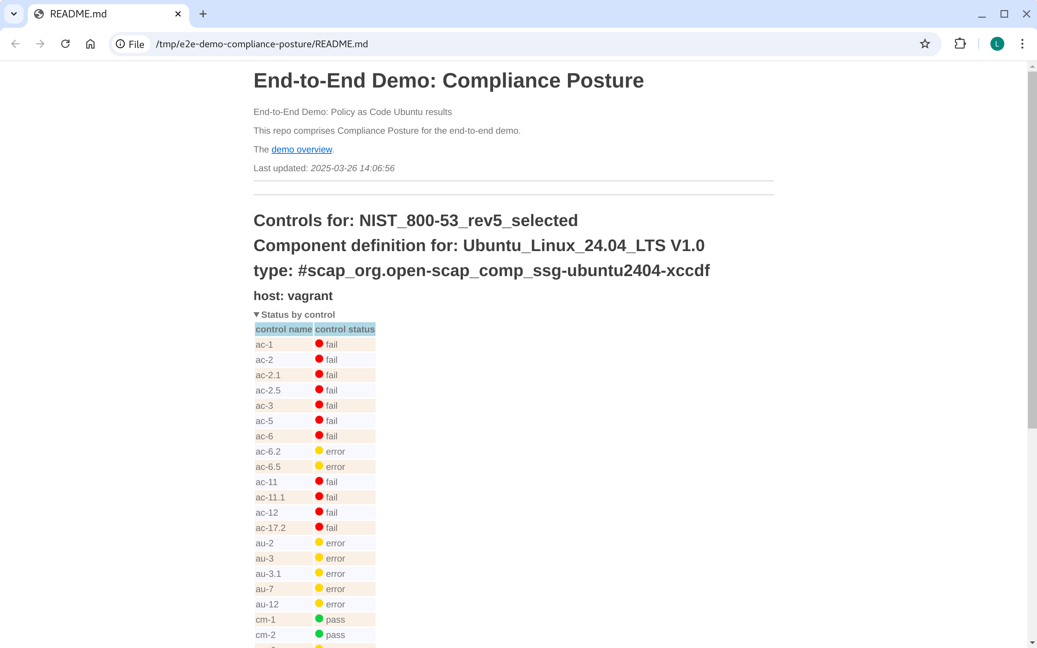
Posture (by control)

Slide 15
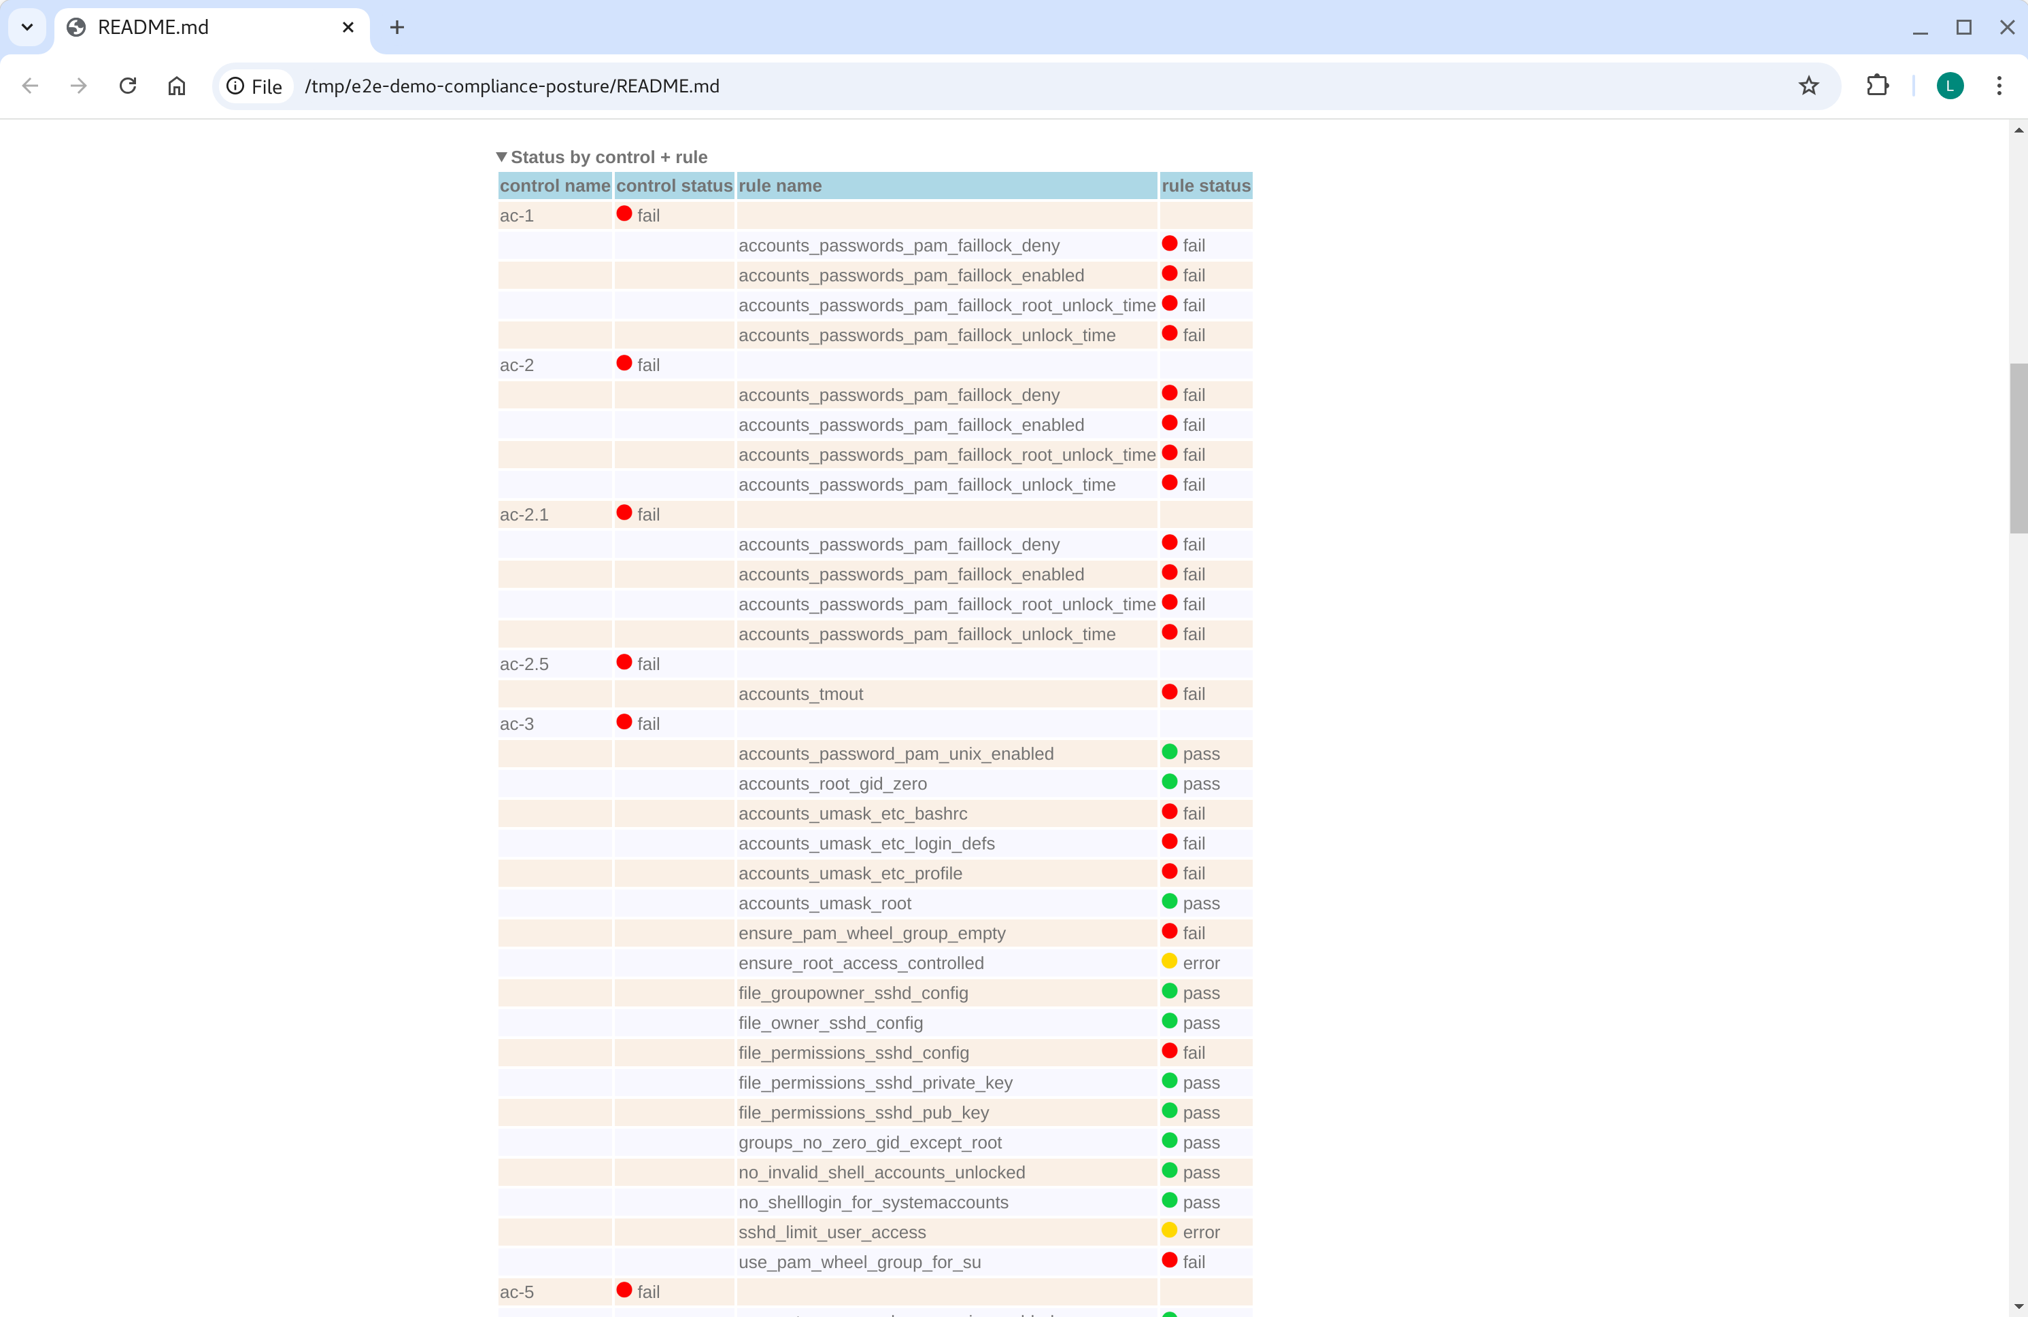
Posture (by control and rule)

