Slide 1
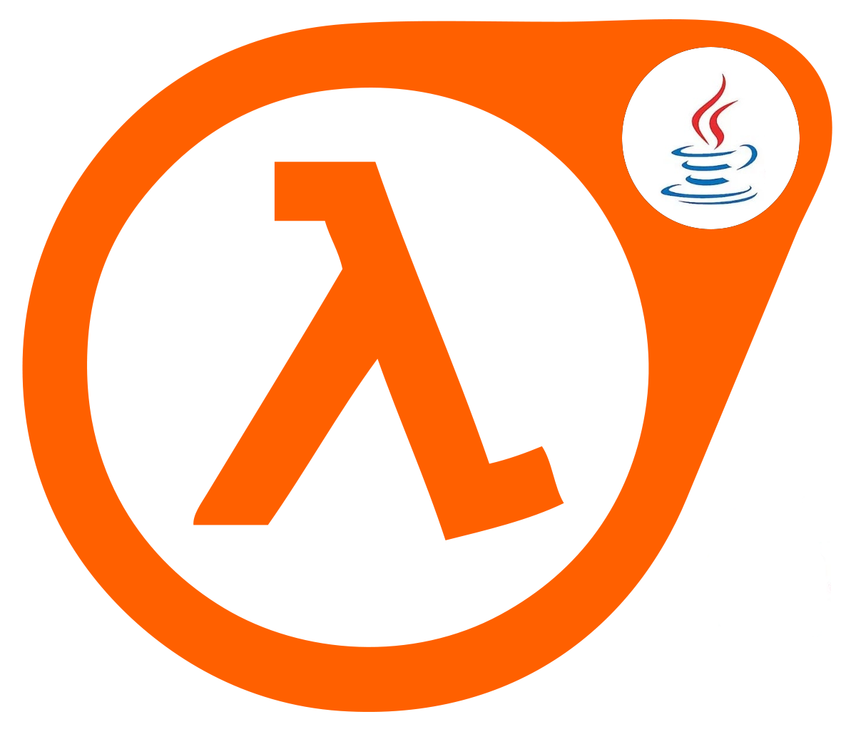
JAVA ⁸
Yet Another Introduction To
LAMBDAS and STREAMS

Slide 2
Lambdas – new in Java⁸
Functions that can be used as a parameter
Allows declarative coding
Easier to program in java
(it’s about time)
See class org.obapanel.yaitlambdas.slides.Slide2

Slide 3
Lambdas – Inside
It’s like that lambdas works as internal anonymous classes; in code we can see as equivalents.
In reality, bytecode implementation is more efficient
  Use invokeDynamic y and other Java wizardy.
  Equal or more efficient than anonymous classes. With less memory and namespace usage.
See class org.obapanel.yaitlambdas.slides.Slide2

Slide 4
Lambdas: functional coding
Lambdas allow functional programming
With streams, we can define what we do (functional) instead of how we do (imperative)
Less lines and complexity(usually)
No absolute rules !!
Note: for now, we consider declarative and functional
programming as the same; we know they aren’t.
See class org.obapanel.yaitlambdas.slides.Slide4

Slide 5
Lambdas and final values
Local variables pass to lambda copying value (not reference)
  So, the variables must be final or effective final
  Lambdas are more efficient if there are not external values, but that’s not possible in every case.
This does not apply to class or static properties
You can use Holder or AtomicXXX for mutable values
See class org.obapanel.yaitlambdas.slides.Slide5

Slide 6
Lambdas: Good practices
Lambdas can be horrible if clean code and good practices are not used.
Good practices
  One line for lambda
  One operation inside, avoid complex sentences
  Do not nest lambdas
Help lambdas and yourself: REFACTOR.
See class org.obapanel.yaitlambdas.slides.Slide6

Slide 7
Streams
  Pipeline of functions that will be applied to collections
  Package java.util.stream
  Can use and transform data, but it doesn’t alter the original collection.
  Declarative programming of operations
  2 types of operations:
    Intermediate
    Terminal
See class org.obapanel.yaitlambdas.slides.Slide7

Slide 8
Streams: intermediate
Intermediate operations doesn’t produce a direct result; they return the stream
Lazy execution
Some in a stream, in a sucession (when they are executed, the order of coding is used)
  Some are short-circuit and trim the process on the stream.
See class org.obapanel.yaitlambdas.slides.Slide8

Slide 9
Streams: terminal
Terminal operations produce a direct result, an object.
Only one for stream; the same stream can’t be reused after a terminal operation.
  Some are short-circuit and trim the process on the stream. .
Eager execution,
and forces the previous intermediates to be executed.
See class org.obapanel.yaitlambdas.slides.Slide8

Slide 10
Intermediate operations
Operacion | Preserves count | Preserves type | Preserves order | Shortcircuit
map |  |  |  |  | Convert one object to other
filter |  |  |  |  | Discards objects based on condition
distict |  |  |  |  | Allows only non equals objects
sorted |  |  |  |  | Sorts objects
peek |  |  |  |  | Applies cosumer to object

Slide 11
Intermediate operations
Operacion | Preserves count | Preserves type | Preserves order | Shortcircuit
skip |  |  |  |  | Cut collection size from the bottom
limit |  |  |  |  | Cut collection size from the top
flatMap |  |  |  |  | Like map, but eliminates intermediate collections
Note: I think that there are all the operations
See class org.obapanel.yaitlambdas.slides.Slide10

Slide 12
Terminal operations
Operation | Output
reduce | One object | Cumulate elements into one
collect | List, map or set | Group elements into a new collection
forEach | Void | Iterates over elements after intermediates
findFirst | Optional of one Object | Get the first element
findAny | Optional of one Object | Get the ¿? element
anyMatch | Boolean | TRUE if one element meets the predicate
allMatch | Boolean | TRUE if all meets predicate
noneMatch | Boolean | TRUE if none meets predicate

Slide 13
Terminal operations
Operation | Output
count | Long | Numer of elements
max | Optional of one Object | Maximum data, according to natural order or comparator
min | Optional of one Object | Minimum data, according to natural order or comparator
sum * | Long/Int/Double | Sum of all elements
average * | Long/Int/Double | Avg of all elements
* only in streams of numbers like IntStream
Note: I think that there are all the operations...
See class org.obapanel.yaitlambdas.slides.Slide13

Slide 14
Types of streams and builders
Usually, we will use the collections stream in Java (the one which has been reviewed here)
  We have seen the mayority of methods
There are streams for basic types: IntStream, LongStream, DoubleStream
  Most methods are shared, but there can be others
Generate streams
  With Stream.builder
  With values with Stream.of
  With a supplier and Stream.generate
  Warning: this last operation generates an infinite stream
See class org.obapanel.yaitlambdas.slides.Slide14

Slide 15
Parallel Streams
Streams can be executed in parallel, to break operations into some threads
Rules
  Don’t use shared mutable data
  Don’t use blocking operations
  Only with a massive data set
  Be careful in multithread enviroments, specially when you don’t control thread generation
See class org.obapanel.yaitlambdas.slides.Slide15

Slide 16
Streams notes
Use streams to make clear and clean code
  Stream has a little worse performance than iterative soluctions, and iterative has a little worse performance than index based solutions (some milliseconds at max)
  But code is cleaner and reusable
Don’t use in IO operations, Preferible no usar en IO, especially with external systems (bbdd, nosql, etc.)
Code and compare imperative and declarative methods.

Slide 17
Code Lambdas
Only make a new lambda type if we are sure that we need it and we have checked that is necessary and doesn’t exist.
  Review package java.util.function
  https://docs.oracle.com/javase/8/docs/api/java/util/function/package-summary.html
  Don’t repeat code.
  Use already existing interfaces in Java

Slide 18
Code Lambdas
We generate an inteface with only one effective abstract method
  Class will be annotated with @FunctionalInterface.
  This is the method that will be executed/implemented within the lambda
Even it is not recommended
  There can be more non abstract methods (default) in the interface
  We can overload the main method (with other non-abstract)
  Inheritance of interfaces is accepted
But don’t overuse these last behaviour, maintain clean code
See class org.obapanel.yaitlambdas.slides.Slide18

Slide 19
Final notes
Look to the documentation
  Javadoc
  Web (StackOverflow, baeldung.com, etc.)
Search examples, reuse code, review, etc.
REFACTORIZE CODE !

