Slide 1
Point Cloud Library Agentification
Software Development Project
Iuri Andrade, Oscar Lima, Shehzad Ahmed
22.11.2013

Slide 2
Presentation Content
Current Progress
Software Demo
Objective for the next sprint

Slide 3
Current Progress
Utilizing Point Cloud Library components
Data or Input sources
Point cloud file reader
Kinect Camera
Output sources
Point cloud file writer
Point cloud Viewer
Filter components
Pass through filter
Downsampling filter
Statiscal outlier removal
Radius outlier removal

Slide 4
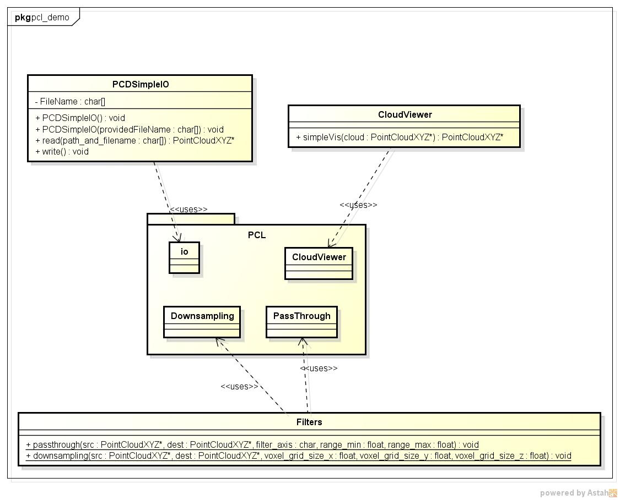
Software Demo

Slide 5
Objective for the next Sprint
Implement the functionalities as agents
Input
Configuration
Output
Integrate agents in ROS
Wrap each agent with a ROS node
Input => Subscriber
Parameter Configurations
Output => Publisher
Create a Dynamic reconfigure node
Runtime configuration of agent parameters

Slide 6
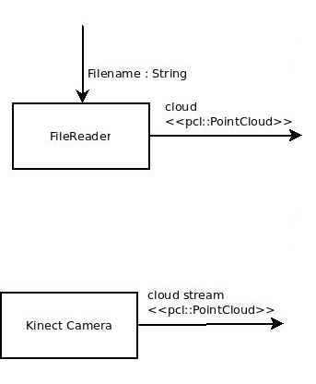
Agents Diagram

Slide 7
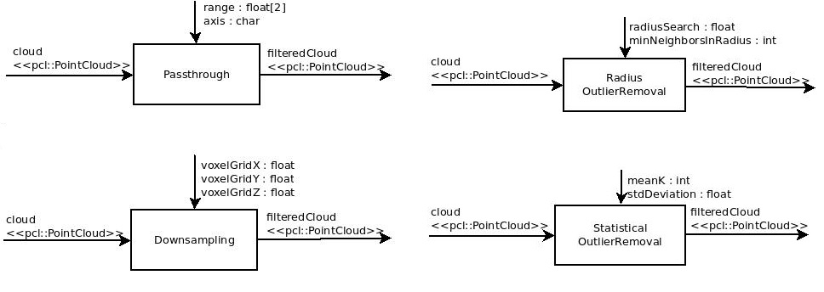
Agents Diagram

Slide 8
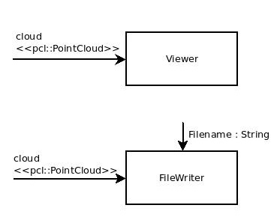
Agents Diagram

Slide 9


