Slide 1

Point Cloud Library Agentification
a-
Software Development Project
Iuri Andrade, Oscar Lima, Shehzad Ahmed
20.01.2014

Slide 2
Presentation Content
Current Progress
Software Description
Future Work

Slide 3
Current Progress
Implemented agents to use PCL functionalities
  Data or Input sources
    Point cloud file reader
    Kinect Camera
  Output sources
    Point cloud file writer
    Point cloud viewer
  Filter components
    Passthrough
    Downsampling
    Statistical outlier removal
    Radius outlier removal

Slide 4
Software Description
Architecture
  Class Diagrams
  Agents Diagrams
  Code Convention (ROS C++ Style)
  Dynamic Pipeline

Slide 5
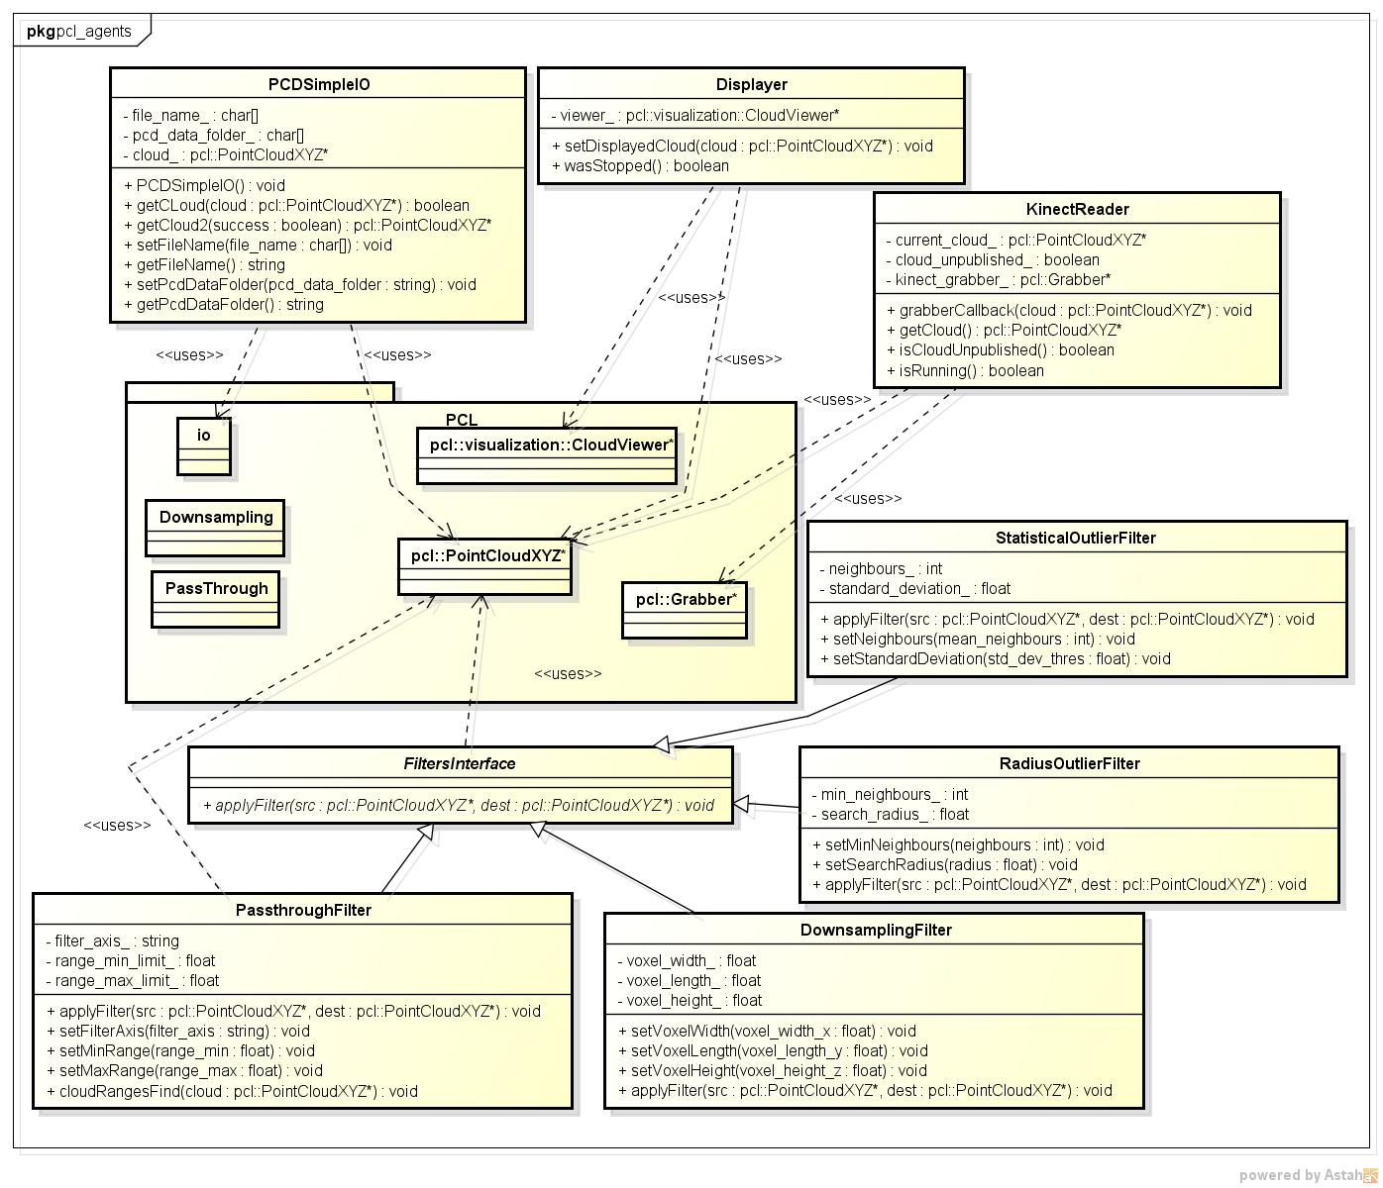

Slide 6
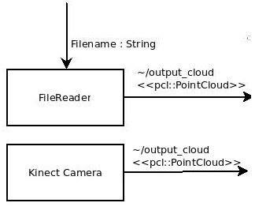
  Architecture – Agents Diagram

Slide 7
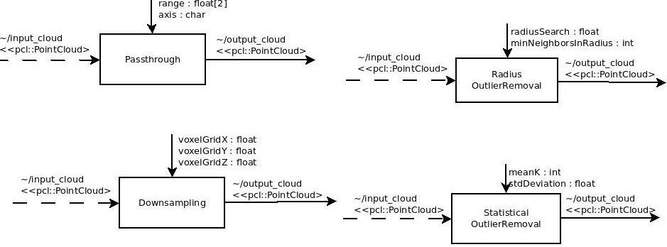
  Architecture – Agents Diagram

Slide 8
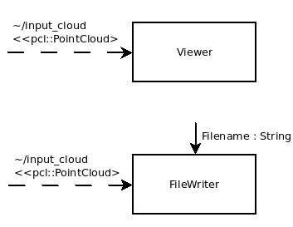
  Architecture – Agents Diagram

Slide 9
Software Description
Patterns
  Wrapper(adapter)
  Composition
  Messaging

Slide 10
Demonstration

Slide 11
Future work
Add more PCL functionalities e.g. segmentation
Create a layer of agents with the ability to receive tasks and autonomously connect the available agents to make pipelines

Slide 12


