Slide 1

Point Cloud Library Agentification
a-
Software Development Project
Iuri Andrade, Oscar Lima, Shehzad Ahmed
20.01.2014

Slide 2
Presentation Content
Current Progress
Software Description
Future Work

Slide 3
Current Progress
Implemented agents to use PCL functionalities
Data or Input sources
Point cloud file reader
Kinect Camera
Output sources
Point cloud file writer
Point cloud viewer
Filter components
Passthrough
Downsampling
Statistical outlier removal
Radius outlier removal

Slide 4
Software Description
Architecture
Class Diagrams
Agents Diagrams
Code Convention (ROS C++ Style)
Dynamic Pipeline

Slide 5
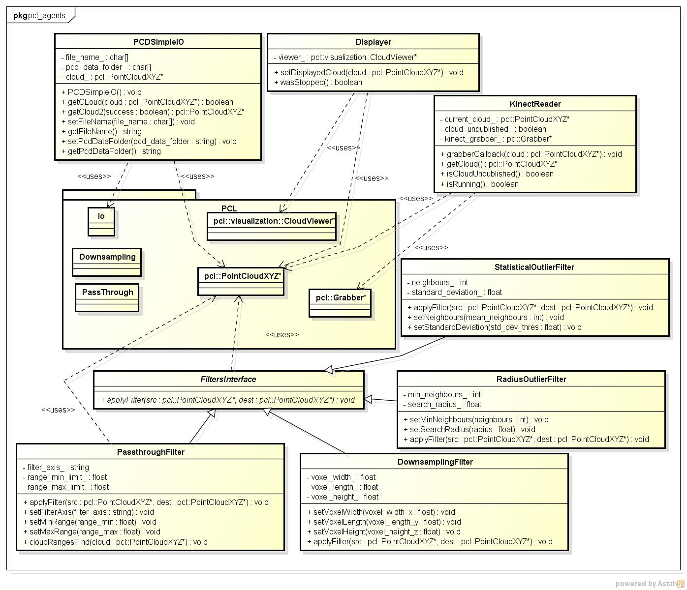

Slide 6
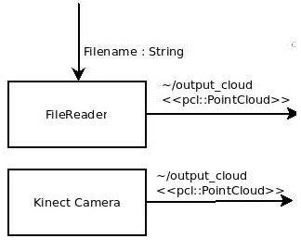
Architecture – Agents Diagram

Slide 7
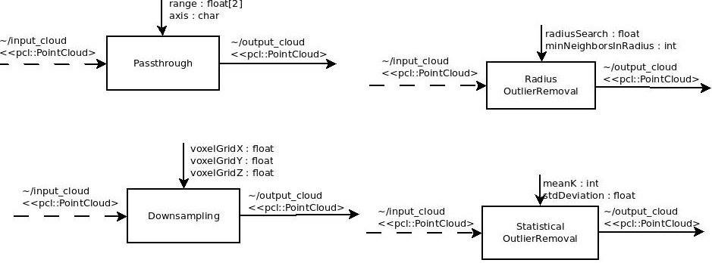
Architecture – Agents Diagram

Slide 8
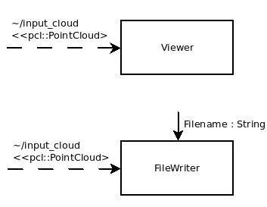
Architecture – Agents Diagram

Slide 9
Software Description
Patterns
Wrapper(adapter)
Composition
Messaging

Slide 10
Demonstration

Slide 11
Future work
Add more PCL functionalities e.g. segmentation
Create a layer of agents with the ability to receive tasks and autonomously connect the available agents to make pipelines

Slide 12


