Slide 1

Meeting August 26, 2024
Forward and inverse modeling of wave propagation combining classical and machine learning approaches
Student: Oscar Andrés Rincón Cardeño
Advisors: Nicolas Guarín Zapata and Silvana Montoya
Applied Mechanics research group
Universidad EAFIT

Slide 2
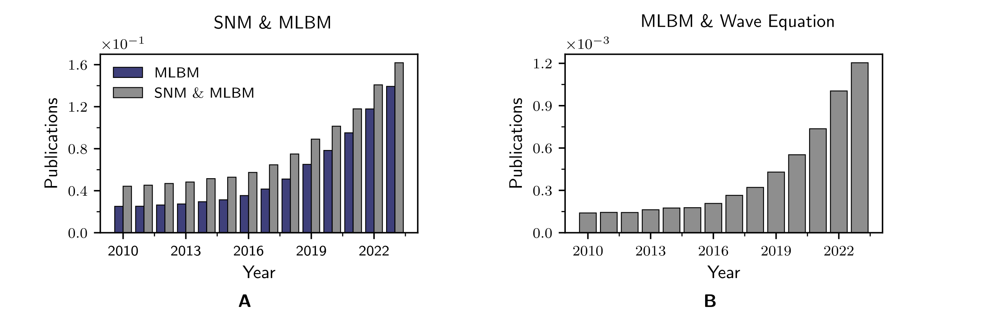
Introduction
The growth of literature related to machine learning and wave propagation modeling is shown.
Possible causes
Hardware
GPU
Storage
Available data
Open-source packages
Tensorflow
PyTorch
JAX
Machine learning-based methods (MLBM) and standard numerical methods (SNM) (A), as well as MLBM specifically associated with wave propagation modeling (B).
https://github.com/oscar-rincon/review-elastic-waves/tree/main/main/publications_number_year

Slide 3

Research Question
What machine learning techniques have been applied to model the wave equation in computational seismology?
Forward Problem
Inverse problem
Surrogate models

Slide 4
Justification
In principle, machine learning can offer a promising balance between computational cost and accuracy.
Given the rapid growth of the field:
1. Uncertainty about what machine learning based methods have been applied and demostrated to be an efficient complement or alternative to standard numerical methods.
2. Already proposed methods may still haven’t been fully explored in the context of seismic wave propagation modeling.

Slide 5
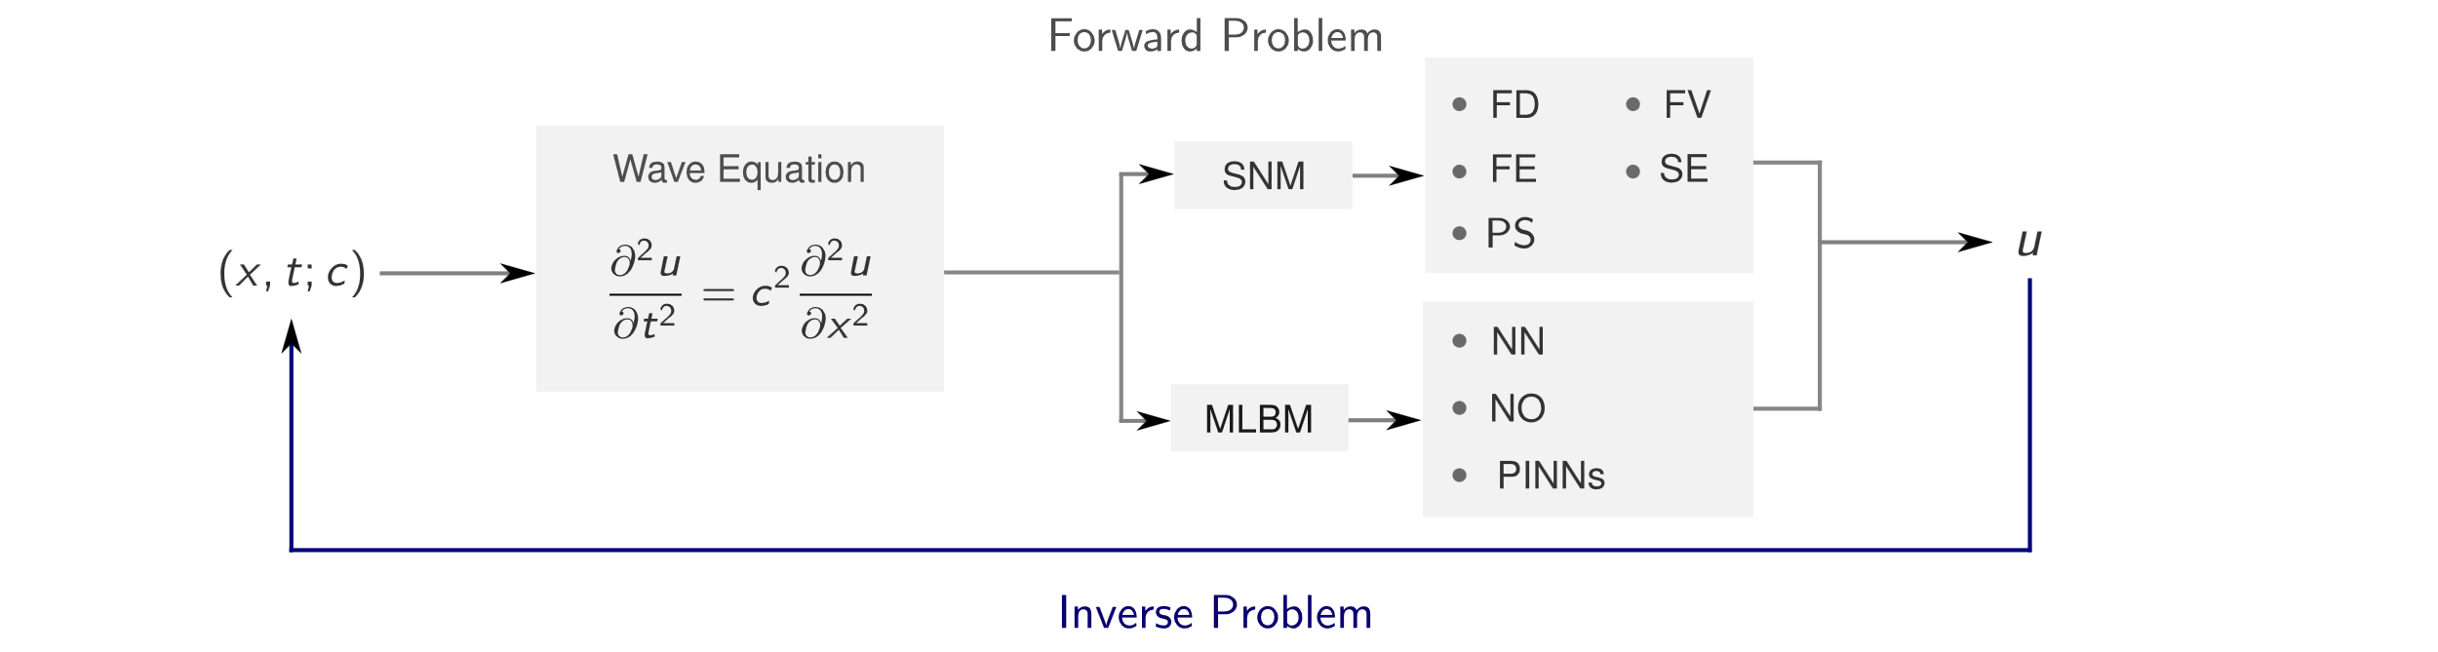
Modeling of Wave Propagation
Scheme of the forward and inverse problems encountered in solving partial differentialequations. In the forward scenario, the inputs (x, t; c) are employed to characterize a model across PDEs.

Slide 6
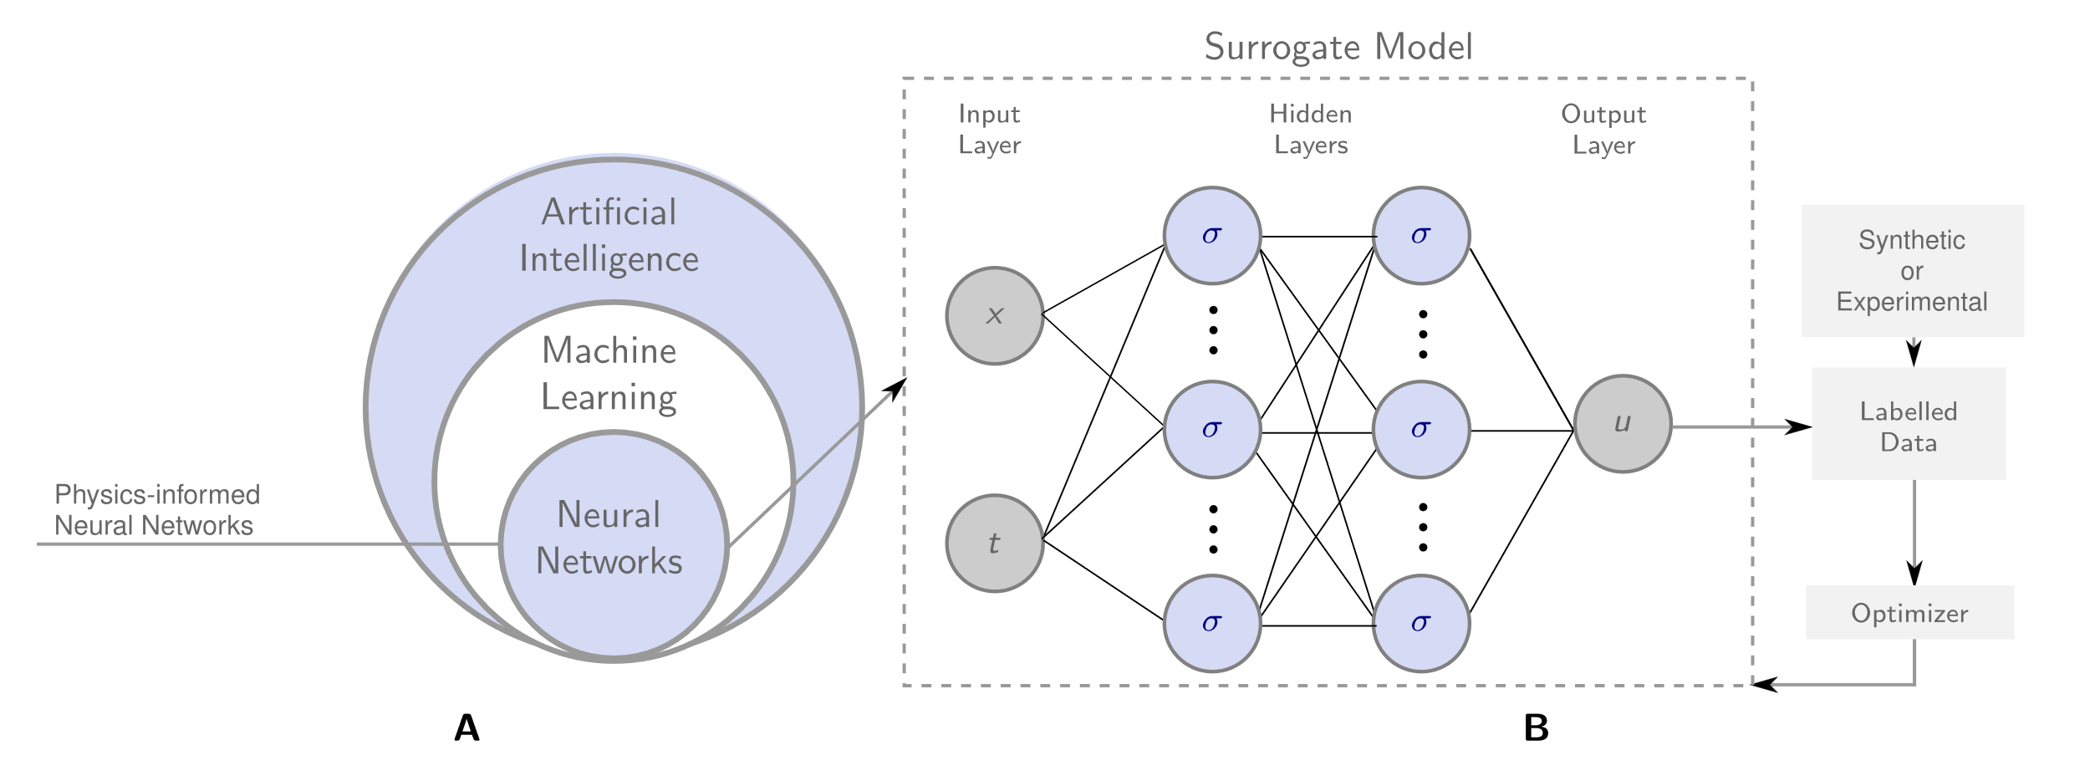
Machine learning Based Methods
Artificial Intelligence subsets and artifical neural networks. (A) Deep learning as a subsetof machine learning and artificial intelligence and (B) basic architecture of artificial neural networks.

Slide 7
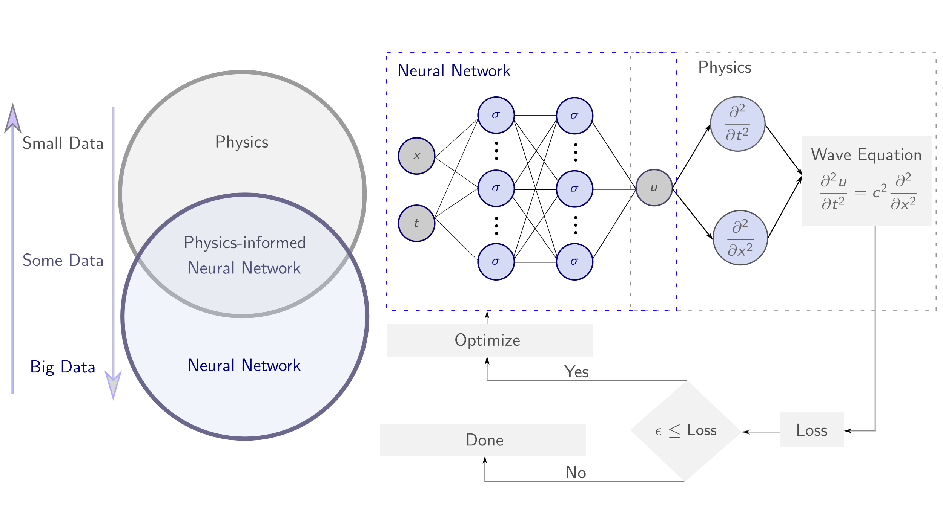
Machine learning Based Methods
Physics-informed neural networks scheme applied to the wave equation.

Slide 8
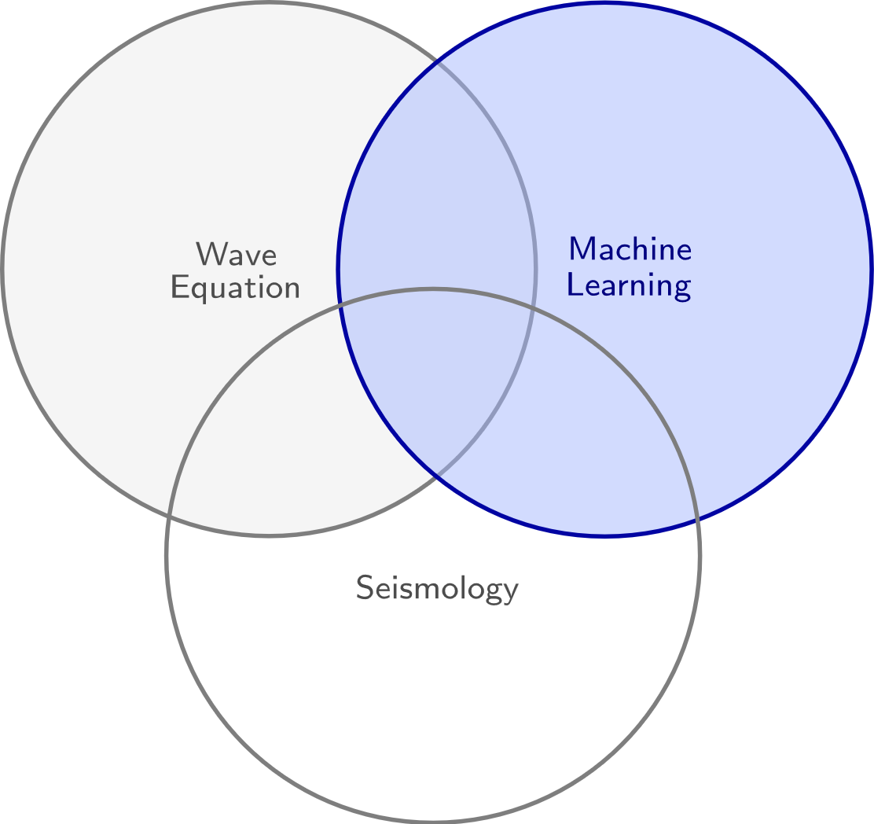
Applications
Inclusion criteria
We considered studies that:
Machine learning methods applied to computational seismology.
Incorporate descriptions of physical phenomena through partial differential equations.
Reported a quantitative ora supported qualitative comparison of the implemented model’s computational efficiency relative to standard numerical methods.
Are applied to solve inverse problems.

Slide 9
Applications
Exclusion criteria
We not considered studies that:
Did not provide a comparison at all.
Compared their results only to other machine learning methods.
Focused on accuracy comparisons without addressing computational times were also excluded.
Are outside the scope of computational seismology.

Slide 10
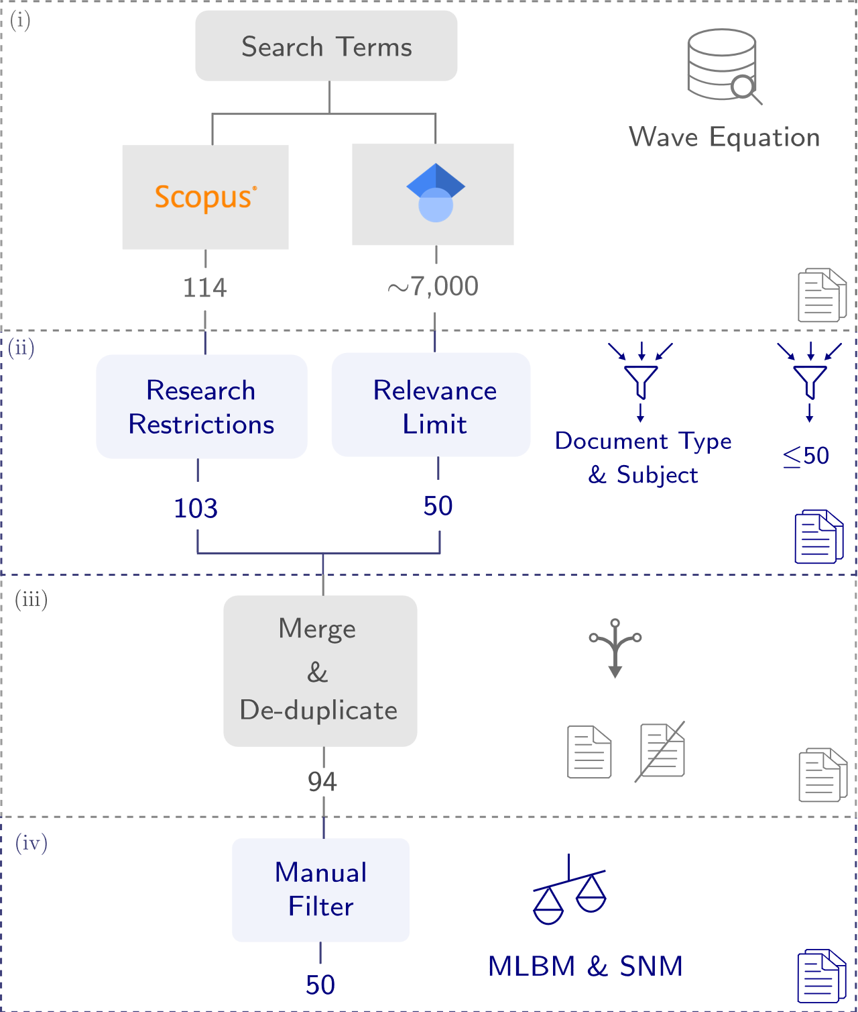
Search strategy
Query
("machine learning" OR "deep learning" OR "neural networks") AND ("seismic" OR "seismology") AND "wave equation" AND (modeling OR modelling OR model OR simulation)

