Slide 1
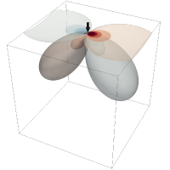

Meeting July 29, 2024
Forward and inverse modeling of wave propagation combining classical and machine learning approaches
Student: Oscar Andrés Rincón Cardeño
Advisors: Nicolas Guarín Zapata and Silvana Montoya
Applied Mechanics research group
Universidad EAFIT

Slide 2
Content
Literature review
Reproduction of the results presented in Raissi et al. (2019)
Problem statement

Slide 3
Literature review
Modeling of Mechanical Wave Propagation - Narrative
Standard Numerical Methods to Model Wave Equation - Narrative
Machine learning Methods to Model Mechanical Wave Propagation - Narrative
Applications- Systematic
https://github.com/oscar-rincon/review-elastic-waves/tree/main/refs

Slide 4
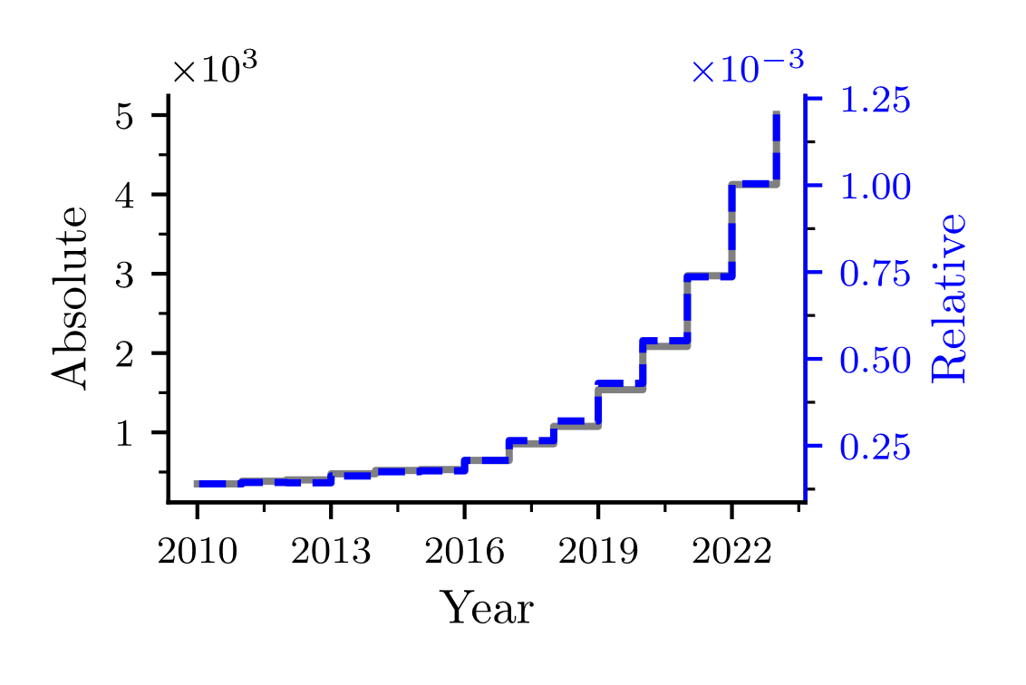
Introduction
Queries:
"machine learning" OR "deep learning" OR "neural networks" AND "wave propagation" OR "wave equation" AND (modeling OR modelling OR model OR simulation)
PUBYEAR > 2009 AND PUBYEAR < 2024
Possible causes
Hardware
GPU
Storage
Available data
Open-source packages
Tensorflow
PyTorch
JAX
https://github.com/oscar-rincon/review-elastic-waves/tree/main/main/publications_number_year

Slide 5
Modeling of Mechanical Wave Propagation
Mathematical modeling
Types
Static
Dynamic
Typically with
Partian
Differential
Equations
A particular case
Two general approaches
Mechanical Wave Equation
Forward
Inverse
Scalar
Elastic
Problem
Problem
Waves
Waves
Requiered
Numerical
Methods
https://github.com/oscar-rincon/review-elastic-waves/tree/main/figs

Slide 6
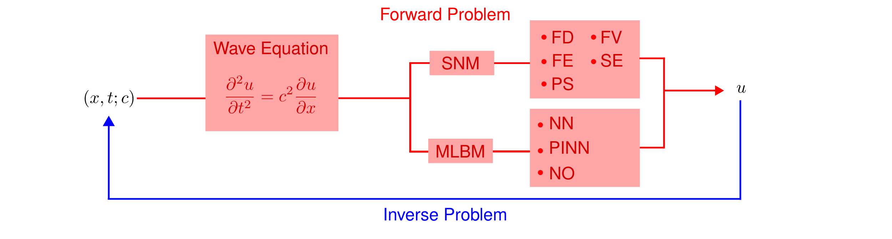
Modeling of Mechanical Wave Propagation
https://github.com/oscar-rincon/review-elastic-waves/tree/main/figs

Slide 7
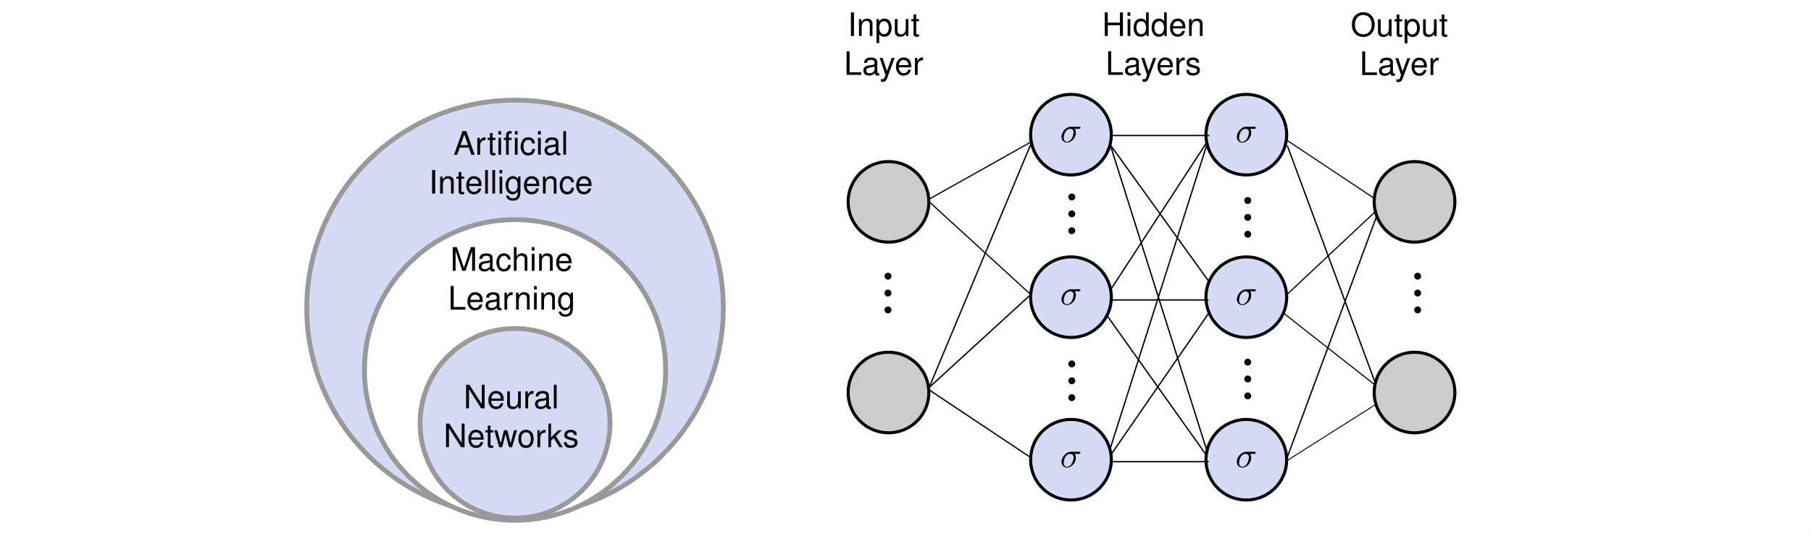
Machine learning Methods to solve Diferential Equations
Machine Learning
Reinforced Suport Vector Machine
Neural Networks
Neural Networks
Data Driven
Physics Based
Shallow Networks
Extreme Learning Machine – Pseudo-inverse
Deep Learning
Backpropagation
https://github.com/oscar-rincon/review-elastic-waves/tree/main/figs

Slide 8
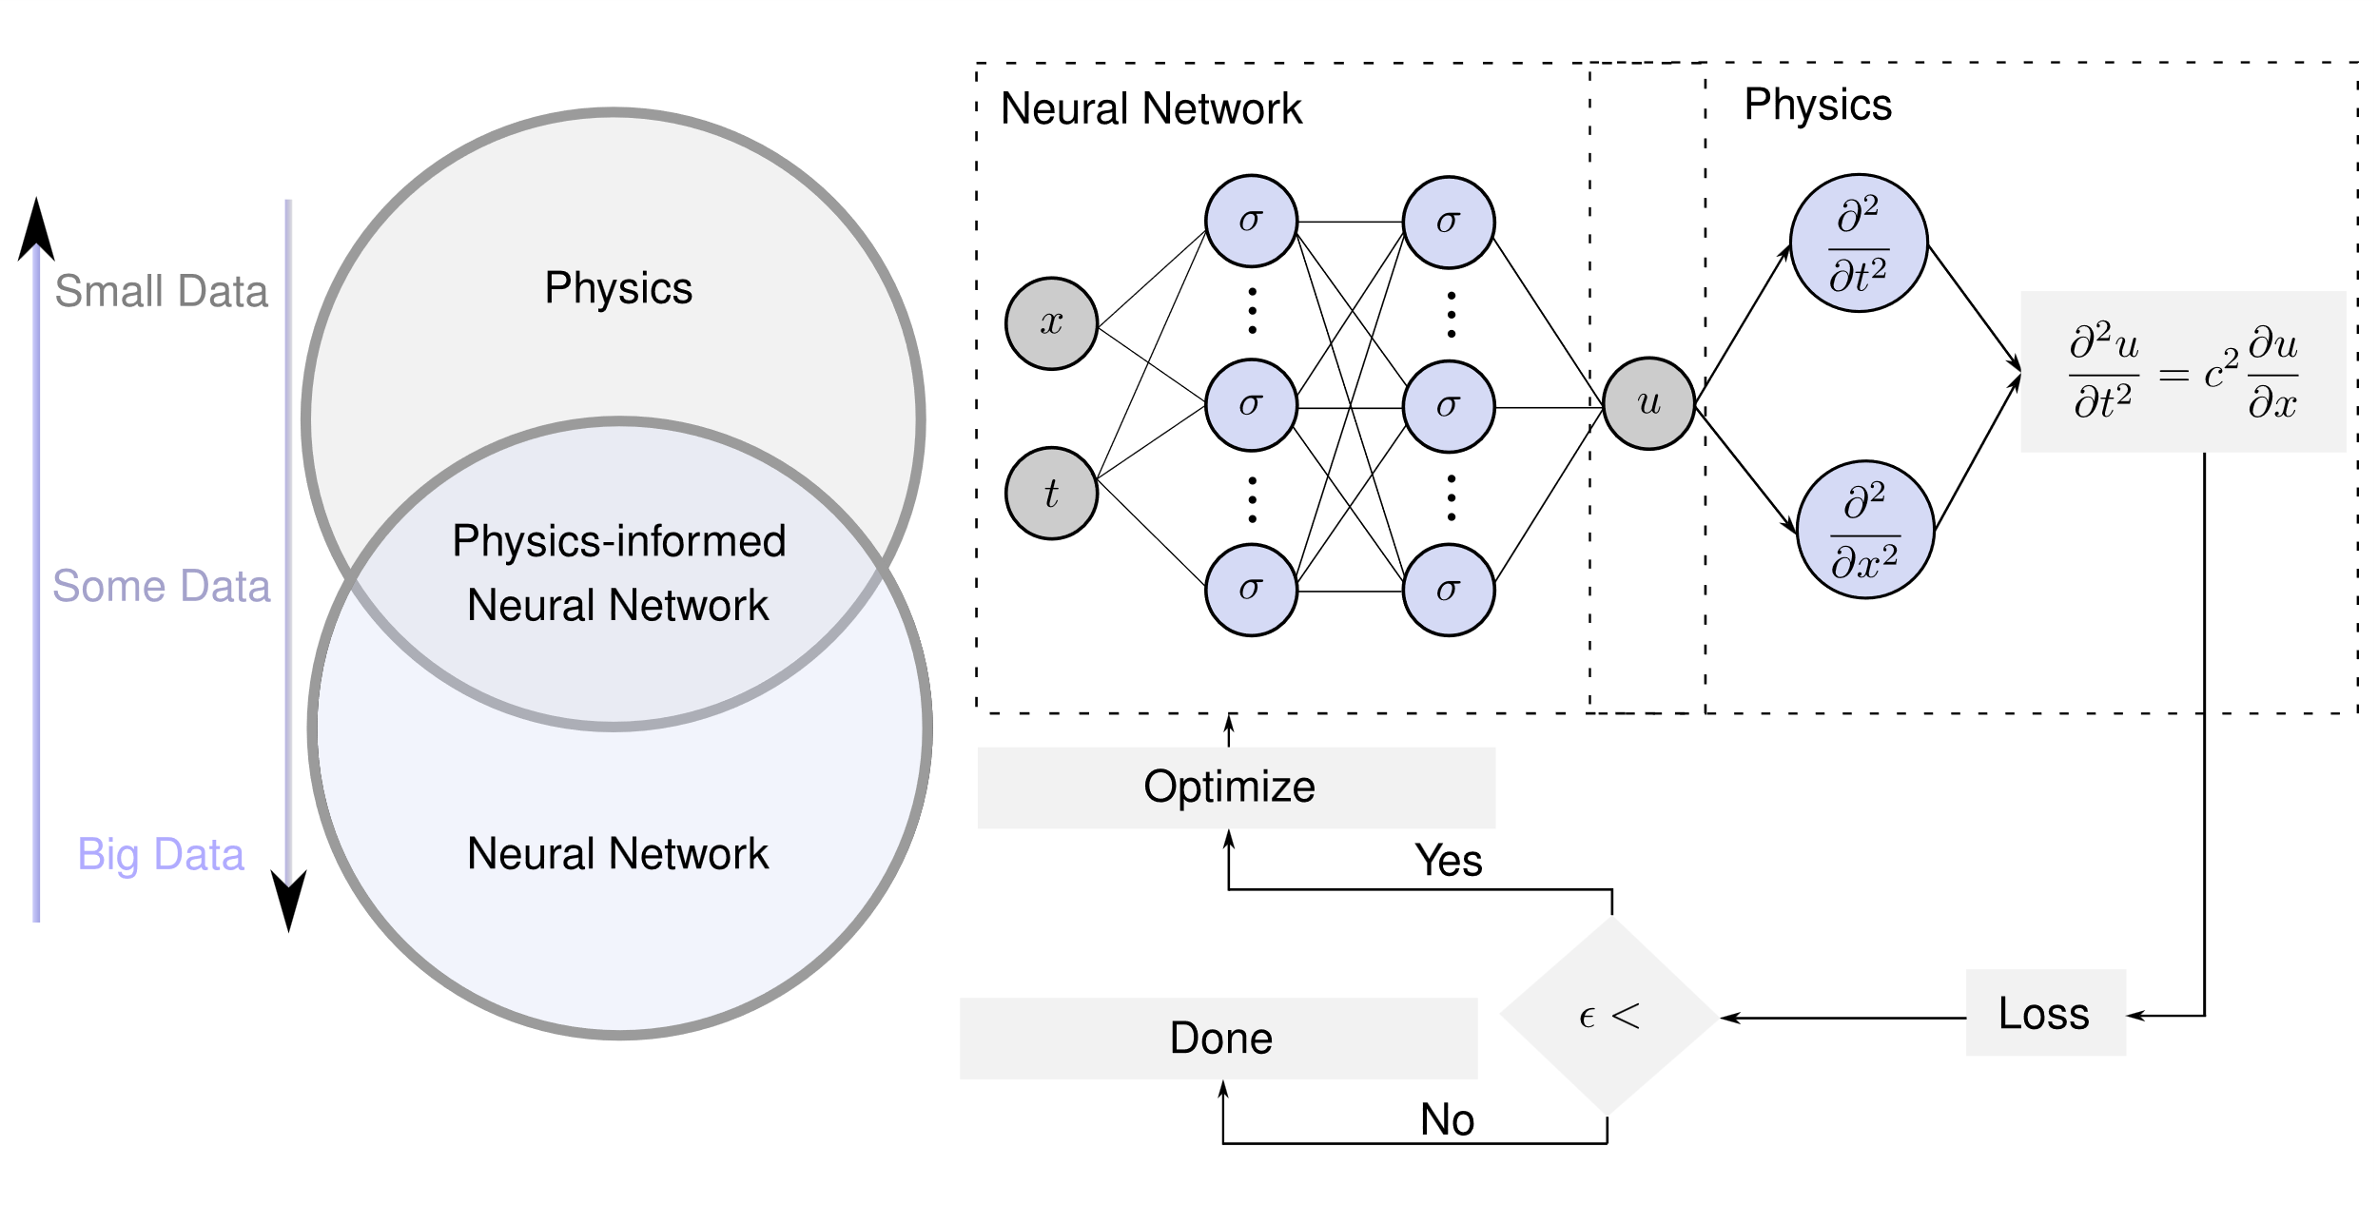
Physics-informed neural networks - PINN
https://github.com/oscar-rincon/review-elastic-waves/tree/main/figs

Slide 9
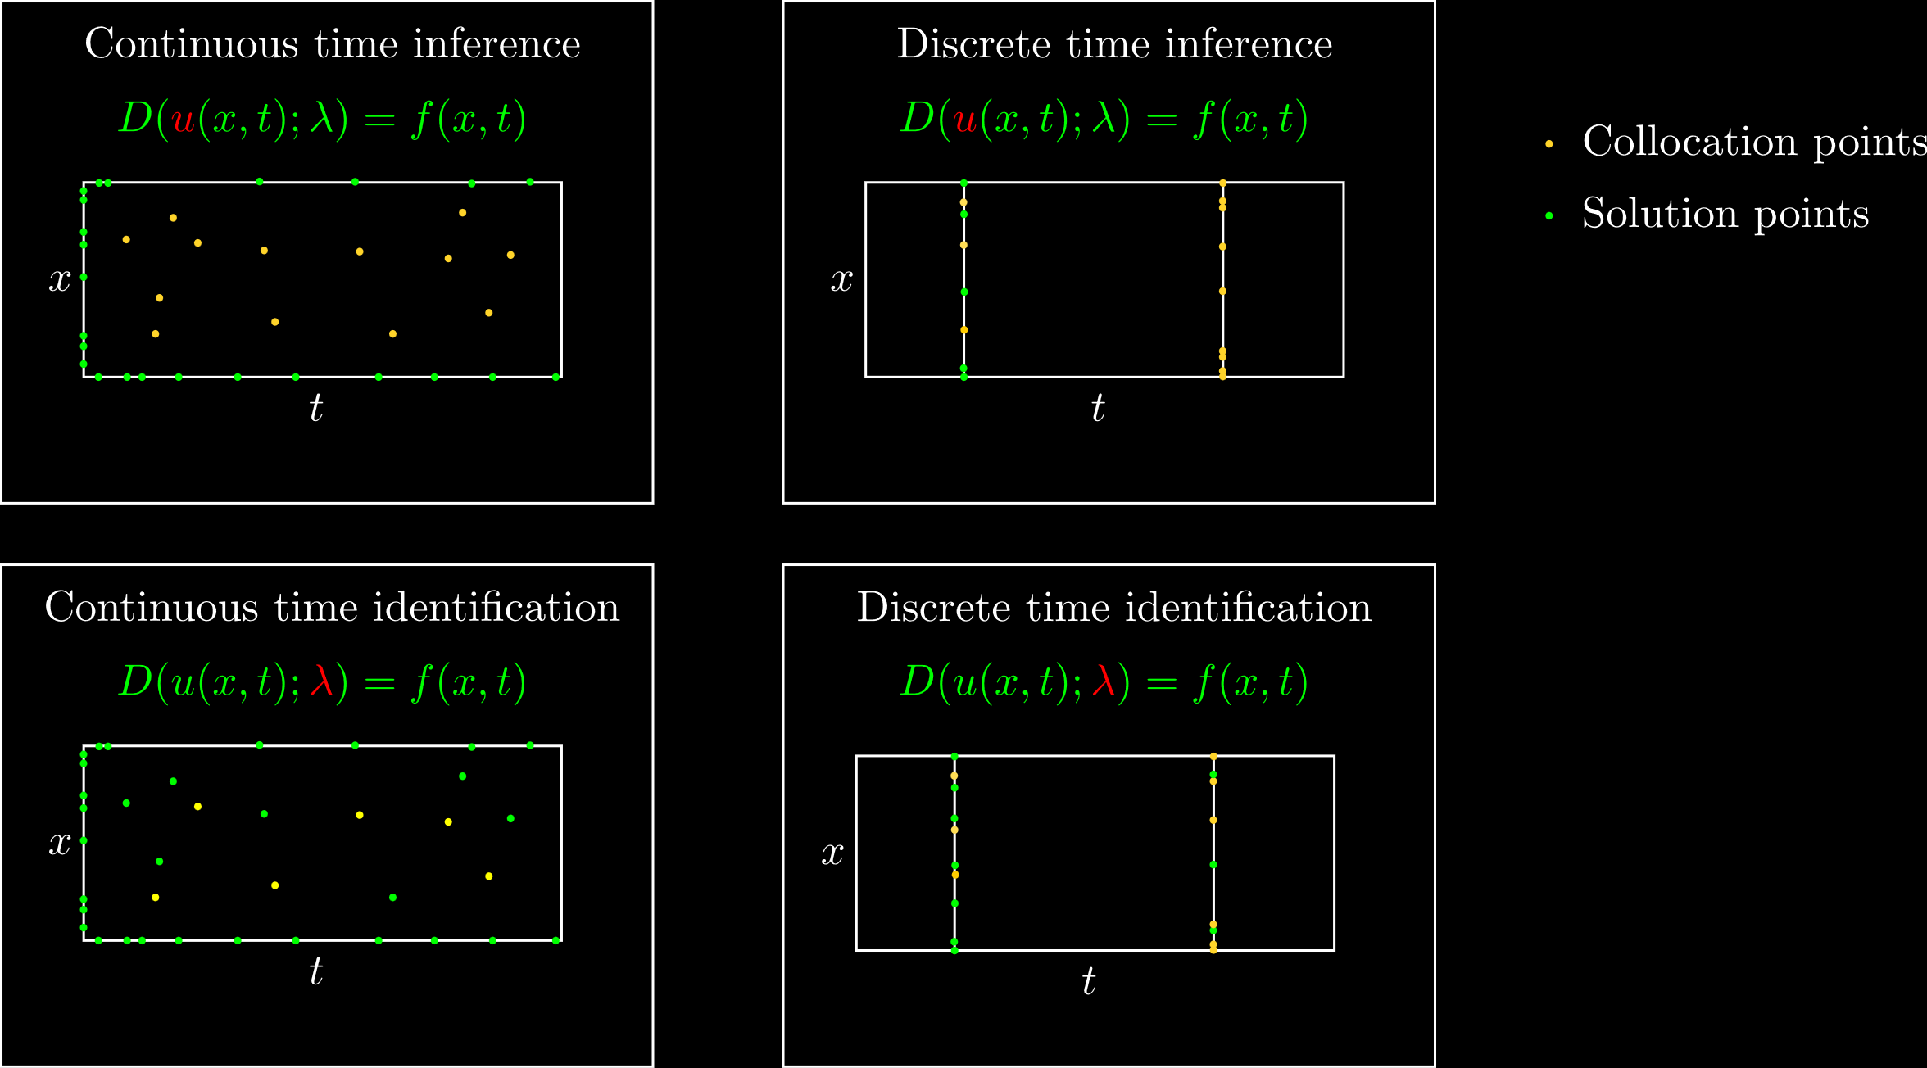
Raissi et al. (2019)
https://github.com/oscar-rincon/ReScience-PINNs

Slide 10
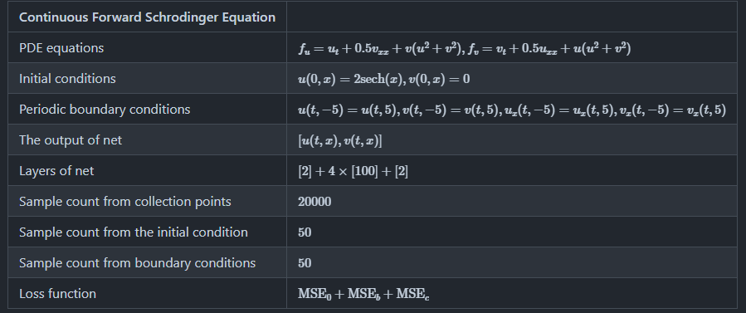

Continuous time inference
https://github.com/oscar-rincon/ReScience-PINNs/tree/main/main/continuous_time_inference%20(Schrodinger)

Slide 11
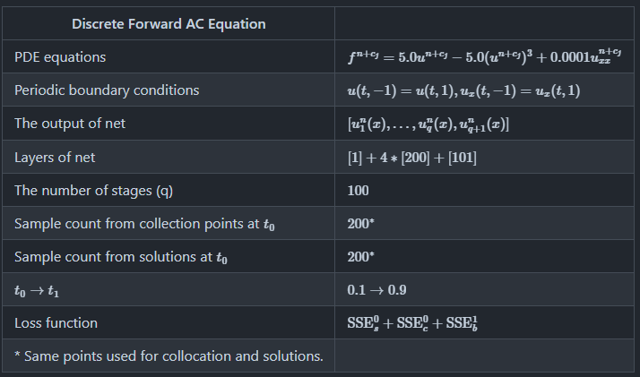

Discrete time inference
https://github.com/oscar-rincon/ReScience-PINNs/tree/main/main/discrete_time_inference%20(AC)

Slide 12
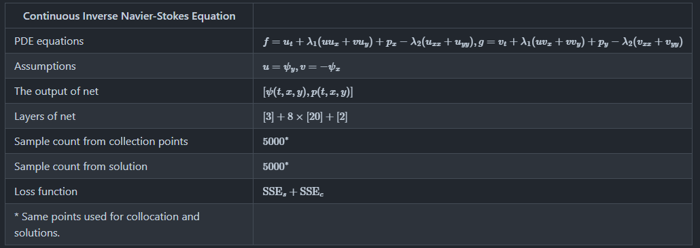
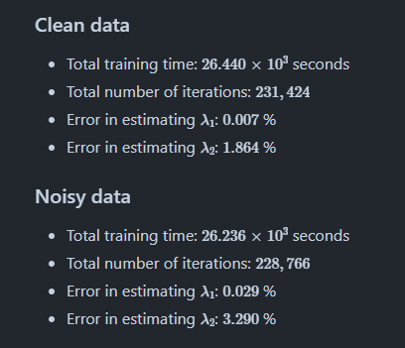
Discrete time identification
https://github.com/oscar-rincon/ReScience-PINNs/tree/main/main/continuous_time_identification%20(Navier-Stokes)

Slide 13
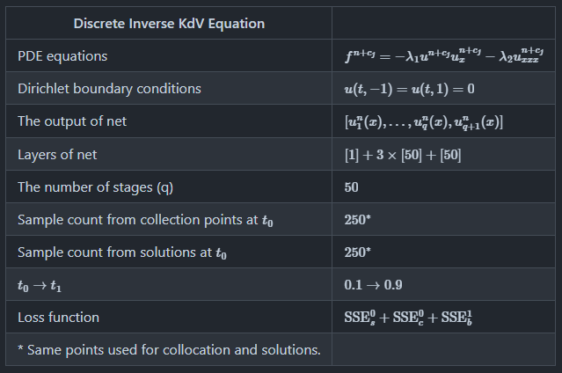
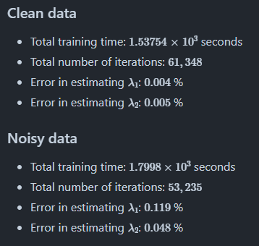
Continuous time identification
https://github.com/oscar-rincon/ReScience-PINNs/tree/main/main/discrete_time_identification%20(KdV)

Slide 14
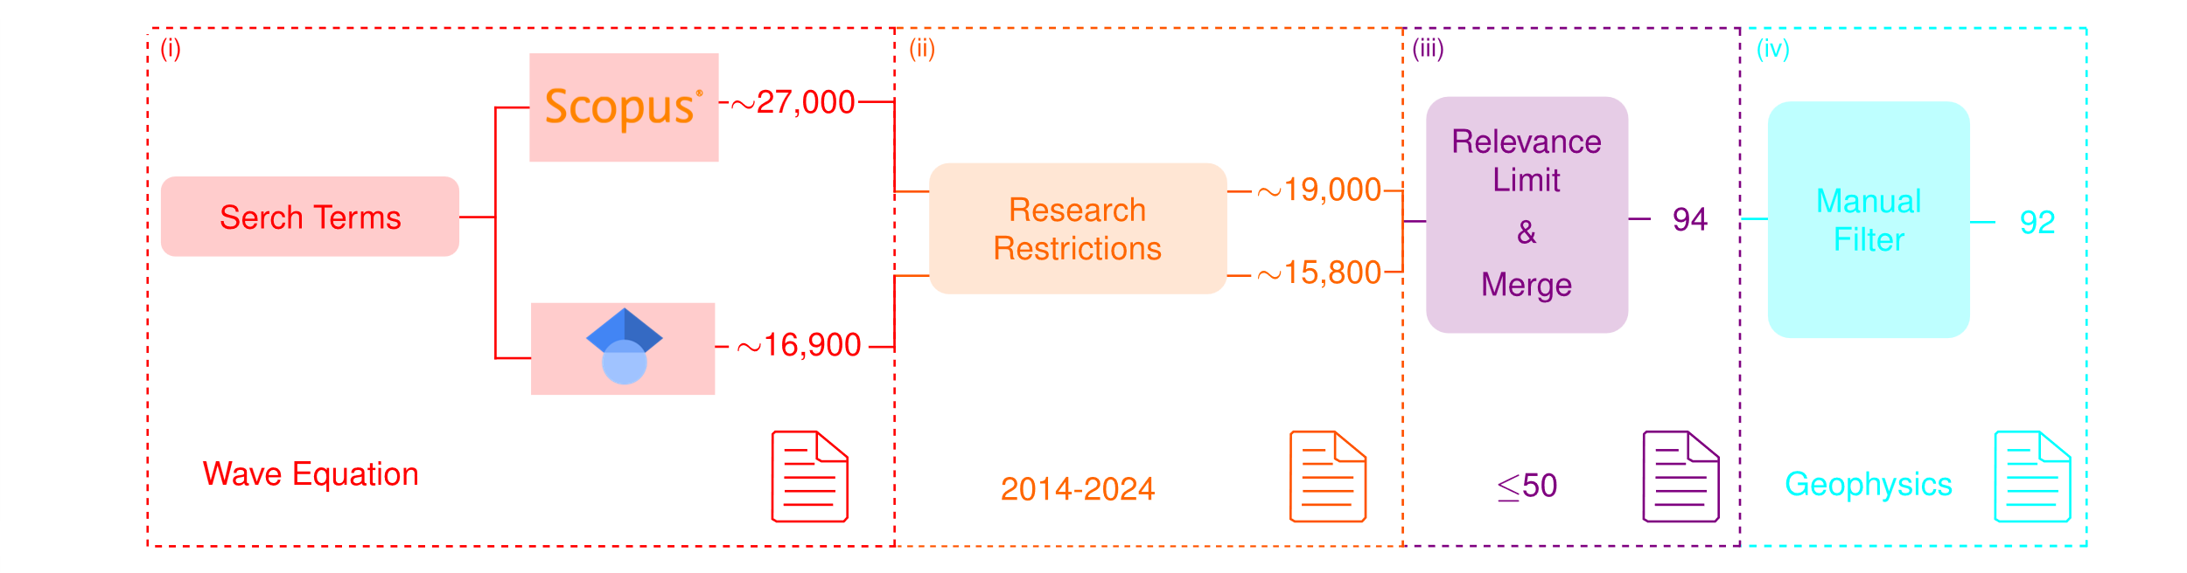
Systematic Review of Applications

Slide 15
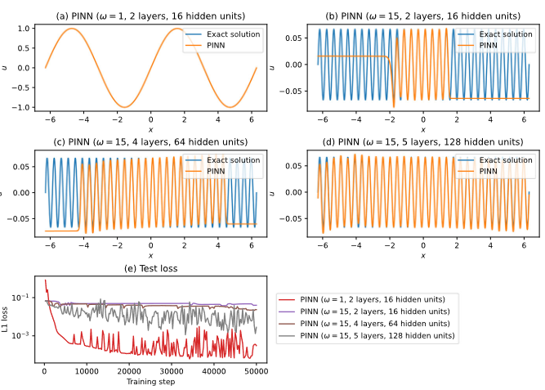
Advantages / Disadvantages of PINN vs Standard numerical methods
Simple implementation -> Interdisciplinary
Easily adaptable to both problems with (inverse) or without data (forward)
Fast model evaluation – (seconds)
Possibility of transfer learning
Uncertainty on required architecture
Unacurate
Slow training times - (hours vs minutes)
Possible local minimals
Function approximation of Large or complex domains

Slide 16
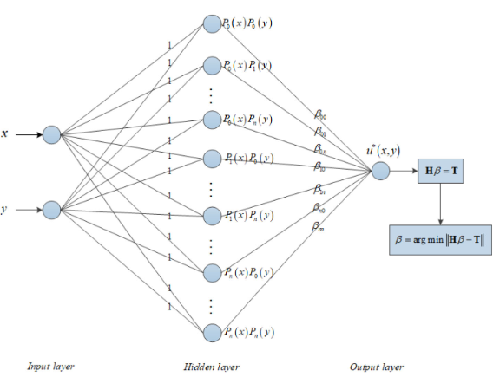
Extreme Learning Machine - ELM
It runs quickly – pseudoinverse
Comparable accuracies to standard methods
Not local minimals
Can be used with orthogonal neural networks
Still not applied to elastic wave equations

