Slide 1
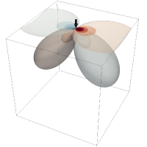

Meeting July 29, 2024
Forward and inverse modeling of wave propagation combining classical and machine learning approaches
Student: Oscar Andrés Rincón Cardeño
Advisors: Nicolas Guarín Zapata and Silvana Montoya
Applied Mechanics research group
Universidad EAFIT

Slide 2
Content
Literature review
Reproduction of the results presented in Raissi et al. (2019)
Problem statement

Slide 3
Literature review
Modeling of Mechanical Wave Propagation - Narrative
Standard Numerical Methods to Model Wave Equation - Narrative
Machine learning Methods to Model Mechanical Wave Propagation - Narrative
Applications- Systematic
https://github.com/oscar-rincon/review-elastic-waves

Slide 4
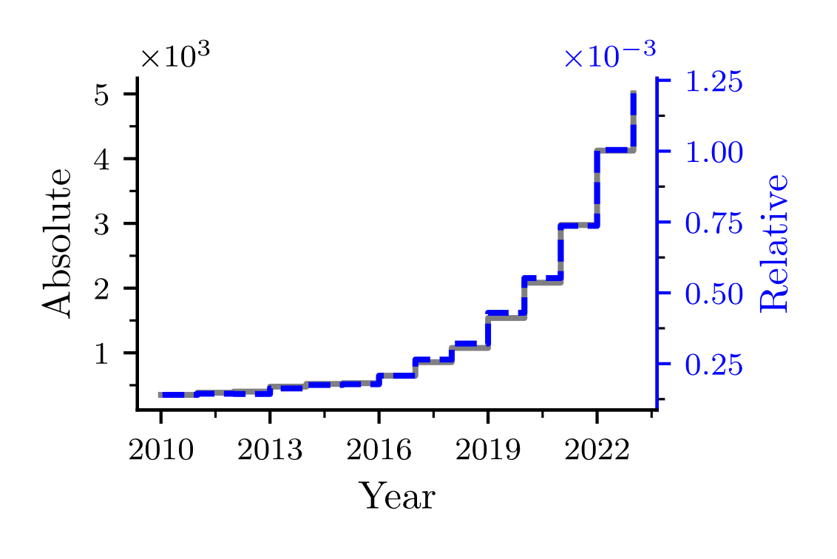
Introduction
"machine learning" OR "deep learning" OR "neural networks" AND "wave propagation" OR "wave equation" AND (modeling OR modelling OR model OR simulation)

Slide 5
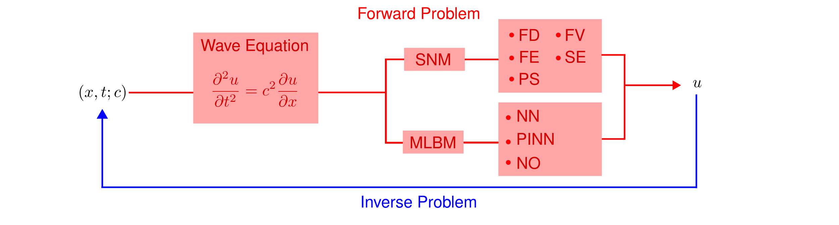
Modeling of Mechanical Wave Propagation
The process of determining the causes of a set of observations is known as the inverse problem (Tarantola, 2005), aiming to infer, for example, the properties of a medium based on its reaction to mechanical wave propagation.

Slide 6
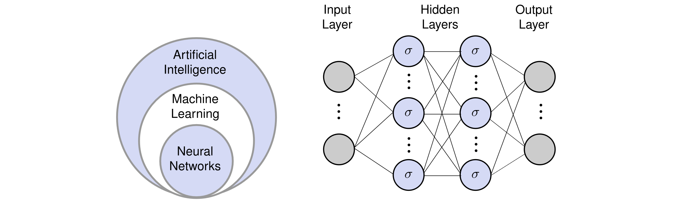
Machine learning Methods to solve Diferential Equations

Slide 7
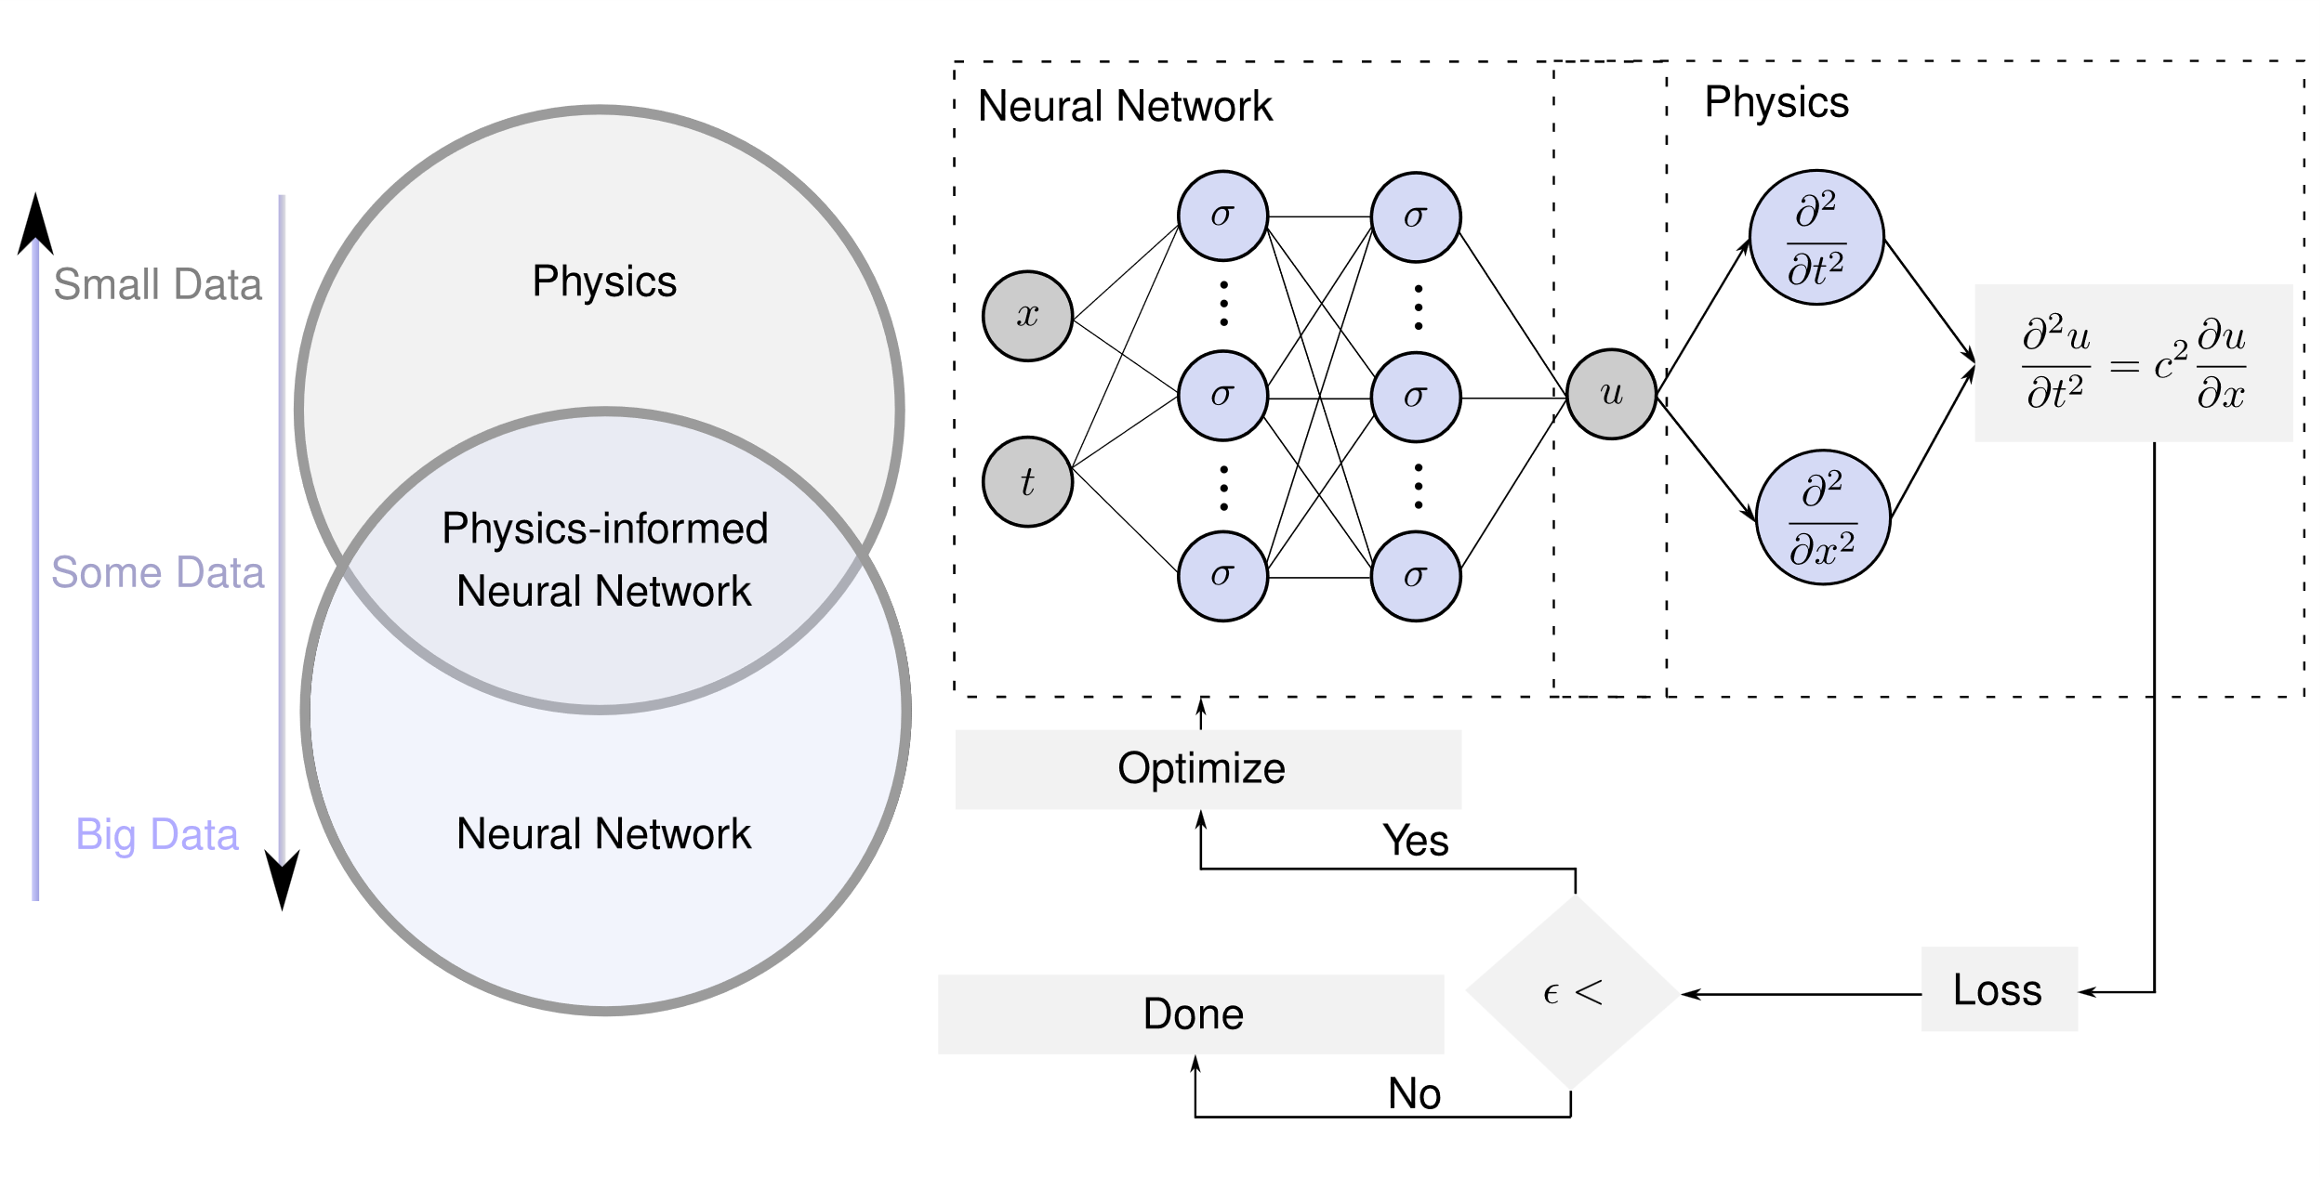
Physics-informed neural networks

Slide 8
Raissi et al. (2019)
Continuous time identification
https://github.com/oscar-rincon/ReScience-PINNs

Slide 9
Raissi et al. (2019)
Discrete time inference
https://github.com/oscar-rincon/ReScience-PINNs

Slide 10
Raissi et al. (2019)
Discrete time inference
https://github.com/oscar-rincon/ReScience-PINNs

Slide 11
Raissi et al. (2019)
Continuous time inference
https://github.com/oscar-rincon/ReScience-PINNs

Slide 12
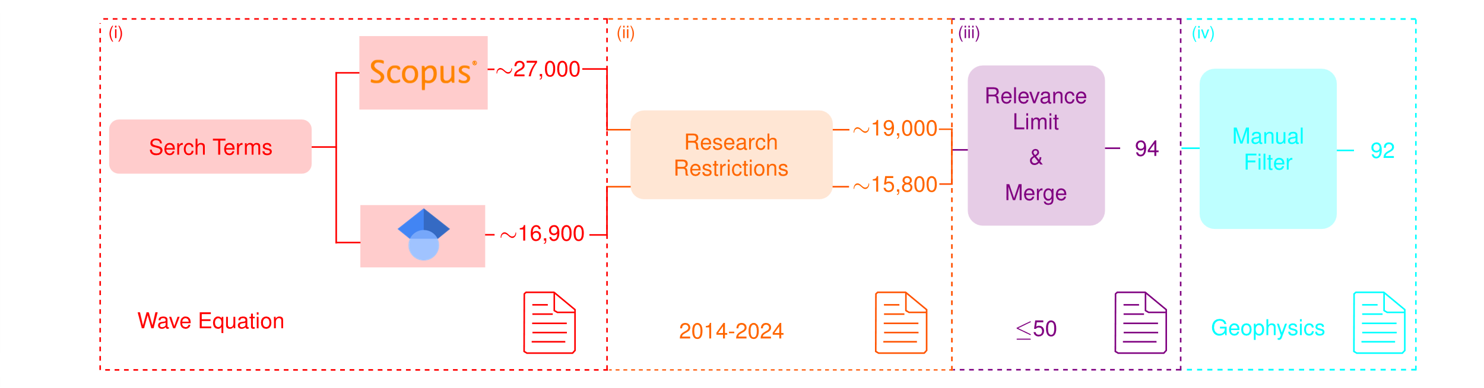
Revisión Sistemática de aplicaciones

Slide 13
Ventajas / Desvantajas

