Slide 1
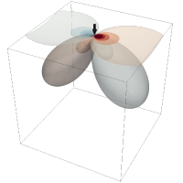

Meeting July 29, 2024
Forward and inverse modeling of wave propagation combining classical and machine learning approaches
Student: Oscar Andrés Rincón Cardeño
Advisors: Nicolas Guarín Zapata and Silvana Montoya
Applied Mechanics research group
Universidad EAFIT

Slide 2
Content
Literature review
Reproduction of the results presented in Raissi et al. (2019)
Problem statement

Slide 3
Literature review
Modeling of Mechanical Wave Propagation - Narrative
Standard Numerical Methods to Model Wave Equation - Narrative
Machine learning Methods to Model Mechanical Wave Propagation - Narrative
Applications- Systematic
https://github.com/oscar-rincon/review-elastic-waves/tree/main/refs

Slide 4
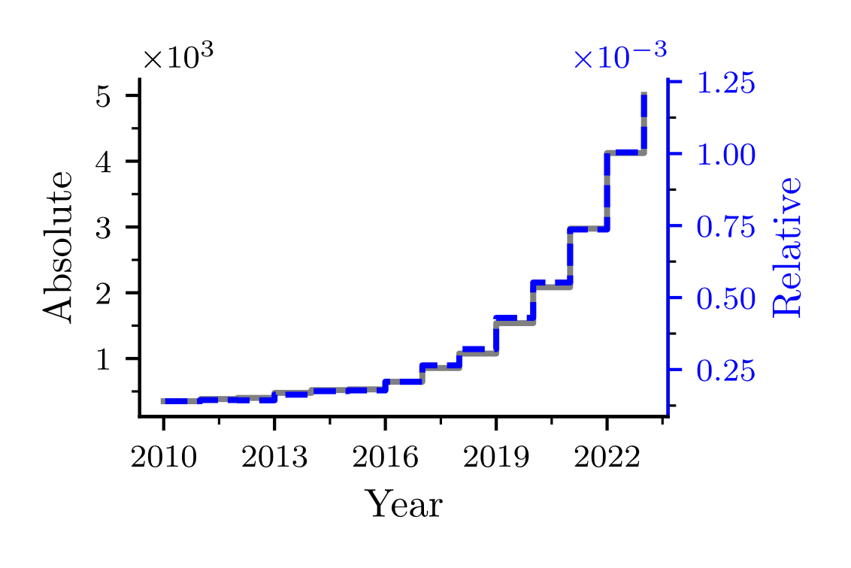
Introduction
Queries:
"machine learning" OR "deep learning" OR "neural networks" AND "wave propagation" OR "wave equation" AND (modeling OR modelling OR model OR simulation)
PUBYEAR > 2009 AND PUBYEAR < 2024
Possible causes
Hardware
GPU
Storage
Available data
Open-source packages
Tensorflow
PyTorch
JAX
https://github.com/oscar-rincon/review-elastic-waves/tree/main/main/publications_number_year

Slide 5
Modeling of Mechanical Wave Propagation
Mathematical modeling
Types
Static
Dynamic
Typically with
Partian
Differential
Equations
A particular case
Two general approaches
Mechanical Wave Equation
Forward
Inverse
Scalar
Elastic
Problem
Problem
Waves
Waves
Requiered
Numerical
Methods

Slide 6
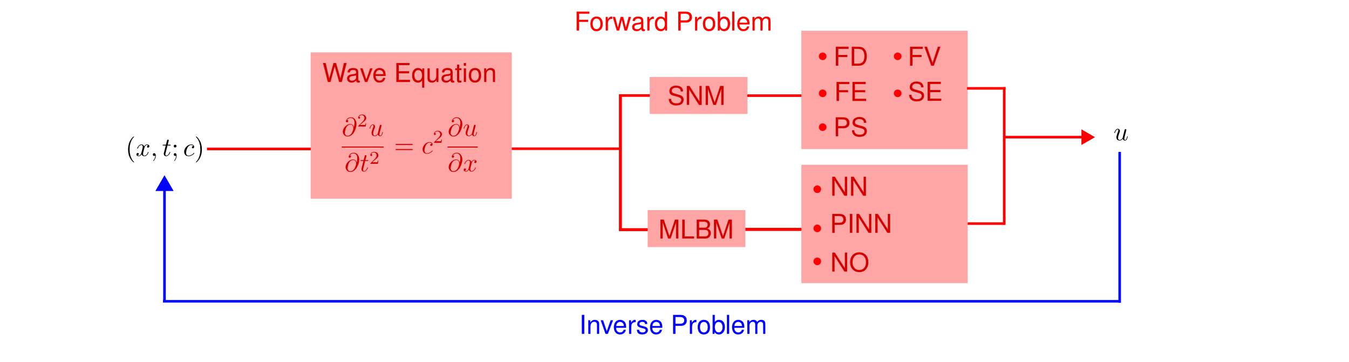
Modeling of Mechanical Wave Propagation

Slide 7
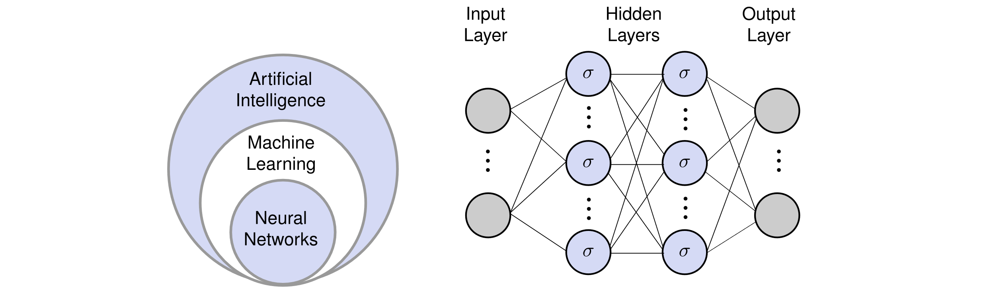
Machine learning Methods to solve Diferential Equations
Machine Learning
Reinforced Suport Vector Machine
Neural Networks
Neural Networks
Data Driven
Physics Based
Shallow Networks
Extreme Learning Machine
Deep Learning
Backpropagation

Slide 8
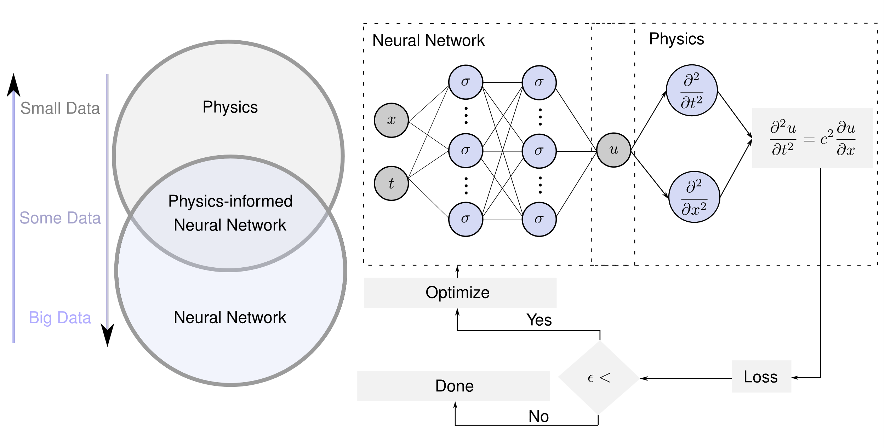
Physics-informed neural networks

Slide 9
Raissi et al. (2019)
Continuous time identification
https://github.com/oscar-rincon/ReScience-PINNs

Slide 10
Raissi et al. (2019)
Discrete time inference
https://github.com/oscar-rincon/ReScience-PINNs

Slide 11
Raissi et al. (2019)
Discrete time inference
https://github.com/oscar-rincon/ReScience-PINNs

Slide 12
Raissi et al. (2019)
Continuous time inference
https://github.com/oscar-rincon/ReScience-PINNs

Slide 13
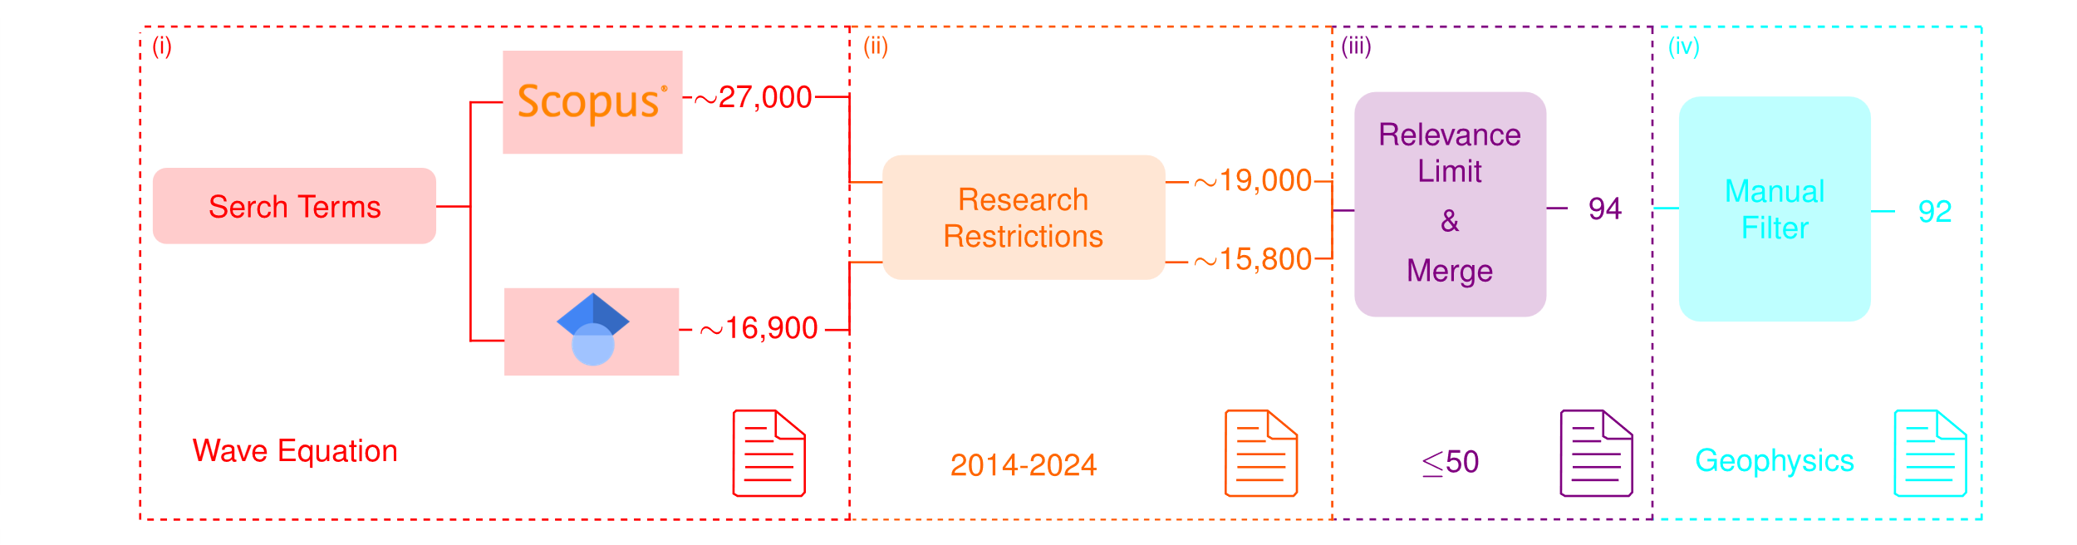
Revisión Sistemática de aplicaciones

Slide 14
Advantages / Disadvantages

