Slide 1
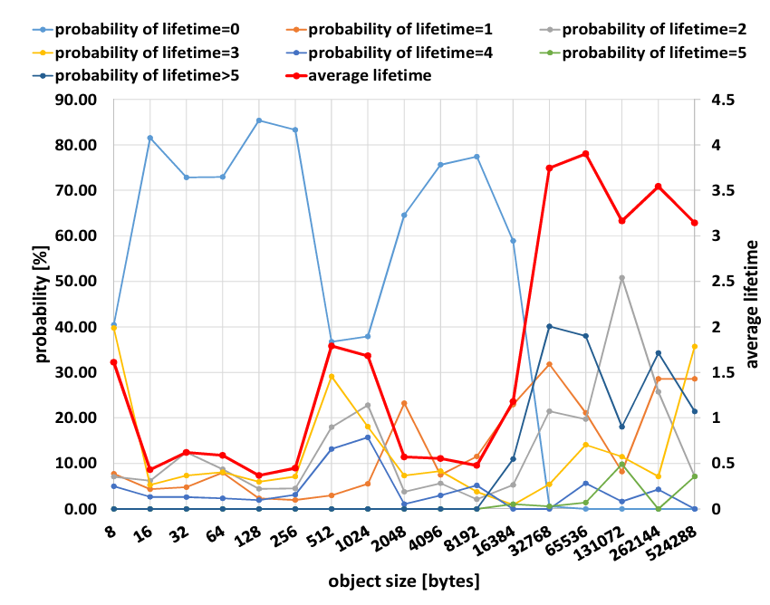
Garbage Collection Time Reduction Method Based on Allocation Control Using Object Size
Hiroki Yamada
Takeshi Kamiyama
Masato Oguchi
Saneyasu Yamaguchi
Garbage collection (GC) is an important function that affects application performance.
Android 8 and later uses Generational Concurrent Copying GC (Generational CCGC).
Generational CCGC allocates blocks called “regions” to objects.
The ratio of being reclaimed in the first GC.
Mori et al. showed the relationship between object size and lifetime in practical Android applications [1].
↓
We expect that improving the region allocation policy based on object size will improve the GC effectiveness and
the application performance.
Object Size
[1]Ryusuke Mori, Masato Oguchi, Saneyasu Yamaguchi, "Promotion Condition Optimization based on Application Features in Generational GC of Android Application Runtime", IPSJ Journal of Information Processing, Vol. 26, pp. 509-517, 2018., doi: 10.2197/ipsjjip.26.509

