Slide 1
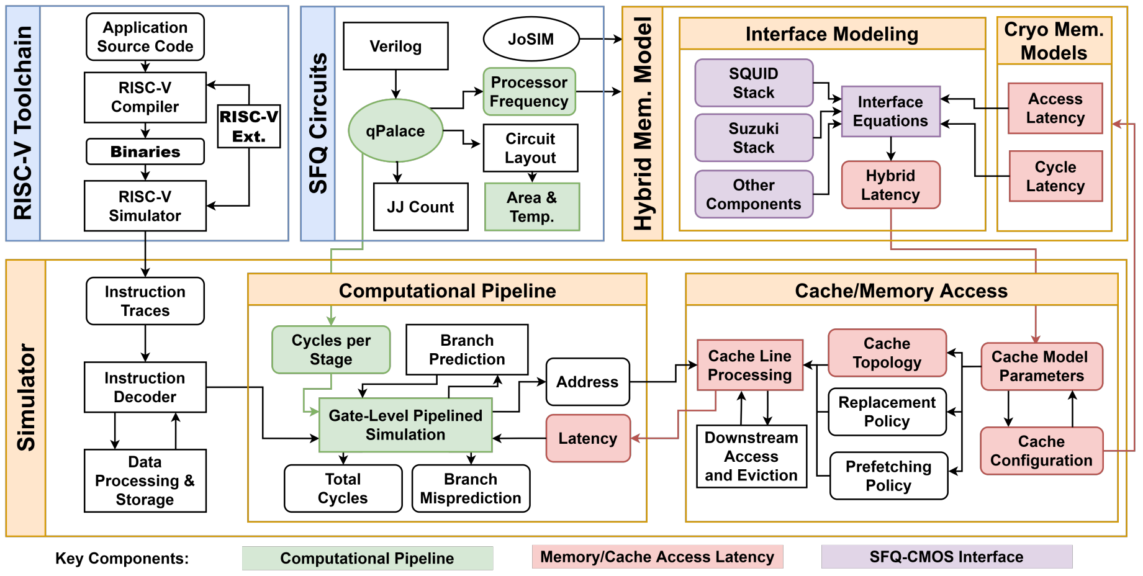
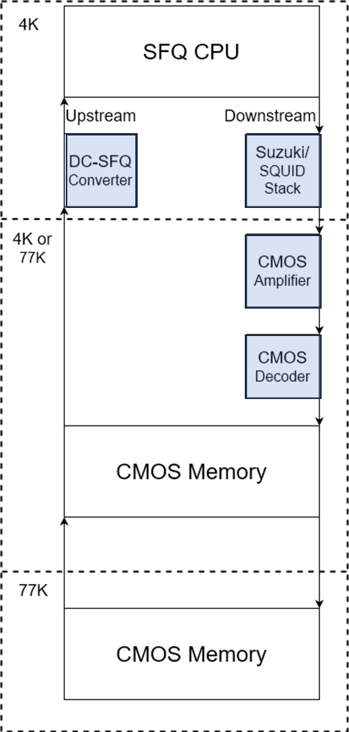
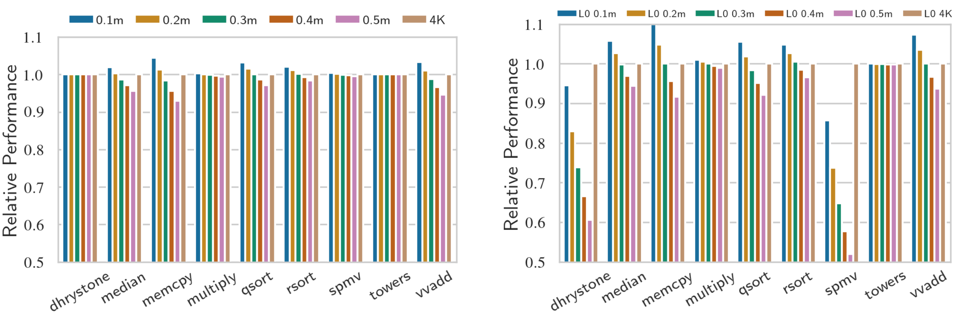
An End-to-end Simulation Framework for Cryogenic Computing Systems
Notes:
Highlight contributions here

Slide 2
Custom SFQ/CMOS Interface Circuits Developed In-House
Output drivers | Data rate (Gbps) | Swing (mVpp) | Power (µW) | FOM (fJ/bit) | Area (µm²) | Type of bias | Fabrication process
Suzuki stack | 5 | 44.8 | 160 | 32.0 | 9,000 | AC | MIT LL 10 kA/cm²
Low-power Suzuki stack | 5 | 40.8 | 43.9 | 8.78 | 9,000 | AC | MIT LL 10 kA/cm²
Differential Suzuki stack | 5 | 89.6 | 320 | 64.0 | 18,000 | AC | MIT LL 10 kA/cm²
Self-resetting Suzuki stack | 5 | 45.0 | 346 | 69.2 | 9,000 | DC | MIT LL 10 kA/cm²
Ternary Suzuki stack | 7.5 | 5.73 and 10.93 | 128 | 17.1 | N/A | AC | MIT LL 10 kA/cm²
4JL gate | 5 | 4.98 | 10.5 | 2.10 | 4,000 | AC | MIT LL 10 kA/cm²
SQUID stack | 20 | 5.55 | 91.8 | 4.59 | 180,000 | DC | MIT LL 10 kA/cm²
PAM-4 SQUID stack | 40 | 2.07, 3.82, and 5.78 | 137 | 3.43 | 270,000 | DC | MIT LL 10 kA/cm²
4JL gate (resistor-less) | 5 | 4.00 | 0.1 | 0.02 | 3,500 | AC | SEEQC 1 kA/cm²
Self-resetting 4JL gate (resistor-less) | 5 | 2.10 | 0.1 | 0.02 | 4,100 | DC | SEEQC 1 kA/cm²
Sent to tape-out
Post-layout simulation stage
Fabricated and tested.
New version sent to tape-out
Sent to tape-out

