Slide 1
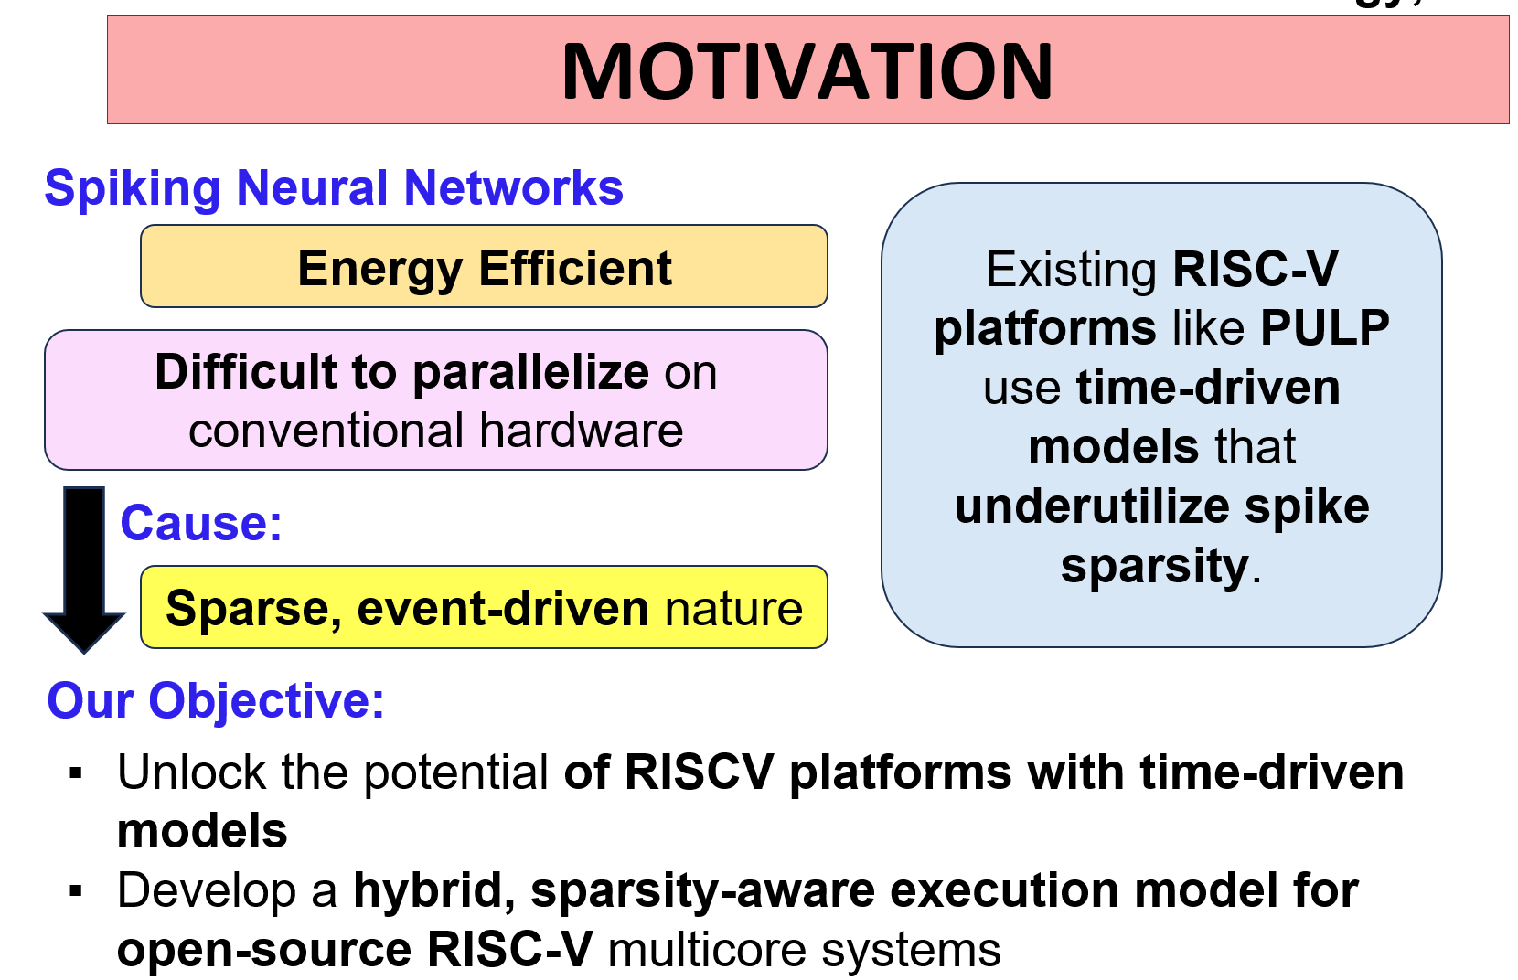
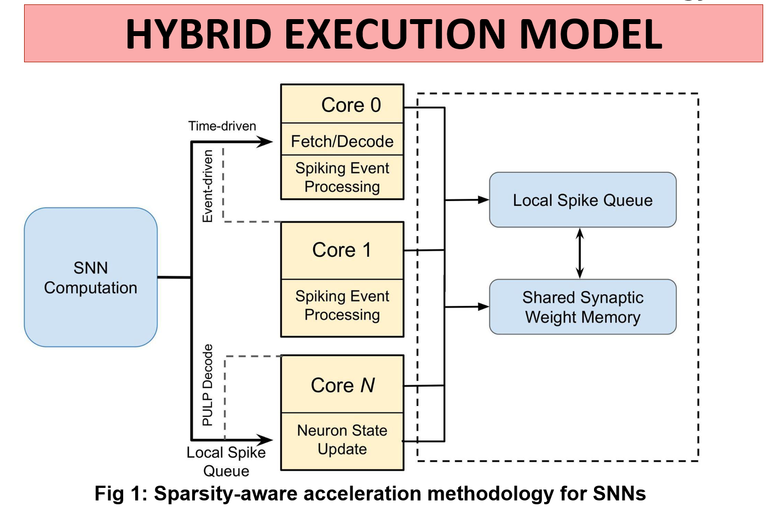
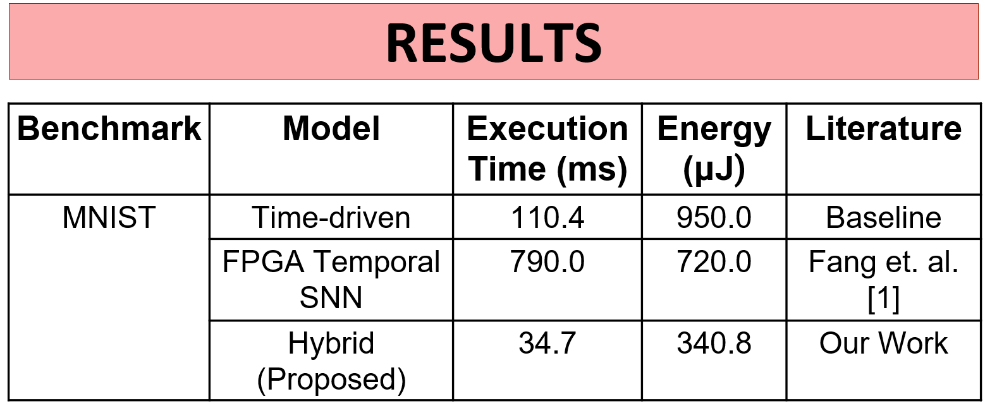

Sparsity-Aware Acceleration of Spiking Neural Networks on RISC-V Based Multi-Core Systems
Sonam, Sneha Agarwal, Sujay Deb

