Slide 1
Employee Resignation
Maybe you are searching among the branches ,for what only appears in the roots
By RUMI

Slide 2
Contents
Business Understanding
Data Understanding
Findings
Model
Conclusions
Recommendations
Q&A

Slide 3
Objectives
Determine what makes employees quit an organisation
Perform data analysis on the different features and find how they affect an employee leaving or staying in an organisation
Use predictive analytics to find more patterns in the data

Slide 4

Business Understanding
An company X wants to be able to know what makes employees quit an organisation and what makes them stay in the organisation

Slide 5
Data Understanding
The data is from HR_comma_sep.csv
The dataset had 10 columns and 14999 rows

Slide 6
Key Findings

Slide 7
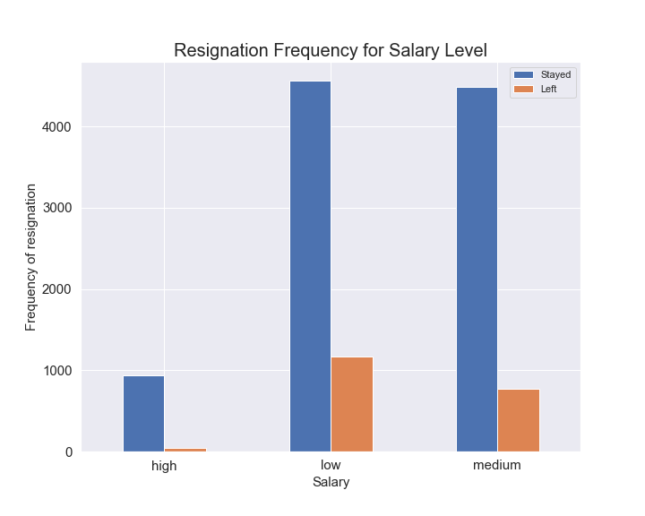
Resigantion frequency per salary level
Employees who quit the most those with lower salary while those with high salary are the least likely to quit

Slide 8
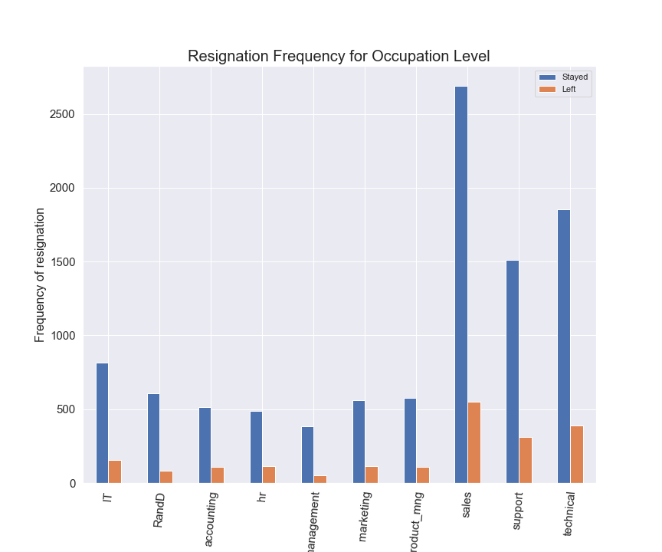
Resignation frequency per occupation
Employees from sales are most likely to quit while those in management are the least likely

Slide 9
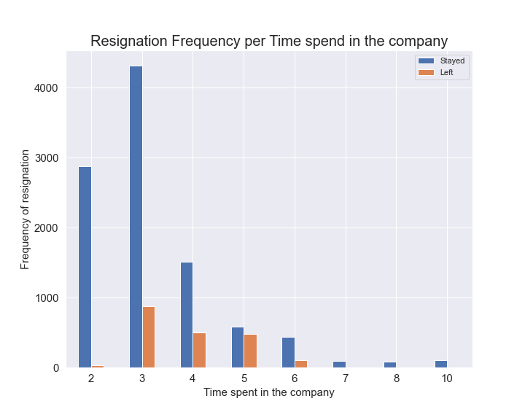
Resignation frequency per time in company
Employees are most likely to quit in their 3rd year with the company and least likely past 7 yrs working for the company

Slide 10
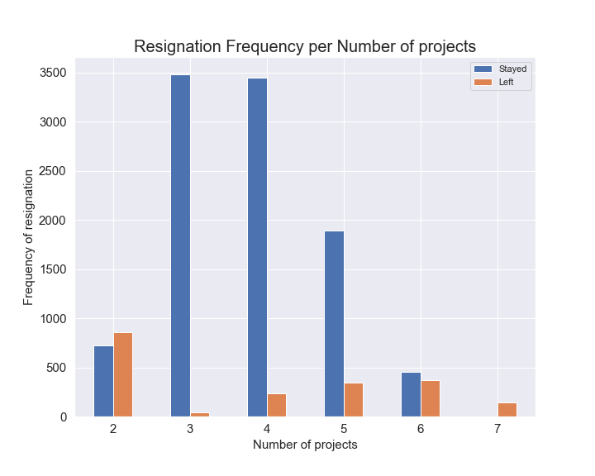
Resignation frequency per number of projects
Employees with 2 projects are the most likely to quit while the likelyhood to quit increases with no of projects past 3 those with 3 projects are the least likely to quit

Slide 11
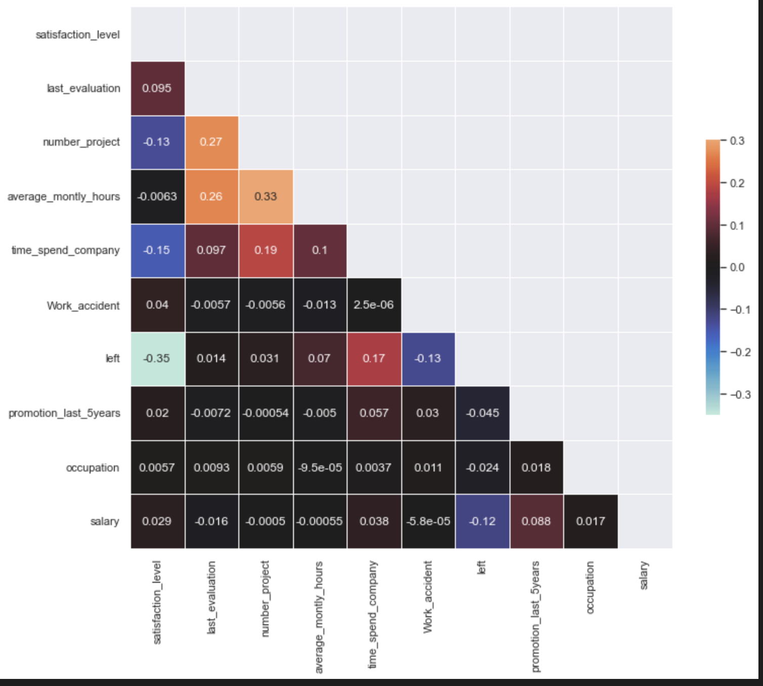

Correlation Chart
Satisfactory level is the most correlated column to leaving
Time spent with company is positively correlated to leaving
Work accident is negatively correlated with leaving

Slide 12
Modelling
Models used:
Logistic Regression model with accuracy of 84%
Decision Tree classifier Model with accuracy of 96%
Random forest classifier Model with accuracy of 98%

Slide 13
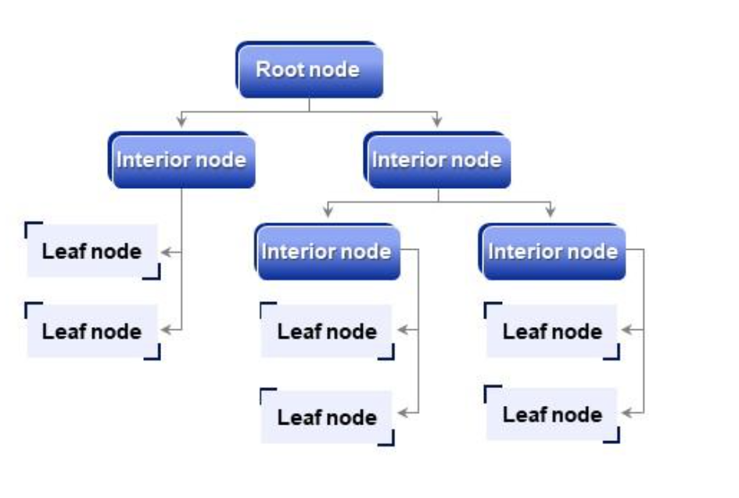
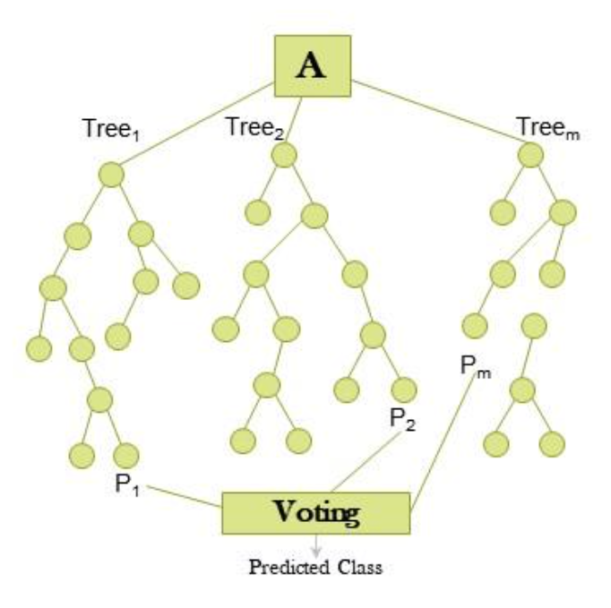
Machine learning models used
Decision Tree Classifier(96%)
Random Forest Classifier(98%)
This was the final model picked

Slide 14
Conclusions
Its clear that employees who quit the most are those with lower salary while those with high salary are the least likely to quit
Employees from sales are most likely to quit while those in management are the least likely
The feature that is most correlated to leaving is satisfactory level
The feature time spent in company is positively correlated with employee leaving the organisation

Slide 15
Conclusions
Employees with 2 projects are the most likely to quit while the likelyhood to quit increases with no of projects past 3 those with 3 projects are the least likely to quit
Employees are most likely to quit in their 3rd year with the company and least likely past 7 yrs working for the company

Slide 16
Recommendations
We recommend companies should use predictive analysis to predict whether an employee will quit before hiring them
We recommend companies to find ways to improve workers satisfactory level as it is the most correlated with leaving
We recommend companies to carry out why time spent in the company is positively to an employee leaving the organisation

Slide 17

Thank you

