Slide 1
Election Network Analysis

Slide 2
Introduction
a democracy-focused NGO is interested in learning which networks are responsible for seeding and spreading political hashtags in the upcoming August 9th General Election. They have extracted the mentions from several hashtags and need more analysis.

Slide 3
Objectives
Find the most significant nodes in the network and the role they play
Distinguish the key accounts publishing and posting the hashtags
Find out the key influential accounts and background information on them
Find and Identify trend jackers

Slide 4
Findings

Slide 5
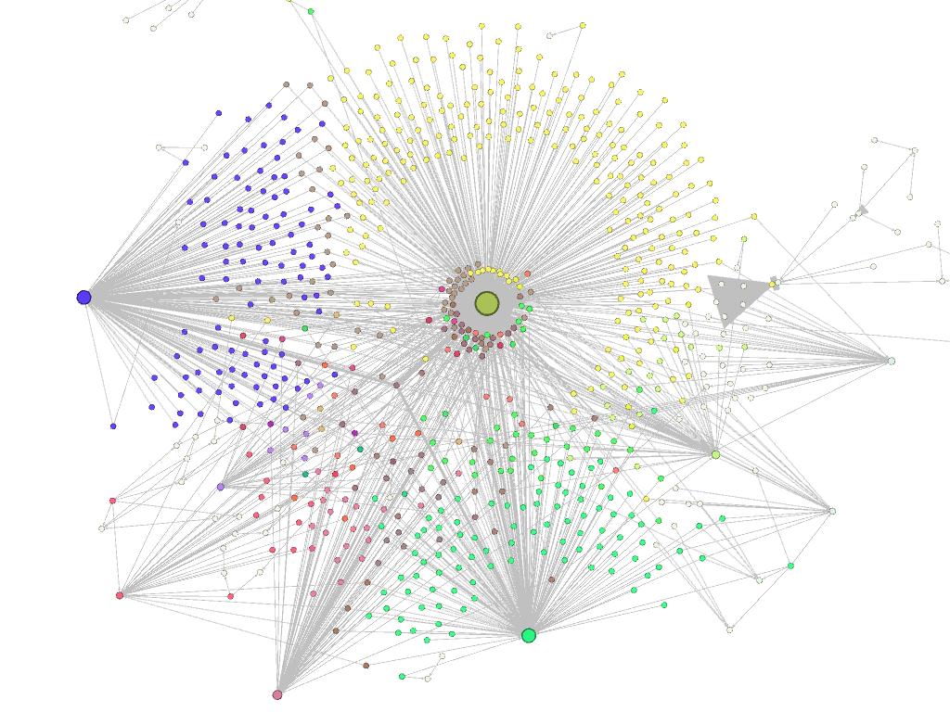
The Most Significant Nodes
Gephi Network Visualization
The most significant nodes were :
Yellow :@williamruto
Blue : @williamruto , @railaodinga, @citizentv
Green : @williamruto , @railaodinga
Red : @nationafrica , @williamruto, @railaodinga , @dci_kenya

Slide 6
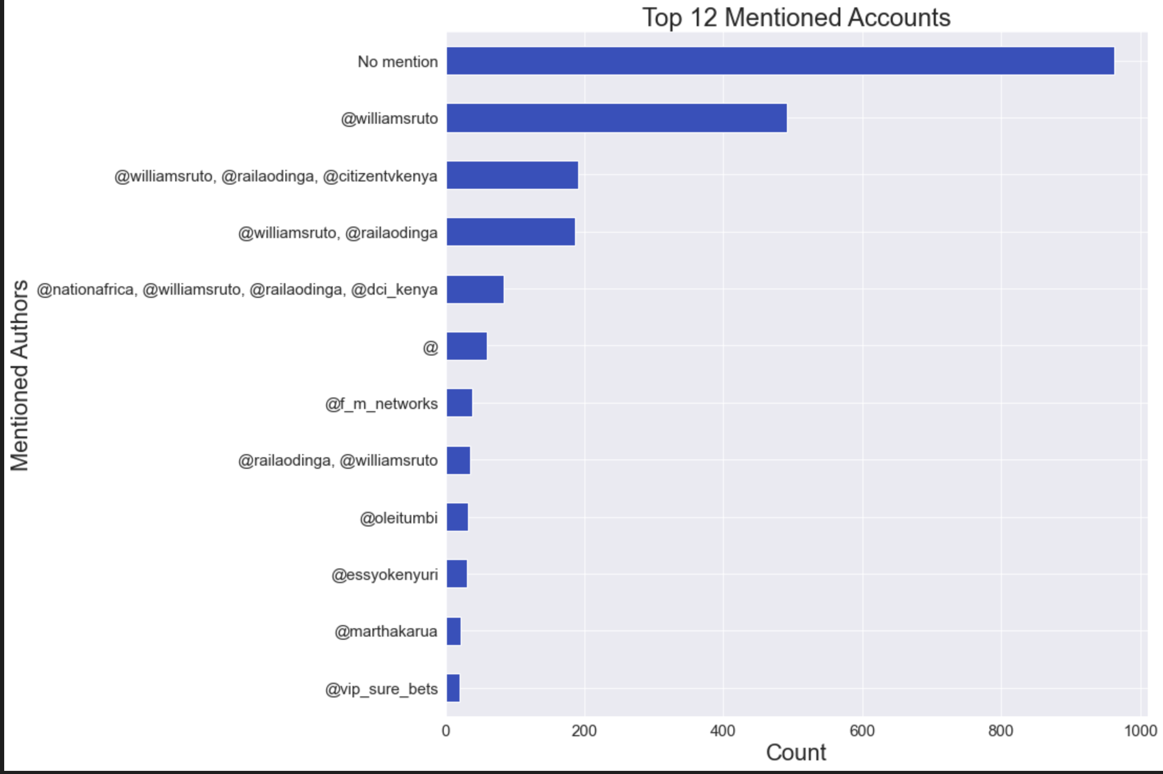
Top 12 Mentioned Accounts
The most mentioned account was @williamruto

Slide 7
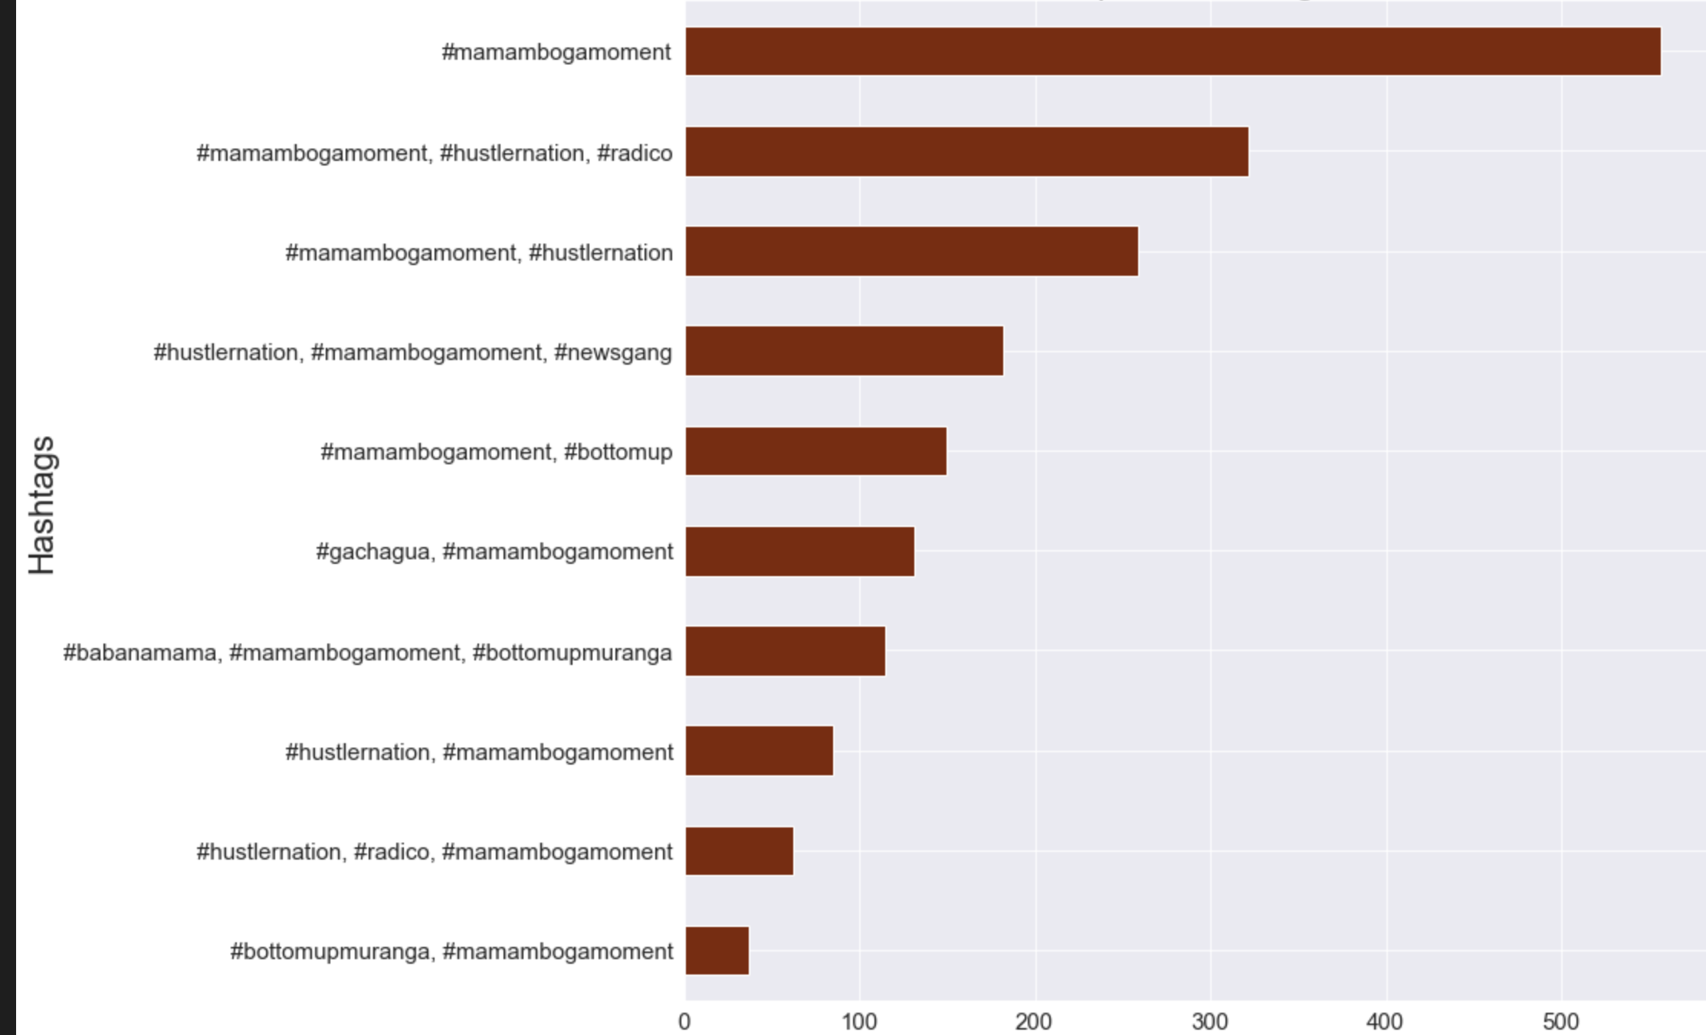
Top Hashtags
The most common hashtag was #mamambogamoment

Slide 8
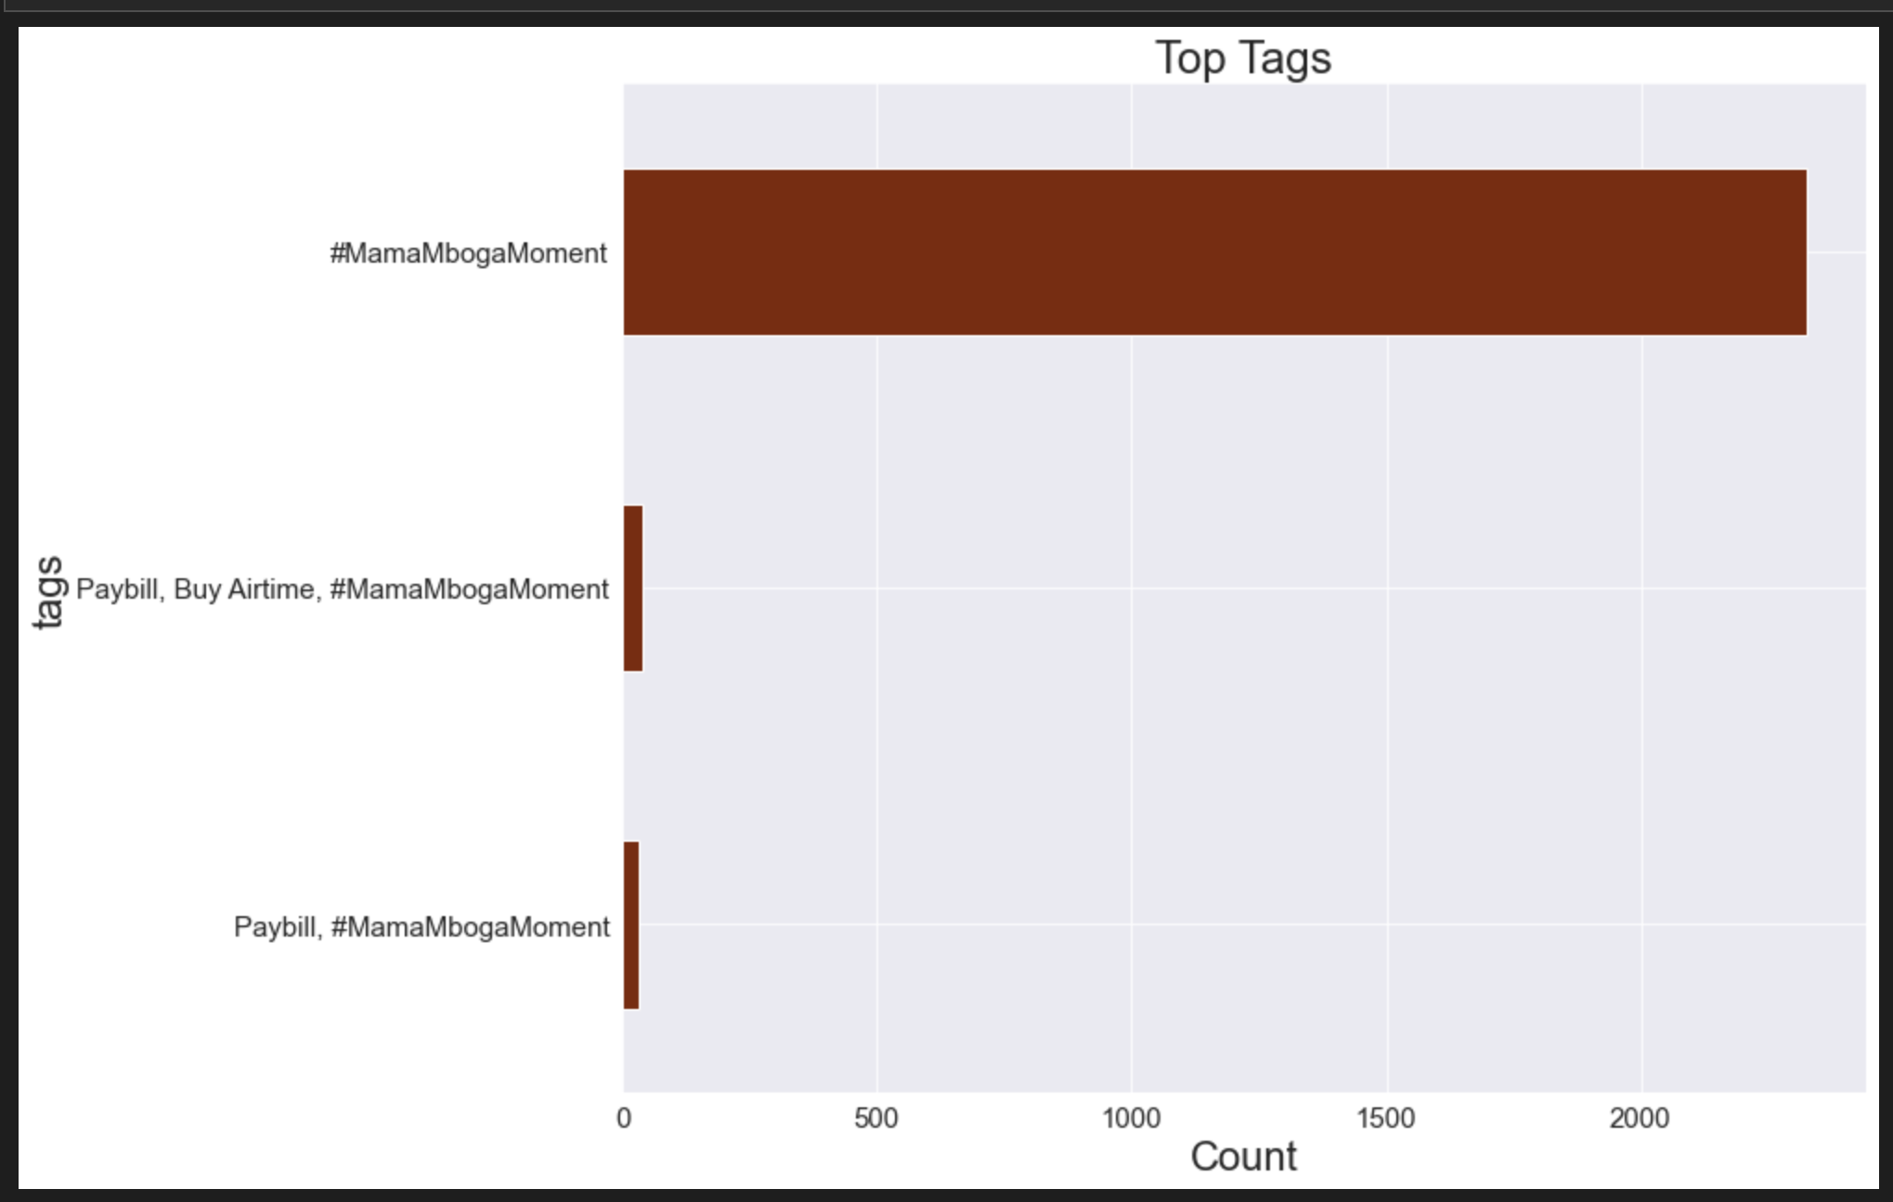
Top Tags
The most common hashtag is #MamaMbogaMoment however we identify trendjackers in the paybill, Buy Airtime ,#MamaMbogaMoment

Slide 9
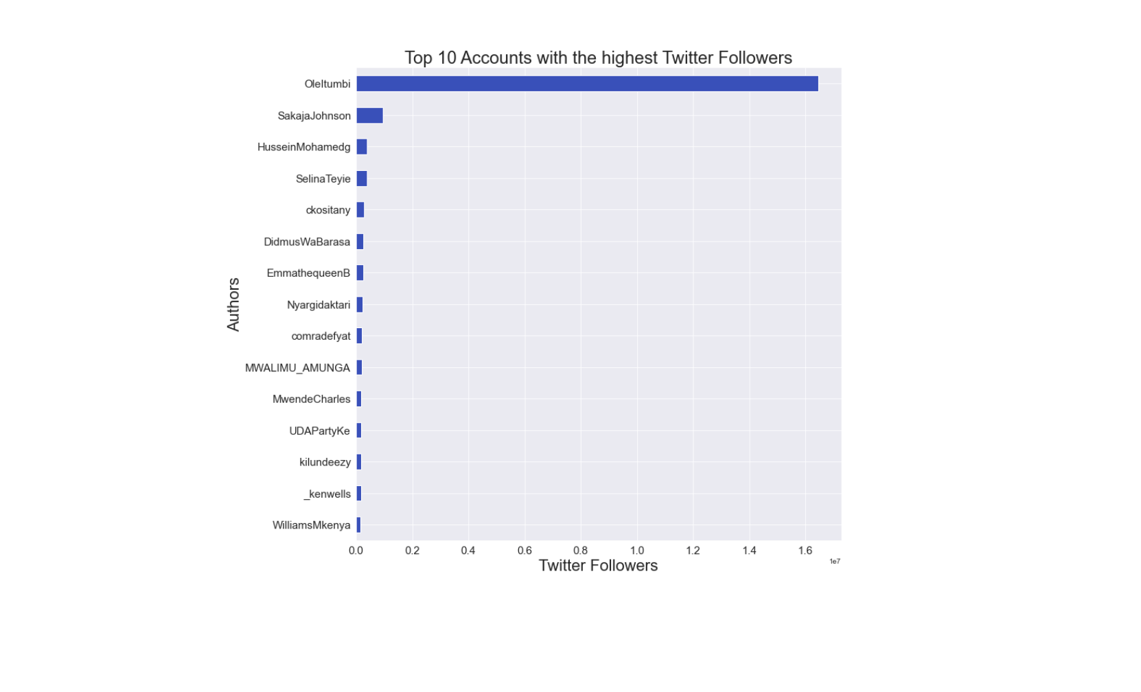
Top Followed Accounts
The most followed account is Oleltumbi

Slide 10
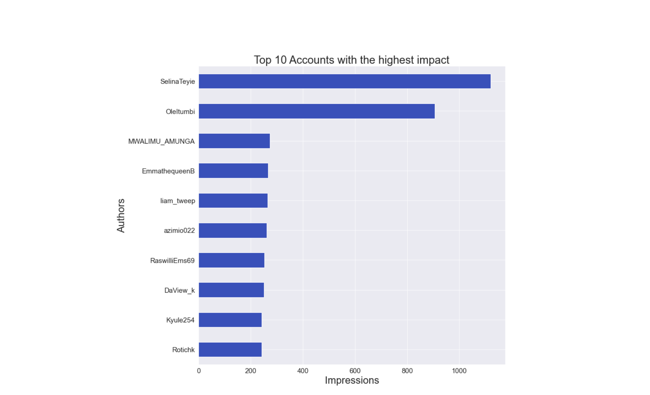
Top 10 Accounts with highest impact
The Account with the most impact was Selina Teyle followed closely by Oleitumbi

Slide 11
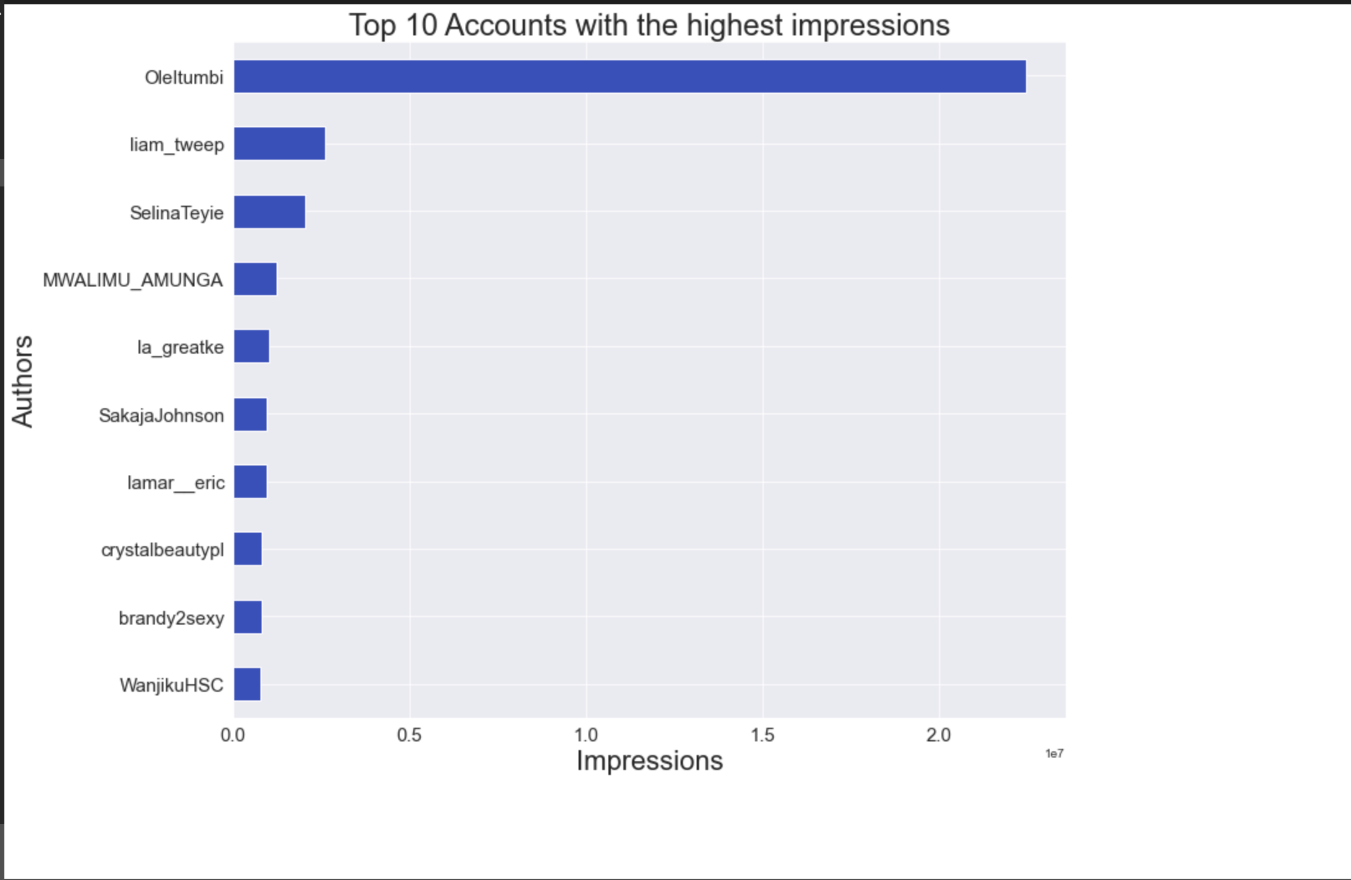
Top 10 Accounts with highest impression
The Account with the highest impression was Oleitumbi

Slide 12
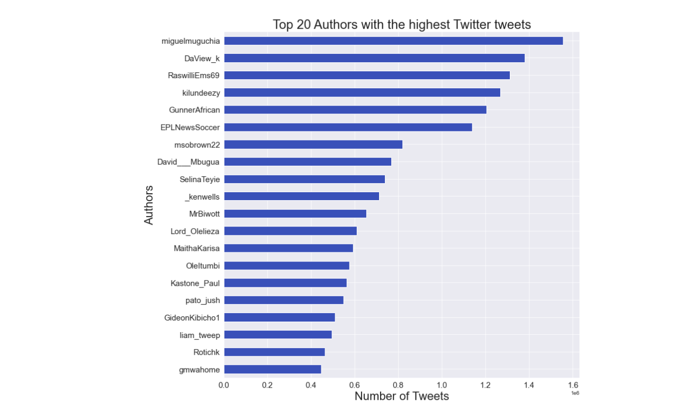
Accounts with the most Tweets
The Account with the most Tweets was miguelmuguchia

Slide 13
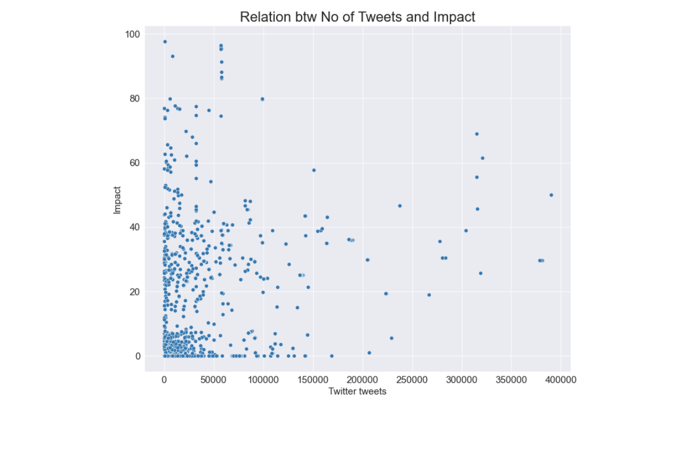
Relationship between No of tweets and Impact
There is weak correlation between the number of Twitter tweets and the Impact an Account has

Slide 14
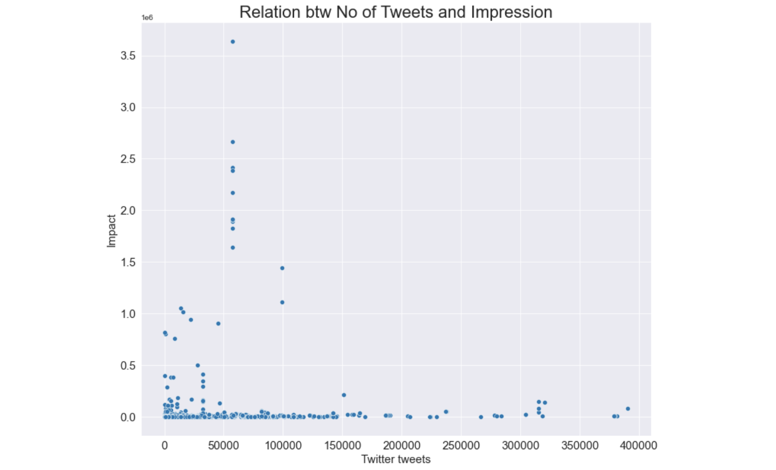
Relationship btw No of Tweets and Impression
There is weak correlation between the number of Twitter tweets and the Impression an Account has

Slide 15
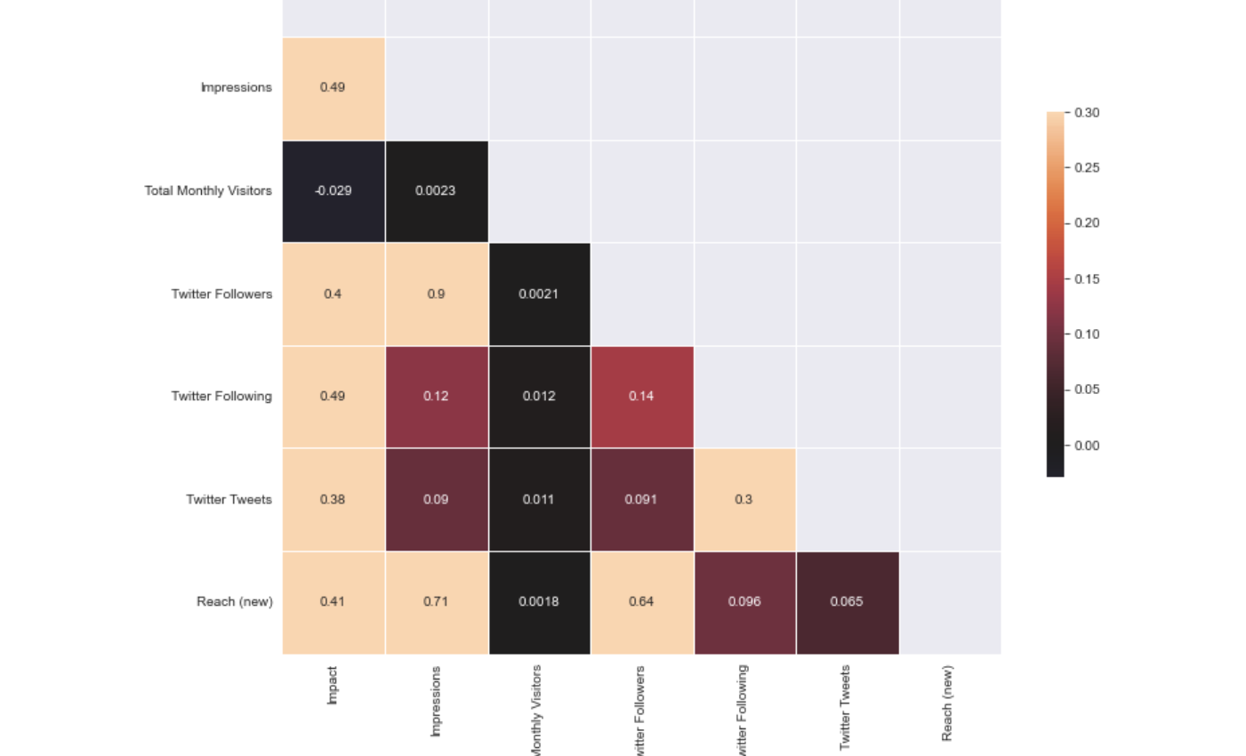
Correlation Chart
The following show strong correlations :
Impressions and Twitter followers of 0.9
Impressions and Reach(new) of 0.71
Twitter followers and Reach(new) of 0.64

Slide 16
Conclusions
We concluded that the top three most significant nodes were @williamruto , @williamruto , @railaodinga, @citizentv and @williamruto , @railaodinga
We concluded the most significant features for node are the number of followers, the Impact and Impression an account has
We concluded that there is presence of trend jackers because of the tags that were linked to #MamaMbogaMoment but do not speak to the significance of the issue instead they were promoting buying of Airtime
We concluded that there is little correlation between the number of tweets with the impact the Account has

Slide 17
Conclusions
We concluded that there is also little correlation between number of tweets and the Impression the account has
We concluded that there is strong correlation between the number of followers an account has and the number of new users an account reaches

Slide 18
Recommendations
We recommend further analysis on the dataset
We recommend the ngo to consider accounts that have a combination of these features : High followers, high impact and high impression as they are very influential on the platform
We recommend the Ngo to consider the most mentioned Accounts as they are influential too

Slide 19
Thank you Q&A

